Slide 1

13 jQuery Server App: Part 2
Peter H. Chen

Slide 2
13 jQuery Server App
https://www.tutorialspoint.com/graphql/graphql_validation.htm
jQuery Server App
We Setup the jQuery

Slide 3
13.1 Step 1

Slide 4
13.1 Step 1
https://www.tutorialspoint.com/graphql/graphql_validation.htm
Step 1: Create 13-jquery-server-app02 project folder
Copy 13-jquery-server-app01 to 13-jquery-server-app02.

Slide 5
13.2 Step 2

Slide 6
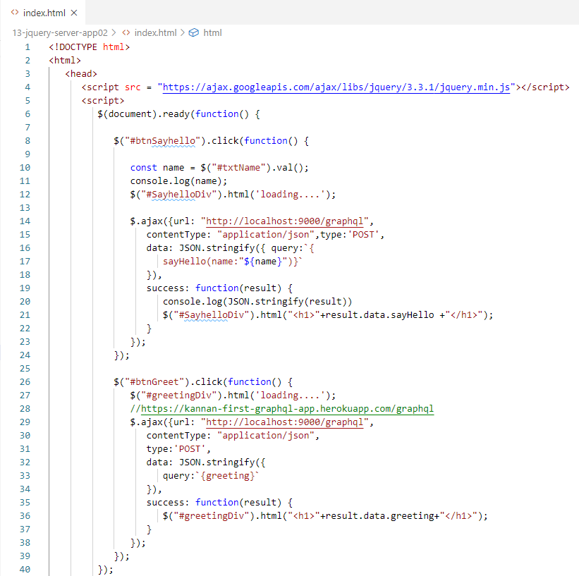
13.2 Step 2
https://www.tutorialspoint.com/graphql/graphql_validation.htm
Step 2: Create HTML
We will create a client application in jquery and invoke both the methods.
Following is the code for index.html file.
The index.html page sends requests to the server when the buttons – Greet and SayHello are clicked. We will make asynchronous request using $.ajax() function.

Slide 7
13.3 Verify

Slide 8
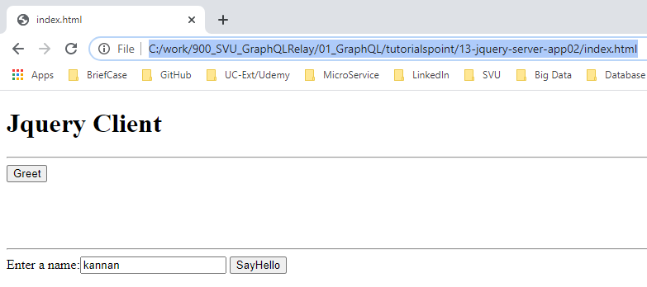
13.3 Verify
https://www.tutorialspoint.com/graphql/graphql_validation.htm
Verify
Open Chrome
> file:///C:/work/900_SVU_GraphQLRelay/01_GraphQL/tutorialspoint/13-jquery-server-app02/index.html

Slide 9
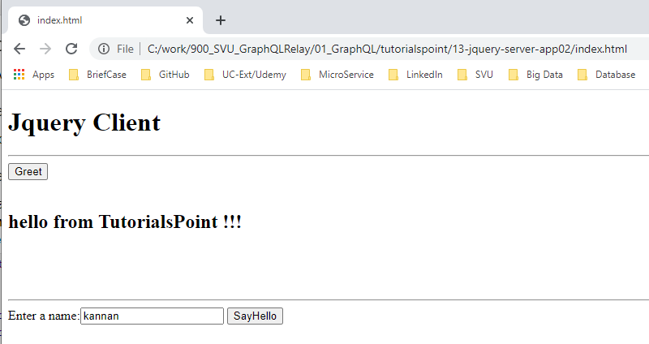
13.3 Verify
https://www.tutorialspoint.com/graphql/graphql_validation.htm
Click Greet

Slide 10
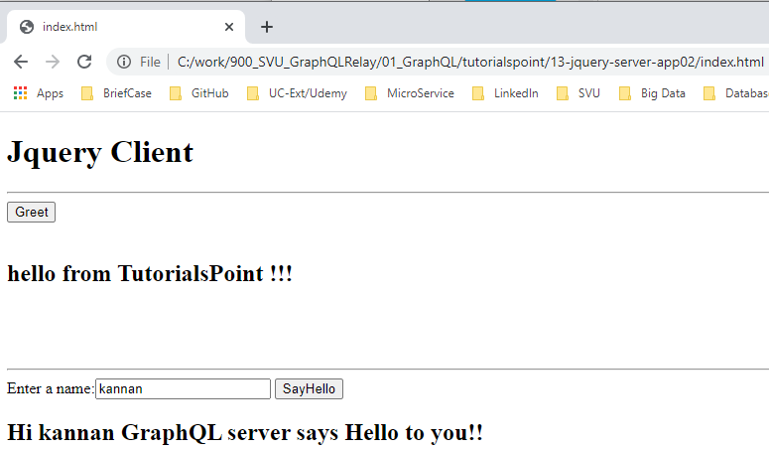
13.3 Verify
https://www.tutorialspoint.com/graphql/graphql_validation.htm
Click Say Hello button.

Slide 11
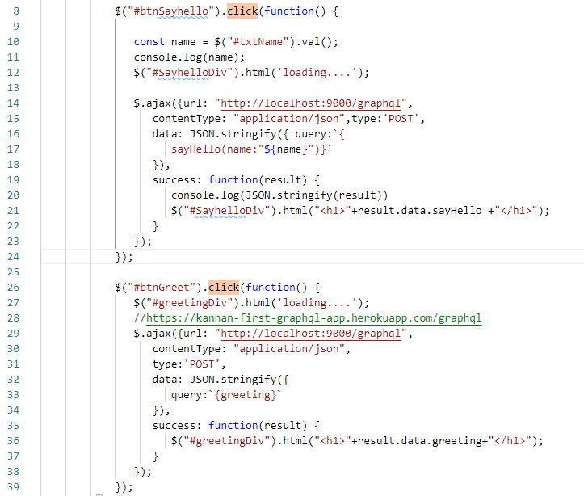
13.3 Verify
https://www.tutorialspoint.com/graphql/graphql_validation.htm
Click button call the http://localhost:9000/graphql for sayHello() and Query (greeting).

Slide 12
End of Chapter

