Slide 1

10 Query: Part 1
Peter H. Chen

Slide 2
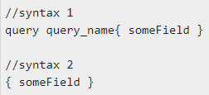
10 Query: Part 1
https://www.tutorialspoint.com/graphql/graphql_query.htm
A GraphQL operation can either be a read or a write operation.
A GraphQL query is used to read or fetch values while a mutation is used to write or post values.
In either case, the operation is a simple string that a GraphQL server can parse and respond to with data in a specific format.
The popular response format that is usually used for mobile and web applications is JSON.
The syntax to define a query is as follows:

Slide 3
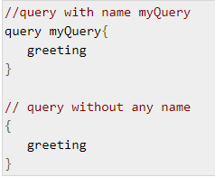
10 Query: Part 1
https://www.tutorialspoint.com/graphql/graphql_query.htm
Following is an example of a query:
It is clear from the below example that the query keyword is optional.
GraphQL queries help to reduce over fetching of data.
Unlike a Restful API, GraphQL allows a user to restrict fields that should be fetched from the server.
This means smaller queries and lesser traffic over the network; which in turn reduces the response time.
Illustration 1 - Query Student Model with a Custom Field
In this example, we have a set of students stored in a json file.
Each student model has fields like firstName, lastName and id but no fullName.
Here, we will discuss how to make a query to retrieve fullName of all students.
For this, we need to create fullName field in both schema resolver.
Let us see how to do this illustration using the below steps:

Slide 4
10.1 Step 1

Slide 5
10.1 Step 1
https://www.tutorialspoint.com/graphql/graphql_query.htm
Step 1: Create 10-query-app
Copy 09-resolver-app to 10-query-app (or Follow step 3 to step 5 of 03-step.pptx).

Slide 6
10.2 Step 2

Slide 7
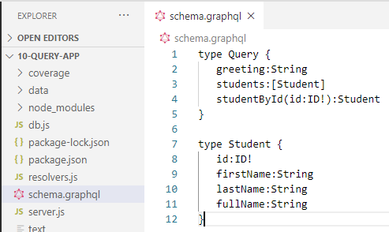
10.2 Step 2
https://www.tutorialspoint.com/graphql/graphql_query.htm
Step 2: Create Schema
Create schema.graphql file in the project folder 10-query-app as the following code.
Note:
There is no fullName field in the students.json file.
However, we need to fetch the fullname of the student via a query.
The fullName, in this case will be a custom field that isn't available with the data source.

Slide 8
10.3 Step 3

Slide 9
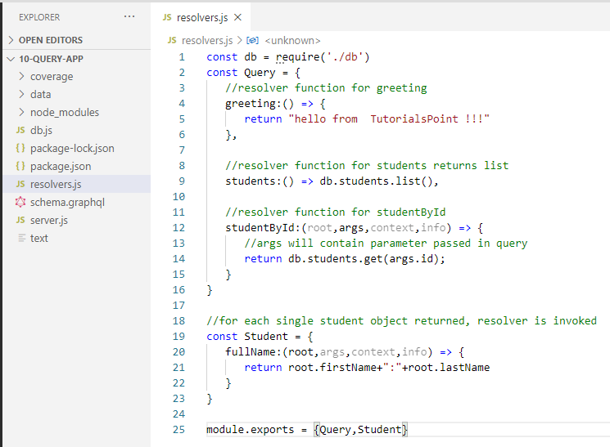
10.3 Step 3
https://www.tutorialspoint.com/graphql/graphql_query.htm
Step 3: Create Resolver
Create a file resolvers.js in the project folder and add the following code:

Slide 10
10.4 Step 4

Slide 11
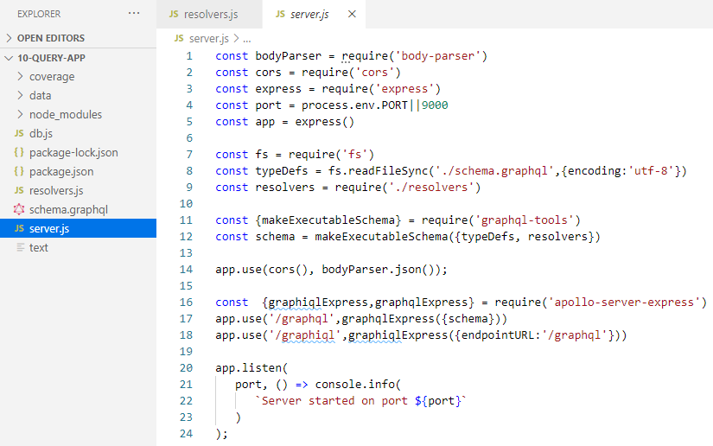
10.4 Step 4
https://www.tutorialspoint.com/graphql/graphql_query.htm
Step 4: Run the Application
Copy server.js file from step 8 in the 03_Setup.pptx.

Slide 12
10.5 Step 5

Slide 13
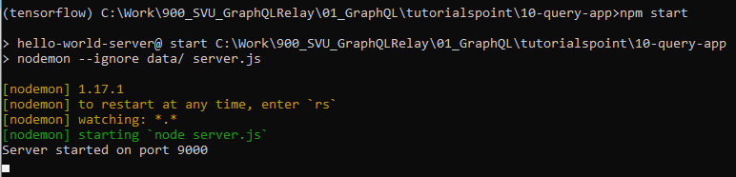
10.5 Step 5
https://www.tutorialspoint.com/graphql/graphql_query.htm
Step 5: Run Application
Execute the command npm start in the terminal.
> npm start
Or
> node server.js

Slide 14
10.6 Step 6

Slide 15
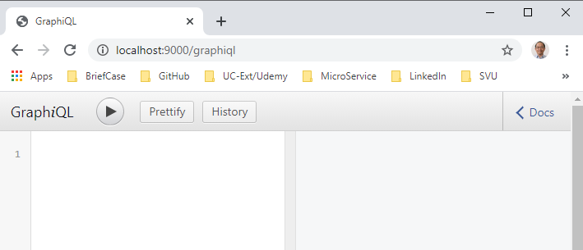
10.6 Step 6
https://www.tutorialspoint.com/graphql/graphql_query.htm
Step 6: Verification
The server will be up and running on 9000 port.
Here, we use GraphiQL as a client to test the application.

Slide 16
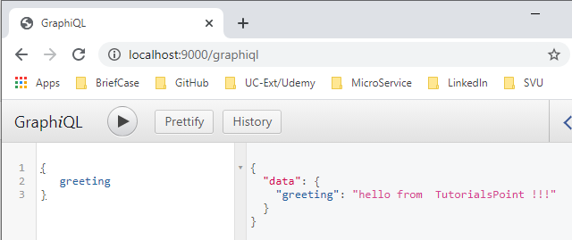
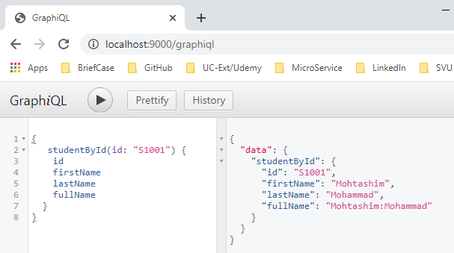
10.6 Step 6
https://www.tutorialspoint.com/graphql/graphql_query.htm
Step 6: Verification
Open browser and type the URL http://localhost:9000/graphiql.
Type the following query in the editor

Slide 17
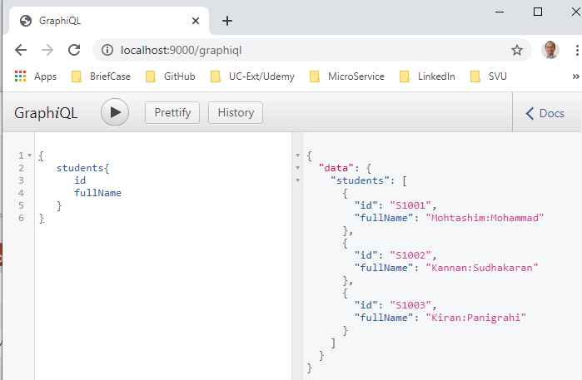
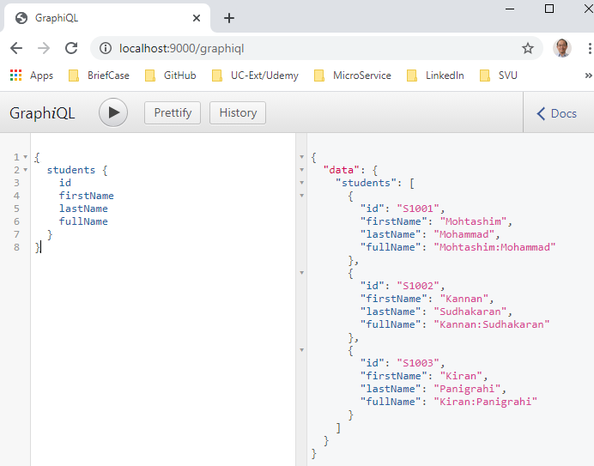
10.6 Step 6
https://www.tutorialspoint.com/graphql/graphql_query.htm
Step 6: Verification
Open browser and type the URL http://localhost:9000/graphiql.
Type the following query in the editor

Slide 18
End of Chapter

