Slide 1

15 Apollo Server and Client: Part 1
Peter H. Chen

Slide 2
15 Apollo Server and Client: Part 1
https://www.tutorialspoint.com/graphql/graphql_apollo_client.htm
Apollo Server and Client
We discuss Apollo Server to build graphql specification on server side.
Apollo Client is quick and easy to build production ready GraphQL server. Now let us understand the client side.
Apollo Client is the easiest way to use GraphQL to build client applications.
The Apollo client is designed to help developer quickly build a UI that fetches data with GraphQL and can be used with any JavaScript front-end.
Apollo Client supports the following platforms
No | Platform & Framework
1 | JavaScript React, Angular, Vue, Meteor, Ember
2 | WebComponents Polymer, lit-apollo
3 | Native Mobile Native Android with Java, Native iOS with Swift

Slide 3
15 Apollo Server and Client: Part 1
https://www.tutorialspoint.com/graphql/graphql_apollo_client.htm
Apollo Server and Client
Caching is one of the major features of Apollo Client.
apollo-boost is a convenience package which brings in a bunch of other dependencies.
Illustration
Let us see how to use Apollo Client to build client applications using the following steps.
Setting up Server
We have to follow the below steps for setting up a server

Slide 4
15.1 Step 1

Slide 5
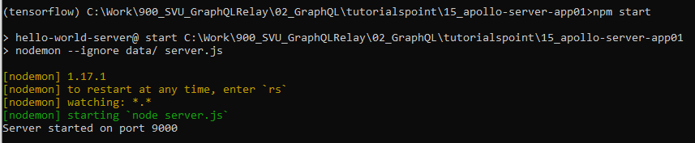
15.1 Step 1
https://www.tutorialspoint.com/graphql/graphql_apollo_client.htm
Step 1: Setup 15_apollo-server-app01
Copy the 14_react-server-app02 to 15_apollo-server-app01 (or Follow steps 3 to 5 as 03_Setup.pptx).
Start anaconda prompt:
(base) [work-directory] > conda activate tensorflow
(tensorflow) [work-directory] > npm start
Make sure it working before we start to work.

Slide 6
15.2 Step 2

Slide 7
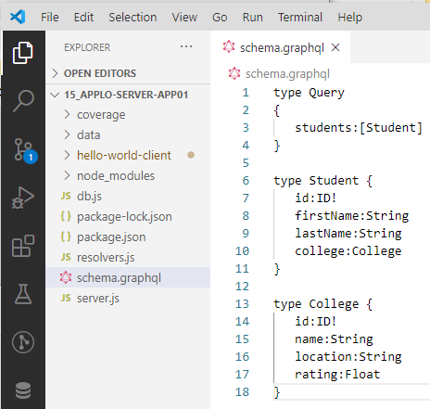
15.1 Step 2
https://www.tutorialspoint.com/graphql/graphql_apollo_client.htm
Step 2: Create Schema
Add schema.graphql file in the project folder apollo-server-app01 and add the following code

Slide 8
15.3 Step 3

Slide 9
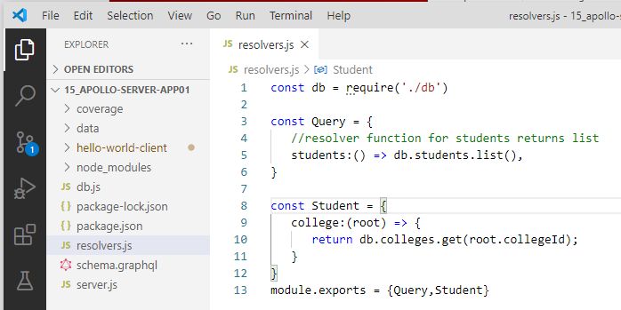
15.3 Step 3
https://www.tutorialspoint.com/graphql/graphql_apollo_client.htm
Step 3. Create a Resolver:
Create resolver.js file in folder 15-apollo-server-app01 as follow:

Slide 10
15.4 Step 4

Slide 11
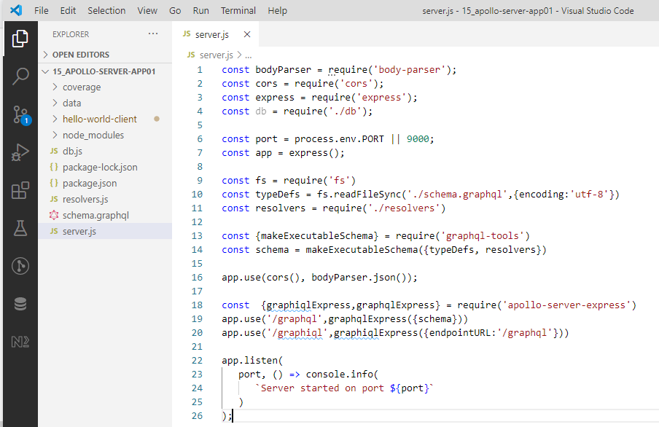
15.4 Step 4
https://www.tutorialspoint.com/graphql/graphql_apollo_client.htm
Step 4. Create Server.js
Create a server.js file (Same as step 8 of 03_Setup.pptx).

Slide 12
15.5 Step 5

Slide 13
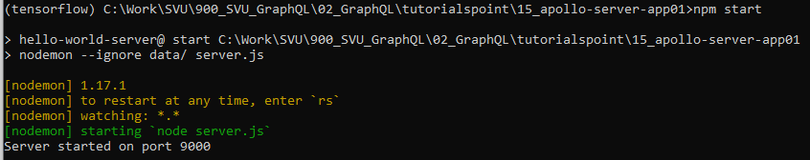
15.5 Step 5
https://www.tutorialspoint.com/graphql/graphql_apollo_client.htm
Step 5: Run GraphQL Serve
Open Command Prompt terminal.
> npm start
GraphQL run on port 9000.

Slide 14
15.6 Verify

Slide 15
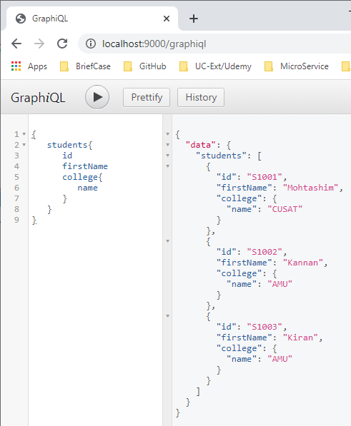
15.6 Verify
https://www.tutorialspoint.com/graphql/graphql_apollo_client.htm
Step 6. Verify
Open Chrome
> localhost:9000/graphiql
Enter
> {
> students {
> firstName
> college {
> name
> }
> }
> }
Click (>) Run

Slide 16
15.7 Summary

Slide 17
15.7 Summary
https://www.tutorialspoint.com/graphql/graphql_apollo_client.htm
Summary
We have done the server setup for Apollo Client.
We will discuss the Apollo Client next.

Slide 18
End of Chapter

