Slide 1

15 Apollo Client: Part 2
Peter H. Chen

Slide 2
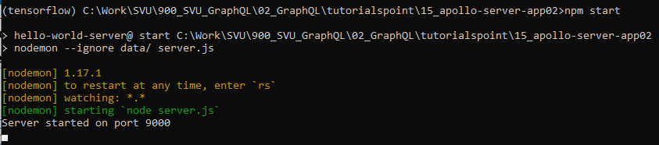
15 Apollo Client: Part 2
https://www.tutorialspoint.com/graphql/graphql_apollo_client.htm
Run Apollo Server
In this discussion, we discuss Apollo Client.
Copy 15_apollo-server-app01 into 15_apollo-server-app02
> cd 15_apollo-server-app02
> npm start
server application on port number 9000.

Slide 3
15 Apollo Client: Part 2
https://www.tutorialspoint.com/graphql/graphql_apollo_client.htm
Run Apollo Client
We have server application on port number 9000.
The server terminal should be kept running before executing the client application.
Now, we discuss Apollo Client.
We will run client on the second terminal.
Open a new terminal for client and create the react application.
React application will be running on port number 3000.

Slide 4
15.1 Step 1

Slide 5
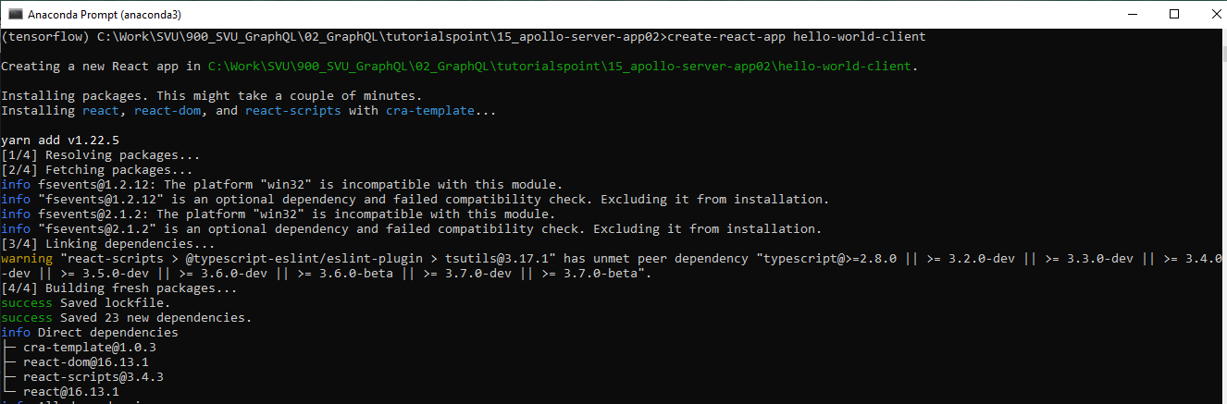
15.1 Step 1
https://www.tutorialspoint.com/graphql/graphql_apollo_client.htm
Step 1: Create a React Application
Open anaconda prompt
> conda activate tensorflow
> cd [work-directory, i.e., 15_apollo-server-app02]
Stop the running server before we create the client.
> create-react-app hello-world-client

Slide 6
15.2 Step 2

Slide 7
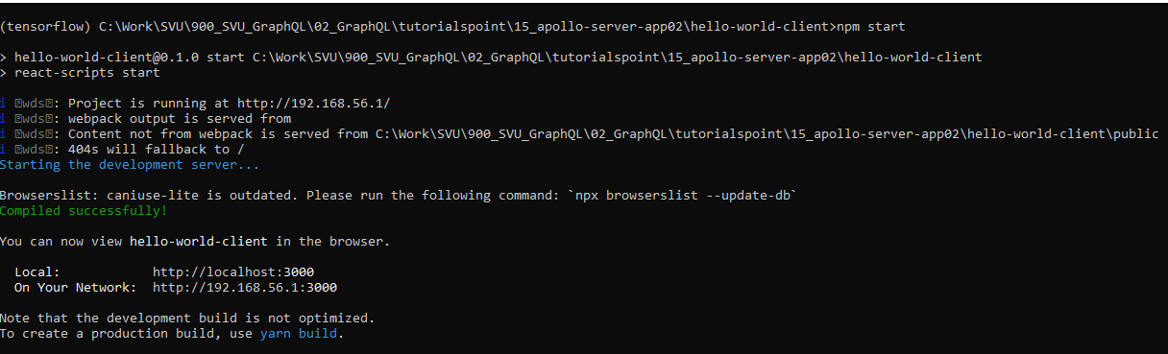
15.2 Step 2
https://www.tutorialspoint.com/graphql/graphql_apollo_client.htm
Step 2: Start Client
Start the server in the Server terminal (15_apollo-server-app02):
> npm start
> cd hello-world-client
In the client terminal, type the following command
Open chrome browser
(tensorflow) …/15_apollo-serce-app02/hello-world-client > npm start
The client is running under port 3000.

Slide 8
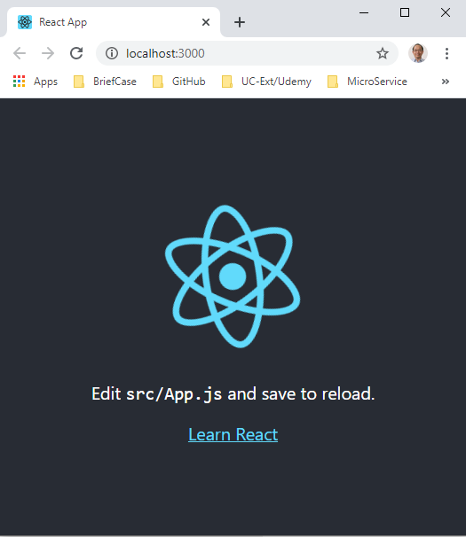
15.2 Step 2
https://www.tutorialspoint.com/graphql/graphql_apollo_client.htm
Step 2: Start Client
The default React Client is automatically bring up.

Slide 9
15.3 Step 3

Slide 10
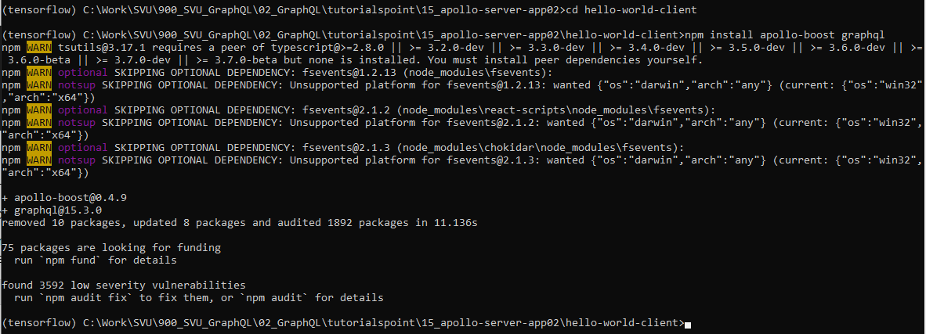
15.3 Step 3
https://www.tutorialspoint.com/graphql/graphql_apollo_client.htm
Step 3: Install Apollo Libraries
Now, we need to modify the our Client Application.
First, we need to install Apollo Client Libraries: apollo-boost and grapql
Control-C to quit the default react application.
> npm install apollo-boost graphql

Slide 11
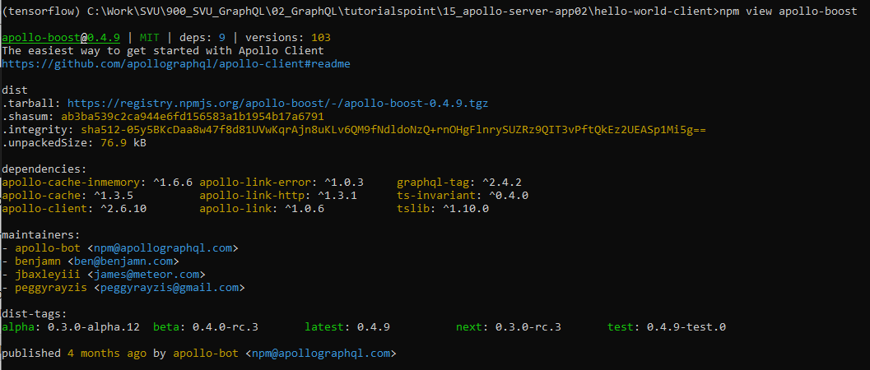
15.3 Step 3
https://www.tutorialspoint.com/graphql/graphql_apollo_client.htm
Step 3: Install Apollo Libraries
This will download the graphql libraries for client side and also the Apollo Boost package.
We can cross check this by typing npm view in apollo-boost dependencies.
> npm view apollo-boost
This will have many dependencies as shown below.
We can clearly see that Apollo-Client library is installed.

Slide 12
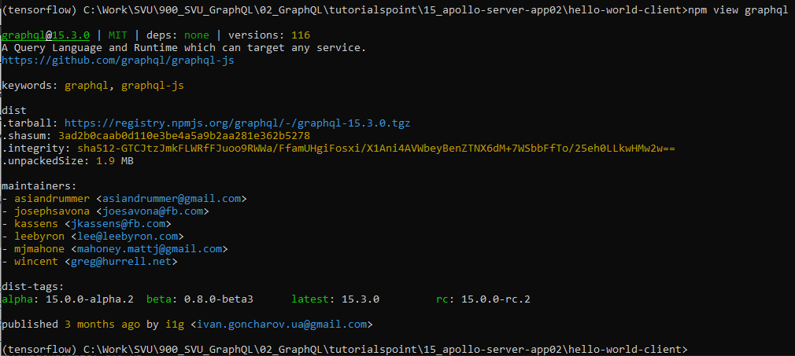
15.3 Step 3
https://www.tutorialspoint.com/graphql/graphql_apollo_client.htm
Step 3: Install Apollo Libraries
Check graphql.
> npm view graphql
This will have many dependencies as shown below

Slide 13
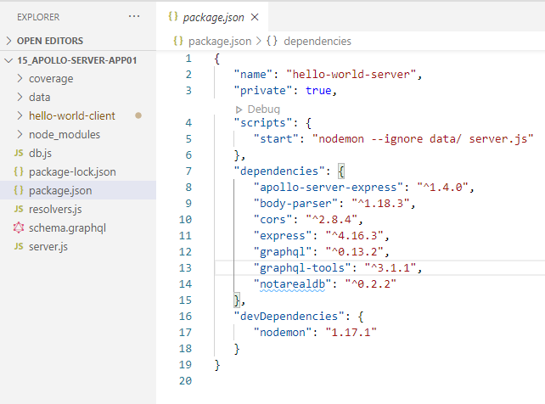
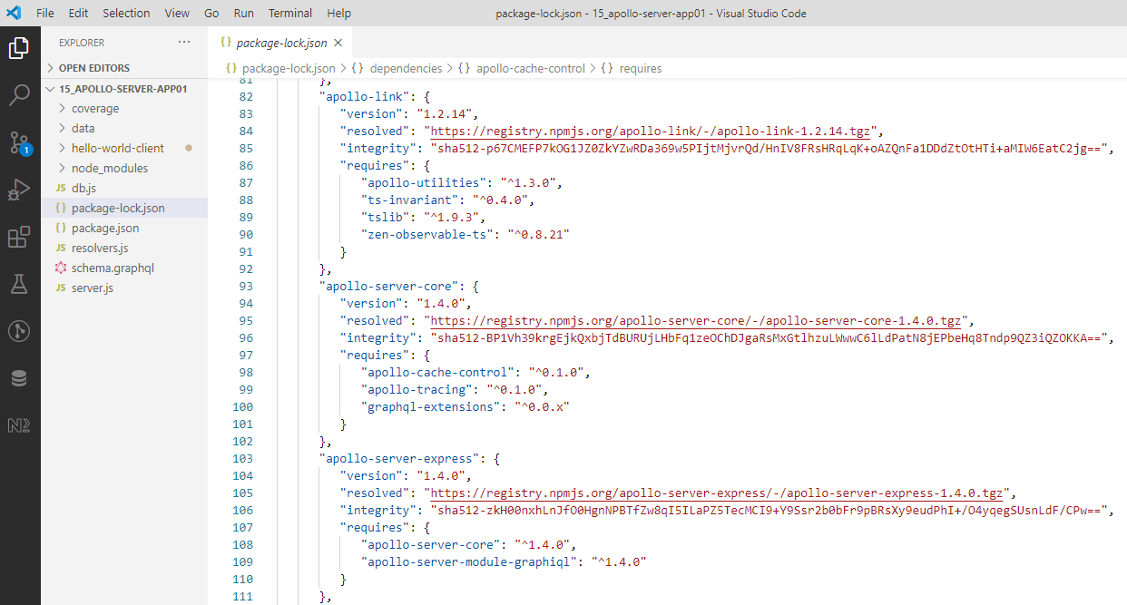
15.3 Step 3
https://www.tutorialspoint.com/graphql/graphql_apollo_client.htm
Step 3: Install Apollo Libraries
Check package.json and package-lock.json
Note:
1. package.json: records the minimum version you app needs. If you update the versions of a particular package, the change is not going to be reflected here.
2. package-lock.json: records the exact version of each installed package which allows you to re-install them. Future installs will be able to build an identical dependency tree.

Slide 14
15.4 Step 4

Slide 15
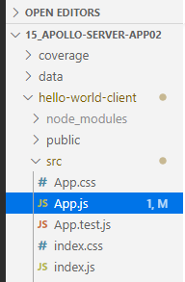
15.4 Step 4
https://www.tutorialspoint.com/graphql/graphql_apollo_client.htm
Step 4: Modify App Component in App.js File
You only need to keep the App.js in src folder and index.html in public folder.
The directory structure is given below

Slide 16
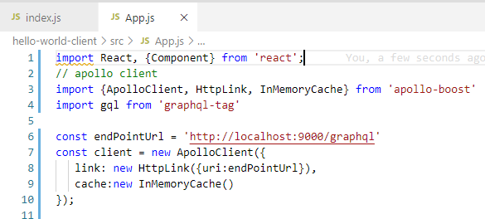
15.4 Step 4
https://www.tutorialspoint.com/graphql/graphql_apollo_client.htm
Step 4: Modify App Component in App.js File
With Apollo Client, we can directly call server without the use of fetch API.
Following code snippet shows how to import Apollo Client:
Note: The queries and mutations should not be embedded in a string made with back tick notation. This is because, the gql function directly parses the queries. This means, a programmer can directly write queries in the same way when writing queries in GraphiQL tool. The gql is a tag function which will parse the template string written in back tick notation to graphql query object. The Apollo Client query method returns a promise.

Slide 17
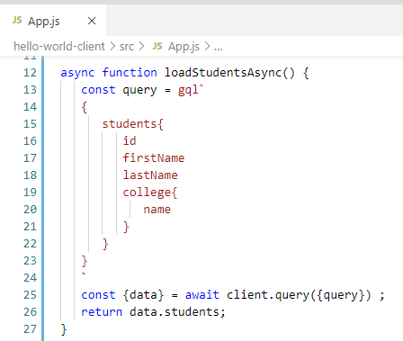
15.4 Step 4
https://www.tutorialspoint.com/graphql/graphql_apollo_client.htm
Step 4: Modify App Component in App.js File
In the previous discussion, we discussed how to use fetch API for HTTP requests.
The following code shows how to use gql function.
The loadStudentsAsync function uses graphql client to query the server.

Slide 18
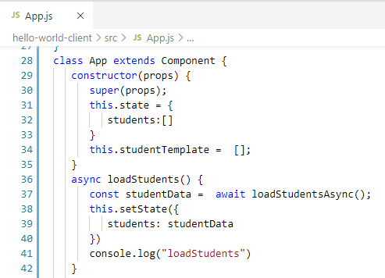
15.4 Step 4
https://www.tutorialspoint.com/graphql/graphql_apollo_client.htm
Step 4: Modify App Component in index.js File
Following is the App.js in react application

Slide 19
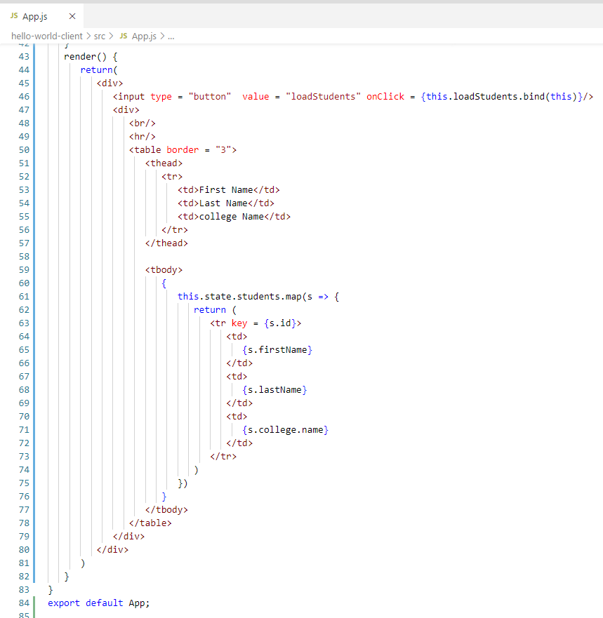
15.4 Step 4
https://www.tutorialspoint.com/graphql/graphql_apollo_client.htm
Step 4: Modify App Component in index.js File
React render() function.

Slide 20
15.5 Verify

Slide 21
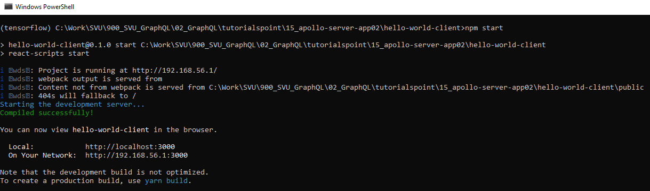
15.5 Verify
https://www.tutorialspoint.com/graphql/graphql_apollo_client.htm
Step 5: Verify
Open Chrome
(tensorflow) [Apollo-Client-Work-directory, …/hello-world-client]> npm start

Slide 22
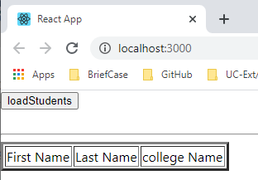
15.5 Verify
https://www.tutorialspoint.com/graphql/graphql_apollo_client.htm
Step 5: Verify
The default apollo client is bringing up.

Slide 23
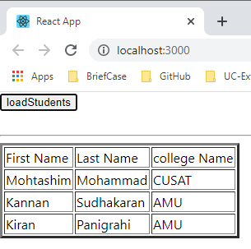
15.5 Verify
https://www.tutorialspoint.com/graphql/graphql_apollo_client.htm
Step 5: Verify
Click “loadStudents” button to load and display data.

Slide 24
End of Chapter

