Slide 1

11 Return Object of Mutation: Part 3
Peter H. Chen

Slide 2
11 Return Object of Mutation: Part 3
https://www.tutorialspoint.com/graphql/graphql_mutation.htm
Return Object of Mutation: Part 3
It is best practice to return an object in mutation.
For example, the client application wants to fetch student and college details.
In this case, rather than making two different requests, we can create a query that returns an object containing students and their college details.
Copy 10-query-app01 to 11-mutation-app03 (or Follow steps 3 to 5 explained in the Setup.pptx).

Slide 3
11.1 Step 1

Slide 4
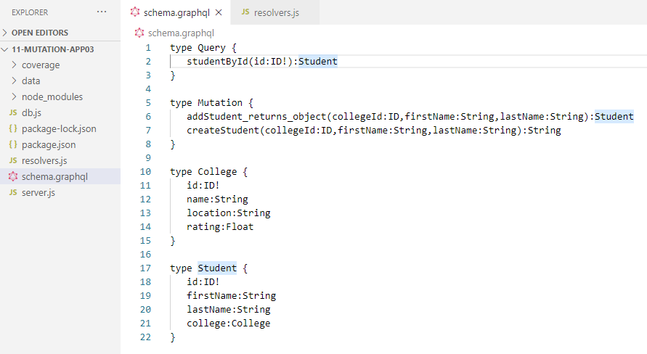
11.1 Step 2
https://www.tutorialspoint.com/graphql/graphql_mutation.htm
Step 1: Create schema.graphql
Add a new method named addStudent which returns object in mutation type of schema.graphql.
Let us learn how to access the college details through student details.
Add college type in the schema file.

Slide 5
11.2 Step 2

Slide 6
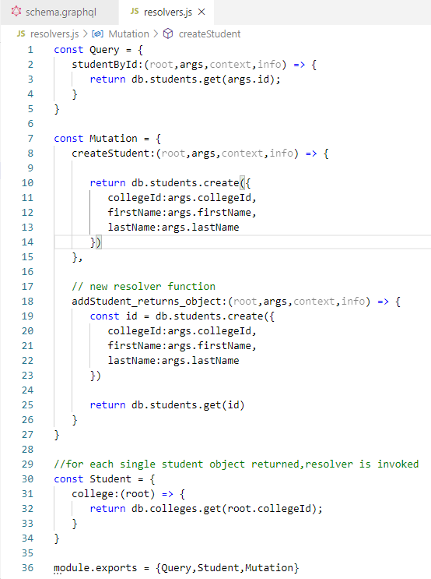
11.2 Step 2
https://www.tutorialspoint.com/graphql/graphql_mutation.htm
Step 3: Update the resolvers.js File
Update a file resolvers.js in the project folder and add the following code:

Slide 7
11.3 Run Application

Slide 8
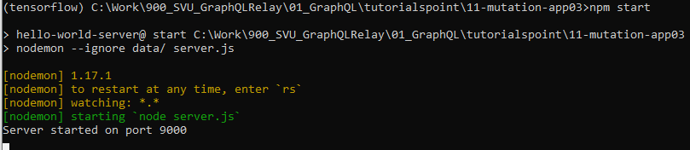
11.3 Run Application
https://www.tutorialspoint.com/graphql/graphql_mutation.htm
Step 3: Run Application

Slide 9
11.4 Before Mutation

Slide 10
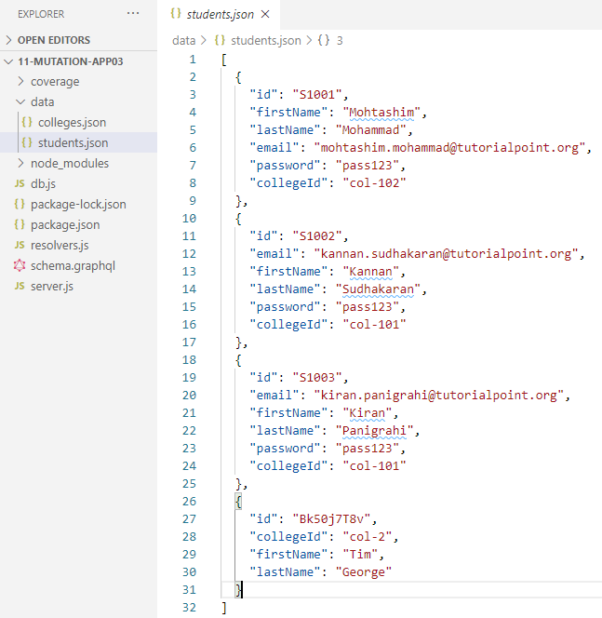
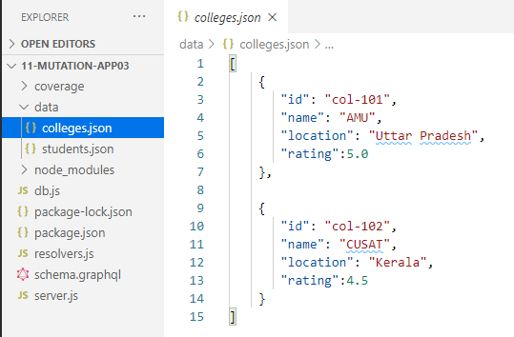
11.4 Before Mutation
https://www.tutorialspoint.com/graphql/graphql_mutation.htm
Before Mutation

Slide 11
11.5 Mutation

Slide 12
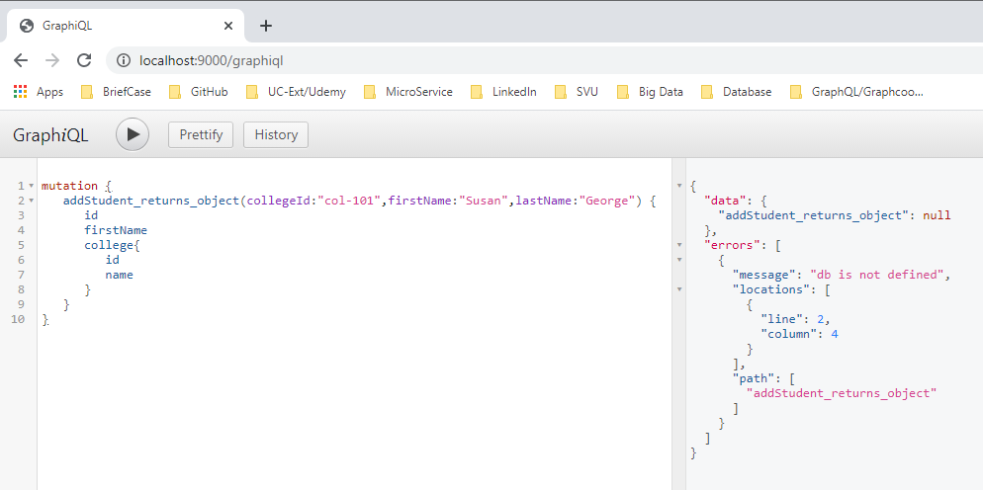
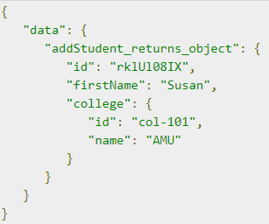
11.5 Mutation
https://www.tutorialspoint.com/graphql/graphql_mutation.htm
Run Mutation: Error
Run Mutation: Expected Result

Slide 13
11.6 After Mutation

Slide 14
11.6 After Mutation
https://www.tutorialspoint.com/graphql/graphql_mutation.htm
After Mutation: Nothing Change because the Error in GraphQL.

Slide 15
11.7 Summary

Slide 16
11.7 Summary
https://www.tutorialspoint.com/graphql/graphql_mutation.htm
Object Mutation does not work well in GraphQL.

Slide 17
End of Chapter

