Slide 1

17 Cache Server: Part 1
Peter H. Chen

Slide 2
17 Cache Server: Part 1
https://www.tutorialspoint.com/graphql/graphql_caching.htm
Caching is the process of storing data in a temporary storage area called cache.
When you return to a page you've recently visited, the browser can get those files from the cache rather than the original server.
This saves your time, and network from the burden of additional traffic.
Client applications interacting with GraphQL are responsible for caching data at their end.
One possible pattern for this is reserving a field, like id, to be a globally unique identifier.
InMemory Cache
InMemoryCache is a normalized data store commonly used in GraphQL client applications without use of other library like Redux.

Slide 3
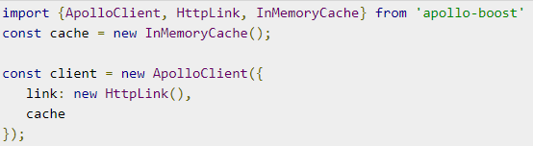
17 Cache Server: Part 1
https://www.tutorialspoint.com/graphql/graphql_caching.htm
The sample code to use InMemoryCache with ApolloClient is given below:

Slide 4
17 Cache Server: Part 1
https://www.tutorialspoint.com/graphql/graphql_caching.htm
The InMemoryCache constructor takes an optional config object with properties to customize your cache.
No | Parameter & Description
1 | addTypename A boolean to determine whether to add __typename to the document (default: true)
2 | dataIdFromObject A function that takes a data object and returns a unique identifier to be used when normalizing the data in the store
3 | fragmentMatcher By default, the InMemoryCache uses a heuristic fragment matcher
4 | cacheRedirects A map of functions to redirect a query to another entry in the cache before a request takes place.

Slide 5
17 Cache Server: Part 1
https://www.tutorialspoint.com/graphql/graphql_caching.htm
Illustration
We will create a SPA (Single Page Application) in ReactJS with two tabs – one for the home tab and another for students.
The students tab will load data from a GraphQL server API.
The application will query for students data when the user navigates from the home tab to the students tab.
The resulting data will be cached by the application.
We will also query the server time using getTime field to verify if the page is cached.
If data is returned from the cache, the page will display the time of very first request sent to the server.
If the data is a result of a fresh request made to the sever, it will always show the latest time from server.
Setting up the Server
Following are the steps for setting up the server.

Slide 6
16.1 Step 1

Slide 7
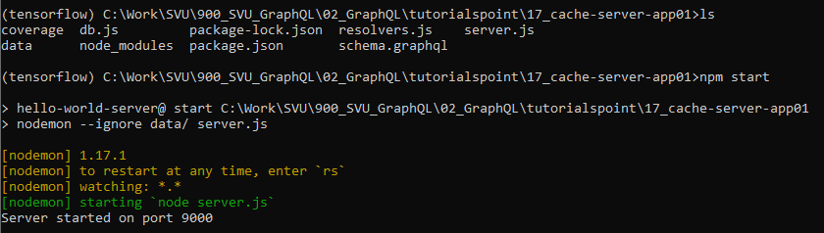
16.1 Step 1
https://www.tutorialspoint.com/graphql/graphql_caching.htm
Step 1: Create auto-server-app01
Copt 10_query_app01 to 15_cache-server-app01 (Follow Step 3 to 5 of 01_Setup.pptx)
Strat anaconda prompt
> conda activate tensorflow
(tensorflow) [work-folder) > npm start

Slide 8
16.2 Step 2

Slide 9
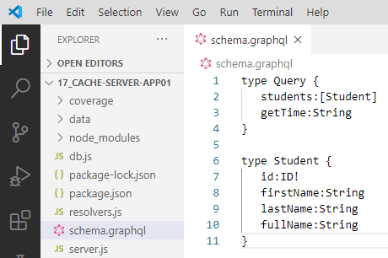
16.2 Step 2
https://www.tutorialspoint.com/graphql/graphql_caching.htm
Step 2: Create Schema
Add schema.graphql file in the project folder cache-server-app and add the following code:

Slide 10
16.3 Step 3

Slide 11
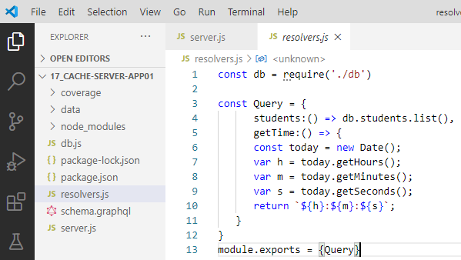
16.3 Step 3
https://www.tutorialspoint.com/graphql/graphql_caching.htm
Step 3: Add Resolvers
Create a file resolvers.js in the project folder, and add the following code

Slide 12
16.4 Check server.js

Slide 13
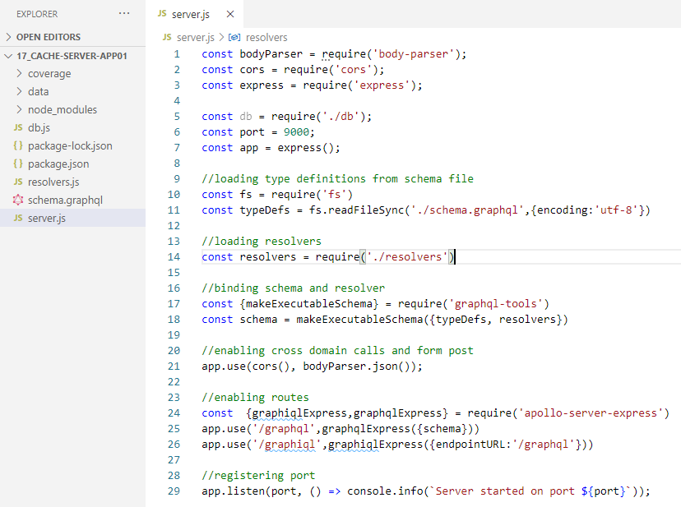
16.4 Check server.js
https://www.tutorialspoint.com/graphql/graphql_caching.htm
Check server.js
Server should look like as follow:

Slide 14
16.5 Step5

Slide 15
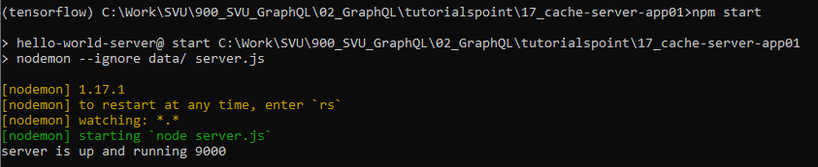
16.5 Step 5
https://www.tutorialspoint.com/graphql/graphql_caching.htm
Verify Run Server
> npm start

Slide 16
16.6 Verify Graphiql

Slide 17
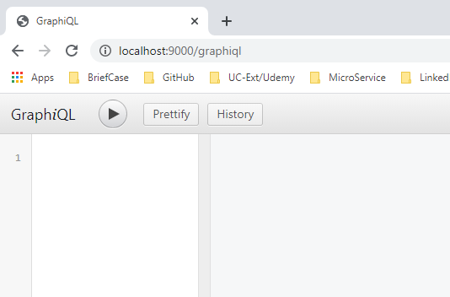
16.6 Verify Graphiql
https://www.tutorialspoint.com/graphql/graphql_caching.htm
Verify Graphiql
Open Chrome
> localhost:9000/graphiql

Slide 18
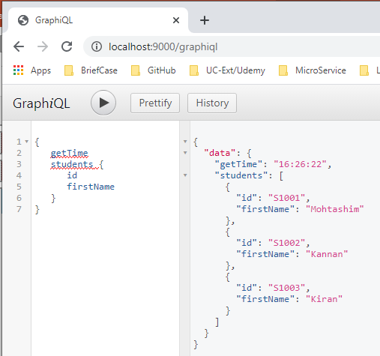
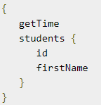
16.6 Verify Graphiql
https://www.tutorialspoint.com/graphql/graphql_caching.htm
Verify Graphiql
Open Chrome
> localhost:9000/graphiql

Slide 19
16.7 Summary

Slide 20
16.7 Summary
https://www.tutorialspoint.com/graphql/graphql_caching.htm
Summary
We have done the server setup.
Next, we will implement ReactJS for the client side.

Slide 21
End of Chapter

