Slide 1

17 Cache Client: Part 2
Peter H. Chen

Slide 2
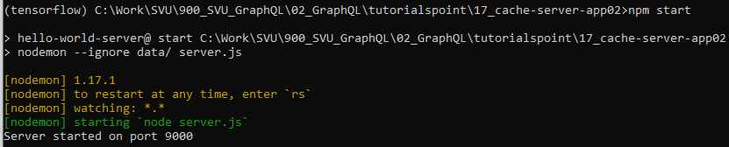
17 Cache Client: Part 2
https://www.tutorialspoint.com/graphql/graphql_apollo_client.htm
Cache Client
Copy the 17_cache-server-app01 to 17_cahe-server-app02
Verify the server is working properly before we add the Frontend ReactJS.
> cd 17_cache-server-app02
> npm start

Slide 3
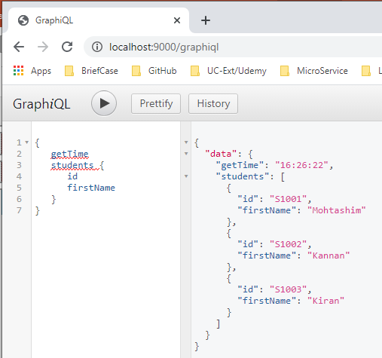
17 Cache Client: Part 2
https://www.tutorialspoint.com/graphql/graphql_apollo_client.htm
Cache Client
Open Chrome
In the grapipl editor type
{
setTime
students {
Id
firstName
}
}

Slide 4
17.1 Step 1

Slide 5
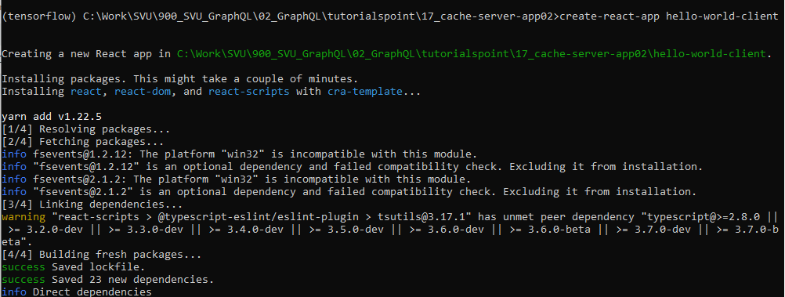
17.1 Step 1
https://www.tutorialspoint.com/graphql/graphql_apollo_client.htm
Create ReactJS Application
Open another anaconda prompt
> conda activate tensorflow
(tensorflow) [17_cache-server-app02] > create-react-app hello-world-client

Slide 6
17.2 Test Server and Client

Slide 7
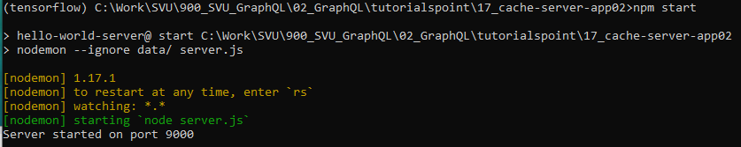
17.2 Test Server and Client
https://www.tutorialspoint.com/graphql/graphql_apollo_client.htm
In the 17-cache-server-app01 directory, bring up the cache server:
The server run at port 9000
> npm start

Slide 8
17.2 Test Server and Client
https://www.tutorialspoint.com/graphql/graphql_apollo_client.htm
In the 17-cache-server-app01/hello-world-client directory
Install router modules for react using following command
(tensorflow) hello-world-client> npm install react-router-dom

Slide 9
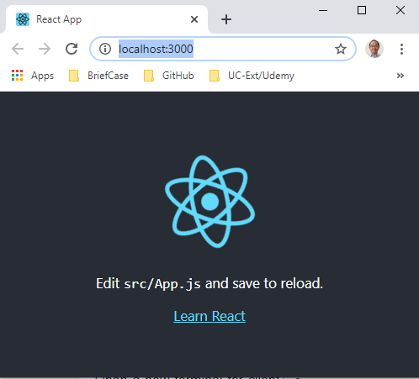
17.2 Test Server and Client
https://www.tutorialspoint.com/graphql/graphql_apollo_client.htm
In the 17-cache-server-app01/hello-world-client directory, bring up the cache server:
Open Chrome
Bring the React and run at port 3000 (localhost:3000)
(tensorflow) hello-world-client> npm start

Slide 10
17.3 Install Apollo Client

Slide 11
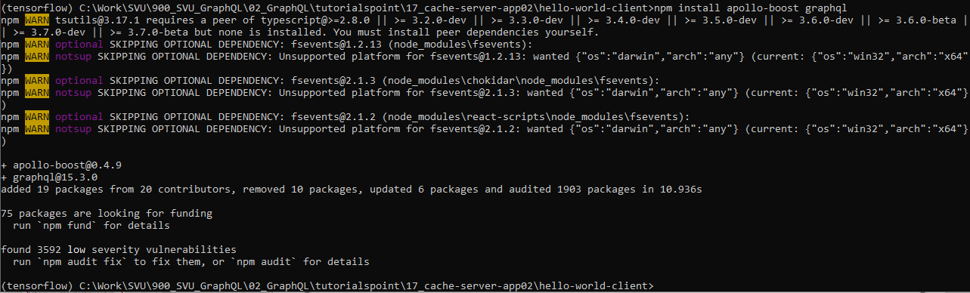
17.3 Install Apollo Client
https://www.tutorialspoint.com/graphql/graphql_apollo_client.htm
In the 17-cache-server-app01/hello-world-client directory
> install apollo-boost graphql

Slide 12
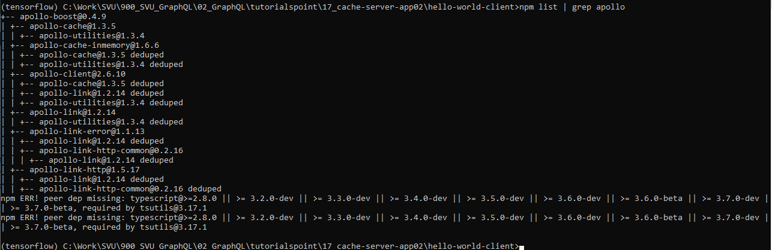
17.3 Install Apollo Client
https://www.tutorialspoint.com/graphql/graphql_apollo_client.htm
In the 17-cache-server-app01/hello-world-client directory
> npm list | grep apollo
This will download the graphql libraries for client side and also the Apollo Boost package. We can cross verify this by typing npm view apollo-boost dependencies. This will have many dependencies as shown below

Slide 13
17.3 Install Apollo Client
https://www.tutorialspoint.com/graphql/graphql_apollo_client.htm
In the 17-cache-server-app01/hello-world-client directory
> npm list | grep apollo
This will download the graphql libraries for client side and also the Apollo Boost package. We can cross verify this by typing npm view apollo-boost dependencies. This will have many dependencies as shown below

Slide 14
17.4 Route Components

Slide 15
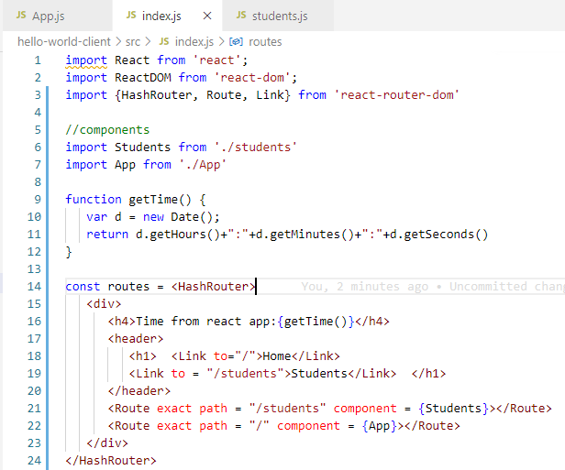
17.4 Route Components
https://www.tutorialspoint.com/graphql/graphql_apollo_client.htm
Modify index.js in src folder and index.html in public folder.
We add the router of ‘/’ and ‘/students’.
‘/’ is for import App component and ‘/students’ is for import Students component.

Slide 16
17.5 App Component

Slide 17
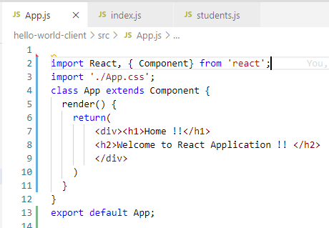
17.5 App Component
https://www.tutorialspoint.com/graphql/graphql_apollo_client.htm
App component.

Slide 18
17.6 Students Component

Slide 19
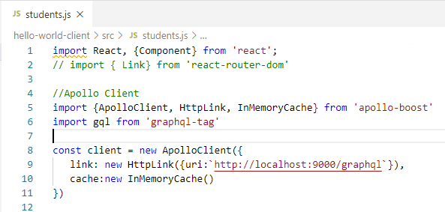
17.6 Students Component
https://www.tutorialspoint.com/graphql/graphql_apollo_client.htm
student.js: ApolloClient, Hotlink, and InMemoryCache Apollo-boost

Slide 20
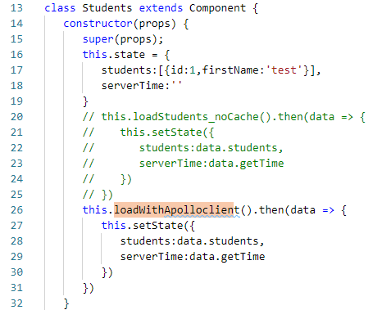
17.6 Students Component
https://www.tutorialspoint.com/graphql/graphql_apollo_client.htm
student.js: props and state of Students Component

Slide 21
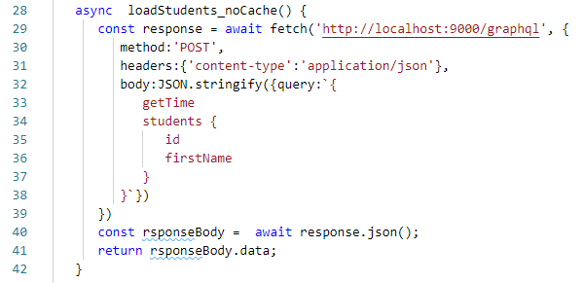
17.6 Students Component
https://www.tutorialspoint.com/graphql/graphql_apollo_client.htm
student.js: loadStudent without Cache (We do not use this function).

Slide 22
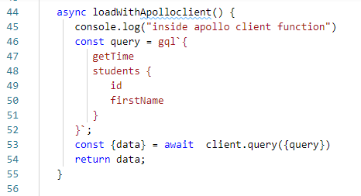
17.6 Students Component
https://www.tutorialspoint.com/graphql/graphql_apollo_client.htm
student.js: loadStudent with ApolloClient Cache

Slide 23
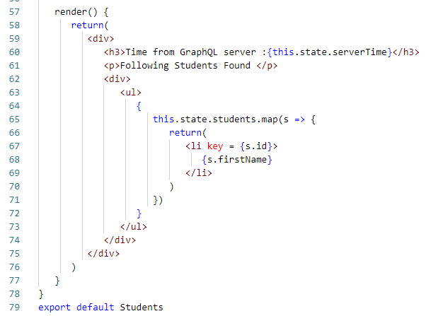
17.6 Students Component
https://www.tutorialspoint.com/graphql/graphql_apollo_client.htm
student.js: render Students Component.
Display Student Name

Slide 24
17.7 Verify

Slide 25
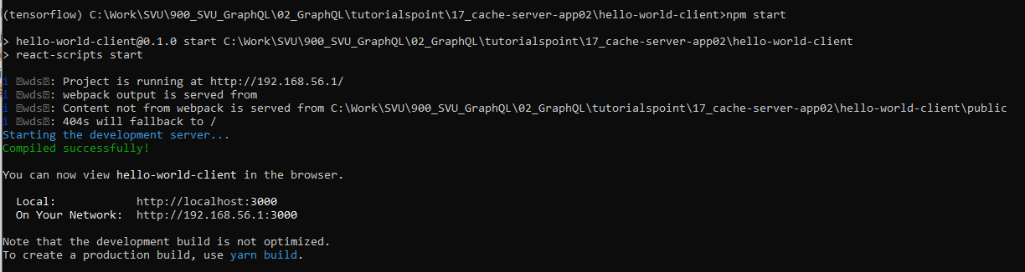
17.7 Verify
https://www.tutorialspoint.com/graphql/graphql_apollo_client.htm
Verify
In hello-world-client directory
> npm start

Slide 26
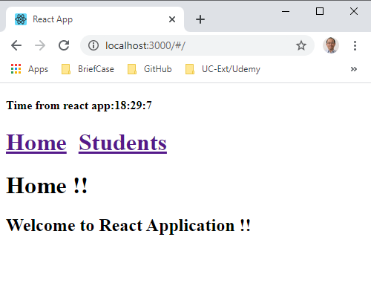
17.7 Verify
https://www.tutorialspoint.com/graphql/graphql_apollo_client.htm
Verify
In hello-world-client directory
> npm start

Slide 27
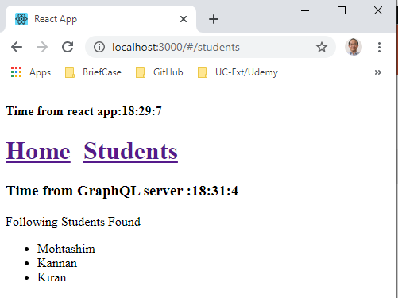
17.7 Verify
https://www.tutorialspoint.com/graphql/graphql_apollo_client.htm
Verify
Click Link “Students”. Get the student ID and display Student name

Slide 28
17.8 Change to Without Cache

Slide 29
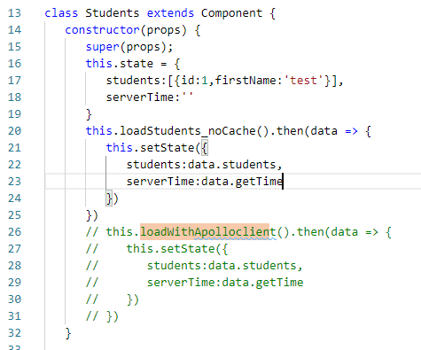
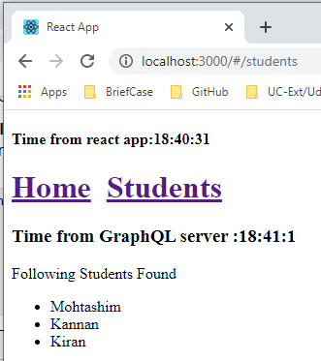
17.8 Change to Without Cache
https://www.tutorialspoint.com/graphql/graphql_apollo_client.htm
Change from with Cache to Without Cache
If you change the load method to loadStudents_noCache in the constructor of StudentComponent, the output will not cache the data.
This shows the difference between caching and non-caching.
This data is not cache and a little bit slow to switch.

Slide 30
End of Chapter

