Slide 1

3 Install Jenkins
Peter H. Chen

Slide 2
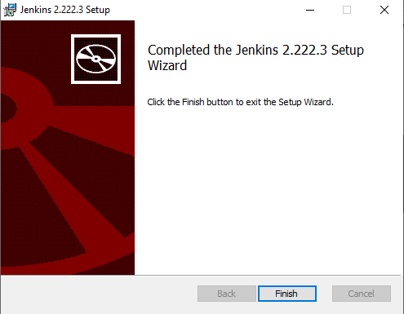
3 Install Jenkins
https://www.youtube.com/watch?v=MlvNXFdPhB8
Install Jenkins
Go to “jenkins.io” and download the latest version.
Unzip and double click exe file to install Jenkins.
Jenkins is installed under “C:\Program Files (x86)\Jenkins”

Slide 3
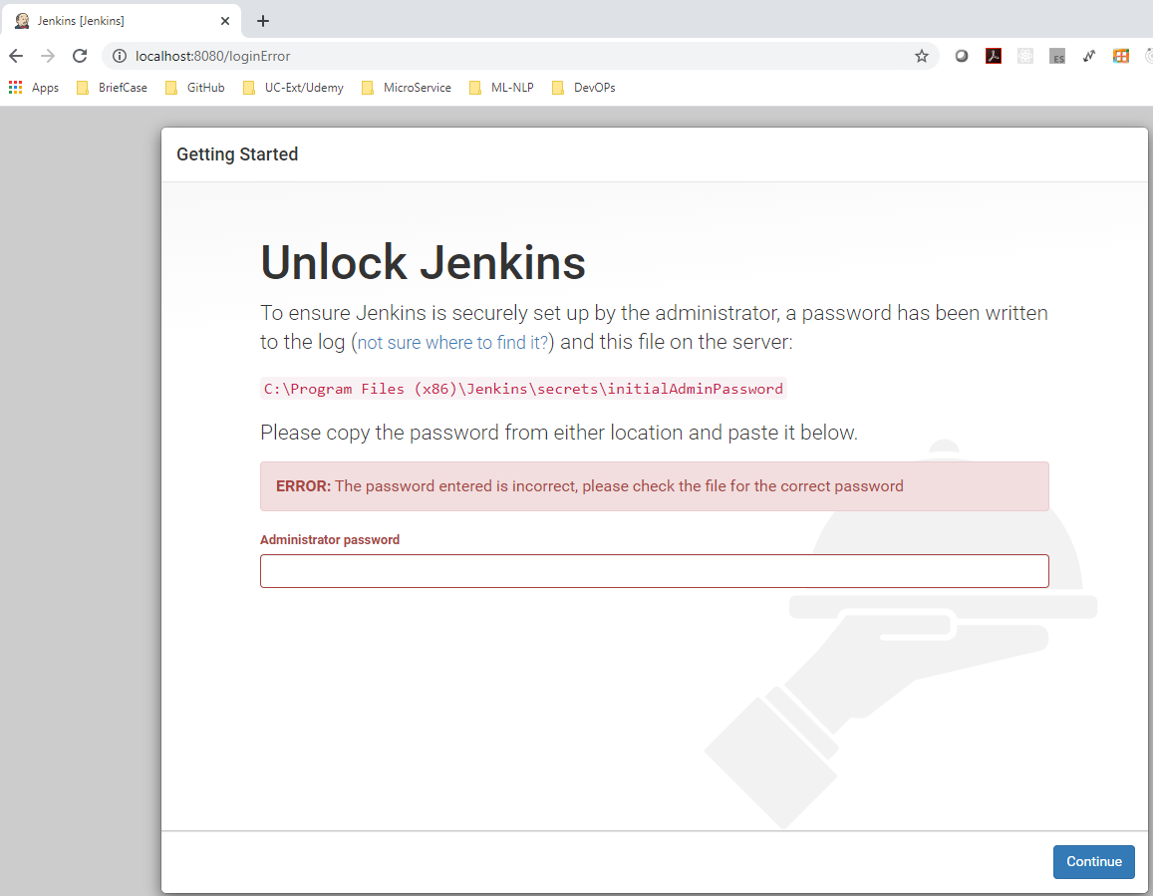
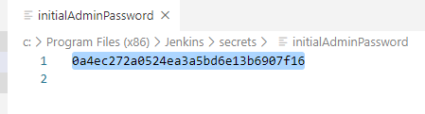
3 Install Jenkins
https://www.youtube.com/watch?v=MlvNXFdPhB8
Install Jenkins
Open browser:
> localhost:8080
Copy password in C:\Porgream File (x86)\Jenkins\secrets\initialAdminPassword into the Password and click continue

Slide 4
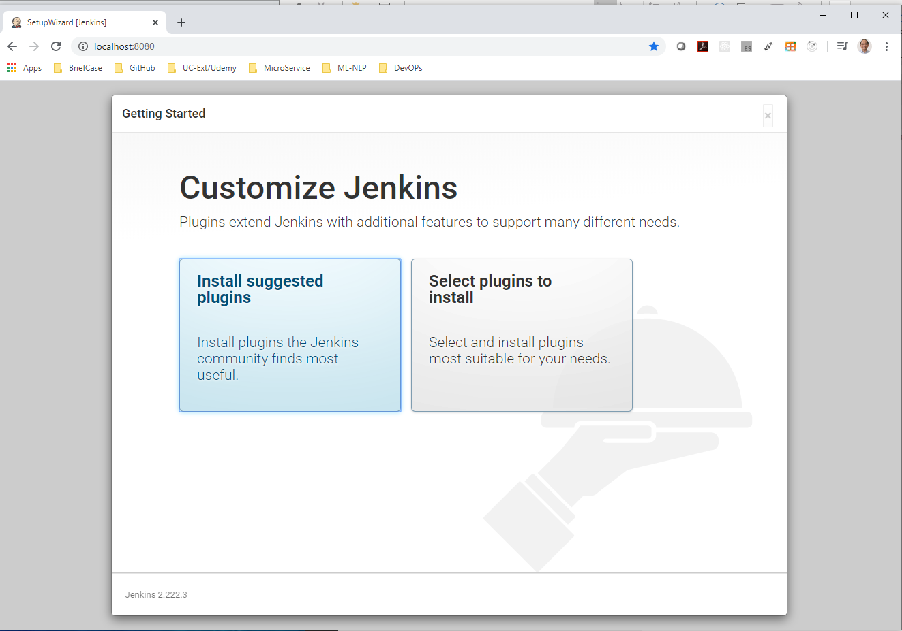
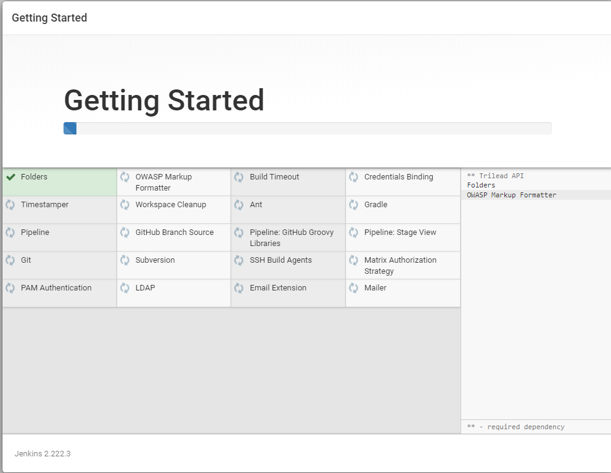
3 Install Jenkins
https://www.youtube.com/watch?v=MlvNXFdPhB8
Install Jenkins
You enter the Jenkins page.
Click “Install the Suggested Plugins”

Slide 5
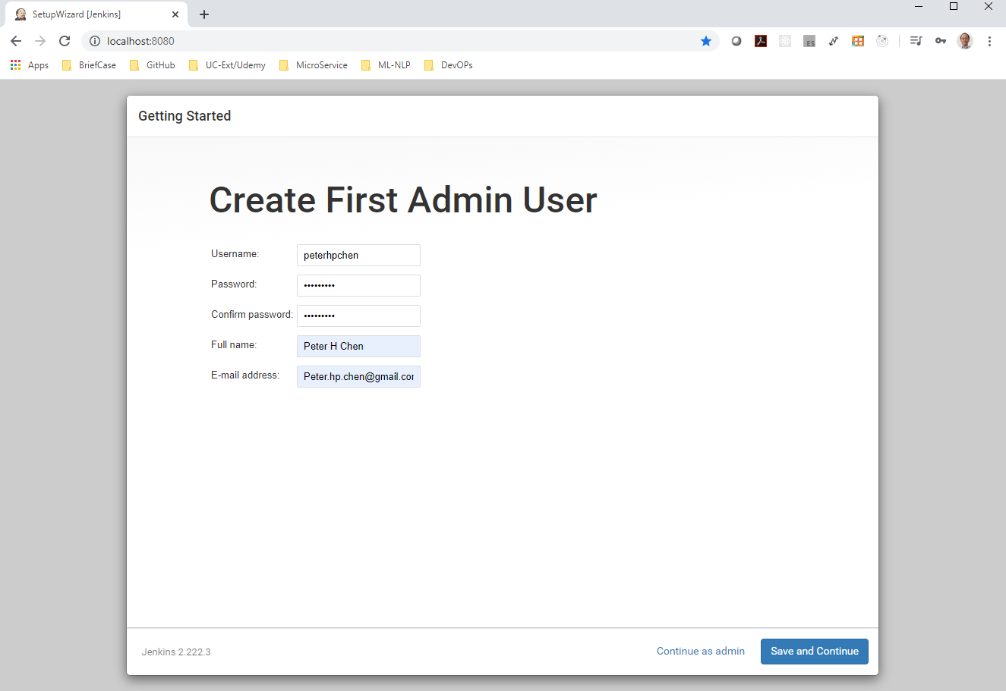
3 Install Jenkins
https://www.youtube.com/watch?v=MlvNXFdPhB8
Install Jenkins
Username: peterhpchen, password: Pcxxxx=xx
Full Name: Peter H. Chen, email address: peter.hp.chen@gmail.com

Slide 6
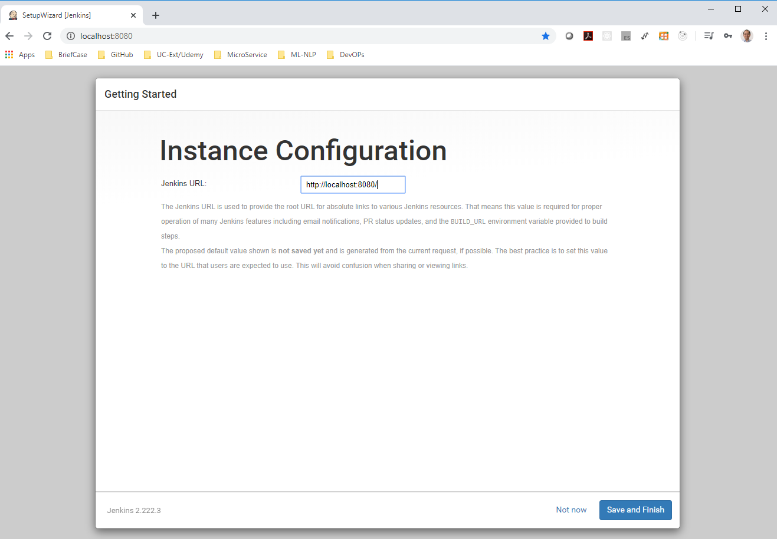
3 Install Jenkins
https://www.youtube.com/watch?v=MlvNXFdPhB8
Install Jenkins
Instance: >localhost:8080

Slide 7
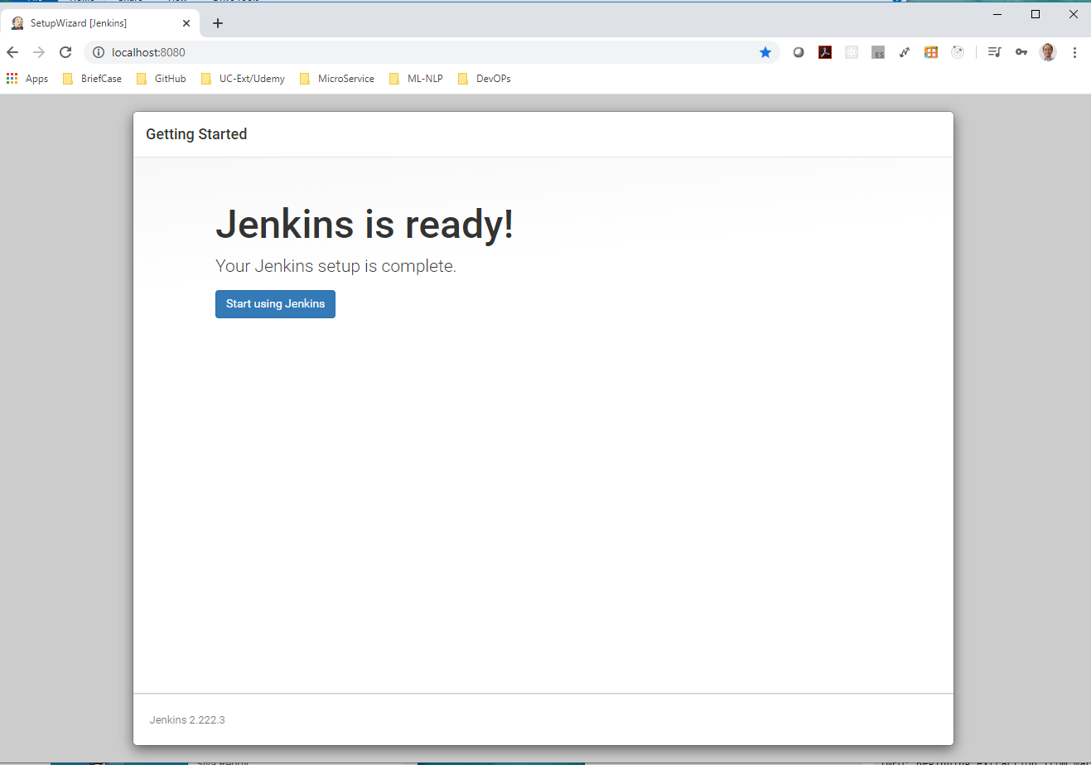
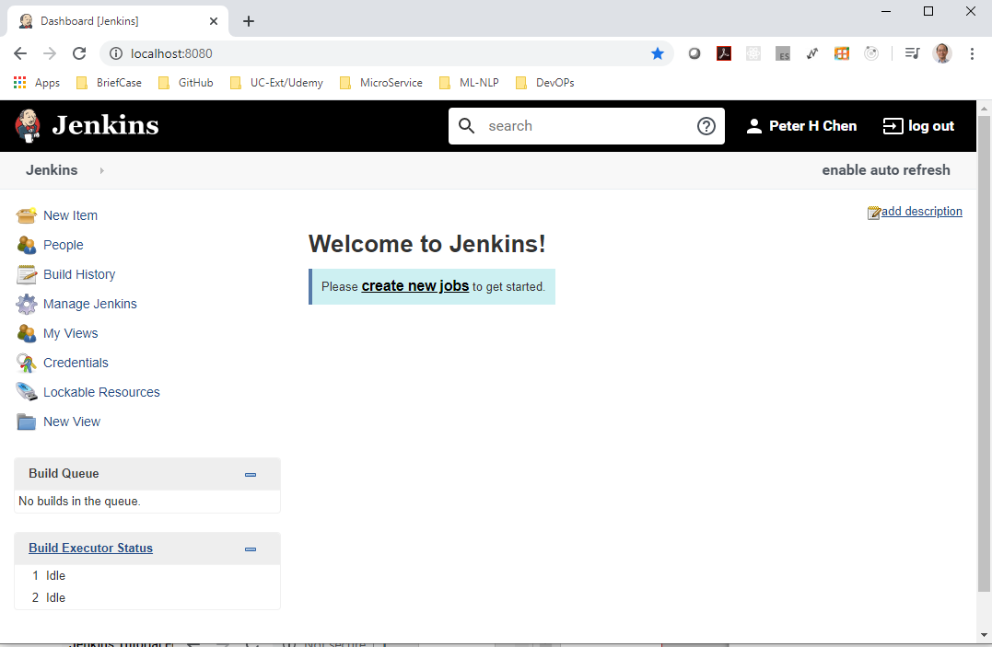
3 Install Jenkins
https://www.youtube.com/watch?v=MlvNXFdPhB8
Install Jenkins
Jenkins is ready!

Slide 8
End of Chapter

