Slide 1

4 Jenkins Project
Peter H. Chen

Slide 2
4 Jenkins Project
https://www.youtube.com/watch?v=MlvNXFdPhB8
Jenkins Project
We discuss how to create and run the Jenkins Project.

Slide 3
4.1 Create Jenkins Project

Slide 4
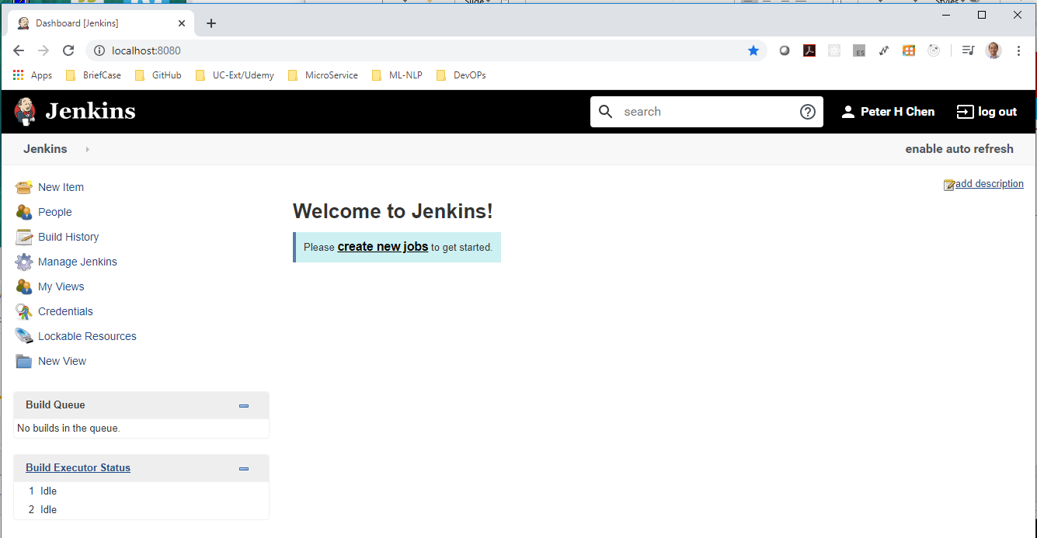
4.1 Create Jenkins Project
https://www.youtube.com/watch?v=MlvNXFdPhB8
Create Jenkins Project
> localhost:8080
Click “create new Jobs” (or “New Item”)

Slide 5
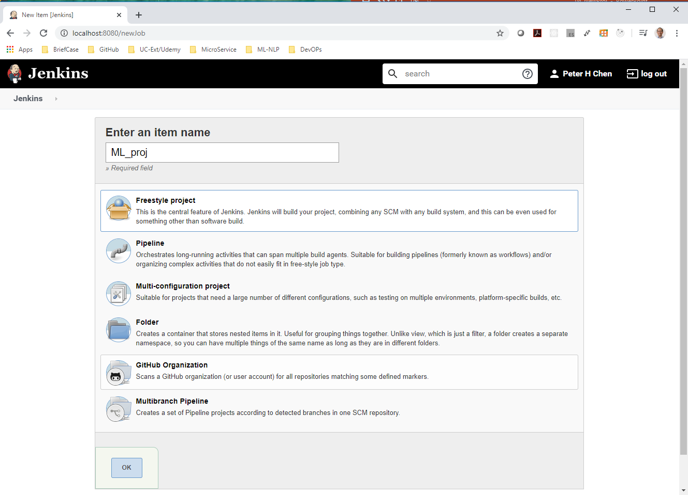
4.1 Create Jenkins Project
https://www.youtube.com/watch?v=MlvNXFdPhB8
Create Jenkins Project
Enter an item name: ML_proj
Select Freestyle Project and Click OK.

Slide 6
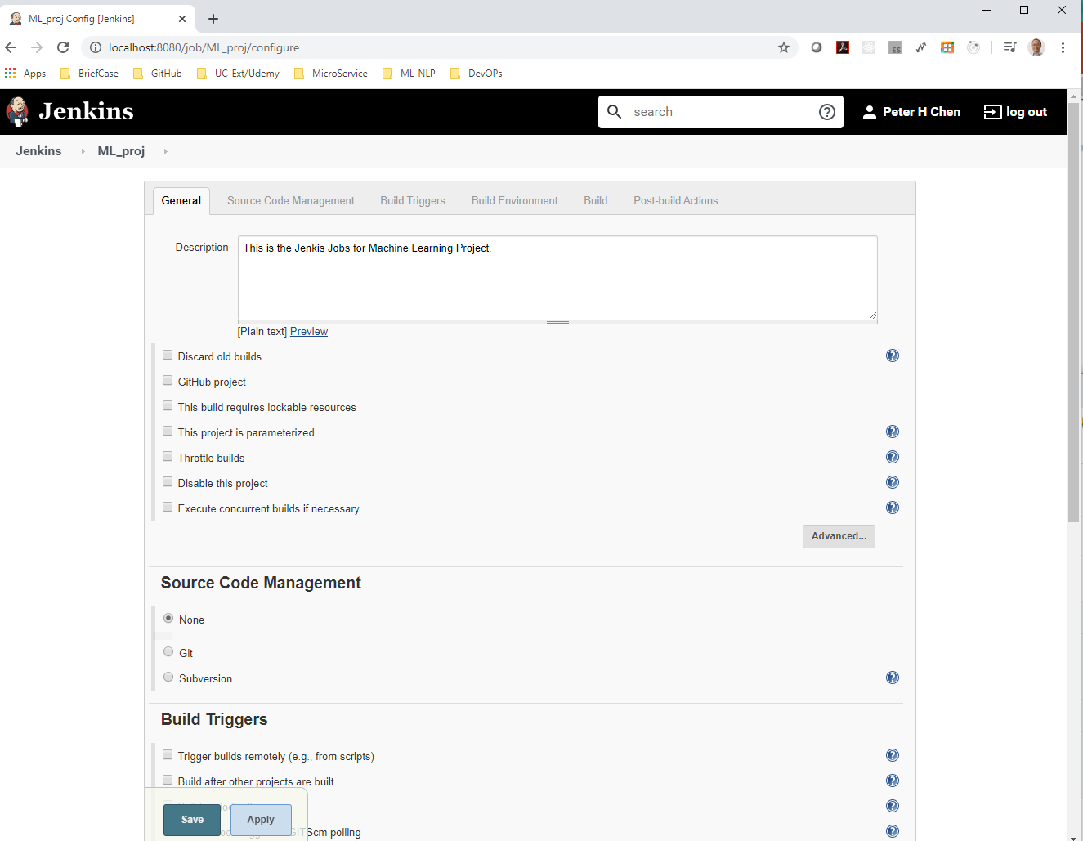
4.1 Create Jenkins Project
https://www.youtube.com/watch?v=MlvNXFdPhB8
Create Jenkins Project
There are items: General, Source Code Management, Build Triggers, Build Environment, Build, and Post-build Actions.
Type in Description: “Machine Learning Projects”

Slide 7
4.2 Execute Command

Slide 8
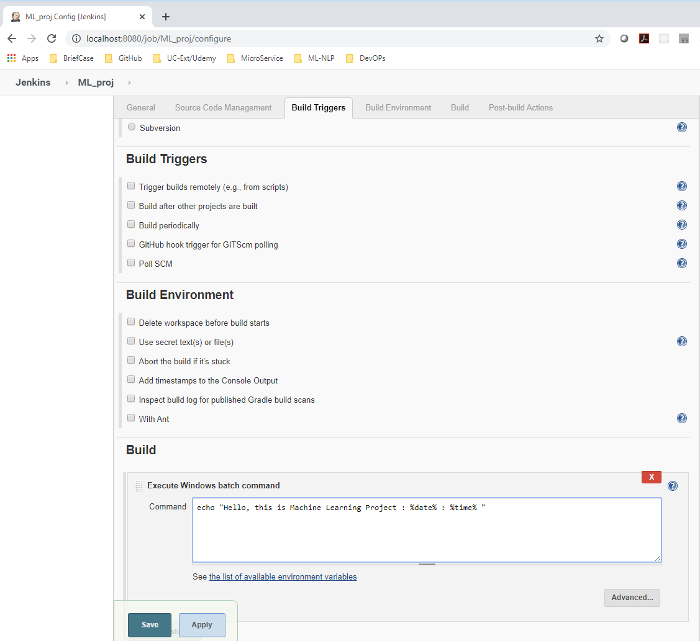
4.2 Execute Command
https://www.youtube.com/watch?v=MlvNXFdPhB8
Execute Command
Scroll down in Build Section.
Select “Execute Windows batch command”
In the command area: echo “This is Machine Learning Project: %date% : %time%”
Click “Apply” button and then “Save” button.

Slide 9
4.3 Build

Slide 10
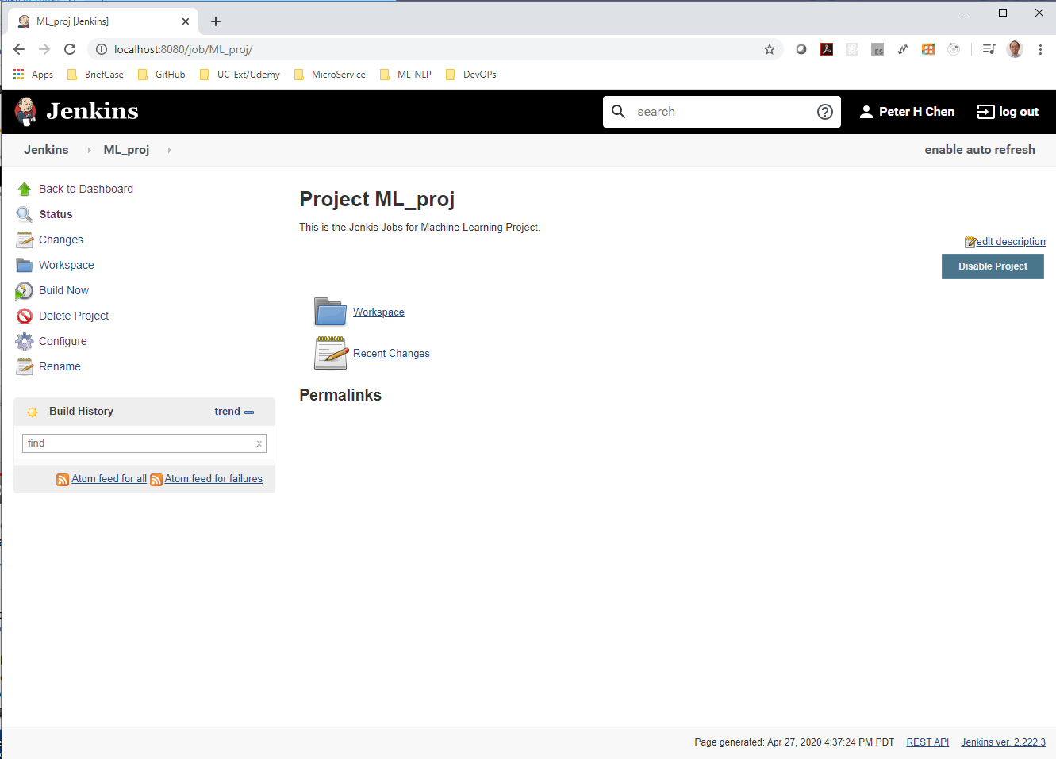
4.3 Build
https://www.youtube.com/watch?v=MlvNXFdPhB8
Build
Now, click “Build Now”

Slide 11
4.4 Create Item

Slide 12
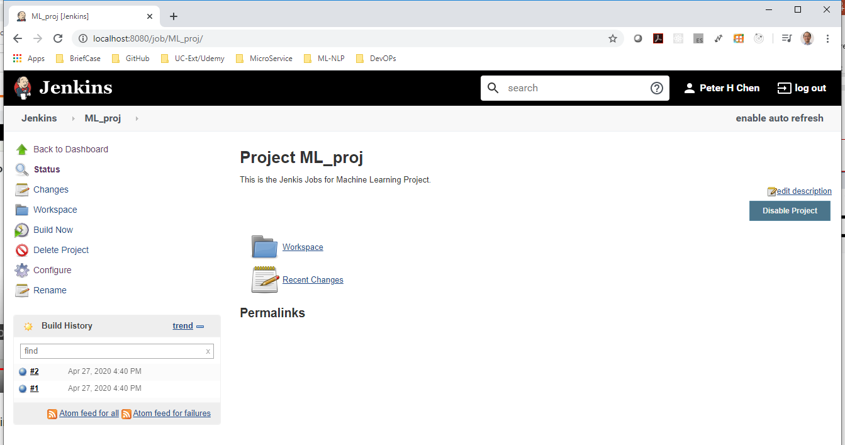
4.4 Create Item
https://www.youtube.com/watch?v=MlvNXFdPhB8
Create Item
Once, you click “Build Now”. You can see Build History display #1, #2, and etc.
Click “#1”

Slide 13
4.5 Check Item Content

Slide 14
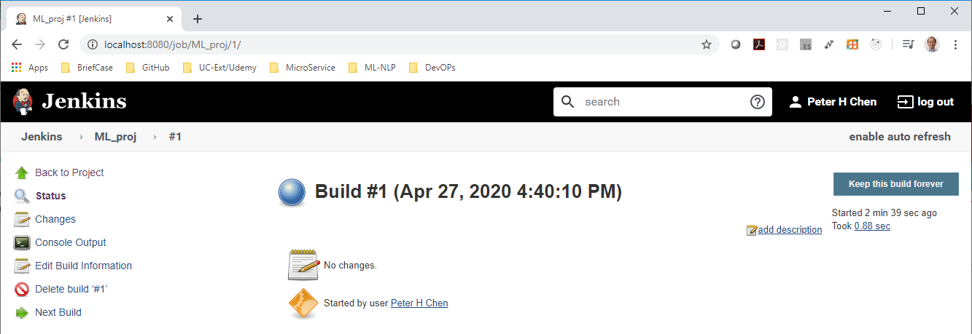
4.5 Check Item Content
https://www.youtube.com/watch?v=MlvNXFdPhB8
Check Item Content
You can see the content of “#1”.
Click “Console Output”

Slide 15
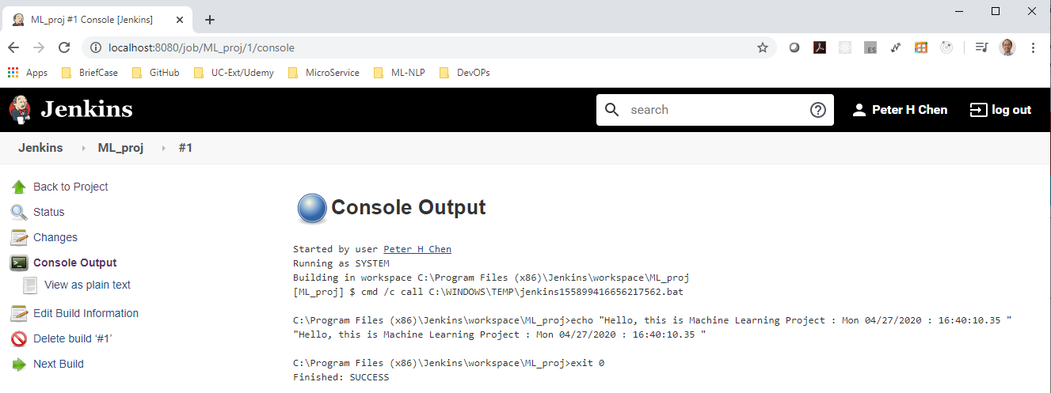
4.5 Check Item Content
https://www.youtube.com/watch?v=MlvNXFdPhB8
Check Item Content
You can see the content of “#1”.
Click “Console Output”

Slide 16
End of Chapter

