Slide 1

6 Naïve Method
Peter H. Chen

Slide 2
6 Naïve Method
https://www.tutorialspoint.com/time_series/time_series_naive_methods.htm
Naïve Method
Use t for actual value and t-1 for mean of series.

Slide 3
6.1 Naïve Statistics

Slide 4
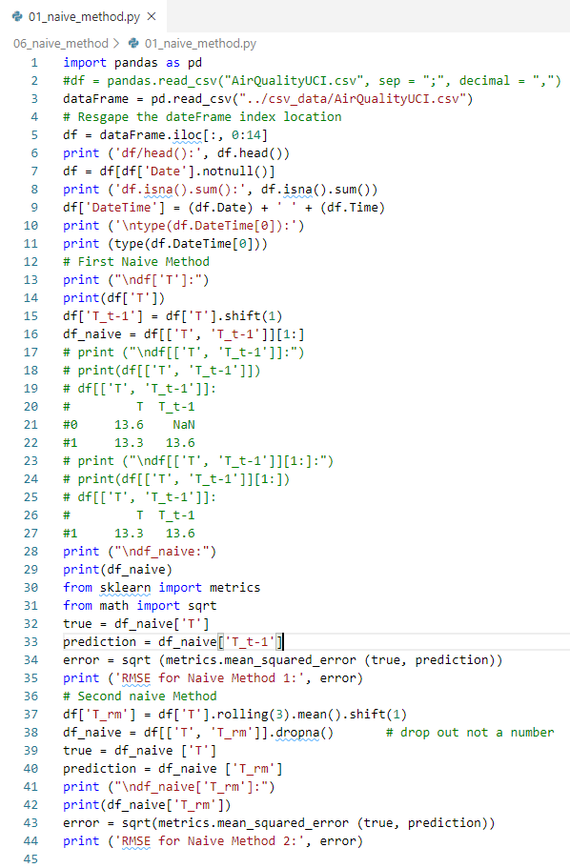
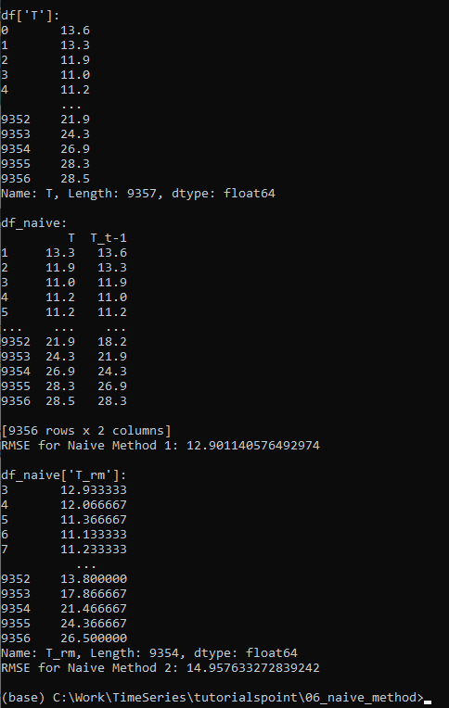
6.1 Naïve Statistics
https://www.tutorialspoint.com/time_series/time_series_naive_methods.htm
Naïve Statistics

Slide 5
6.1 Naïve Statistics
https://www.tutorialspoint.com/time_series/time_series_naive_methods.htm
Points to Note
You can write a very simple function for calculating root mean squared error. Here, we have used the mean squared error function from the package ‘sklearn’ and then taken its square root.
In pandas df[‘column_name’] can also be written as df.column_name, however for this dataset df.T will not work the same as df[‘T’] because df.T is the function for transposing a dataframe.
So use only df[‘T’] or consider renaming this column before using the other syntax.

Slide 6
End of Chapter

