Slide 1

2 Introduction to Time Series
Peter H. Chen

Slide 2
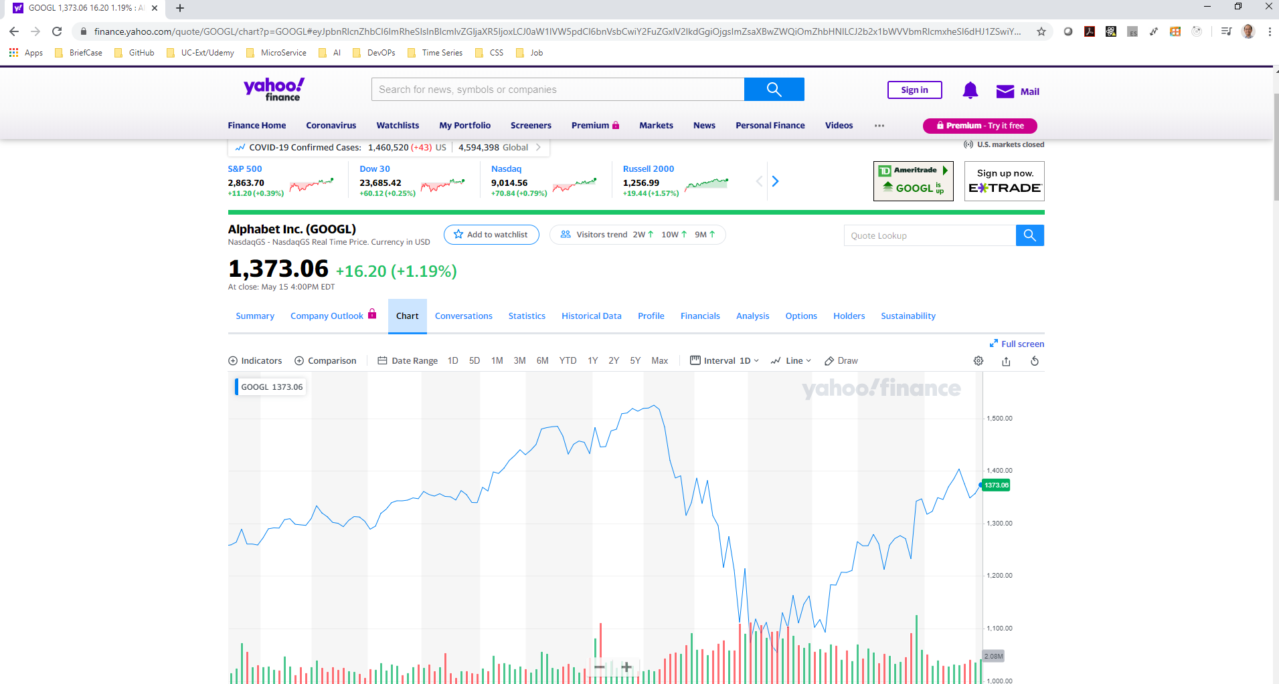
2 Introduction to Time Series
https://www.youtube.com/watch?v=r0s4slGHwzE&list=PLeo1K3hjS3uvMADnFjV1yg6E5nVU4kOob
What is Time Series?
Time Series is a set of data points indexed in time order.
For example, the Stock price chart on x-axis. We have date on x-axis and y axis has prices. This is a time series.
In finance data analysis, time series analysis issued a lot.

Slide 3
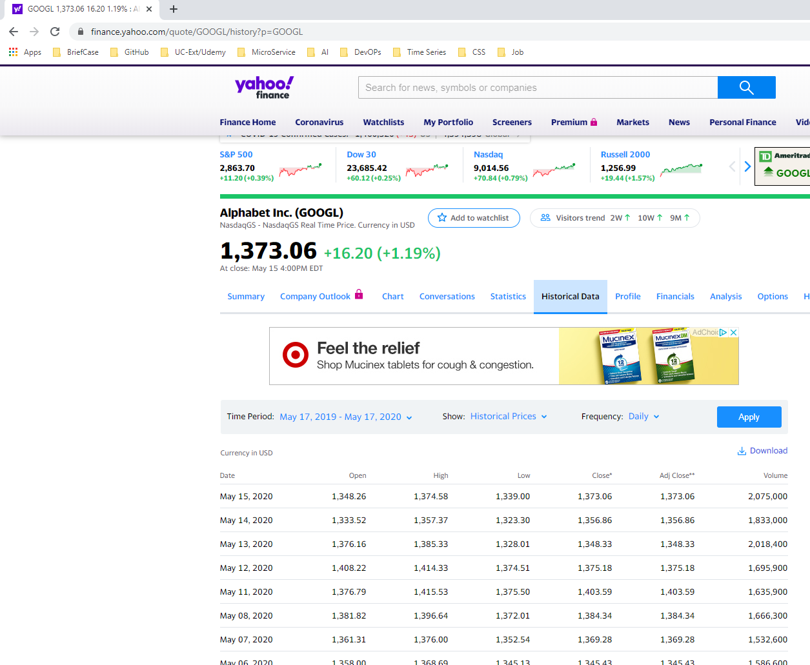
2 Introduction to Time Series
https://www.youtube.com/watch?v=r0s4slGHwzE&list=PLeo1K3hjS3uvMADnFjV1yg6E5nVU4kOob
Download Stock Data
Click the Tab “Historical Data” to see the “Date, Open,High, Low, Close, Adj Close, Volume” data.
Click “Download “ to download in *.csv format data.
Note:
Close Price: Adjusted for splits.
Adjusted close price: Adjusted for both dividends and splits.

Slide 4
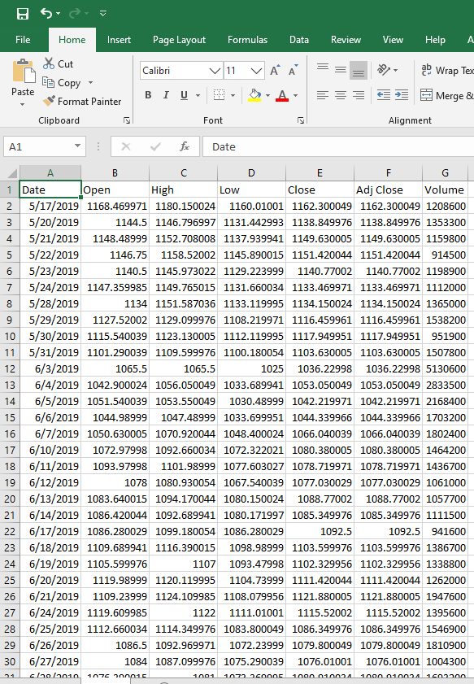
2 Introduction to Time Series
https://www.youtube.com/watch?v=r0s4slGHwzE&list=PLeo1K3hjS3uvMADnFjV1yg6E5nVU4kOob
View Stock Data
Start excel
Open the *.csv file to browse the stock data.

Slide 5
End of Chapter

