Slide 1

3 Preprocess and Visualize
Peter H. Chen

Slide 2
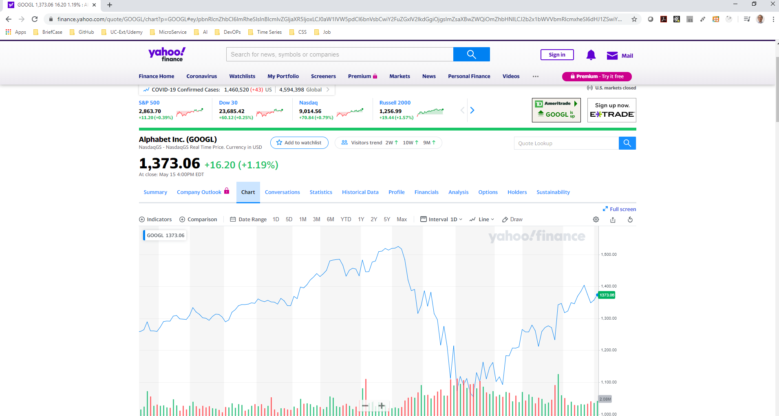
3 Preprocess and Visualize
https://www.tutorialspoint.com/time_series/time_series_data_processing_and_visualization.htm
What is Time Series?
Time Series is a set of data points indexed in time order.
We read the air quality data, apple stock data, and google stock data.

Slide 3
10.1 Read Air Quality Data

Slide 4
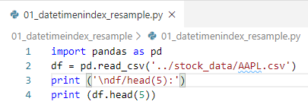
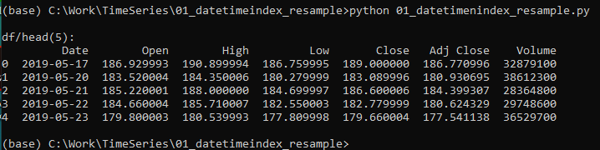
10.1 Read CSV Data
https://www.tutorialspoint.com/time_series/time_series_data_processing_and_visualization.htm
Read CSV Data
> python 01_datetimeindex_resahmple.py

Slide 5
10.2 Read Apple Stock

Slide 6
10.2 Read Apple Stock
https://www.tutorialspoint.com/time_series/time_series_data_processing_and_visualization.htm
Datetimeindex and Resample
> python 01_datetimeindex_resahmple.py

Slide 7
10.3 Read Google Data

Slide 8
10.3 Read Google Data
https://www.tutorialspoint.com/time_series/time_series_data_processing_and_visualization.htm
Datetimeindex and Resample
> python 01_datetimeindex_resahmple.py

Slide 9
End of Chapter

