Slide 1

8 Moving Average
Peter H. Chen

Slide 2
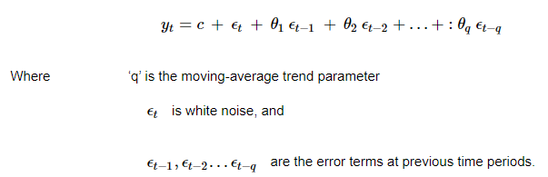
8 Moving Average
https://www.tutorialspoint.com/time_series/time_series_moving_average.htm
Moving Average
For a stationary time series, a moving average model sees the value of a variable at time ‘t’ as a linear function of residual errors from ‘q’ time steps preceding it.
The residual error is calculated by comparing the value at the time ‘t’ to moving average of the values preceding.
Mathematically it can be written as

Slide 3
8 Moving Average
https://www.tutorialspoint.com/time_series/time_series_moving_average.htm
Value of ‘q’ can be calibrated using various methods. One way of finding the apt value of ‘q’ is plotting the partial auto-correlation plot.
A partial auto-correlation plot shows the relation of a variable with itself at prior time steps with indirect correlations removed, unlike auto-correlation plot which shows direct as well as indirect correlations, let’s see how it looks like for ‘temperature’ variable of our data.

Slide 4
8.1 Auto-Correlation

Slide 5
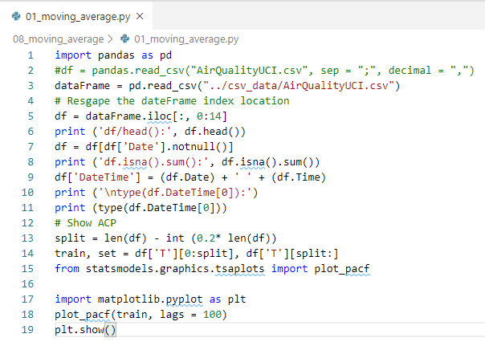
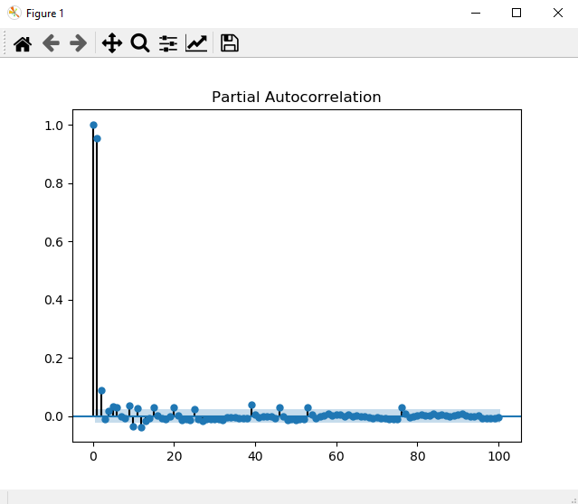
8.1 Auto-Correlation
https://www.tutorialspoint.com/time_series/time_series_moving_average.htm
A partial auto-correlation is read in the same way as a correlogram.

Slide 6
End of Chapter

