Slide 1

4 Docker Lab (Optional)
Peter H. Chen

Slide 2
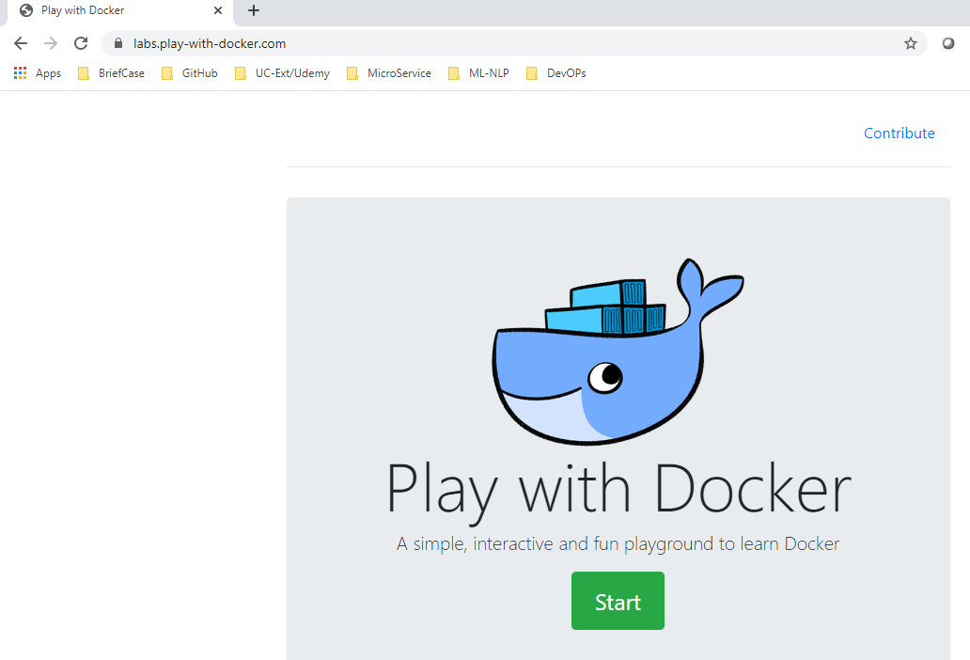
4 Docker Lab (Optional)
https://labs.play-with-docker.com/
Go to Docker Lab: https://labs.play-with-docker.com/
We can practice Docker and get familiar with Docker by Docker lab.

Slide 3
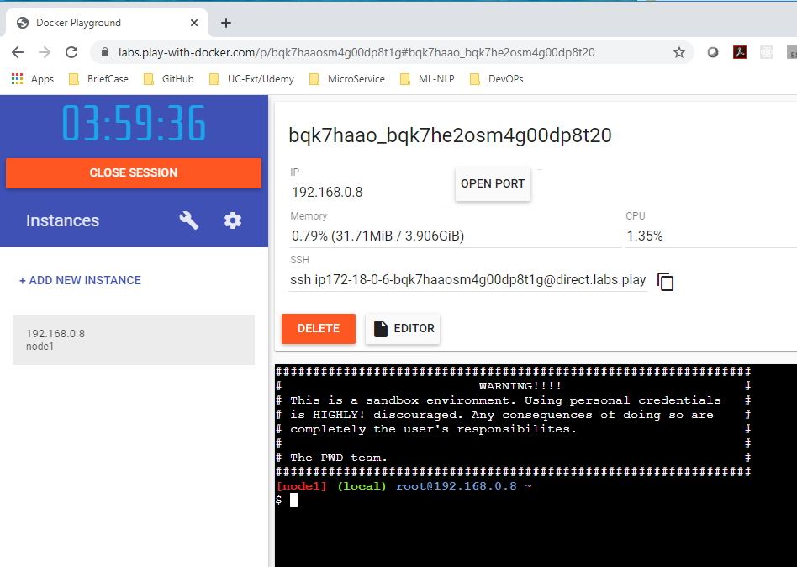
4 Docker Lab (Optional)
https://labs.play-with-docker.com/
Go to Docker Lab: https://labs.play-with-docker.com/
Create Docker instance.

Slide 4
End

