Slide 1

5 Setup Docker for Linux
Peter H. Chen

Slide 2
5 Setup Docker for Linux
https://www.simplilearn.com/tutorials/docker-tutorial/how-to-install-docker-on-ubuntu
This document describes how to setup docker on Linux

Slide 3
5.1 Remove Previous Docker Version

Slide 4
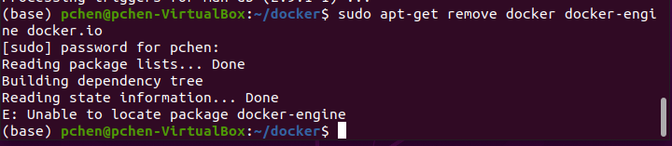
5.1 Remove Previous Docker Version
https://www.simplilearn.com/tutorials/docker-tutorial/how-to-install-docker-on-ubuntu
Remove Previous Docker Version
First, clean up the previous version of docker
> sudo apt-get remove docker docker-engine docker.io

Slide 5
5.2 Update Linux Environment

Slide 6
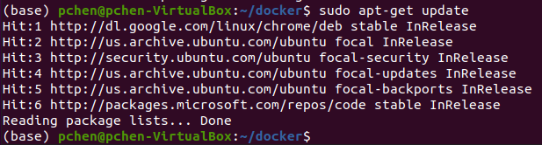
5.2 Update Linux Environment
https://www.simplilearn.com/tutorials/docker-tutorial/how-to-install-docker-on-ubuntu
Update Linux Environment
> sudo apt-get update

Slide 7
5.3 Install Docker

Slide 8
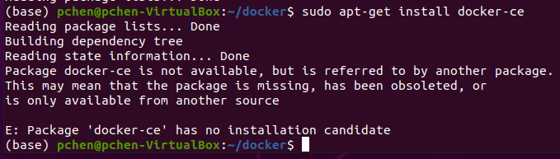
5.3 Install Docker
https://www.simplilearn.com/tutorials/docker-tutorial/how-to-install-docker-on-ubuntu
Install Docker
> sudo apt-get install docker-ce
This command is not work.

Slide 9
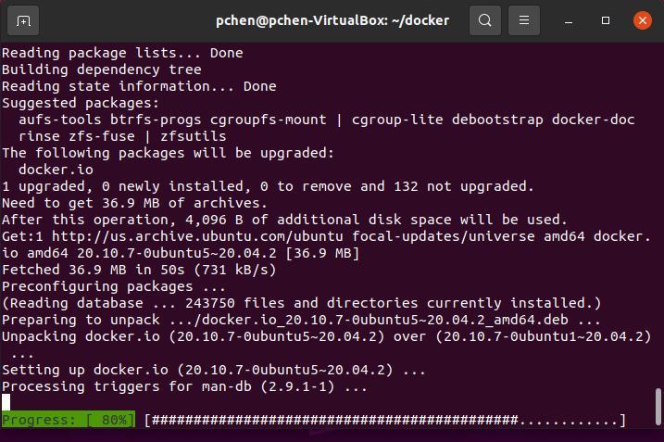
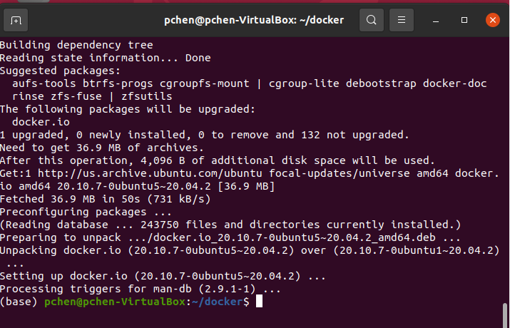
5.3 Install Docker
https://www.simplilearn.com/tutorials/docker-tutorial/how-to-install-docker-on-ubuntu
Install Docker
> sudo apt install docker.io

Slide 10
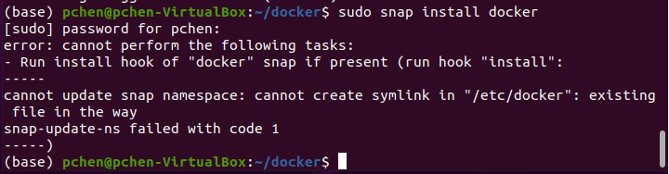
5.3 Install Docker
https://www.simplilearn.com/tutorials/docker-tutorial/how-to-install-docker-on-ubuntu
Install Docker
> sudo snap install docker

Slide 11
5.4 Check Docker Version

Slide 12
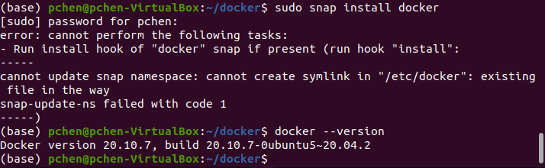
5.4 Check Docker Version
https://www.simplilearn.com/tutorials/docker-tutorial/how-to-install-docker-on-ubuntu
Check Docker Version
> docker --version

Slide 13
5.5 Verify “hello-world”

Slide 14
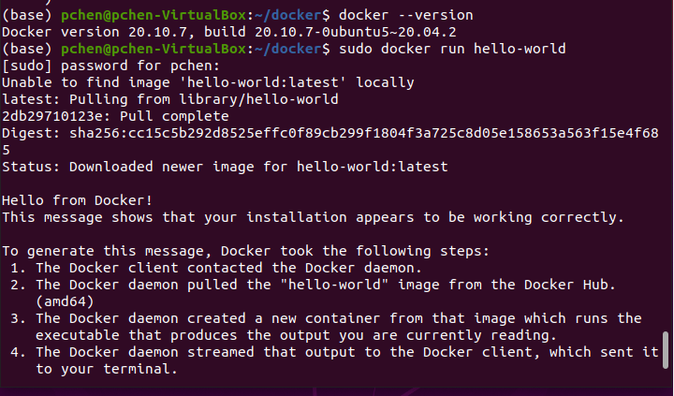
5.5 Verify “hello-world”
https://www.simplilearn.com/tutorials/docker-tutorial/how-to-install-docker-on-ubuntu
Verify “hello-world”
> sudo docker run hello-world
Run “hello-world”. If “hello-world” not found locally, it will download remotely from docker hub and run.

Slide 15
5.6 Basic Docker Command

Slide 16
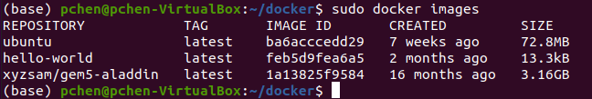
5.6 Basic Docker Command
https://www.simplilearn.com/tutorials/docker-tutorial/how-to-install-docker-on-ubuntu
Basic Docker Command
> sudo docker images
We have “hello-world” images locally.
The “ubuntu” and “xyzsam/gem5-aladdin” are from the previous runs.

Slide 17
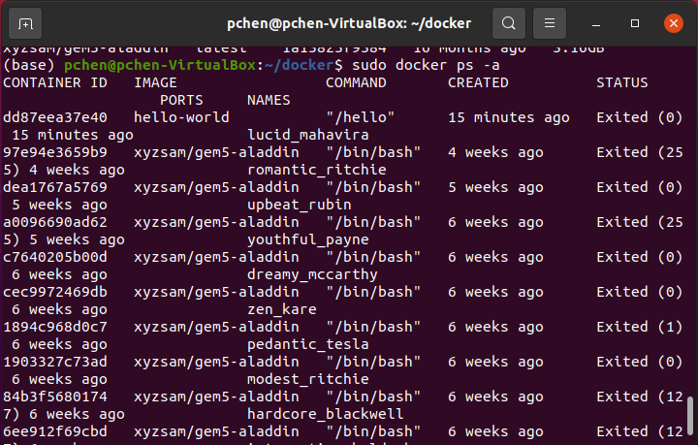
5.6 Basic Docker Command
https://www.simplilearn.com/tutorials/docker-tutorial/how-to-install-docker-on-ubuntu
Basic Docker Command
> sudo docker ps -a
See all the running history containers which were running before.

Slide 18
5.6 Basic Docker Command
https://www.simplilearn.com/tutorials/docker-tutorial/how-to-install-docker-on-ubuntu
Basic Docker Command
> sudo docker ps
See all the running containers. There is none.

Slide 19
End

