Slide 1
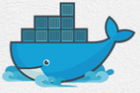
7 Docker Command 02
Peter H. Chen

Slide 2
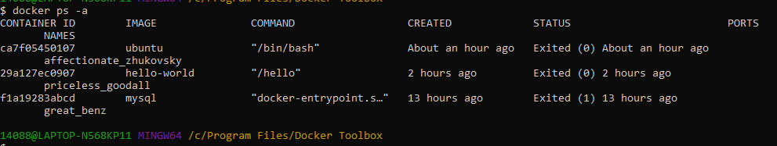
7 Docker Command 02
https://www.youtube.com/watch?v=s0z_OazJNjU&list=PL6tu16kXT9PqdhOZk4MNVtQDJp6xFrotg&index=6
Pull Containers from Docker Hub 02
We have ubuntu already run.
> docker ps -a

Slide 3
7.1 docker run -it ubuntu

Slide 4
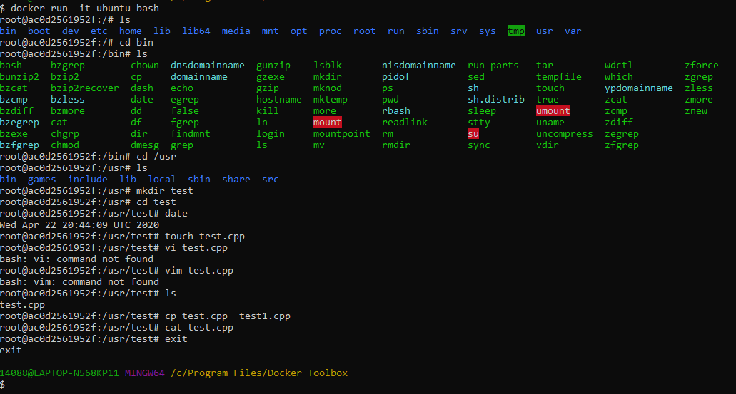
7.1 docker run -it ubuntu
https://www.youtube.com/watch?v=s0z_OazJNjU&list=PL6tu16kXT9PqdhOZk4MNVtQDJp6xFrotg&index=6
> docker run -it ubuntu bash
# -i: interactive, -t: termonal
>> root@ac0d25619252f:#
We run ubuntu as a root user.
> cd /usr
> mkdir test
…
> exit

Slide 5
7.2 docker logs <container id>

Slide 6
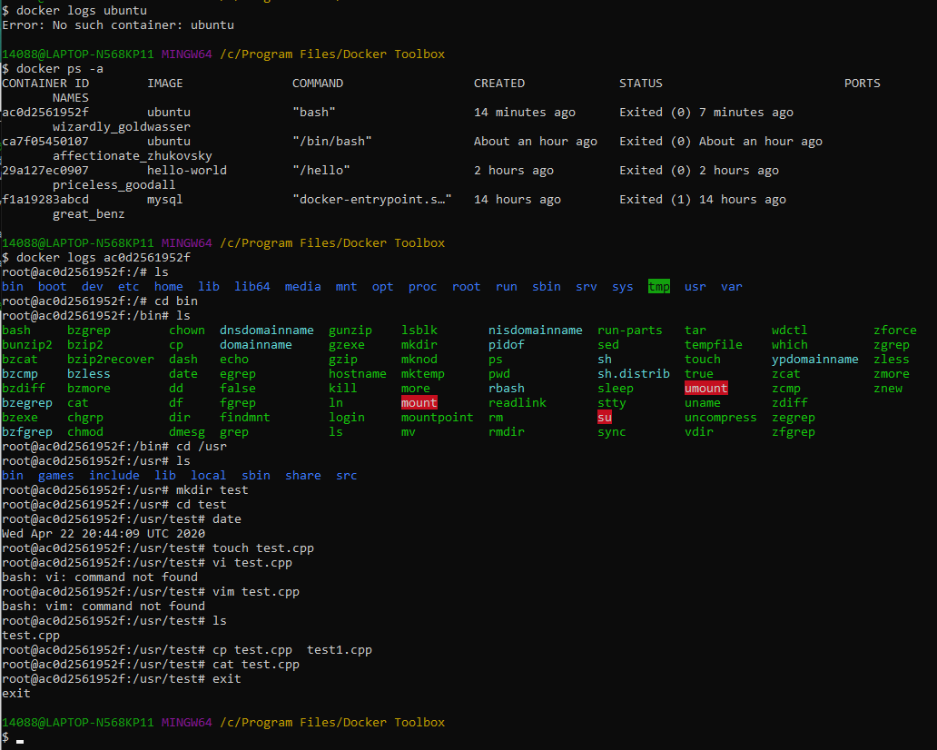
7.2 docker logs <container id>
https://www.youtube.com/watch?v=s0z_OazJNjU&list=PL6tu16kXT9PqdhOZk4MNVtQDJp6xFrotg&index=6
> sudo docker ps -a
# find <ububtu id>
> sudo docker logs <ubuntu id>
Verify all the ubuntu command history that we did earlier in the ubuntu container.

Slide 7
7.3 Use Kitematic (Optional)

Slide 8
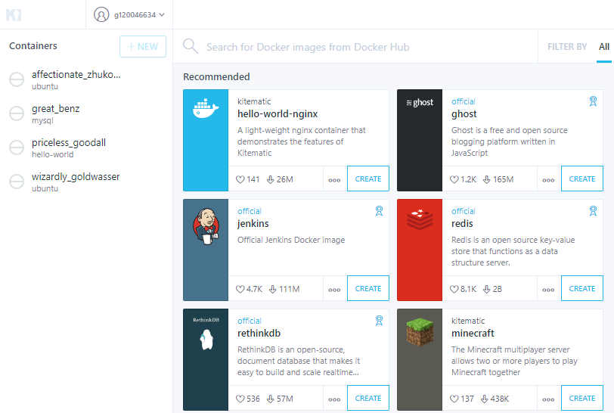

7.3 Use Kitematic
https://www.youtube.com/watch?v=s0z_OazJNjU&list=PL6tu16kXT9PqdhOZk4MNVtQDJp6xFrotg&index=6
Double click kitematic (Optional)
Select container “hello-world-nginx” and click “Create” to start.

Slide 9
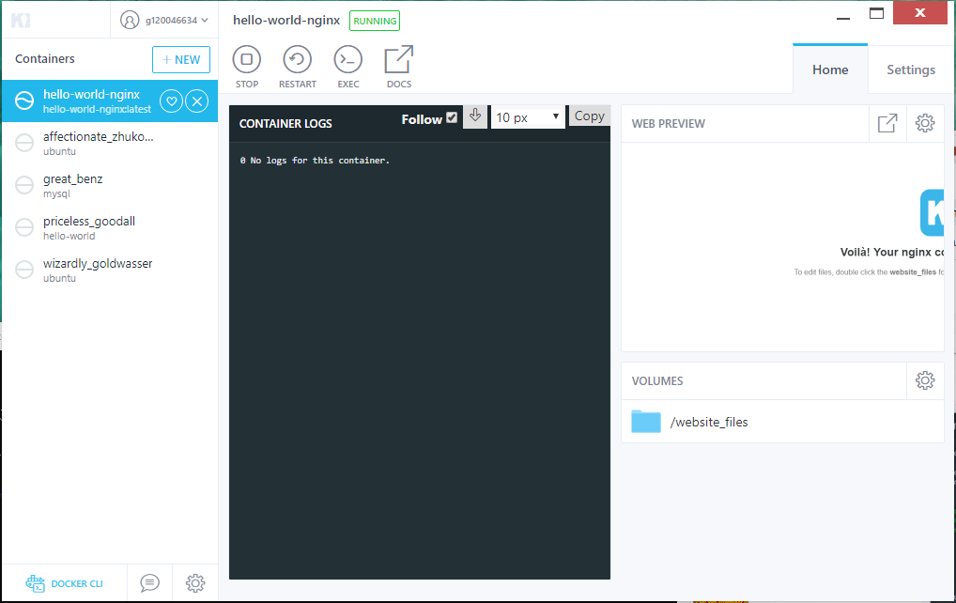
7.3 Use Kitematic
https://www.youtube.com/watch?v=s0z_OazJNjU&list=PL6tu16kXT9PqdhOZk4MNVtQDJp6xFrotg&index=6
Double click kitematic logo.
Select container “hello-world-nginx” and click “Create” to start.
Click “x” to remove the “hello-world-nginx” container.

Slide 10
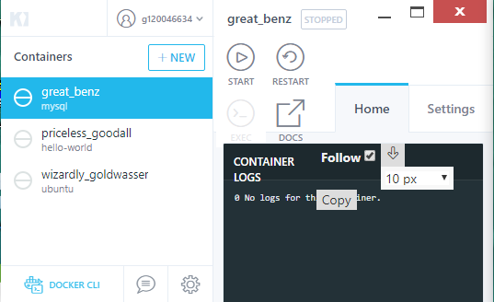
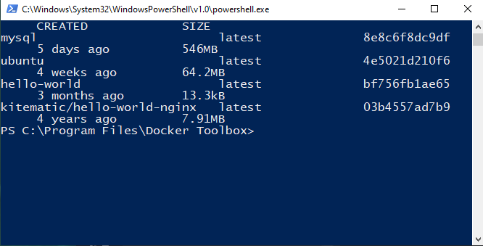
7.3 Use Kitematic
https://www.youtube.com/watch?v=s0z_OazJNjU&list=PL6tu16kXT9PqdhOZk4MNVtQDJp6xFrotg&index=6
Click “DOCKERCLI” to display the “PowerShell”
Kitematic is a GUI mode of Docker Terminal.

Slide 11
7.4 Docker Daemon (Optional)

Slide 12
7.4 Docker Daemon (Optional)
https://www.youtube.com/watch?v=s0z_OazJNjU&list=PL6tu16kXT9PqdhOZk4MNVtQDJp6xFrotg&index=6
What happened behind the scene?
The Docker client contacted the Docker Daemon.
The Docker daemon pulled the image from the Docker hub.
The Docker daemon created a new container from the pulled image. This pulled image runs and produces the output that you are currently reading.
The Docker daemon streamed that output to the Docker client, which sent it to your terminal.

Slide 13
7.5 Summary

Slide 14
7.5 Summary
https://www.youtube.com/watch?v=s0z_OazJNjU&list=PL6tu16kXT9PqdhOZk4MNVtQDJp6xFrotg&index=6
Summary.
There are two ways, i.e., Docker Terminal and Kitemaitc, you can execute the Docker.

Slide 15
End of Chapter

