Slide 1
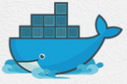
12 Dockerfile
Peter H. Chen

Slide 2
12 Dockerfile
https://www.youtube.com/watch?v=LQjaJINkQXY&list=PLhW3qG5bs-L99pQsZ74f-LC-tOEsBp2rK&index=12
Dockerfile
We discuss the following topics:
1. What is Dockerfile?
2. How to Create Docker file?
3. How to build image from Dockerfile?
We will build the image based on Dockerfile
4. Basic Commands
We will look at the basic command
5. Some Tips and Tricks with Dockerfile

Slide 3
12.1 Dockerfile

Slide 4
12.1 Dockerfile
https://www.youtube.com/watch?v=LQjaJINkQXY&list=PLhW3qG5bs-L99pQsZ74f-LC-tOEsBp2rK&index=12
Dockerfile
Dockerfile is a simple text file with instructions to build image
Automation of Docker Image Creation
FROM
RUN
CMD

Slide 5
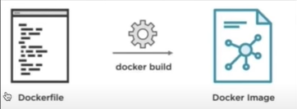
12.1 Dockerfile
https://www.youtube.com/watch?v=LQjaJINkQXY&list=PLhW3qG5bs-L99pQsZ74f-LC-tOEsBp2rK&index=12
Dockerfile
Dockerfile is a simple text file with instructions to build image
You can see, the Dockerfile is a simple text file where we give some instructions to build an image
…and when we do docker build for this Dockerfile, the images gets created.

Slide 6
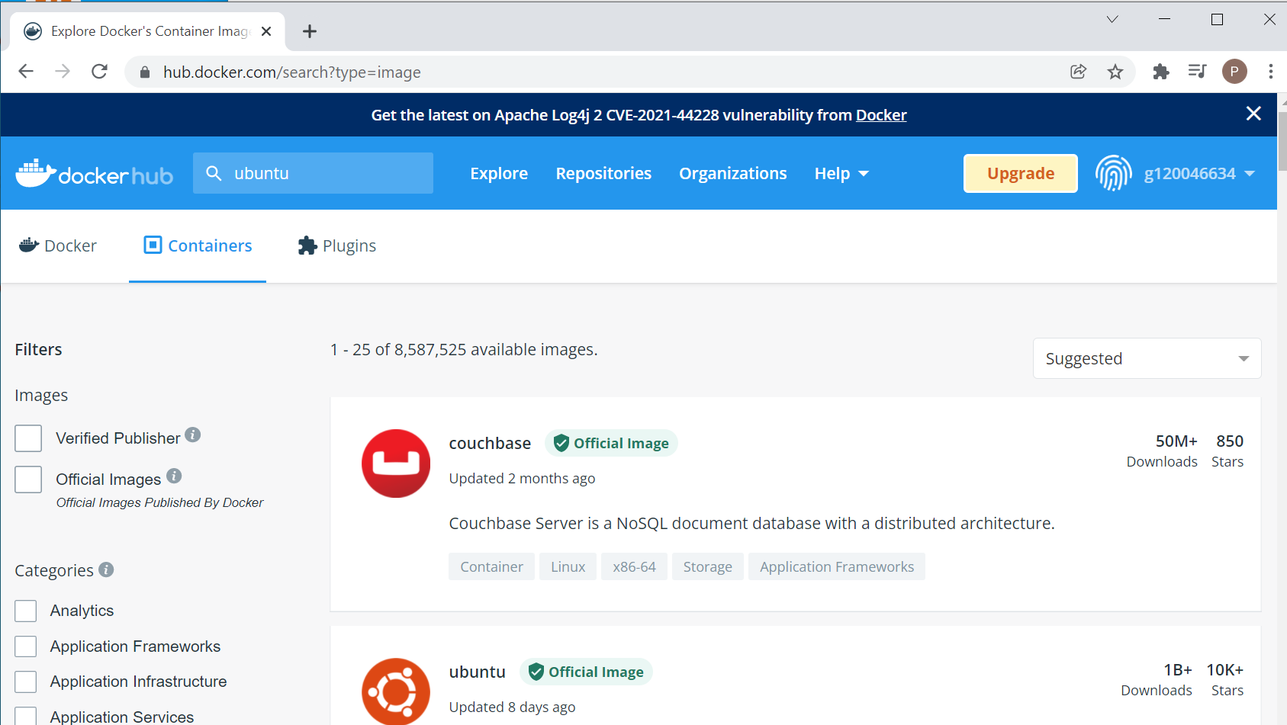
12.1 Dockerfile
https://www.youtube.com/watch?v=LQjaJINkQXY&list=PLhW3qG5bs-L99pQsZ74f-LC-tOEsBp2rK&index=12
Dockerfile
…Right now, we get our images from Docker hub.
We can see a lot of images in the Docker hub repository.
We have pull ubuntu, hello-world, and jenkins images.

Slide 7
12.1 Dockerfile
https://www.youtube.com/watch?v=LQjaJINkQXY&list=PLhW3qG5bs-L99pQsZ74f-LC-tOEsBp2rK&index=12
Dockerfile
Dockerfile is basically Automation of Docker Image Creation
…and there are some basic instructions that you use in the Dockerfile.
FROM
RUN
CMD
Let’s go step by step.

Slide 8
12.1 Dockerfile
https://www.youtube.com/watch?v=LQjaJINkQXY&list=PLhW3qG5bs-L99pQsZ74f-LC-tOEsBp2rK&index=12
Dockerfile
Step 1: Create a file name Dockerfile.
When you run the Docker build commands.
Docker searches for a file name Dockerfile, however, you can also specify some different name. But for now, we use Dockerfile only.
> mkdir DockerFiles
> cd DockerFiles

Slide 9
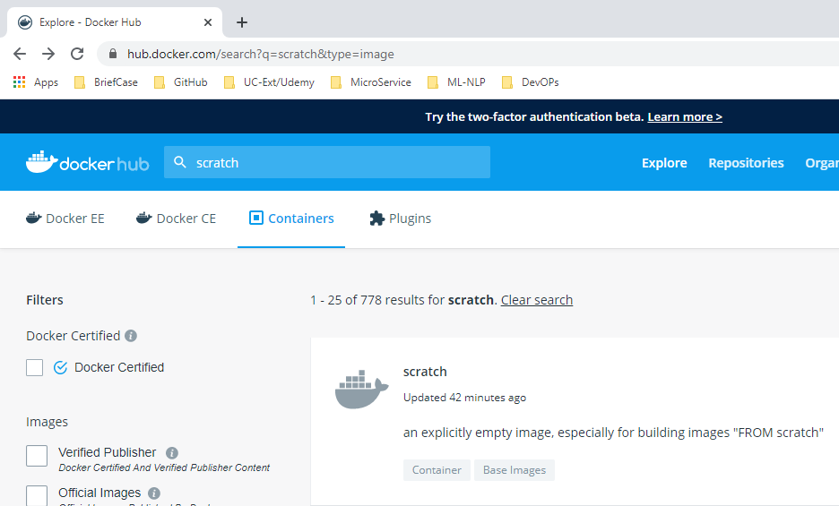
12.1 Dockerfile
https://www.youtube.com/watch?v=LQjaJINkQXY&list=PLhW3qG5bs-L99pQsZ74f-LC-tOEsBp2rK&index=12
Dockerfile
vim Dockerfile
> # Getting base image ubuntu
> # “FROM scratch” image create empty image
> # FROM scratch
> FROM ubuntu
> MAINTAINER Peter Chen <peter.hp.chen@gmail.com>
> RUN apt-get update
> CMD [“echo”, “Hello World..! First Docker Image”]

Slide 10
12.2 Docker Build

Slide 11
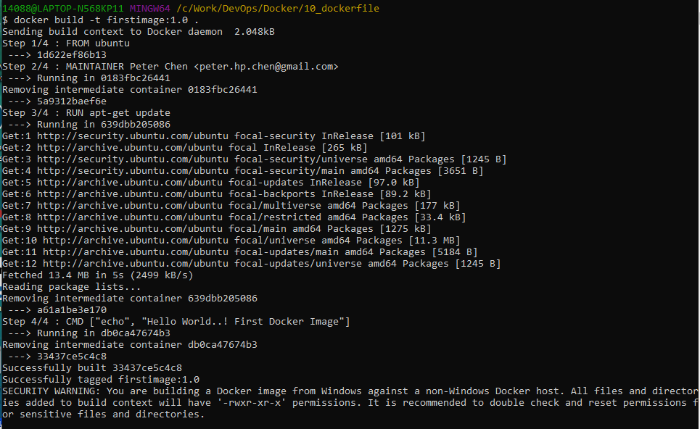
12.2 Docker Build
https://www.youtube.com/watch?v=LQjaJINkQXY&list=PLhW3qG5bs-L99pQsZ74f-LC-tOEsBp2rK&index=12
Docker Build
> docker build -t firstimage:1.0 .
Note: -t: tag .: current folder
“docker build” will use Dockerfile to build the specified images name “firstimage”.

Slide 12
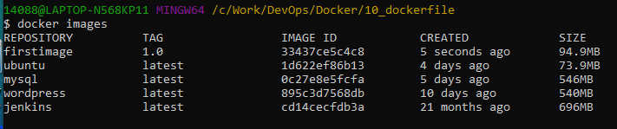
12.1 Dockerfile
https://www.youtube.com/watch?v=LQjaJINkQXY&list=PLhW3qG5bs-L99pQsZ74f-LC-tOEsBp2rK&index=12
Dockerfile
> docker images

Slide 13
12.3 Docker Run

Slide 14
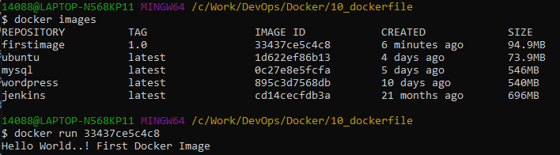
12.3 Docker Run
https://www.youtube.com/watch?v=LQjaJINkQXY&list=PLhW3qG5bs-L99pQsZ74f-LC-tOEsBp2rK&index=12
Docker Run
> docker images
> docker run <image_ID/or firstimage:1.0>

Slide 15
End of Chapter

