Slide 1
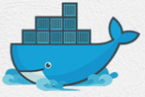
10 Docker Containers
Peter H. Chen

Slide 2
10 What Are Containers
https://www.youtube.com/watch?v=Rv3DAJbDrS0&list=PLhW3qG5bs-L99pQsZ74f-LC-tOEsBp2rK&index=10
Docker Containers
What are Containers?
How to create Containers?
Ho to start/stop Containers?
Basic Commands:
> docker ps
> docker run <image-name>
> docker start <container-name/ID>
> docker stop <container-name/ID>

Slide 3
10.1 What Are Containers

Slide 4
10.1 What Are Containers
https://www.youtube.com/watch?v=Rv3DAJbDrS0&list=PLhW3qG5bs-L99pQsZ74f-LC-tOEsBp2rK&index=10
What Are Containers
Containers are running instances of Docker Images.
Whenever you run an image, it creates a containers.

Slide 5
10.2 Docker Architecture

Slide 6
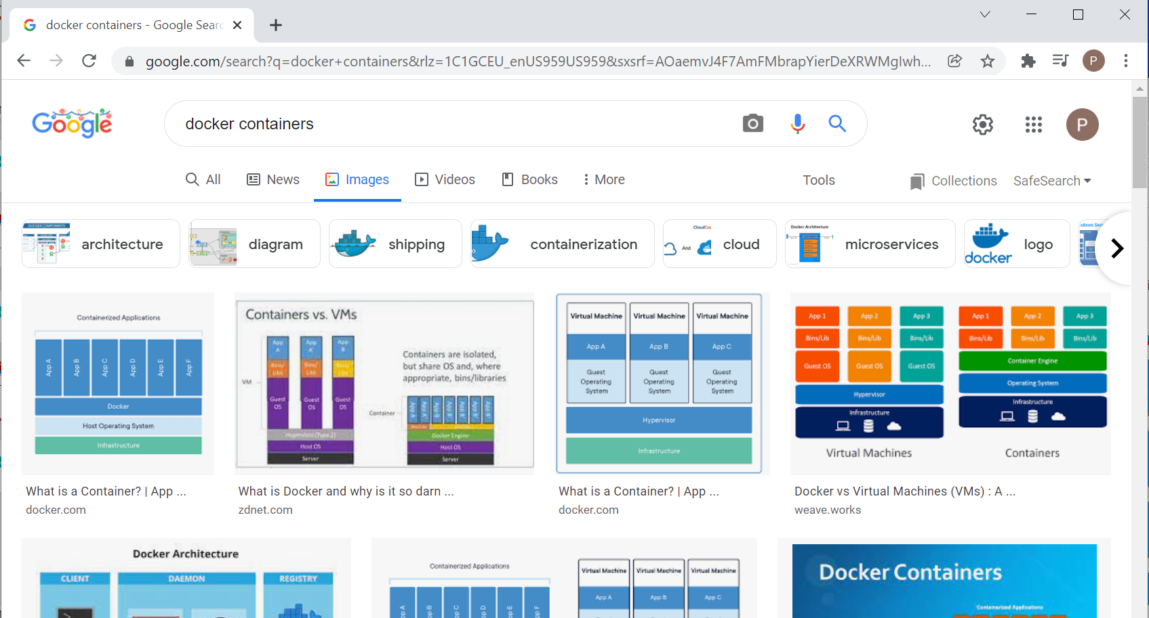
10.2 Docker Architecture
https://www.youtube.com/watch?v=Rv3DAJbDrS0&list=PLhW3qG5bs-L99pQsZ74f-LC-tOEsBp2rK&index=10
Docker Architecture
Google search “docker containers” and click the images.
Click “architecture”

Slide 7
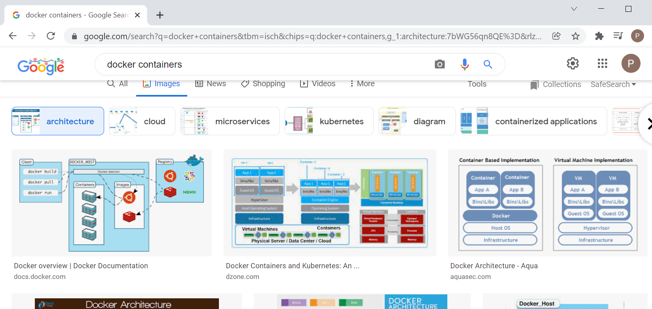
10.2 Docker Architecture
https://www.youtube.com/watch?v=Rv3DAJbDrS0&list=PLhW3qG5bs-L99pQsZ74f-LC-tOEsBp2rK&index=10
Docker Architecture
Select Containers diagram from “www.docker.com”

Slide 8
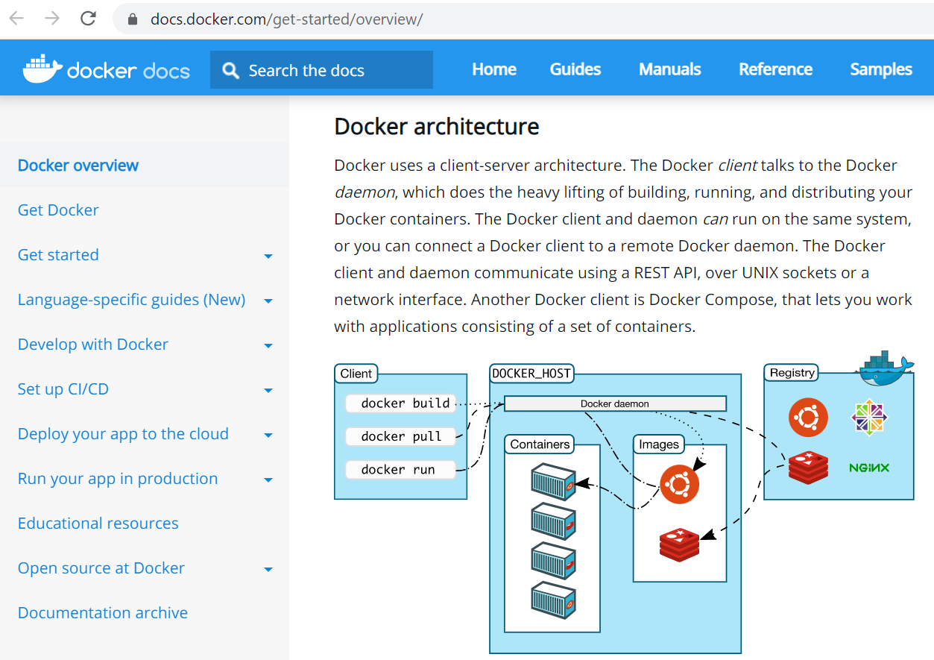
10.2 Docker Architecture
https://www.youtube.com/watch?v=Rv3DAJbDrS0&list=PLhW3qG5bs-L99pQsZ74f-LC-tOEsBp2rK&index=10
Docker Architecture
This particular diagram is the Docker Architecture and components of Docker.

Slide 9
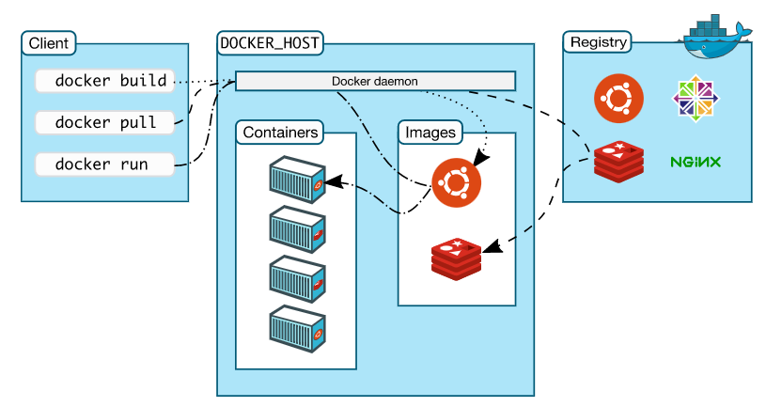
10.2 Docker Architecture
https://www.youtube.com/watch?v=Rv3DAJbDrS0&list=PLhW3qG5bs-L99pQsZ74f-LC-tOEsBp2rK&index=10
Docker Architecture
The Docker components include the Client, Docker Host, and Registry.
The client has the command line whenever user create a docker command or whenever you issue any docker command using your command line on Linux Terminal or command prompt on PowerShell of Windows.
User uses these command to interacts with docker client.

Slide 10
10.2 Docker Architecture
https://www.youtube.com/watch?v=Rv3DAJbDrS0&list=PLhW3qG5bs-L99pQsZ74f-LC-tOEsBp2rK&index=10
Docker Architecture
Then, we have a docker host.
Now, host is also available on your system
…and this docker host has docker daemon, the images, and the container section.

Slide 11
10.2 Docker Architecture
https://www.youtube.com/watch?v=Rv3DAJbDrS0&list=PLhW3qG5bs-L99pQsZ74f-LC-tOEsBp2rK&index=10
Docker Architecture
…and then we have the registry where we have the image.
…so, the register can be a Docker Hub.
The Docker Hub is an online registry where we can get all the images.

Slide 12
10.3 Docker Pull

Slide 13
10.3 Docker Pull
https://www.youtube.com/watch?v=Rv3DAJbDrS0&list=PLhW3qG5bs-L99pQsZ74f-LC-tOEsBp2rK&index=10
Docker Pull
..so, whenever you run a command called “docker pull”.
It actually goes to the registry, such as, Docker Hub.
…Get the image and save the image into your local system on the Docker Host.

Slide 14
10.4 Docker Run

Slide 15
10.4 Docker Run
https://www.youtube.com/watch?v=Rv3DAJbDrS0&list=PLhW3qG5bs-L99pQsZ74f-LC-tOEsBp2rK&index=10
Docker Run
..and when you say “docker run”, it checks for that image on your local system
1. If it is available, it will run that image and create a container from that image.
2. If it is not available, it will go the registry, pull the image, ad then create a container.
2
1

Slide 16
10.5 Docker Build

Slide 17
10.5 Docker Build
https://www.youtube.com/watch?v=Rv3DAJbDrS0&list=PLhW3qG5bs-L99pQsZ74f-LC-tOEsBp2rK&index=10
Docker Build
..and “docker build” is used to create a docker image using Dockerfile
…and then create a container.
We will learn about “docker build” in the coming discussion.
For now, we focus on docker pull and docker run.
How do we create and manage containers.
2
1

Slide 18
10.6 Docker Pull/Run Command

Slide 19
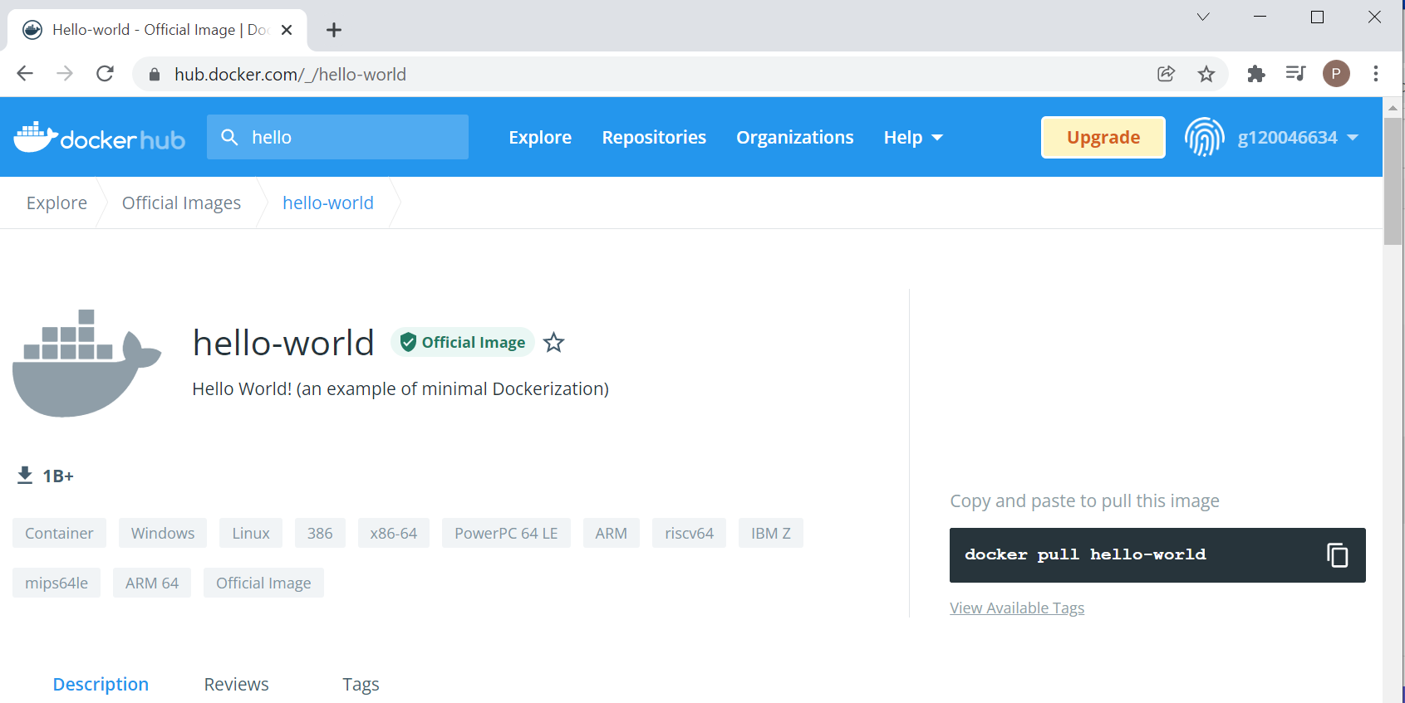
10.6 Docker Pull/Run Command
https://www.youtube.com/watch?v=Rv3DAJbDrS0&list=PLhW3qG5bs-L99pQsZ74f-LC-tOEsBp2rK&index=10
Docker Pull Command
Go to www.dockerhub.com and find the image “hello-world”
> docker pull hello-world

Slide 20
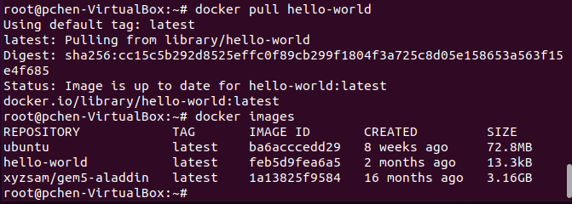
10.6 Docker Pull/Run Command
https://www.youtube.com/watch?v=Rv3DAJbDrS0&list=PLhW3qG5bs-L99pQsZ74f-LC-tOEsBp2rK&index=10
Docker Pull Command
> docker pull hello-world
It will go through the entire cycle to get the image and store in your local system.
> docker images
Check the image “hello-world” is save.

Slide 21
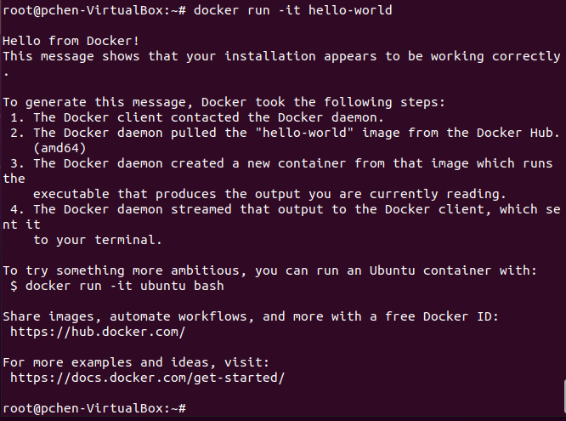
10.6 Docker Pull/Run Command
https://www.youtube.com/watch?v=Rv3DAJbDrS0&list=PLhW3qG5bs-L99pQsZ74f-LC-tOEsBp2rK&index=10
Docker Run Command
> docker run hello-world
You can directly use “docker run” command. It will check the image is available or not, and then save the “hello-world” in your local system
…and finally, create the container.

Slide 22
10.7 Docker Commands

Slide 23
10.7 Docker Commands
https://www.youtube.com/watch?v=Rv3DAJbDrS0&list=PLhW3qG5bs-L99pQsZ74f-LC-tOEsBp2rK&index=10
Docker Commands (1)
> docker ps
> docker run <image-name>
> docker start <container-name/ID>
> docker stop <container-name/ID>
> docker pause <container-name/ID>
> docker unpause <container-name/ID>
> docker top <container-name/ID>
> docker stats <container-name/ID>
Docker Commands (2)
> docker attach <container-name/ID>
> docker stats <container-name/ID>
> docker kill <image-name>
> docker rm <container-name/ID>
> docker history <container-name/ID>

Slide 24
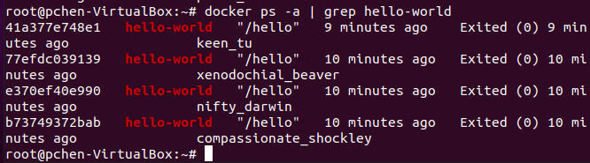
10.7 Docker Commands
https://www.youtube.com/watch?v=Rv3DAJbDrS0&list=PLhW3qG5bs-L99pQsZ74f-LC-tOEsBp2rK&index=10
Docker Commands
> docker ps -a | grep hello-world

Slide 25
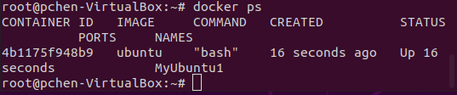
10.7 Docker Commands
https://www.youtube.com/watch?v=Rv3DAJbDrS0&list=PLhW3qG5bs-L99pQsZ74f-LC-tOEsBp2rK&index=10
Docker Commands
> docker run --name MyUbuntu1 -it ubuntu
Open anther terminal (control-alt t).
> docker ps
You will see the “MyUbuntu1” is running.
We have our container running now.

Slide 26


10.7 Docker Commands
https://www.youtube.com/watch?v=Rv3DAJbDrS0&list=PLhW3qG5bs-L99pQsZ74f-LC-tOEsBp2rK&index=10
Docker Commands
On the new terminal (control-alt t)
> docker start MyUbuntu1
> docker stop MyUbuntu1
> docker stop MyUbuntu1
When you stop the “MyUbunt1” the terminal which running the “MyUbuntu1” will be stop (exit) as below.

Slide 27
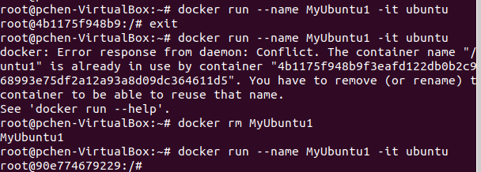

10.7 Docker Commands
https://www.youtube.com/watch?v=Rv3DAJbDrS0&list=PLhW3qG5bs-L99pQsZ74f-LC-tOEsBp2rK&index=10
Docker Commands
On the new terminal (control-alt t), you also can “pause” or “unpause”
> docker pause MyUbuntu1
> docker unpause MyUbuntu1
Note:
When we pause “MyUbunt1”, we cannot use “ls” since the system is “pause”.
When we unpause it, then it will continue to use “ls” command.

Slide 28
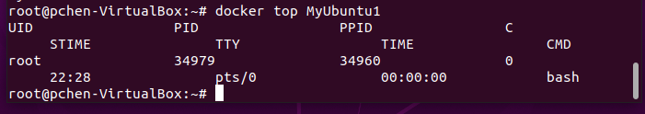
10.7 Docker Commands
https://www.youtube.com/watch?v=Rv3DAJbDrS0&list=PLhW3qG5bs-L99pQsZ74f-LC-tOEsBp2rK&index=10
Docker Commands
> docker top MyUbuntu1

Slide 29
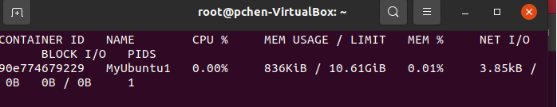
10.7 Docker Commands
https://www.youtube.com/watch?v=Rv3DAJbDrS0&list=PLhW3qG5bs-L99pQsZ74f-LC-tOEsBp2rK&index=10
Docker Commands
> docker stats MyUbuntu1
You can see memory usage and percentage, network input/output, Block I/O, and PID.

Slide 30
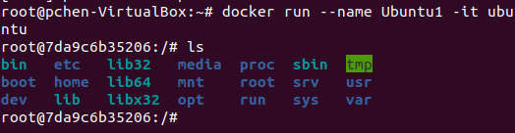
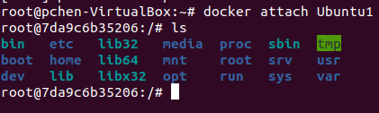
10.7 Docker Commands
https://www.youtube.com/watch?v=Rv3DAJbDrS0&list=PLhW3qG5bs-L99pQsZ74f-LC-tOEsBp2rK&index=10
Docker Commands
> docker attach MyUbuntu1
You can attach the other terminal which running container to current terminal. When you attach, both terminals are synchronous with the same command.

Slide 31
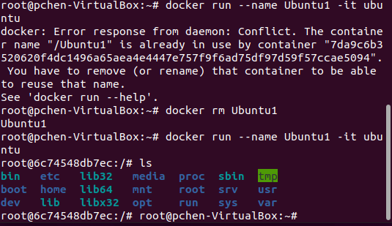

10.7 Docker Commands
https://www.youtube.com/watch?v=Rv3DAJbDrS0&list=PLhW3qG5bs-L99pQsZ74f-LC-tOEsBp2rK&index=10
Docker Commands
> docker run --name –it ubuntu
Open another terminal (control-alt t)
> docker kill MyUbuntu1

Slide 32
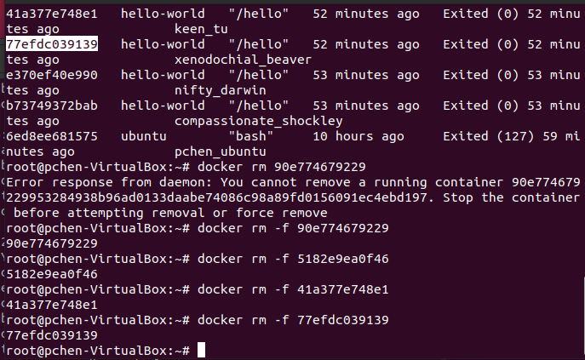
10.7 Docker Commands
https://www.youtube.com/watch?v=Rv3DAJbDrS0&list=PLhW3qG5bs-L99pQsZ74f-LC-tOEsBp2rK&index=10
Docker Commands
> docker rm -f <container-ID>
Will remove the container.
Note:
Kill container, the “ps -a” still see the container ID.
Remove container, “ps -a” the container ID is clean up.

Slide 33
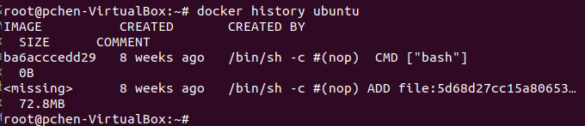
10.7 Docker Commands
https://www.youtube.com/watch?v=Rv3DAJbDrS0&list=PLhW3qG5bs-L99pQsZ74f-LC-tOEsBp2rK&index=10
Docker Commands
> docker history ubuntu
We will see all the history of image ubuntu

Slide 34
End of Chapter

