Slide 1

11 Docker Compose by YML
Peter H. Chen

Slide 2
11 Docker Compose by YML
https://www.youtube.com/watch?v=HUpIoF_conA&list=PLhW3qG5bs-L99pQsZ74f-LC-tOEsBp2rK&index=13
What and Why Docker Compose?
How to install Docker Compose?
How to create Docker Compose File?
How to use Docker Compose file to create services?
Docker Compose Basic Commands

Slide 3
11 Docker Compose by YML
https://www.youtube.com/watch?v=HUpIoF_conA&list=PLhW3qG5bs-L99pQsZ74f-LC-tOEsBp2rK&index=13
What and Why Docker Compose?
Docker Compose:
Docker-compose is used for defining and running multi-controller docker application
Docker-compose uses YAML files to configure application services (docker-compose.yml)
Docker-compose can start all services with a single command: docker-compose up
Docker-compose can stop all services with a single command: docker-compose down
Docker-compose can scale up selected services when required.
s

Slide 4
11.1 Install Docker Compose

Slide 5
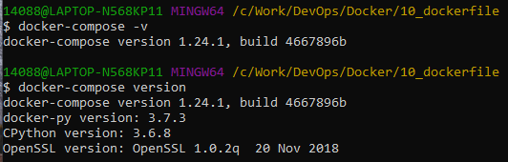
11.1 Install Docker Compose
https://www.youtube.com/watch?v=HUpIoF_conA&list=PLhW3qG5bs-L99pQsZ74f-LC-tOEsBp2rK&index=13
Docker Compose
When we install Docker Toolbox, we already have the “docker-compose”
> docker-compose -v
> docker-compose version

Slide 6
11.2 Microservices

Slide 7
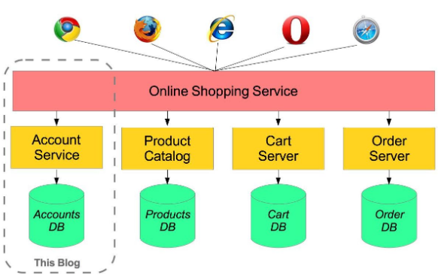
11.2 Microservices
https://www.youtube.com/watch?v=HUpIoF_conA&list=PLhW3qG5bs-L99pQsZ74f-LC-tOEsBp2rK&index=13
Microservices
Each application only take care a specific service.
Google “Microservices Examples”

Slide 8
11.3 docker-compose.yml

Slide 9
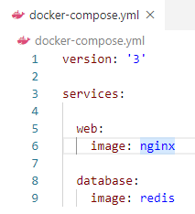
11.3 docker-compose.yml
https://www.youtube.com/watch?v=HUpIoF_conA&list=PLhW3qG5bs-L99pQsZ74f-LC-tOEsBp2rK&index=13
Docker-compose.yml
># Version 1 is for root. Change to version 3
>version: ‘3’
>
>services:
>
># search for docker hub for web service
> web:
> image: nginx
>
># search for docker hub for database service.
> database:
> image: redis

Slide 10
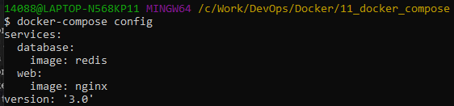
11.3 docker-compose.yml
https://www.youtube.com/watch?v=HUpIoF_conA&list=PLhW3qG5bs-L99pQsZ74f-LC-tOEsBp2rK&index=13
Docker-compose.yml
Command:
> docker-compose config

Slide 11
11.4 docker-compose up

Slide 12
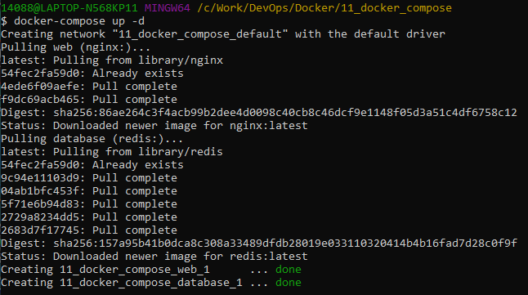
11.4 docker-compose up
https://www.youtube.com/watch?v=HUpIoF_conA&list=PLhW3qG5bs-L99pQsZ74f-LC-tOEsBp2rK&index=13
Docker-compose up
Command up for detached mode
> docker-compose up -d

Slide 13
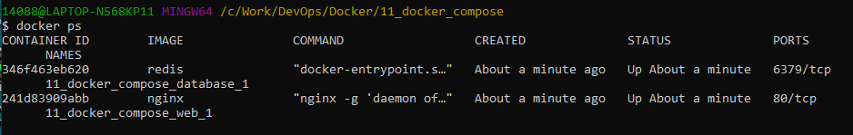
11.4 docker-compose up
https://www.youtube.com/watch?v=HUpIoF_conA&list=PLhW3qG5bs-L99pQsZ74f-LC-tOEsBp2rK&index=13
Docker-compose up
> docker ps

Slide 14
11.5 docker-compose Down

Slide 15
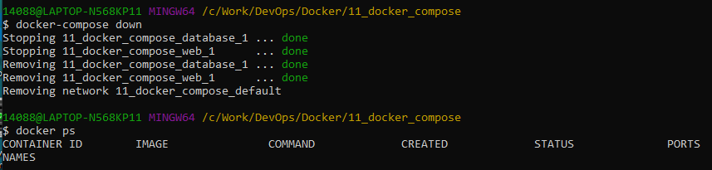
11.5 docker-compose Down
https://www.youtube.com/watch?v=HUpIoF_conA&list=PLhW3qG5bs-L99pQsZ74f-LC-tOEsBp2rK&index=13
Docker-compose down
Command down
> docker-compose down
> docker ps

Slide 16
11.6 port 9090

Slide 17
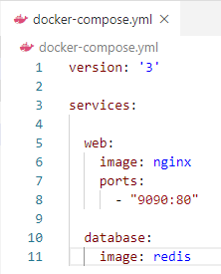
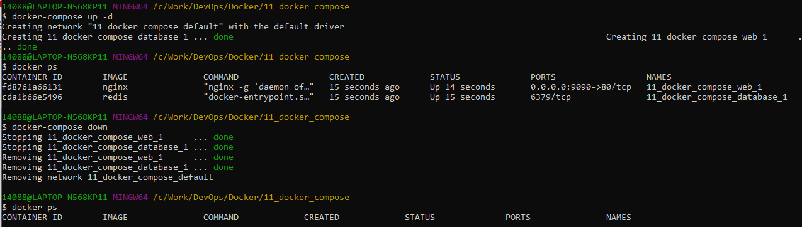
11.6 port 9090
https://www.youtube.com/watch?v=HUpIoF_conA&list=PLhW3qG5bs-L99pQsZ74f-LC-tOEsBp2rK&index=13
Port 9090
Command
> docker-compose up -d
> docker ps
> docker-compose down
> docker ps

Slide 18
11.7 Check YML Syntax

Slide 19
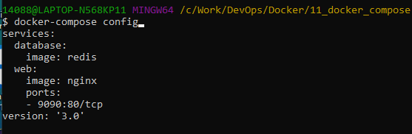
11.7 Check YML Syntax
https://www.youtube.com/watch?v=HUpIoF_conA&list=PLhW3qG5bs-L99pQsZ74f-LC-tOEsBp2rK&index=13
Check YML Syntax
YML syntax check is by command
> docker-compose config

Slide 20
End of Chapter

