Slide 1

3 Docker for Window Home Edition
Peter H. Chen

Slide 2
3 Docker for Window Home Edition
https://www.youtube.com/watch?v=7ra_tB2q0O0&list=PL6tu16kXT9PrTeP07thlsrF8Sf9zHXmh5
https://www.youtube.com/watch?v=YH3sutAsxEM
Docker was developed under Linux. By default, it works with Linux.
Docker also work for Macs and Windows Profession/Enterprise edition after 2016.
You get error message when you install Docker on Windows 10 Home Edition.
How to install Docker for Window Home Edition?
In order to make Docker work for Window Home edition, we need to check window setup for VTX (Virtualization) and turn off Hypervisor.
Install Docker with “Docker Tool”. We can download from GitHub.
Docker Tool need VBManage.exe. We can download from Oracle VirtualBox.
Docker Quick Start Terminal need the Bash shell (C:/Tools/bin/Bash.exe). We can be download from GitHub Git Bash.

Slide 3
3.1 Virtualization and Hypervisor

Slide 4
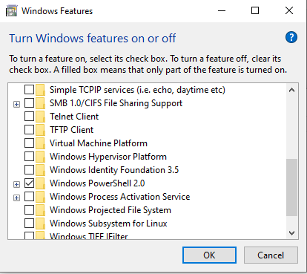
3.1 Virtualization and Hypervisor
https://www.youtube.com/watch?v=YH3sutAsxEM
Enable Virtualization and Turn off Hypervisor
https://www.youtube.com/watch?v=YH3sutAsxEM
We need to make sure two thing:
1. BIOS setting: In my Acer Computer, restart computer, press ALT+Fn+F10 to bring up the BIO Menu, make sure VTX (Virtualization): Enabled.
3. Control Panel > Programs and Features > Turn Windows features : Make sure turn off the “Window Hypervisor Platform”

Slide 5
3.2 Install VirtualBox

Slide 6
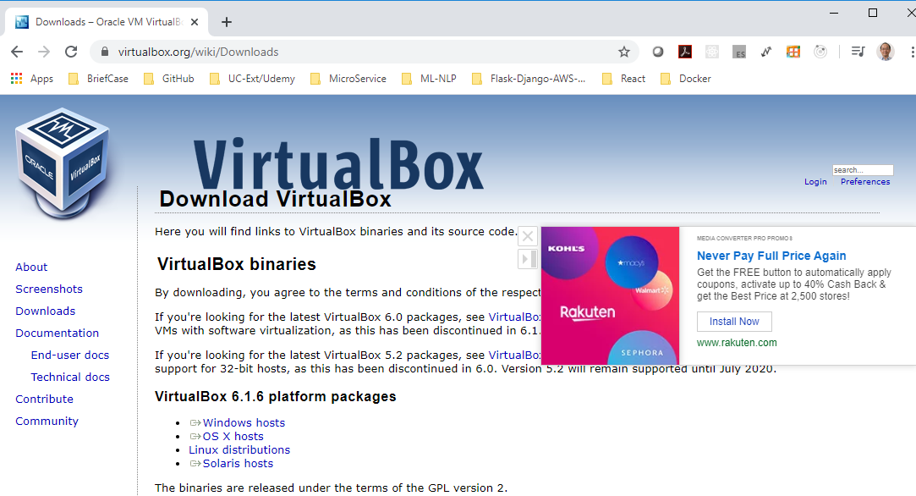
3.2 Install VirtualBox
https://www.youtube.com/watch?v=YH3sutAsxEM
Install VirtualBox
Click “Windows hosts”

Slide 7
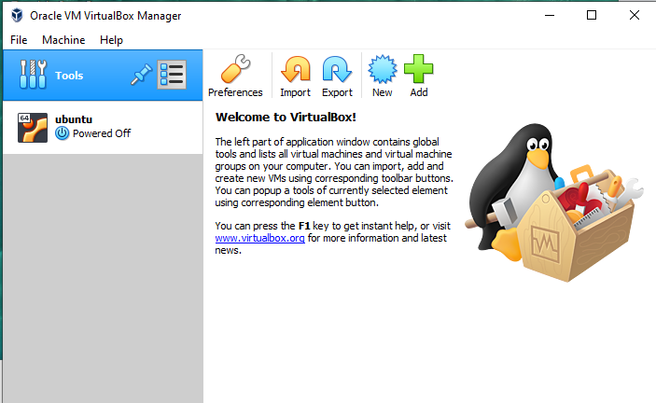
3.2 Install VirtualBox
https://www.youtube.com/watch?v=YH3sutAsxEM
Install VirtualBox
After installed, you have virtualBox.

Slide 8
3.3 Install Git Bash

Slide 9
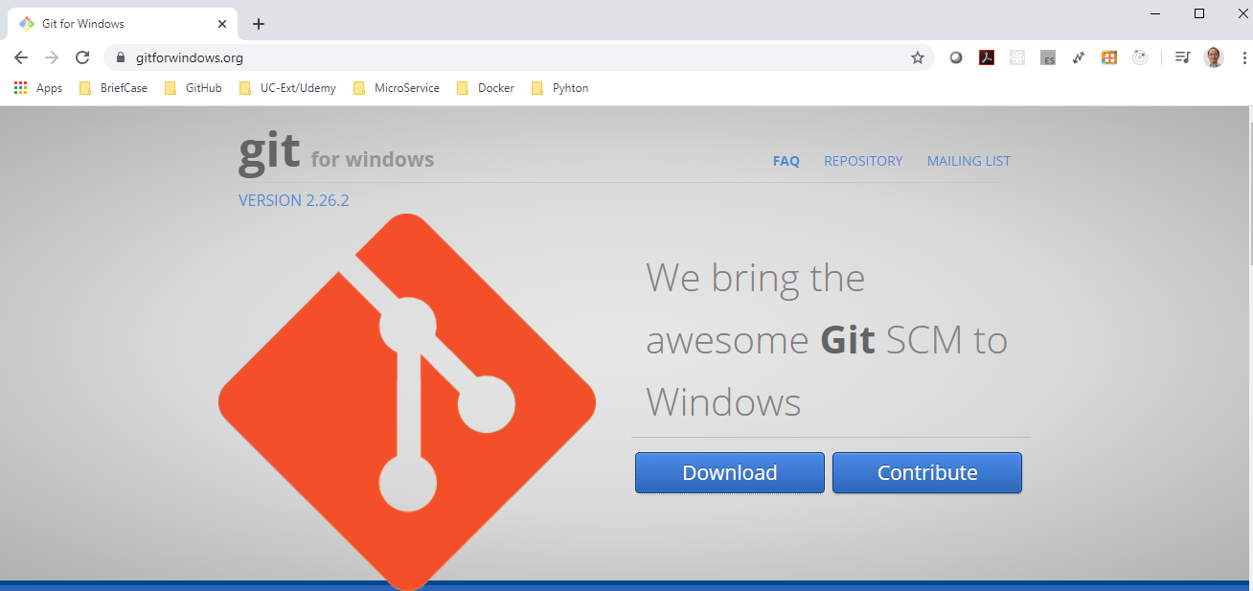
3.3 Install Git Bash
https://www.youtube.com/watch?v=YH3sutAsxEM
Install Git Basb
Download and install window git bash. It provides the bash.exe for docker terminal.
It installed at location “C:\Tools\Git\bin\bash.exe”

Slide 10
3.3 Install Docker Tool

Slide 11
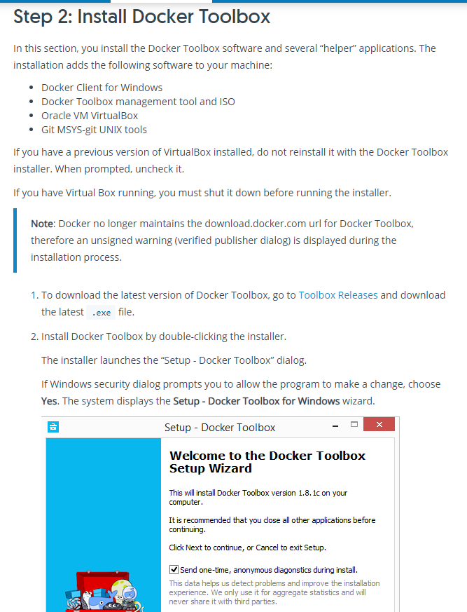
3.3 Install Docker Tool
https://www.youtube.com/watch?v=YH3sutAsxEM
Install Docker Tool
https://docs.docker.com/toolbox/toolbox_install_windows/

Slide 12
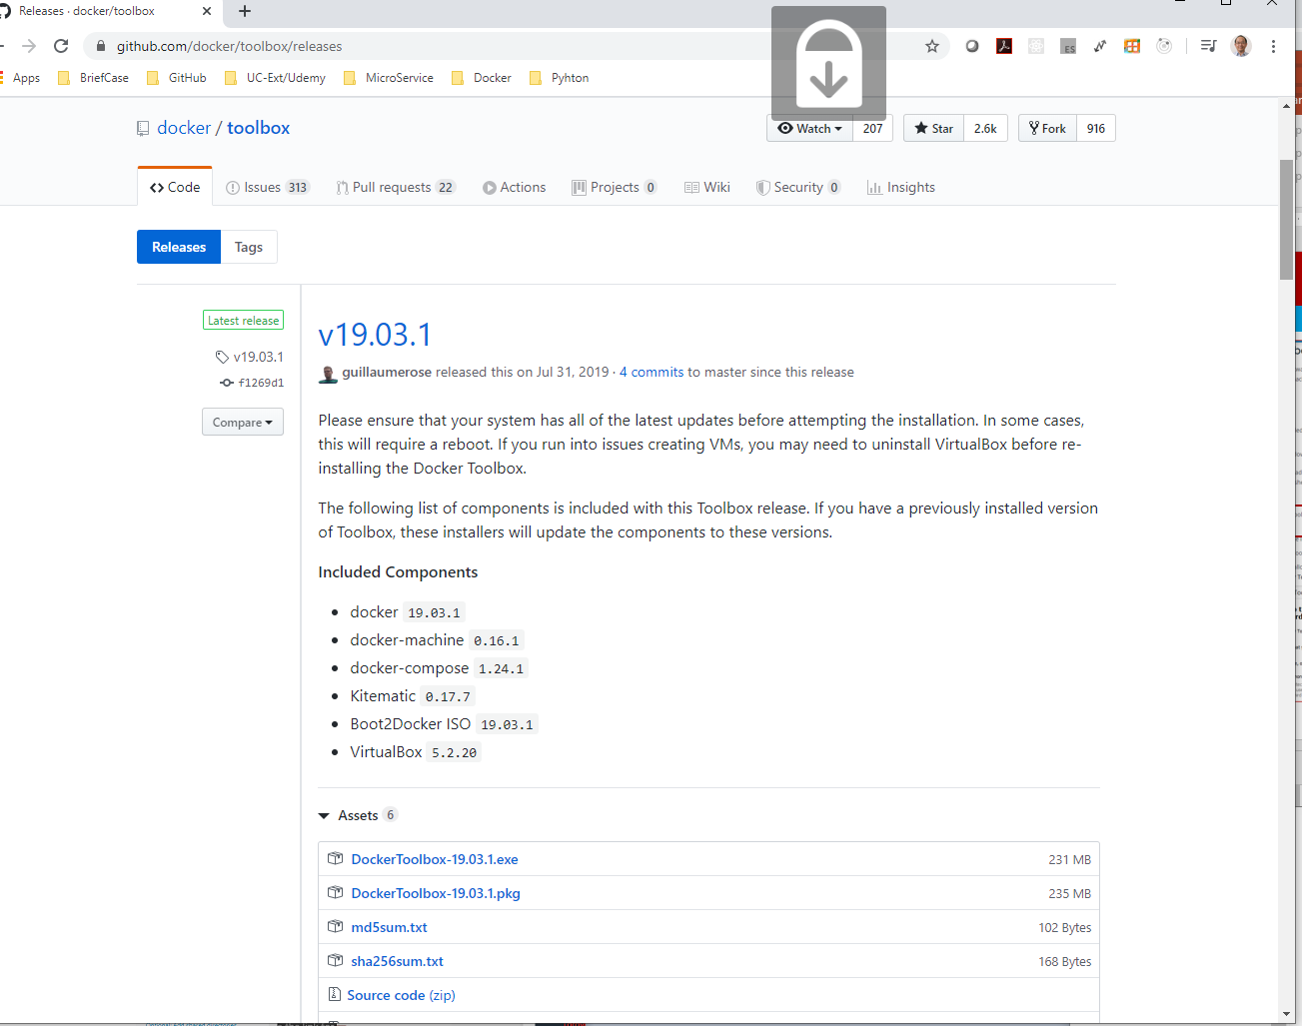
3.3 Install Docker Tool
https://www.youtube.com/watch?v=YH3sutAsxEM
Install Docker Tool
https://github.com/docker/toolbox/releases/
Download docker tool from GitHub.

Slide 13
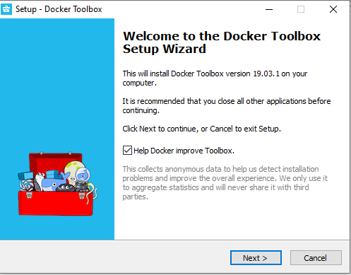
3.3 Install Docker Tool
https://www.youtube.com/watch?v=YH3sutAsxEM
Install Docker Tool
https://github.com/docker/toolbox/releases/
Double click the downloaded “docker tool”

Slide 14
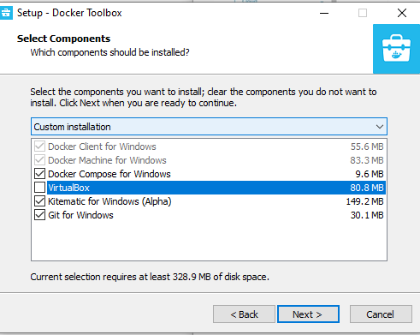
3.3 Install Docker Tool
https://www.youtube.com/watch?v=YH3sutAsxEM
Install Docker Tool
https://github.com/docker/toolbox/releases/
Turn off the Virtual Box installation. We already installed the newest verions from Oracle VirtualBox.

Slide 15
3.3 Install Docker Tool
https://www.youtube.com/watch?v=YH3sutAsxEM
Install Docker Tool
https://github.com/docker/toolbox/releases/
Remove the Virtual Box installation. We already installed from Oracle VirtualBox.

Slide 16
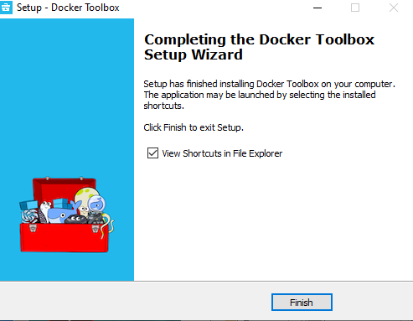
3.3 Install Docker Tool
https://www.youtube.com/watch?v=YH3sutAsxEM
Install Docker Tool
https://github.com/docker/toolbox/releases/
Finished Docker Tool installation.
Reboot window.

Slide 17
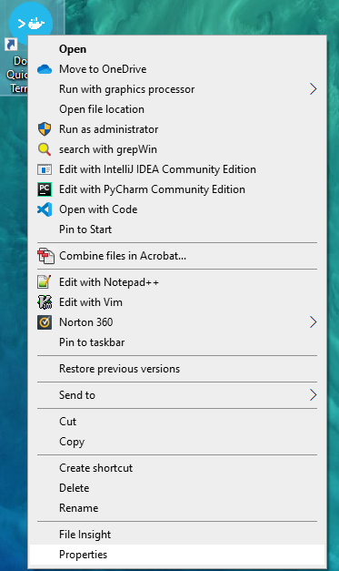

3.3 Install Docker Tool
https://www.youtube.com/watch?v=YH3sutAsxEM
Install Docker Tool
https://github.com/docker/toolbox/issues/335
We need to configure the bash.exe for Docker Quick start termininal.
Select “Docker Quick Terminal”, Right-mouse-click.
Select the properties

Slide 18
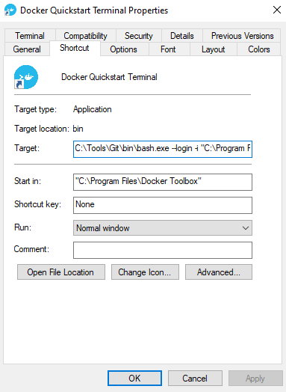
3.3 Install Docker Tool
https://www.youtube.com/watch?v=YH3sutAsxEM
Install Docker Tool
In the Target, put “C:\Tools\Git\bin\bash.exe” …

Slide 19
3.4 Start Docker Tool

Slide 20
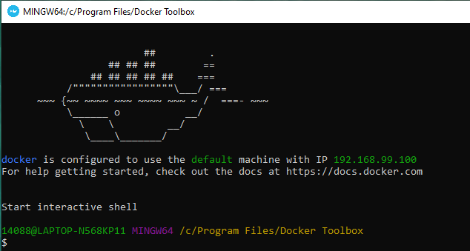
3.4 Start Docker Tool
https://www.youtube.com/watch?v=YH3sutAsxEM
Install Docker Tool
Double click the “Docker Quick Start Terminal …”

Slide 21
3.5 Docker Command

Slide 22
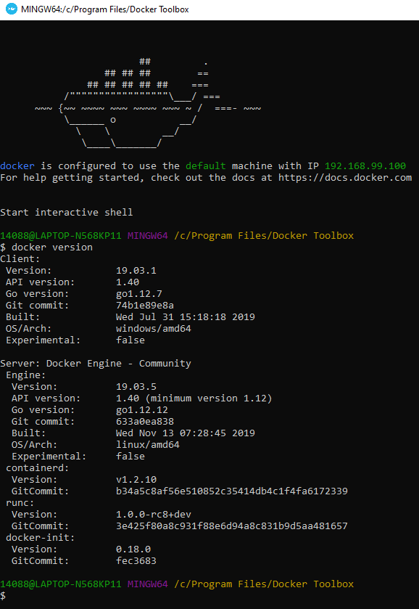
3.5 Docker Command
https://www.youtube.com/watch?v=YH3sutAsxEM
Docker Version
> docker version
Docker client version is 19.03.1
The Server is Docker Engine 19.03.5.
The OS daemon is Linux/amd64 provided by Oracle VirtualBox.

Slide 23
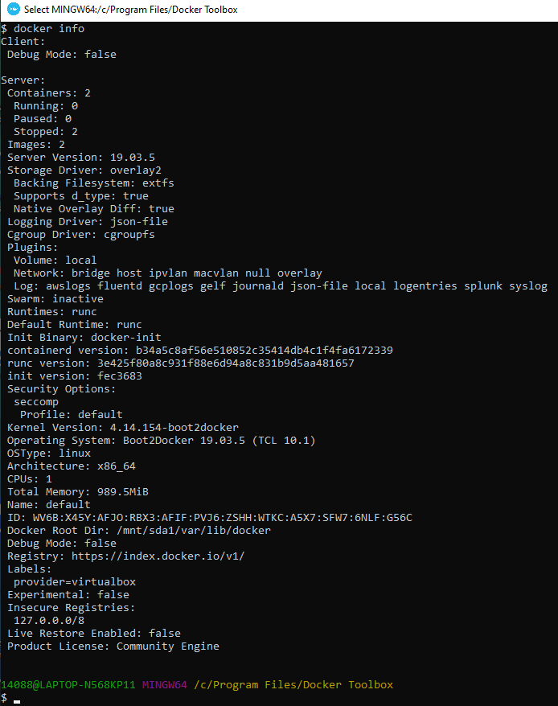
3.5 Docker Command
https://www.youtube.com/watch?v=YH3sutAsxEM
Docker inf
> docker info
Server container: 2, Running, pause, stopped, images, etc.

Slide 24

3.5 Docker Command
https://www.youtube.com/watch?v=YH3sutAsxEM
Clear command
> clear

Slide 25
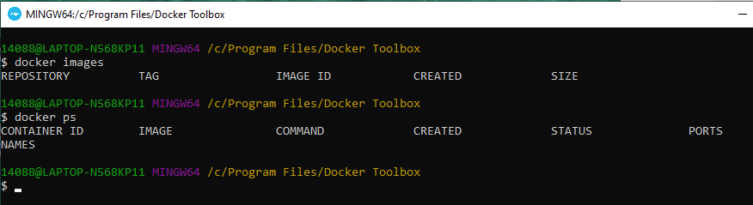
3.5 Docker Command
https://www.youtube.com/watch?v=YH3sutAsxEM
Docker Command
> docker images
> docker ps

Slide 26
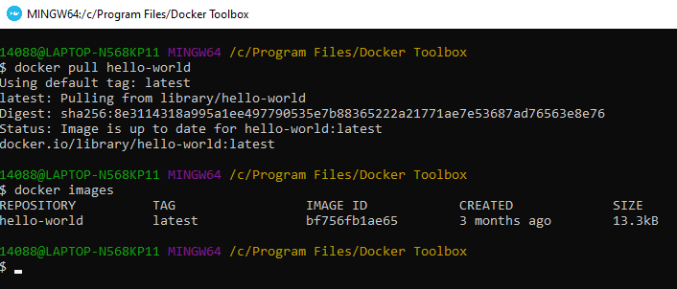
3.5 Docker Command
https://www.youtube.com/watch?v=YH3sutAsxEM
Docker Pull
> docker pull hello-world
> docker images
Note: Docker pull (images from hub.docker.com)

Slide 27
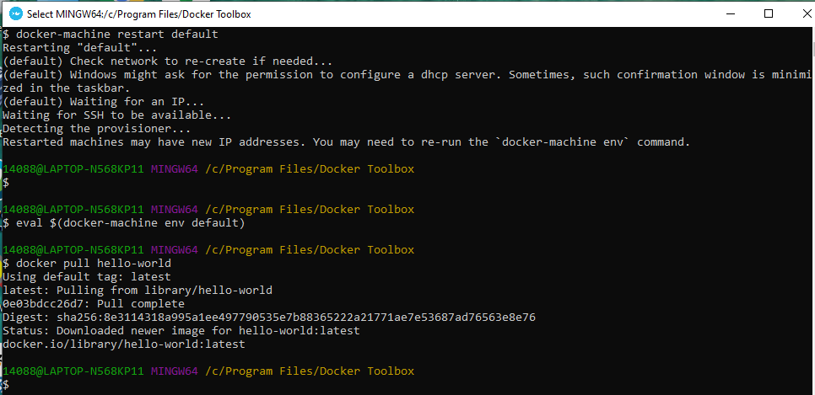
3.5 Docker Command
https://www.youtube.com/watch?v=YH3sutAsxEM
Docker Pull
https://forums.docker.com/t/error-response-from-daemon-get-https-registry-1-docker-io-v2/23741/10
If I have error message: Error response from daemon: Get https://registry-1.docker.io/v2/
Your docker-machine is screw-up.
You need to reset
# 1. Restart the environment
> docker-machine restart default
# 2. Refresh your environment settings
> eval $(docker-machine env default)
After reset the docker-machine and docker environment:
> docker pull hello-world
# Work fine again!!

Slide 28
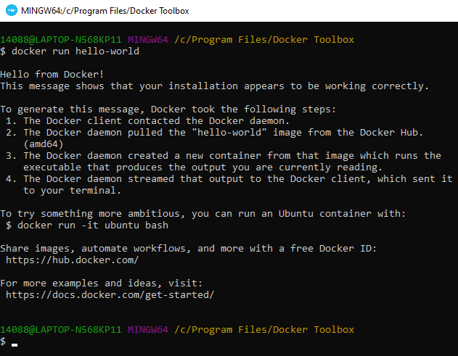
3.5 Docker Command
https://www.youtube.com/watch?v=YH3sutAsxEM
Docker Run
> docker run hello-world

Slide 29
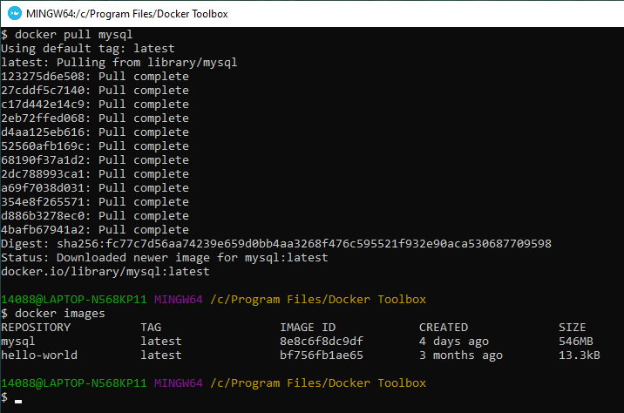
3.5 Docker Command
https://www.youtube.com/watch?v=YH3sutAsxEM
Docker pull mysql
> docker pull mysql
> docker images
Note: Docker pull (images from hub.docker.com)

Slide 30
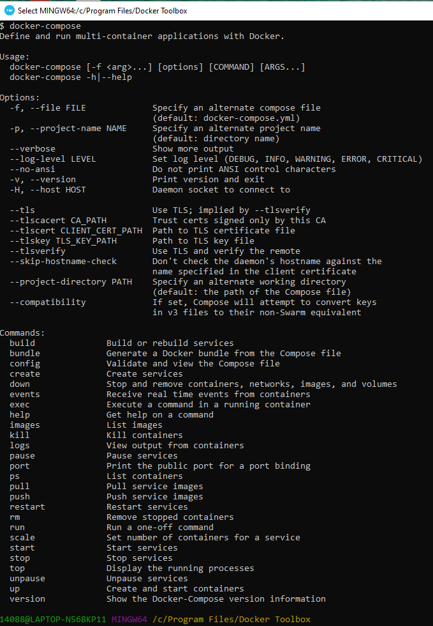
3.5 Docker Command
https://www.youtube.com/watch?v=YH3sutAsxEM
Docker-compose
> docker-compose
Docker compose is a tool for defining and running multi-container application.
Make sure all the tools are installed. You can see all the other commands and usage of document composed which mean you are good to go.
You can start creating YAML files around the various images and create services and you will be all online.

Slide 31
3.5 Docker Command
https://www.youtube.com/watch?v=YH3sutAsxEM
Docker-compose
> exit
Exit the docker bash shell.

Slide 32
3.6 Command Prompt

Slide 33
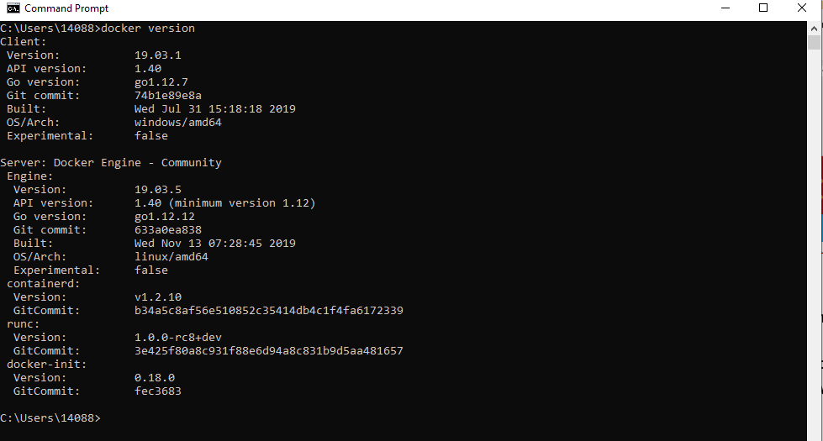
3.6 Command Prompt
https://www.youtube.com/watch?v=YH3sutAsxEM
Command Prompt
You can start with a command prompt
> docker version

Slide 34
3.7 Verify Virtualization by Task Manager

Slide 35
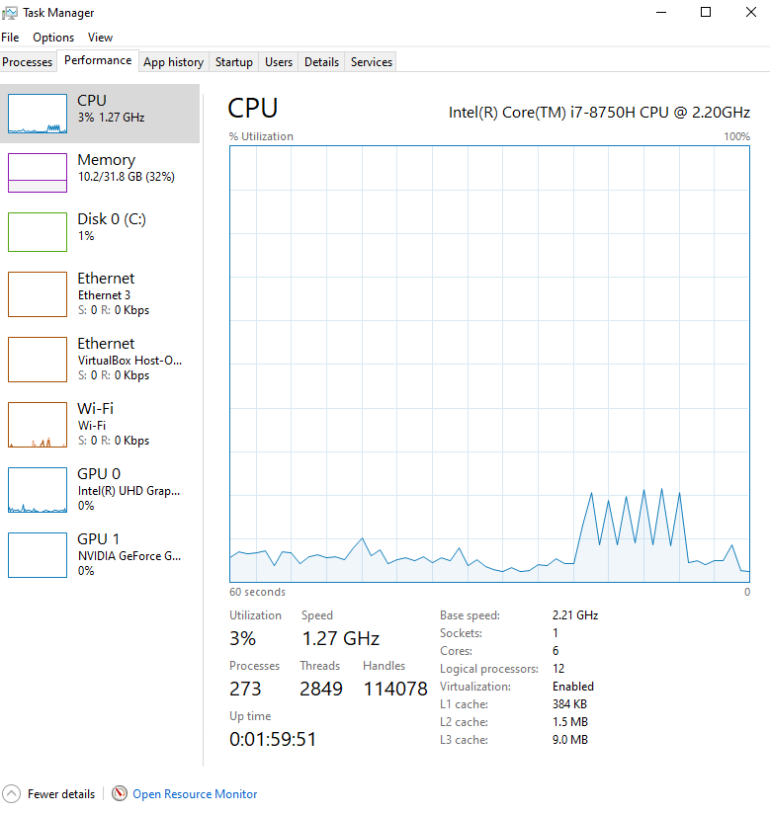
3.7 Verify Virtualization by Task Manager
https://www.youtube.com/watch?v=YH3sutAsxEM
Task Manager
Control+Alt+Del: start the task manager.
This is a Virtualized, a virtual machine.
It is going to show a virtual processes.
You wan to make sure that VTX (virtualization) enabled for BIOS.

Slide 36
3.7 Verify Virtualization by Task Manager
https://www.youtube.com/watch?v=YH3sutAsxEM
Task Manager
We click on CPU to check the performance of CPU.
Virtualization enabled is a entry to show all your logical processors.
If virtualization is not enabled, then you need to reset the BIOS and enabled it.

Slide 37
3.8 More Docker Command

Slide 38
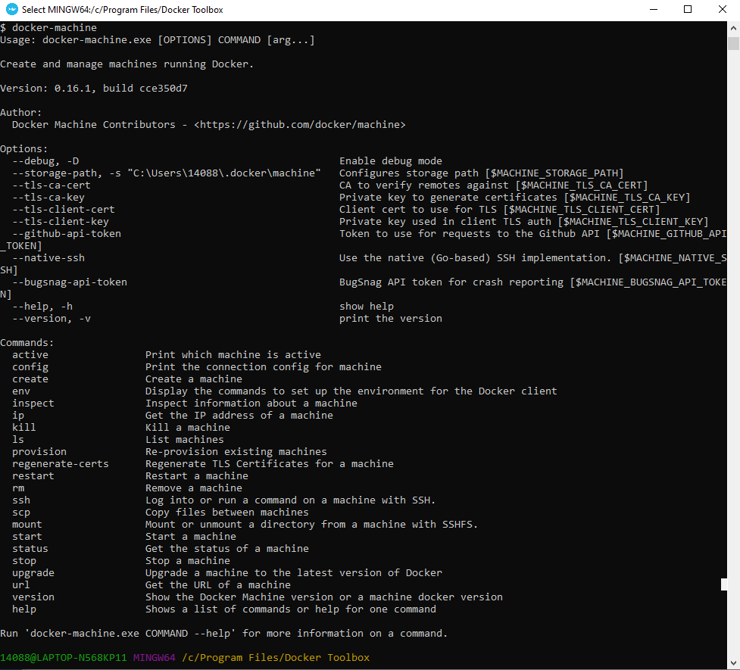
3.8 More Docker Command
https://www.youtube.com/watch?v=YH3sutAsxEM
More Docker Command
If you have communication problem
> docker-machine
Docker-machine will give you the information of your virtual machine for Docker.

Slide 39
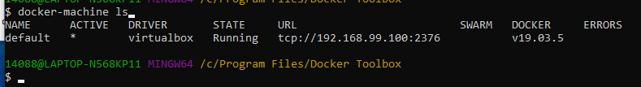
3.8 More Docker Command
https://www.youtube.com/watch?v=YH3sutAsxEM
> docker version
Docker version give you two versions: one for client and one for server version.
The server is Linux, not window. That is because your virtual machine or daemon is run behind the scene.
> docker-machine ls
It tells you the virtual machine run behind the scene.
The machine name is default, the driver is VirtualBox. The virtualBox is free and highly recommended.

Slide 40
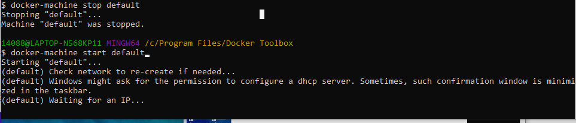
3.8 More Docker Command
https://www.youtube.com/watch?v=YH3sutAsxEM
> docker-machine stop default
> docker-machine start default
If you have any trouble, stop and then start the virtual machine daemon.
Always check your virtual machine is there online by
> docker-machine ls

Slide 41
End of Chapter

