Slide 1

10 Dockerfile
Peter H. Chen

Slide 2
10 Dockerfile
https://www.youtube.com/watch?v=LQjaJINkQXY&list=PLhW3qG5bs-L99pQsZ74f-LC-tOEsBp2rK&index=12
What is Dockerfile?
How to Create Docker file?
How to build image from Dockerfile?
Basic Commands

Slide 3
10.1 Dockerfile

Slide 4
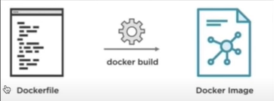
10.1 Dockerfile
https://www.youtube.com/watch?v=LQjaJINkQXY&list=PLhW3qG5bs-L99pQsZ74f-LC-tOEsBp2rK&index=12
Dockerfile
A text file with instructions to build image
Automation of Docker Image Creation
There are some basic instructions that you use in the Dockerfile.
FROM
RUN
CMD

Slide 5
10.1 Dockerfile
https://www.youtube.com/watch?v=LQjaJINkQXY&list=PLhW3qG5bs-L99pQsZ74f-LC-tOEsBp2rK&index=12
Dockerfile
Step 1: Create a file name Dockerfile. When you run the Docker build commands. Docker searches for a file name Dockerfile, however, you can also specify some different name. But for now, we use Dockerfile only.
> mkdir DockerFiles
> cd DockerFiles

Slide 6
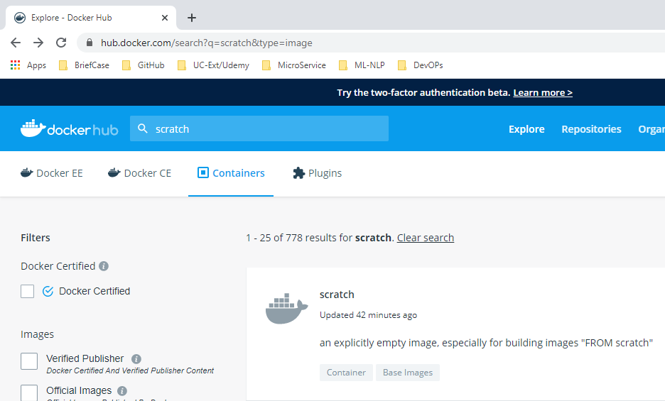
10.1 Dockerfile
https://www.youtube.com/watch?v=LQjaJINkQXY&list=PLhW3qG5bs-L99pQsZ74f-LC-tOEsBp2rK&index=12
Dockerfile
vim Dockerfile
> # Getting base image ubuntu
> # Create empty image
> # FROM SCRATCH
> FROM ubuntu
> MAINTAINER Peter Chen <peter.hp.chen@gmail.com>
> RUN apt-get update
> CMD [“echo”, “Hello World..! First Docker Image”]

Slide 7
10.2 Docker Build

Slide 8
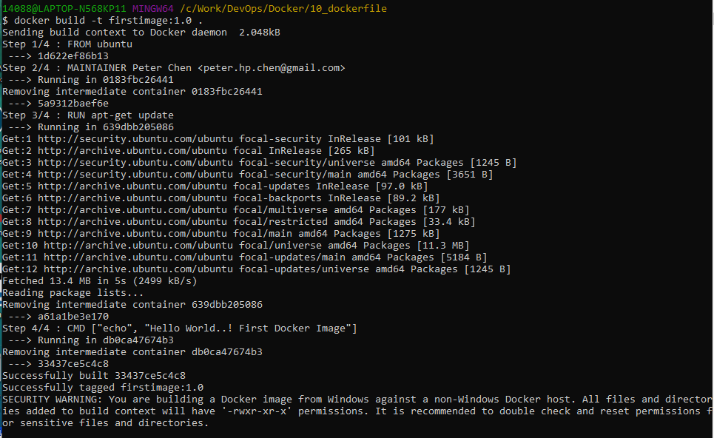
10.2 Docker Build
https://www.youtube.com/watch?v=LQjaJINkQXY&list=PLhW3qG5bs-L99pQsZ74f-LC-tOEsBp2rK&index=12
Docker Build
> docker build -t firstimage:1.0 .
Note: -t: tag .: current folder

Slide 9
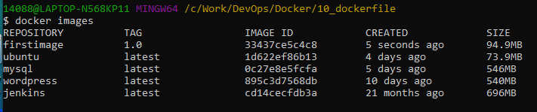
10.1 Dockerfile
https://www.youtube.com/watch?v=LQjaJINkQXY&list=PLhW3qG5bs-L99pQsZ74f-LC-tOEsBp2rK&index=12
Dockerfile
> docker images

Slide 10
10.3 Docker Run

Slide 11
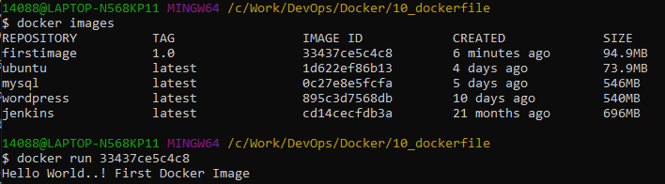
10.3 Docker Run
https://www.youtube.com/watch?v=LQjaJINkQXY&list=PLhW3qG5bs-L99pQsZ74f-LC-tOEsBp2rK&index=12
Docker Run
> docker images
> docker run <image_ID>

Slide 12
End of Chapter

