Slide 1

4 Docker Command
Peter H. Chen

Slide 2
3 Docker Command
https://www.youtube.com/watch?v=v-sVpk8nxbA&list=PL6tu16kXT9PqdhOZk4MNVtQDJp6xFrotg&index=4
We discuss working with Docker and container.
Docker can be executed via
Git Shell (Windows)
Command prompt (Windows)
Terminal (Mac/Linux)

Slide 3
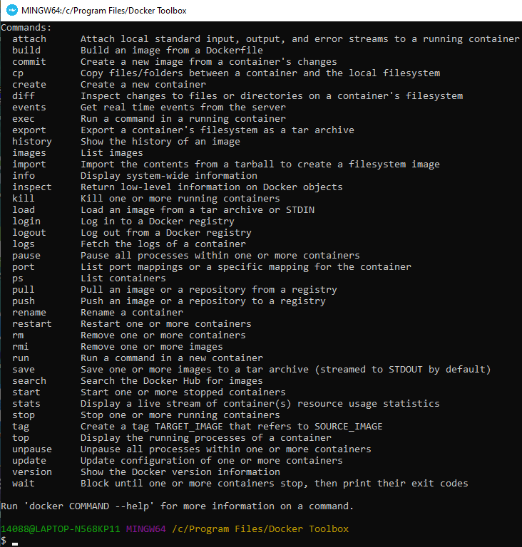
3 Docker Command
https://www.youtube.com/watch?v=v-sVpk8nxbA&list=PL6tu16kXT9PqdhOZk4MNVtQDJp6xFrotg&index=4
> docker --help

Slide 4
3 Docker Command
https://www.youtube.com/watch?v=v-sVpk8nxbA&list=PL6tu16kXT9PqdhOZk4MNVtQDJp6xFrotg&index=4
Behind the scenes
All these commands are actually executed in a tiny Linux Distribution which sits in your Docker Tool of Window 10 Home (or Hyper-v of Window Pro/Enterprise).
The Docker Tool (or Hyper-v) will automatically connect to your internet and deploy your Hyper-v machine.

Slide 5
3 Docker Command
https://www.youtube.com/watch?v=v-sVpk8nxbA&list=PL6tu16kXT9PqdhOZk4MNVtQDJp6xFrotg&index=4
Common used Command
> docker --help
Command for Containers:
> docker create # create a new container
> docker pull # Pull an image from docker hub
> docker push # Push an image to docker hub
> docker ps # List the running process in your docker
docker ps -a; List all the container which actually being executed all the information of these containers: Container ID, name, tag name, and port number which is being exposed and
> docker ps -a (show all containers)
> docker rm # remove the particular container from the docker.
> docker stop # stop the executing container from your

Slide 6
4.1 Run Docker Command

Slide 7
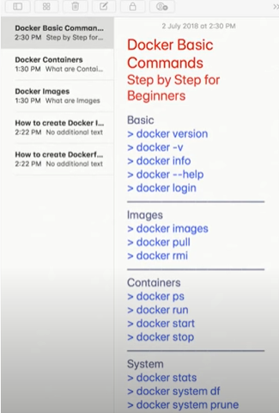
4.1 Run Docker Command
https://www.youtube.com/watch?v=HqBMEmoAd1M&list=PLhW3qG5bs-L99pQsZ74f-LC-tOEsBp2rK&index=8
Docker command

Slide 8
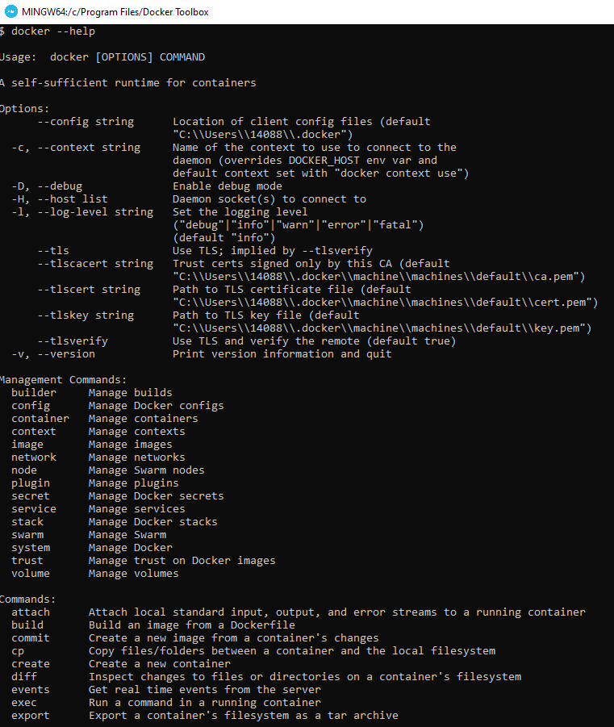
4.1 Run Docker Command
https://www.youtube.com/watch?v=v-sVpk8nxbA&list=PL6tu16kXT9PqdhOZk4MNVtQDJp6xFrotg&index=4
> docker --help

Slide 9
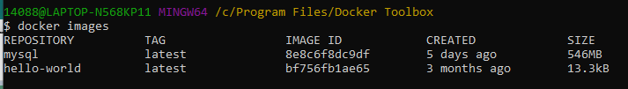
4.1 Run Docker Command
https://www.youtube.com/watch?v=v-sVpk8nxbA&list=PL6tu16kXT9PqdhOZk4MNVtQDJp6xFrotg&index=4
> docker ps
> docker ps -a
You can actually stop the container by using “docker stop <container ID>”.
> docker images

Slide 10
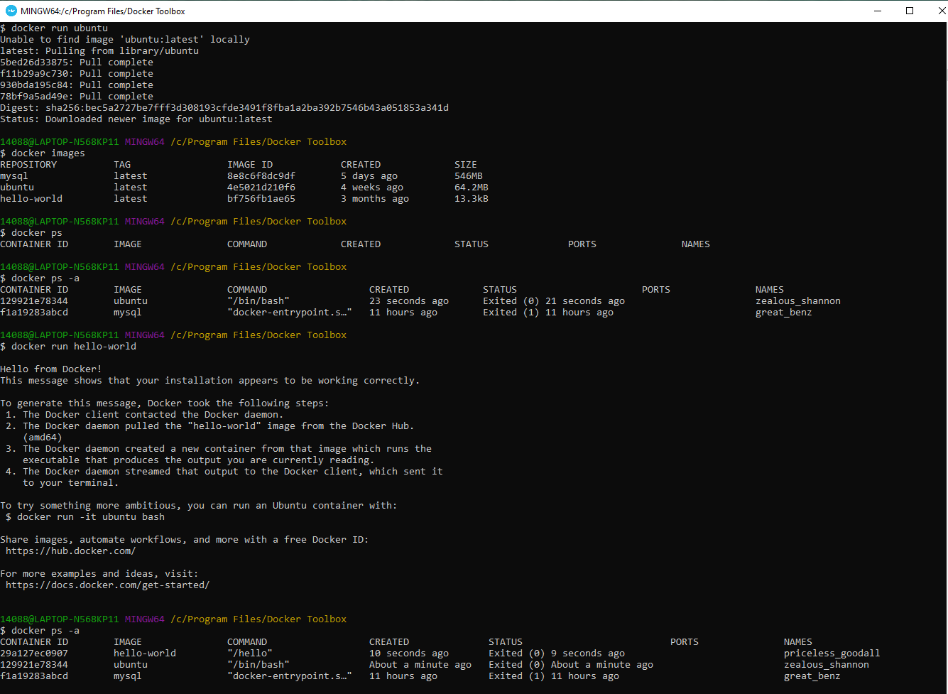
4.1 Run Docker Command
https://www.youtube.com/watch?v=v-sVpk8nxbA&list=PL6tu16kXT9PqdhOZk4MNVtQDJp6xFrotg&index=4
> docker run ubuntu
> docker run hello-world
> docker ps -a
> docker images

Slide 11
End of Chapter

