Slide 1

13 Docker Compose by YML
Peter H. Chen

Slide 2
13 Docker Compose by YML
https://www.youtube.com/watch?v=HUpIoF_conA&list=PLhW3qG5bs-L99pQsZ74f-LC-tOEsBp2rK&index=13
Docker Compose
1. What and Why Docker Compose?
2. How to install Docker Compose?
> docker-compose -v
> docker-compose version
> apt install docker-compose
3. How to create Docker Compose File?
5. How to use Docker Compose file to create services?
6. Docker Compose Basic Commands
> sudo docker-compose up -d
> sudo docker-compose down
7. Tips: How to scale the services?
> sudo docker-compose up -d --scale database=4

Slide 3
13.1 What/Why Docker Compose?
https://www.youtube.com/watch?v=HUpIoF_conA&list=PLhW3qG5bs-L99pQsZ74f-LC-tOEsBp2rK&index=13
What and Why Docker Compose?
Before we install Docker compose, we want to know what is docker compose and why do you need it.
What is Docker Compose?
1. Tool for defining and running multi-container docker applications.
2. Use yaml files to configure application services (docker-compose.yml)
3. Can start all services with a single command: docker compose up
4. Can stop all services with a single command: docker compose down
5. Can scale up selected services when required.

Slide 4
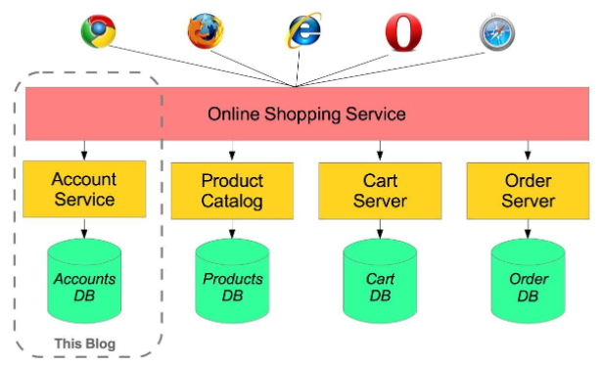
13.1 What/Why Docker Compose?
https://www.youtube.com/watch?v=HUpIoF_conA&list=PLhW3qG5bs-L99pQsZ74f-LC-tOEsBp2rK&index=13
What and Why Docker Compose?
Search for “micro-services in spring”.
We have online shopping services, for example, we have amazon.com
…or any online shopping services
We have multiple modules, such as, account service, product catalog service, cart service, order service, user service, and so on.

Slide 5
13.1 What/Why Docker Compose?
https://www.youtube.com/watch?v=HUpIoF_conA&list=PLhW3qG5bs-L99pQsZ74f-LC-tOEsBp2rK&index=13
What and Why Docker Compose?
In Micro services, we have separate application and separate database.
…so, account service will have its separate database, separate application, separate servers.
Similarly, the product catalog will be separated.
So whenever, we want to make any changes in one module, we do not have to touch any other module and scaling up is very efficient.

Slide 6
13.1 What/Why Docker Compose?
https://www.youtube.com/watch?v=HUpIoF_conA&list=PLhW3qG5bs-L99pQsZ74f-LC-tOEsBp2rK&index=13
What and Why Docker Compose?
Suppose, my product range have increased tremendously.
…and we need the larger database.
…so, we just need to increase the size of product database and we will not touch any other modules.
Now, for this kind of application architecture, if we want to crease with docker.
We need to use “docker compose”.

Slide 7
13.1 What/Why Docker Compose?
https://www.youtube.com/watch?v=HUpIoF_conA&list=PLhW3qG5bs-L99pQsZ74f-LC-tOEsBp2rK&index=13
What is Docker Compose?
So, what is the docker compose?
1. It is a tool for defining and running multi-container docker applications.
2. We use yaml files to create these configure files which is named docker-compose.yml. We will see how to create later on.
3. We can start all the services with a single command: docker compose up
4. We can stop all services with a single command: docker compose down
5. We can scale up selected services when required.
We will se how to do that later.

Slide 8
13.1 Step 1: Install Docker-Compose

Slide 9
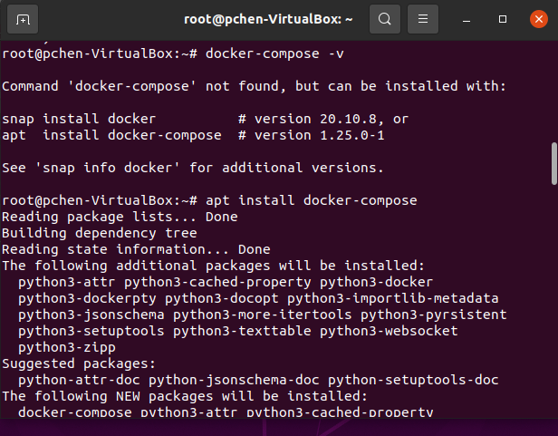
13.1 Step 1: Install Docker-Compose
https://www.youtube.com/watch?v=HUpIoF_conA&list=PLhW3qG5bs-L99pQsZ74f-LC-tOEsBp2rK&index=13
Install Docker-Compose
Now, let’s see how to install the docker-compose.
For windows and Mac, the docker-compose is already there, you can go to command line prompt.
> docker-compose -v
For Linux terminal:
> docker-compose -v
>> docker-compose is not found.
Use “apt install docker-compose” to install docker -compose
> apt install docker-compose

Slide 10
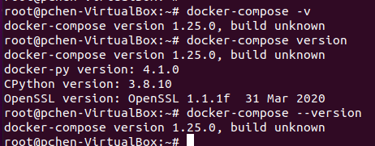
13.1 Step 1: Install Docker-Compose
https://www.youtube.com/watch?v=HUpIoF_conA&list=PLhW3qG5bs-L99pQsZ74f-LC-tOEsBp2rK&index=13
Check Docker-compose version
Above is the easiest way to install docker-compose.
We can try The following commands used to check the docker-compose version:
> docker-compose -v
> docker-compose version
> docker-compose --version
>> docker-compose version: 1.25.0, ….
Now, we have installed the docker-Compose

Slide 11
13.1 Step 1: Install Docker-Compose
https://www.youtube.com/watch?v=HUpIoF_conA&list=PLhW3qG5bs-L99pQsZ74f-LC-tOEsBp2rK&index=13
Install Docker-Compose
There are three ways to install the docker-compose
1. First way: Using command.
Search for “docker-compose installation”
https://docs.docker.com/compose/cli-command/#install-on-linux
> curl -fL https://raw.githubusercontent.com/docker/compose-cli/main/scripts/install/install_linux.sh | sh
2. Second way: Using pip
> pip install -U docker-compose
3. Third way: Using apt
> apt install docker-compose

Slide 12
13.2 Step 2: docker-compose.yml

Slide 13
13.2 Step 2: docker-compose.yml
https://www.youtube.com/watch?v=HUpIoF_conA&list=PLhW3qG5bs-L99pQsZ74f-LC-tOEsBp2rK&index=13
Step 2: Docker-compose.yml
Create docker compose file at any location on your system
File name: docker-compose.yml
> mkdir DockerComposeFile
> cd DockerComposeFile
> vi docker-compose.yml

Slide 14
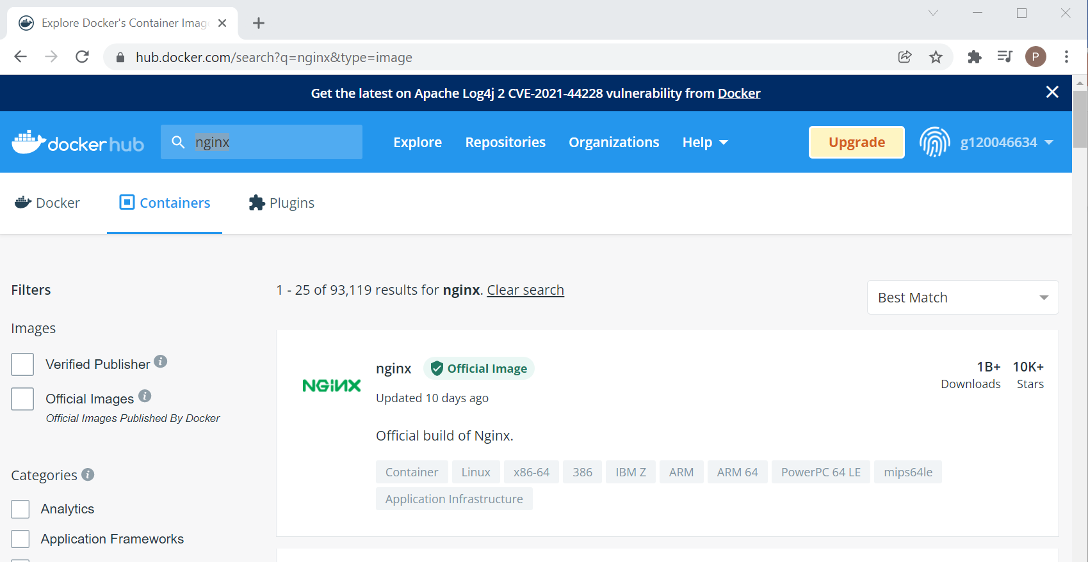
13.2 Step 2: docker-compose.yml
https://www.youtube.com/watch?v=HUpIoF_conA&list=PLhW3qG5bs-L99pQsZ74f-LC-tOEsBp2rK&index=13
Step 2: Docker-compose.yml
Go to Docker Hub. There are a lot of server.
We select the nginx. The nginx is a popular server.

Slide 15
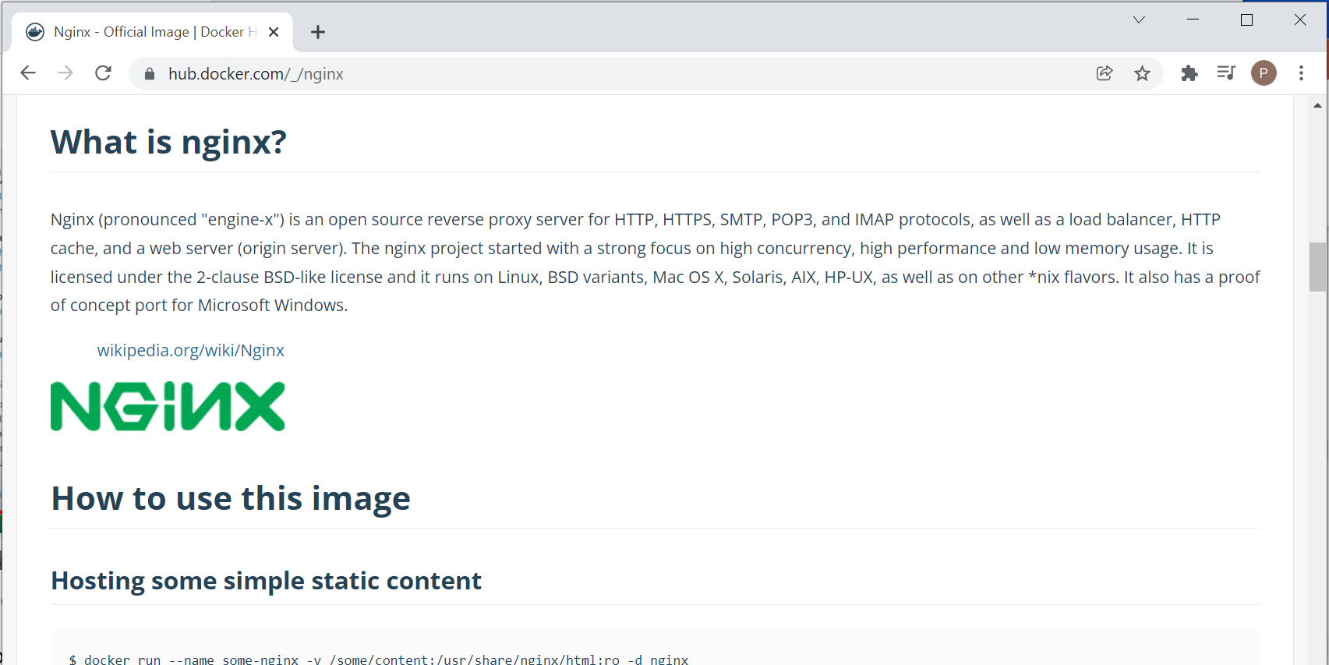
13.2 Step 2: docker-compose.yml
https://www.youtube.com/watch?v=HUpIoF_conA&list=PLhW3qG5bs-L99pQsZ74f-LC-tOEsBp2rK&index=13
Step 2: Docker-compose.yml
Click the description to see the “what is nginx?”
The nginx is an open-source reverse proxy server for HTTP, HTTPS, and etc. protocols.

Slide 16
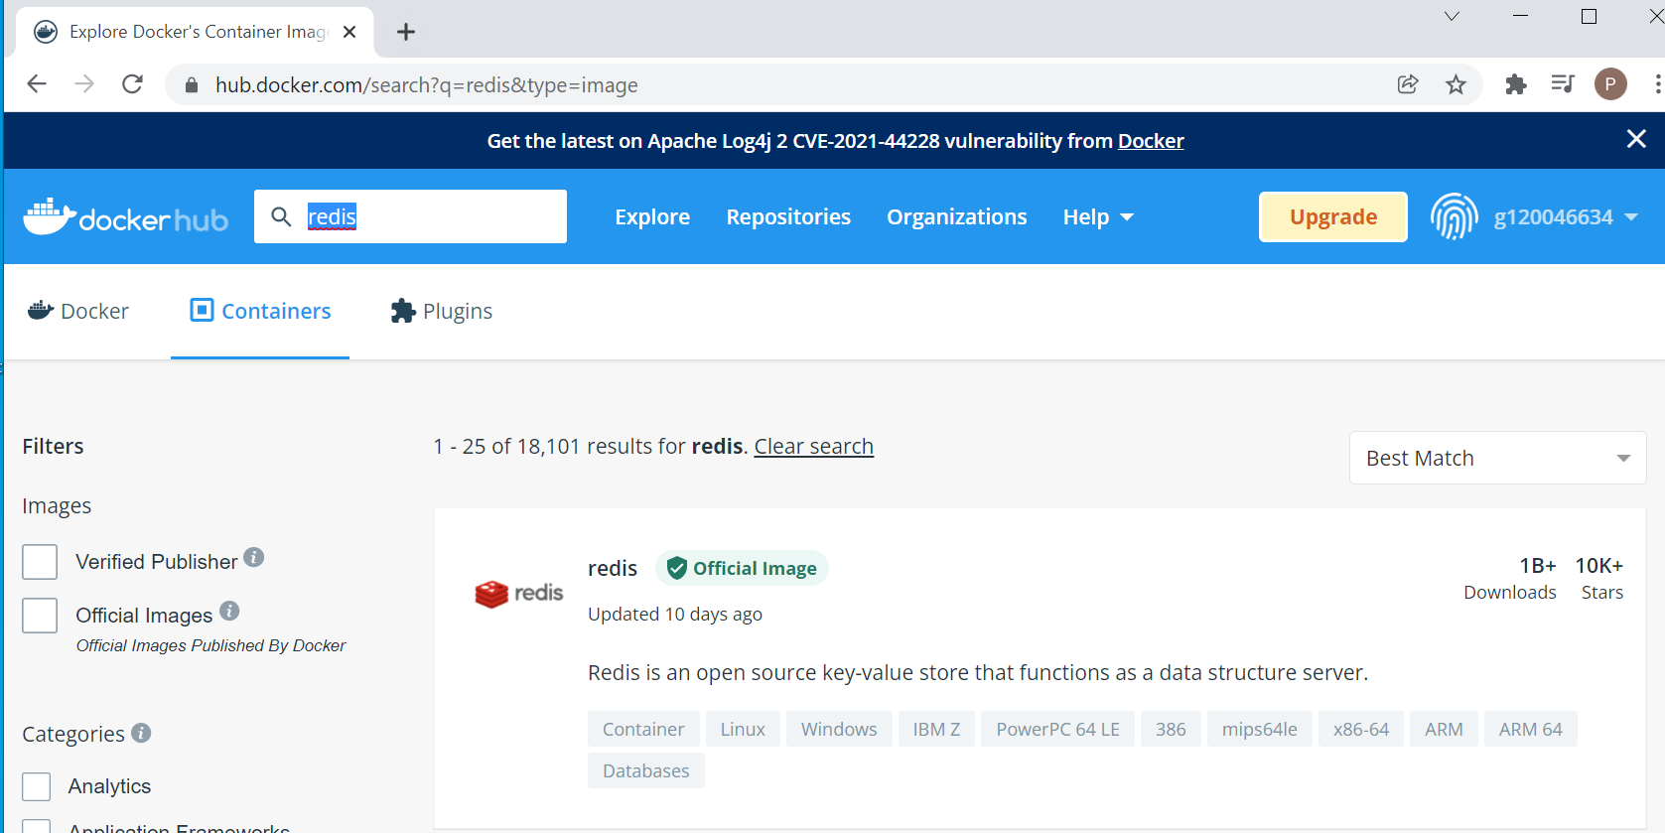
13.2 Step 2: docker-compose.yml
https://www.youtube.com/watch?v=HUpIoF_conA&list=PLhW3qG5bs-L99pQsZ74f-LC-tOEsBp2rK&index=13
Step 2: Docker-compose.yml
We search for redis.
The redis is a key-value database server.

Slide 17
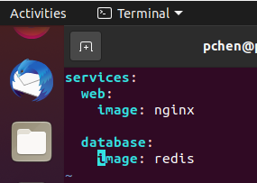
13.2 Step 2: docker-compose.yml
https://www.youtube.com/watch?v=HUpIoF_conA&list=PLhW3qG5bs-L99pQsZ74f-LC-tOEsBp2rK&index=13
Docker-compose.yml
> mkdir DockerComposeFile
> cd DockerComposeFile
> vi docker-compose.yml
In docker-compose.yml file, we define the services for web serverand database server as below.
>> services:
>> web:
>> image: nginx
>> database:
>> image: redis

Slide 18
13.2 Step 2: docker-compose.yml
https://www.youtube.com/watch?v=HUpIoF_conA&list=PLhW3qG5bs-L99pQsZ74f-LC-tOEsBp2rK&index=13
Docker-compose.yml
> mkdir DockerComposeFile
> cd DockerComposeFile
> vi docker-compose.yml
In docker-compose.yml file, we define the services for web server and database server as below.
>> services:
>> web:
>> image: nginx
>> database:
>> image: redis

Slide 19
13.3 Step 3: Validate Docker Command

Slide 20

13.3 Step 3: Validate Docker Command
https://www.youtube.com/watch?v=HUpIoF_conA&list=PLhW3qG5bs-L99pQsZ74f-LC-tOEsBp2rK&index=13
Step 3: Check the validity of file by command:
> docker-compose config
Here, we get some error as below:

Slide 21
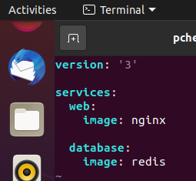
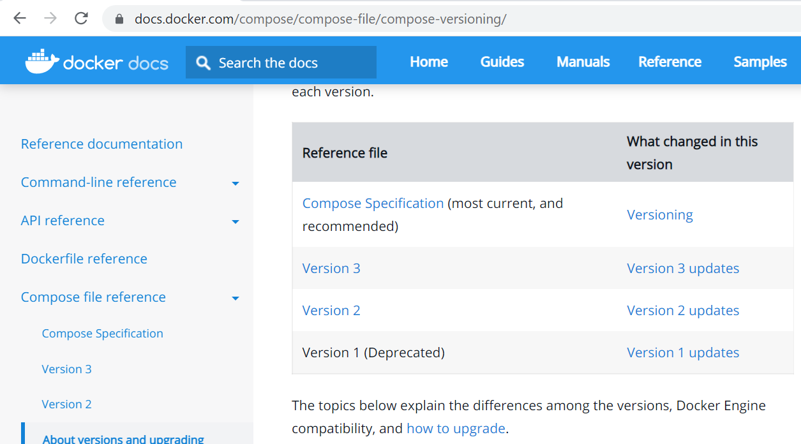
13.3 Step 3: Validate Docker Command
https://www.youtube.com/watch?v=HUpIoF_conA&list=PLhW3qG5bs-L99pQsZ74f-LC-tOEsBp2rK&index=13
Step 3: Check the validity of file by command
We add the version number as below.
Only version ‘2’ or ‘3’ of docker-compose are valid. Version ‘1’ is deprecated and will have error in validation.

Slide 22
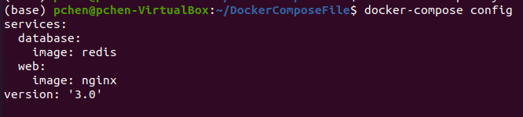
13.3 Step 3: Validate Docker Command
https://www.youtube.com/watch?v=HUpIoF_conA&list=PLhW3qG5bs-L99pQsZ74f-LC-tOEsBp2rK&index=13
Step 3: Check the validity of file by command
We add the version number as below.
Re-validate again:
> docker-compose config
It passes the validation.

Slide 23
13.4 Run docker-compose

Slide 24
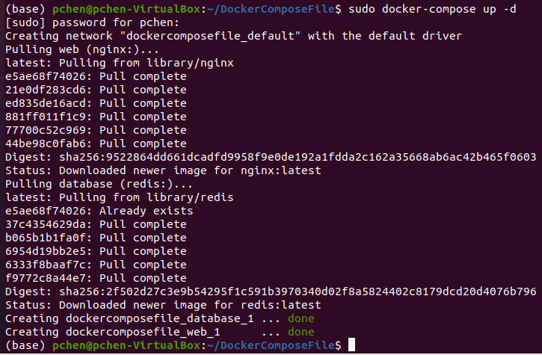
13.4 Run docker-compose
https://www.youtube.com/watch?v=HUpIoF_conA&list=PLhW3qG5bs-L99pQsZ74f-LC-tOEsBp2rK&index=13
Run docker-compose
Command up for detached mode
> sudo docker-compose up -d

Slide 25
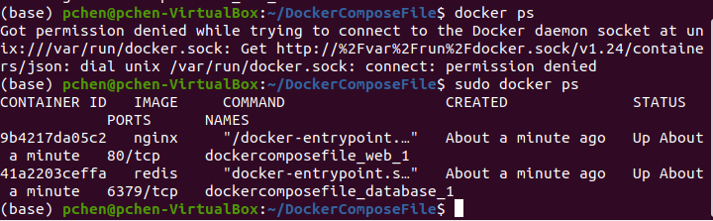
13.4 docker-compose up
https://www.youtube.com/watch?v=HUpIoF_conA&list=PLhW3qG5bs-L99pQsZ74f-LC-tOEsBp2rK&index=13
Docker-compose up
> sudo docker ps
You can see two containers are running.
One is web server nginx and another one is database server redis.

Slide 26
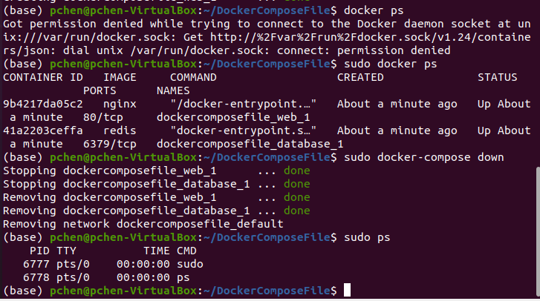
13.4 Run docker-compose
https://www.youtube.com/watch?v=HUpIoF_conA&list=PLhW3qG5bs-L99pQsZ74f-LC-tOEsBp2rK&index=13
Docker-compose down
We can stop docker-compose by the command below
> sudo docker-compose down
> sudo docker ps
We can see no server container is running now.

Slide 27
13.5 Add port 9090

Slide 28
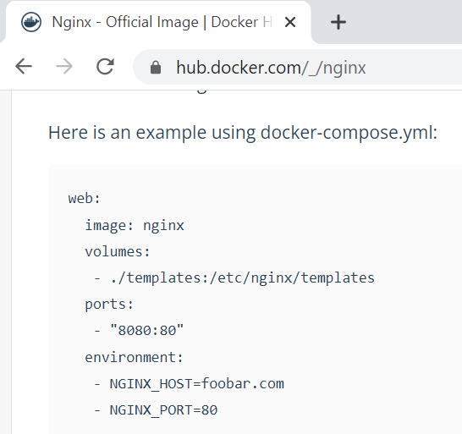
13.5 Add port 9090
https://www.youtube.com/watch?v=HUpIoF_conA&list=PLhW3qG5bs-L99pQsZ74f-LC-tOEsBp2rK&index=13
Port 9090
In docker hub, if we look at description on nginx:
There are some code example for port specification.
We can change the port number from “8080” into “9090” in the host machine.

Slide 29
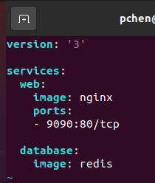
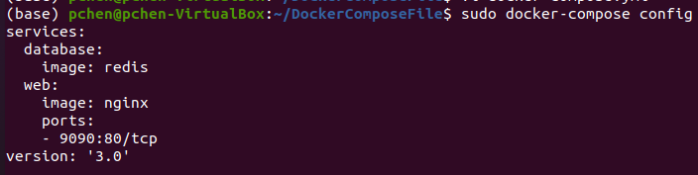
13.5 Add port 9090
https://www.youtube.com/watch?v=HUpIoF_conA&list=PLhW3qG5bs-L99pQsZ74f-LC-tOEsBp2rK&index=13
Port 9090
We add the
Ports:
- 9090:80/tcp
Then, we compile again:
> sudo docker-compose config

Slide 30
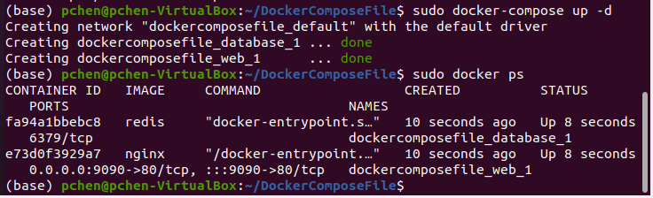
13.5 Add port 9090
https://www.youtube.com/watch?v=HUpIoF_conA&list=PLhW3qG5bs-L99pQsZ74f-LC-tOEsBp2rK&index=13
Port 9090
Then, we run the docker-compose again.
> sudo docker-compose up -d
> sudo ps
Check the web server nginx and database server redis are running.

Slide 31
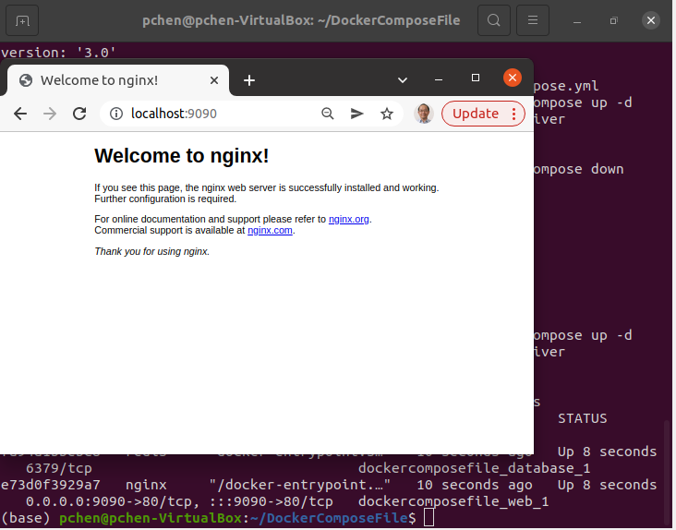
13.5 Add port 9090
https://www.youtube.com/watch?v=HUpIoF_conA&list=PLhW3qG5bs-L99pQsZ74f-LC-tOEsBp2rK&index=13
Port 9090
1. Open the chrome.
2. Check with browser with port number 9090
> localhost:9090
Localhost:9090

Slide 32
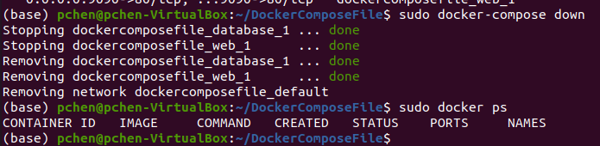
13.5 Add port 9090
https://www.youtube.com/watch?v=HUpIoF_conA&list=PLhW3qG5bs-L99pQsZ74f-LC-tOEsBp2rK&index=13
Port 9090
Stop the docker-compose again.
> sudo docker-compose down
> sudo docker ps

Slide 33
13.6 Docker Compose Down

Slide 34
13.6 Docker Compose Down
https://www.youtube.com/watch?v=HUpIoF_conA&list=PLhW3qG5bs-L99pQsZ74f-LC-tOEsBp2rK&index=13
Docker Compose Down
> sudo docker-compose down
> sudo docker ps

Slide 35
13.7 Scale up Service

Slide 36
13.7 Scale up Service
https://www.youtube.com/watch?v=HUpIoF_conA&list=PLhW3qG5bs-L99pQsZ74f-LC-tOEsBp2rK&index=13
Scale up Service
Docker-Compose bring up the services by using multiple containers, such as, databases service and web service.
We want to scale up particular service.

Slide 37
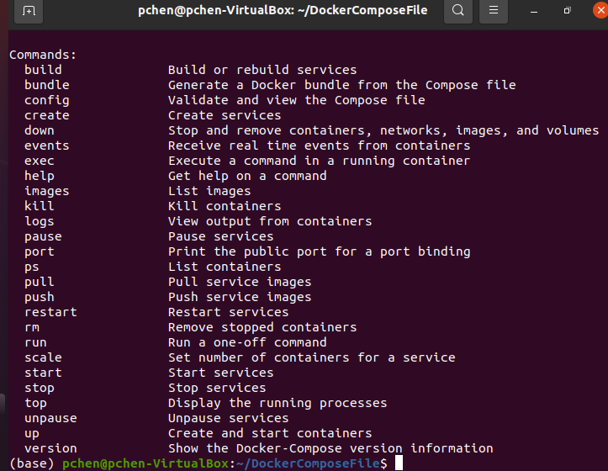
13.7 Scale up Service
https://www.youtube.com/watch?v=HUpIoF_conA&list=PLhW3qG5bs-L99pQsZ74f-LC-tOEsBp2rK&index=13
Scale up Service
> sudo docker-compose --help
We can see there is a “scale” option.

Slide 38
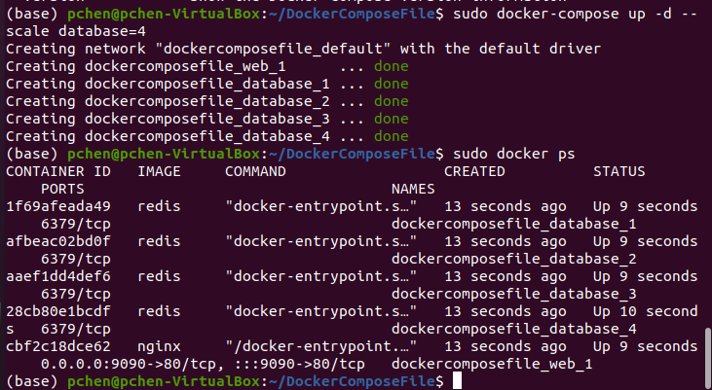
13.7 Scale up Service
https://www.youtube.com/watch?v=HUpIoF_conA&list=PLhW3qG5bs-L99pQsZ74f-LC-tOEsBp2rK&index=13
Scale up Service
> sudo docker-compose up -d --scale database=4
We can scale up the database server by “4”.

Slide 39
13.7 Scale up Service
https://www.youtube.com/watch?v=HUpIoF_conA&list=PLhW3qG5bs-L99pQsZ74f-LC-tOEsBp2rK&index=13
Scale up Service
> sudo docker ps
We can see there are four containers for database servers.

Slide 40
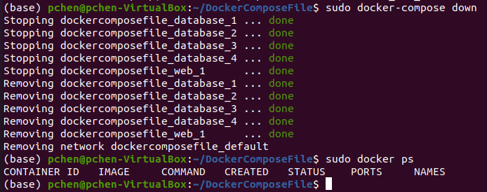
13.7 Scale up Service
https://www.youtube.com/watch?v=HUpIoF_conA&list=PLhW3qG5bs-L99pQsZ74f-LC-tOEsBp2rK&index=13
Scale up Service
> sudo docker-compose down
We will bring all container servers down again.
> sudo ps
Make sure no container is running.

Slide 41
End

