Slide 1
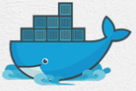
1 Docker Basics
Peter H. Chen

Slide 2
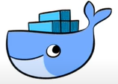
1 Docker Basics
https://www.youtube.com/watch?v=wi-MGFhrad0&list=PLhW3qG5bs-L99pQsZ74f-LC-tOEsBp2rK&index=1
Why need Docker?
The stages of software development: Design, Development, Deployment, Testing/Release.
Docker comes into the picture at the Deployment Stage.
Docker makes the process of application deployment very easy, very efficient, and resolves a lot issues related to deploying applications.
Design
Development
Deployment
Testing/Release

Slide 3
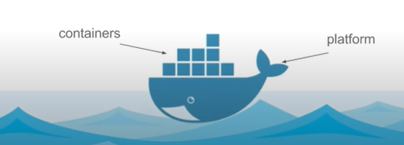
1 Docker Basics
https://www.youtube.com/watch?v=wi-MGFhrad0&list=PLhW3qG5bs-L99pQsZ74f-LC-tOEsBp2rK&index=1
What is Docker?
Docker is the Software Container Platform.

Slide 4
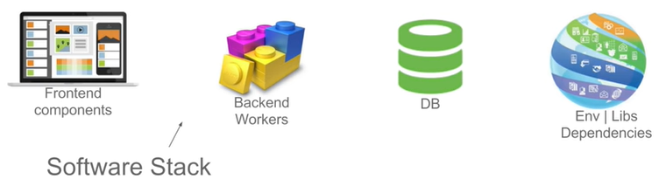
1 Docker Basics
https://www.youtube.com/watch?v=wi-MGFhrad0&list=PLhW3qG5bs-L99pQsZ74f-LC-tOEsBp2rK&index=1
What is the “Software Container Platform” mean?
When we develop the software application, The entire software application consists of a group of front-end components, backend components, database server, libraries, and other environment dependent components.

Slide 5
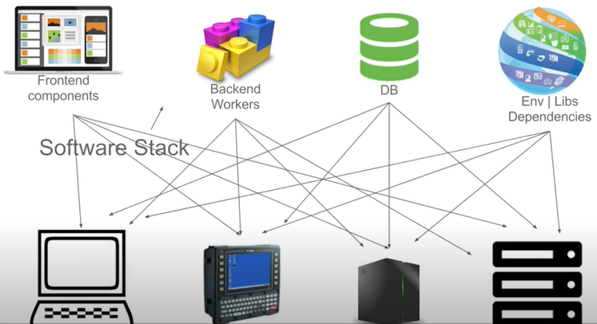
1 Docker Basics
https://www.youtube.com/watch?v=wi-MGFhrad0&list=PLhW3qG5bs-L99pQsZ74f-LC-tOEsBp2rK&index=1
What is the “Software Container Platform” mean? (2)
We have to make sure all these components work on different and wide range of platforms.

Slide 6
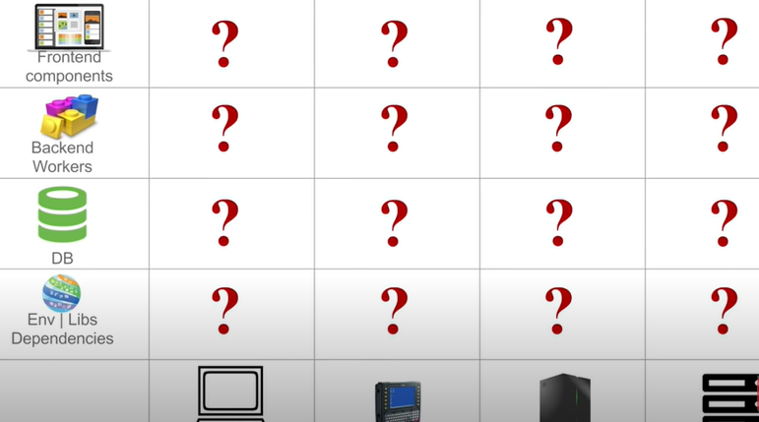
1 Docker Basics
https://www.youtube.com/watch?v=wi-MGFhrad0&list=PLhW3qG5bs-L99pQsZ74f-LC-tOEsBp2rK&index=1
What is the Matrix from the Hell?
If we make a matrix out of above diagram, it will be look like the following.
We have to make sure that all the components the application are compatible with all the possible hardware in the organization:

Slide 7
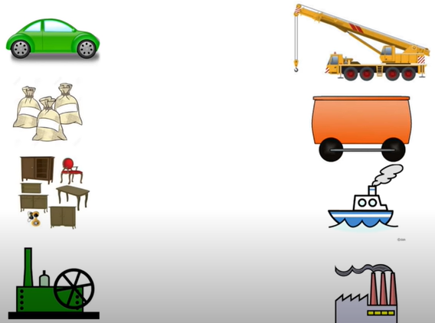
1 Docker Basics
https://www.youtube.com/watch?v=wi-MGFhrad0&list=PLhW3qG5bs-L99pQsZ74f-LC-tOEsBp2rK&index=1
Shipping industry Problem:
When we move the furniture from one place to another place, we have the sem problem.
We have fioriture on the left and shipping equipments on the right.

Slide 8
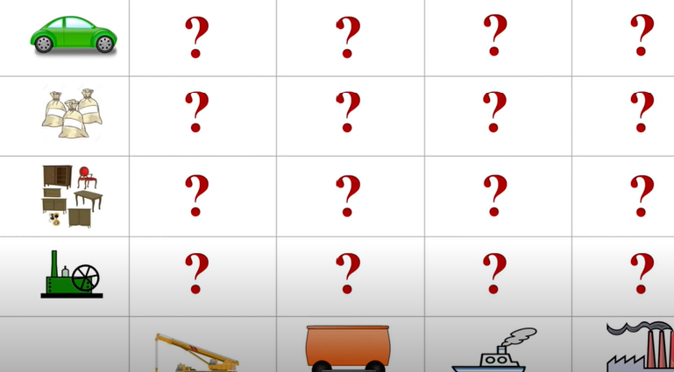
1 Docker Basics
https://www.youtube.com/watch?v=wi-MGFhrad0&list=PLhW3qG5bs-L99pQsZ74f-LC-tOEsBp2rK&index=1
Shipping industry matrix:

Slide 9
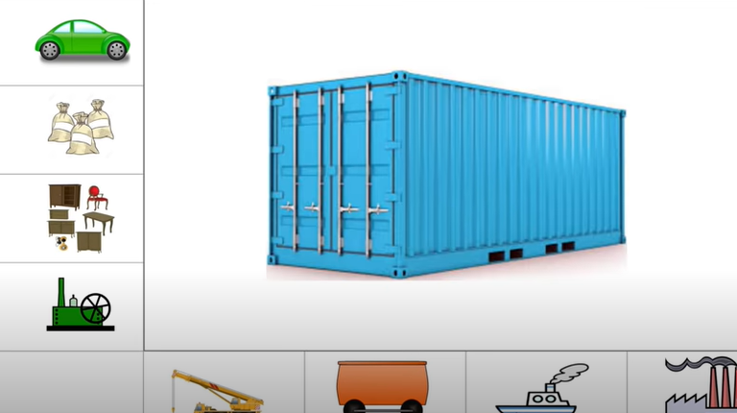
1 Docker Basics
https://www.youtube.com/watch?v=wi-MGFhrad0&list=PLhW3qG5bs-L99pQsZ74f-LC-tOEsBp2rK&index=1
How to solve the Matrix from Hell problem?
We solve the Matrix from the Hell by using the Container.
Container are standard boxes where the goods can be packaged in a standard way.
For example, if you are the furniture manufacture, you need to packaging your furniture into the standard way int the container. You are not worry about the ship through the air, water, who will ship, and etc.

Slide 10
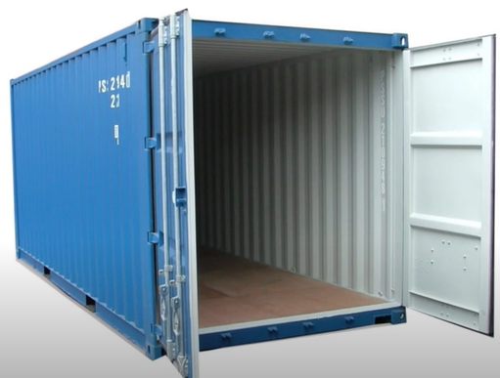
1 Docker Basics
https://www.youtube.com/watch?v=wi-MGFhrad0&list=PLhW3qG5bs-L99pQsZ74f-LC-tOEsBp2rK&index=1
The container make the shipping very easy and efficient.

Slide 11
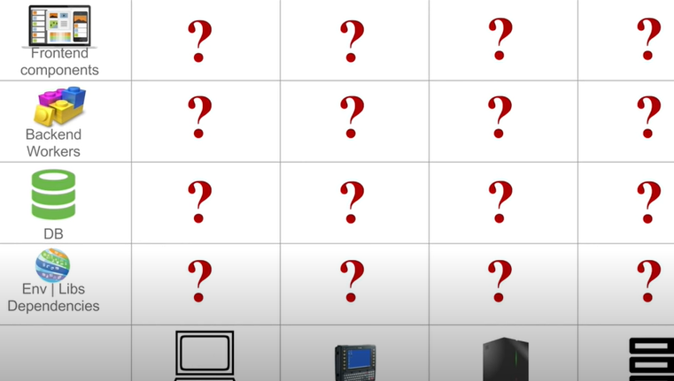
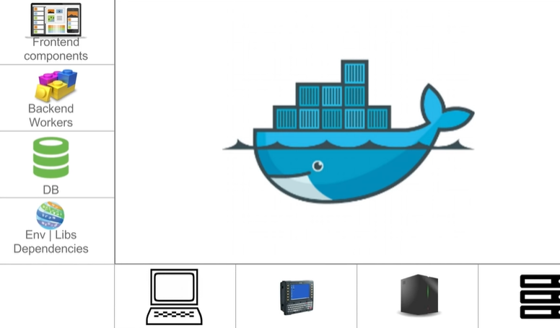
1 Docker Basics
https://www.youtube.com/watch?v=wi-MGFhrad0&list=PLhW3qG5bs-L99pQsZ74f-LC-tOEsBp2rK&index=1
Look the Matrix from the Hell again.
We use the standard way of container with Docker to solve it.

Slide 12
1 Docker Basics
https://www.youtube.com/watch?v=wi-MGFhrad0&list=PLhW3qG5bs-L99pQsZ74f-LC-tOEsBp2rK&index=1
What is Docker?
Docker is a tool designed to make it easier to deploy and run applications aby using containers.
Containers allow a developer to package up an application with all of the parts it needs, such as, libraries and other dependencies, and ship it all out as one package.

Slide 13
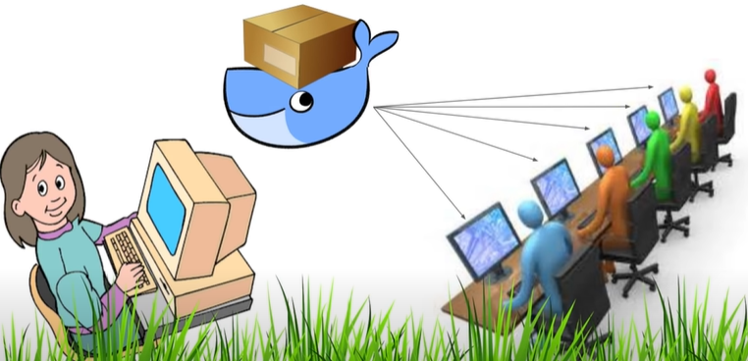

1 Docker Basics
https://www.youtube.com/watch?v=wi-MGFhrad0&list=PLhW3qG5bs-L99pQsZ74f-LC-tOEsBp2rK&index=1
What is Docker?
A developer packages all the software and components into a container and ship to the box called the container and docker will take care of shipping this container to all the platform in a standard way.
Docker container is the standard way to solve Matrix from the Hell.

Slide 14
End of Chapter

