Slide 1
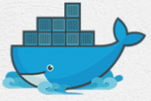
3 Docker Advantage
Peter H. Chen

Slide 2
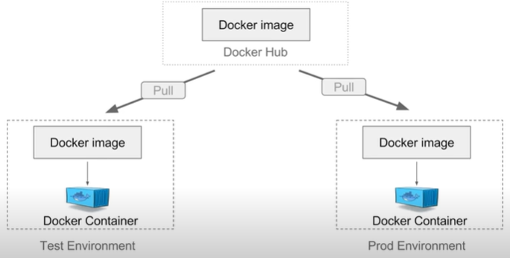
3 Docker Advantage
https://www.youtube.com/watch?v=YCrRy7pBzdc&list=PLhW3qG5bs-L99pQsZ74f-LC-tOEsBp2rK&index=3
Build App Only Once
An Application inside a container can run on any system that has Docker installed.
There is no need to build and configure app multiple times on different platforms.
We can create a Docker image and put on a Docker Hub or any repository.
Then, we can pull this image on any environment and run the image to create a Docker container. Our application will run inside this container.
We can do the same with any environment.

Slide 3
3 Docker Advantage
https://www.youtube.com/watch?v=YCrRy7pBzdc&list=PLhW3qG5bs-L99pQsZ74f-LC-tOEsBp2rK&index=3
Build App Only Once
With Docker, we test the our application inside a container and ship it inside a container.
The environment we test is identical the app will run in production.
These two environments are running the same Docker container.

Slide 4
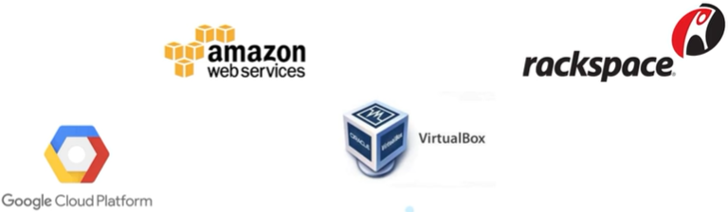
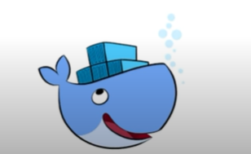
3 Docker Advantage
https://www.youtube.com/watch?v=YCrRy7pBzdc&list=PLhW3qG5bs-L99pQsZ74f-LC-tOEsBp2rK&index=3
Portaibility
The portability is a create feature with Docker. If we create a container with AWS EC2, we can pull this container to a Virtual Box and run. Docker containers can run on any platform.
It can run our local system, AWS EC2, Google Cloud Platform, Rackspace Server, VirtualBox, and etc.
A container running on AWS can easily be ported to VirtualBox.

Slide 5
3 Docker Advantage
https://www.youtube.com/watch?v=YCrRy7pBzdc&list=PLhW3qG5bs-L99pQsZ74f-LC-tOEsBp2rK&index=3
Version Control
Git: Docker has built-in version control system (same as s Git).
Git Repository: Docker containers is similar to Git repositories. We can commit changes to Docker images and version control them.

Slide 6
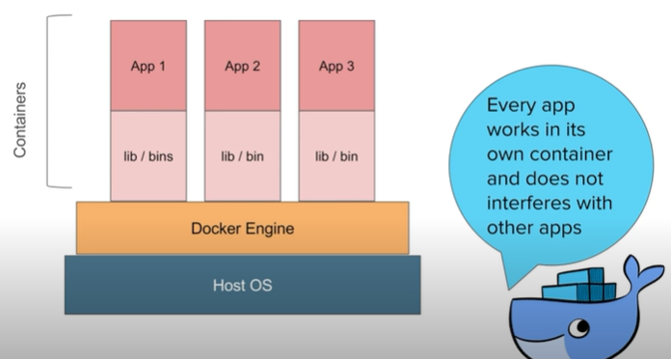
3 Docker Advantage
https://www.youtube.com/watch?v=YCrRy7pBzdc&list=PLhW3qG5bs-L99pQsZ74f-LC-tOEsBp2rK&index=3
Container Isolation
With Docker, every application works in isolation in its own container and does not interferes with other applications running on the same system.
Multiple containers can run on the same system without interference.
We can delete the container without affect other cotnainers in the system.

Slide 7
End of Chapter

