Slide 1
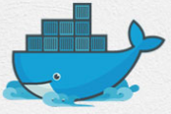
11 Jenkins On Docker
Peter H. Chen

Slide 2
11 Jenkins On Docker
https://www.youtube.com/watch?v=iN3he0eVUyw&list=PLhW3qG5bs-L99pQsZ74f-LC-tOEsBp2rK&index=11
Jenkins on Docker
How to start Jenkins on Docker Container?
Start and Stop Jenkins Container.
How to set Jenkins Home on Docker Volume and Host Machine?
Basic Command:
> docker pull jenkins
> docker run -p 8080:8080 -p 50000:50000 jenkins

Slide 3
11.1 Download Jenkins

Slide 4
11.1 Download Jenkins
https://www.youtube.com/watch?v=iN3he0eVUyw&list=PLhW3qG5bs-L99pQsZ74f-LC-tOEsBp2rK&index=11
Download Jenkins
> docker pull jenkins

Slide 5
11.2 Run Jenkins

Slide 6
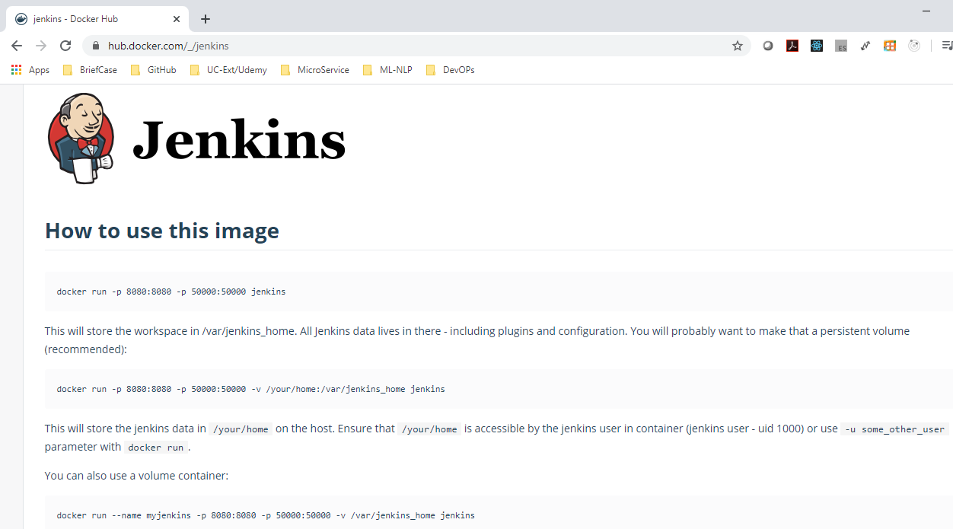
11.2 Run Jenkins
https://www.youtube.com/watch?v=iN3he0eVUyw&list=PLhW3qG5bs-L99pQsZ74f-LC-tOEsBp2rK&index=11
Run Jenkins
Go to hub.docker.com to find the command to run jenkins under docker.
> docker run -p 8080:8080 -p 50000:50000 jenkins
-p 8080:8080 is the port number on the host system, e.g., localhost uses 8080
-p 50000: 50000 jenkins is the port number of the Jenkins Server on docker, jenkins data transfer uses 50000.

Slide 7
End of Chapter

