Slide 1

7 Multiple Container
Peter H. Chen

Slide 2
7 Multiple Container
https://www.youtube.com/watch?v=HY3WDz6j_hU&list=PL6tu16kXT9PqdhOZk4MNVtQDJp6xFrotg&index=7
Multiple Container for Single Operation
We discuss the linking of multiple containers to perform a single operation.
This is very import because there will be a lot of situations where we will be using multiple containers all together to perform one single operation.
For example, we have an application server running in one container and have a database server running in another container, then we will be ending up working with different or multiple container to perform a single operation for opening a web site.
We are going to use the link of Dockers.

Slide 3
7.1 Linking Docker Containers

Slide 4
7.1 Linking Docker Containers
https://www.youtube.com/watch?v=HY3WDz6j_hU&list=PL6tu16kXT9PqdhOZk4MNVtQDJp6xFrotg&index=7
Linking Docker Containers with Links
Linking allow contains to discover each other and securely transfer information about one container to another container.
When you set up a link, you create a conduit (channel) between a source container and a receipt container.
The syntax is:
> docker run--name <app1-container> --llink <app1-container>:<app2-container>

Slide 5
7.2 Link WordPress and MySQL

Slide 6

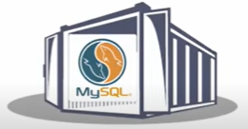
7.2 Link WordPress and MySQL
https://www.youtube.com/watch?v=HY3WDz6j_hU&list=PL6tu16kXT9PqdhOZk4MNVtQDJp6xFrotg&index=7
Link WordPress Container with MySQL Container
Linking allow contains to discover each other and securely transfer information about one container to another container.
We have frontend web site WordPress and backend database server MySQL.
We will download these two containers using Docker run command or Docker pull command to retrieve from Docker Hub to our local Docker (Docker tool or Hyper-V).

Slide 7
7.3 MySQL Image

Slide 8
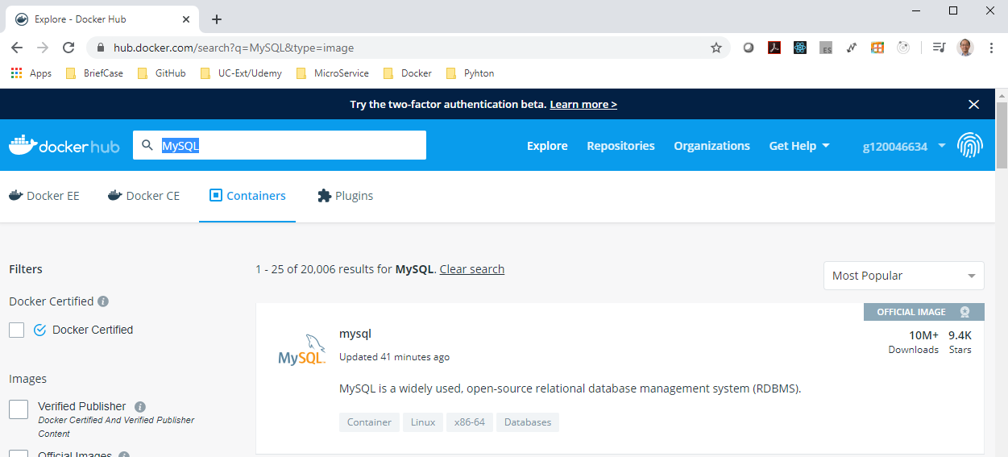
7.3 MySQL Image
https://www.youtube.com/watch?v=HY3WDz6j_hU&list=PL6tu16kXT9PqdhOZk4MNVtQDJp6xFrotg&index=7
Link WordPress Container with MySQL Container
Go to Docker Hub (hub.docker.com) and find the MySQL Container.
Double click to see more information inside “MySQL” image.

Slide 9
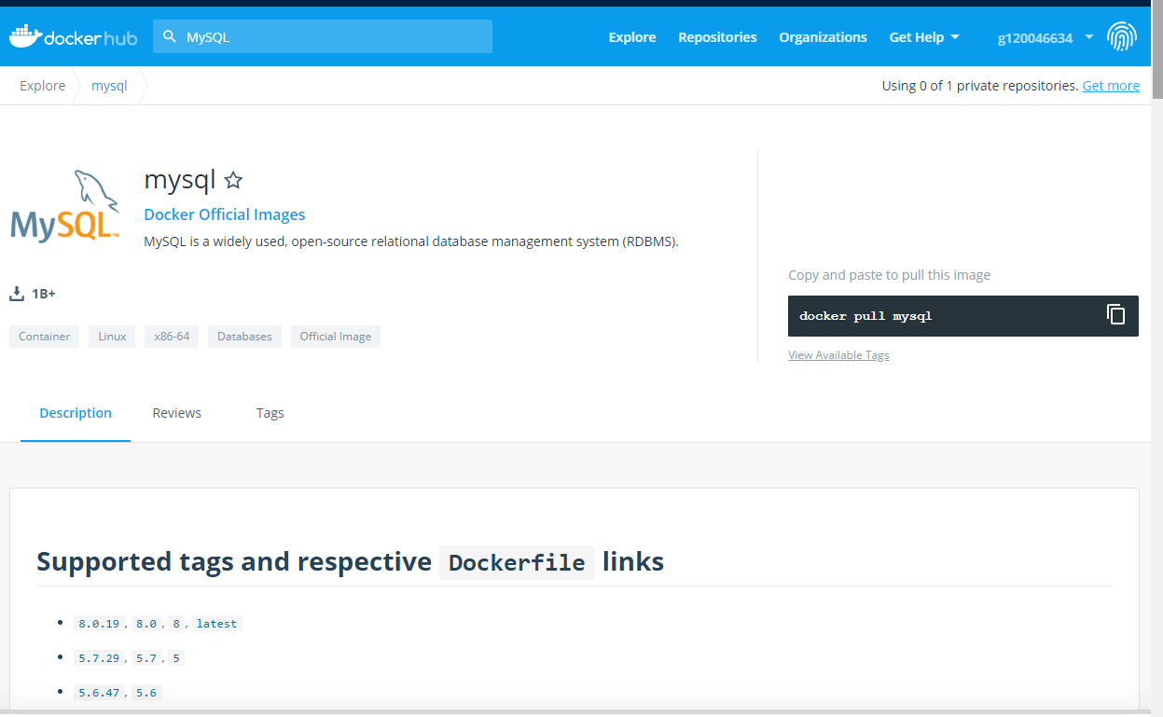
7.3 MySQL Image
https://www.youtube.com/watch?v=HY3WDz6j_hU&list=PL6tu16kXT9PqdhOZk4MNVtQDJp6xFrotg&index=7
The command to get MySQL is
> docker pull mysql
You can copy and paste into your Docker Terminal.

Slide 10
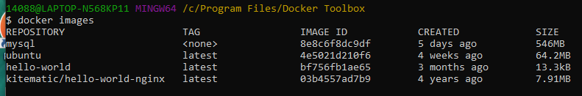
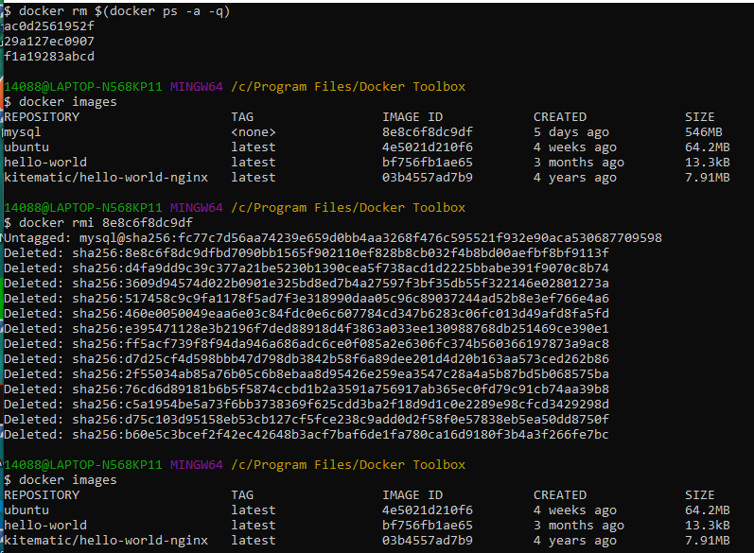
7.3 MySQL Image
https://www.youtube.com/watch?v=HY3WDz6j_hU&list=PL6tu16kXT9PqdhOZk4MNVtQDJp6xFrotg&index=7
How to remove the <none> Tag docker image?
https://jimhoskins.com/2013/07/27/remove-untagged-docker-images.html
Stop the running container in memory.
> docker rm $(docker ps -a -q)
Remove the images from Hard-drive
> docker rmi <image-id>

Slide 11
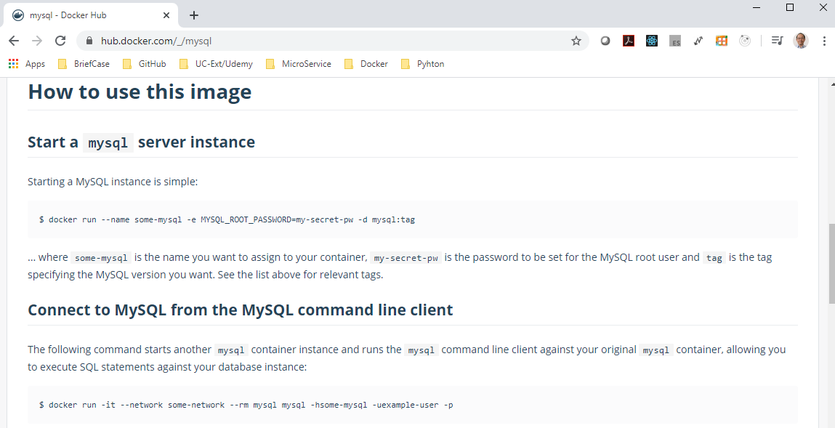
7.3 MySQL Image
https://www.youtube.com/watch?v=HY3WDz6j_hU&list=PL6tu16kXT9PqdhOZk4MNVtQDJp6xFrotg&index=7
The command to Link MySQL is
> docker run --name <app-container> -e MYSQL_ROO_PASSWORD=… -d mysql:tag
The tag is the version you download “latest” is the latest version of tag.

Slide 12
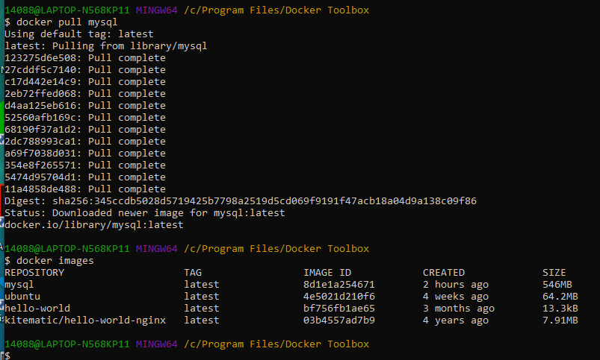
7.3 MySQL Image
https://www.youtube.com/watch?v=HY3WDz6j_hU&list=PL6tu16kXT9PqdhOZk4MNVtQDJp6xFrotg&index=7
The command to get MySQL is
> docker pull mysql
> docker images
You can copy and paste into your Docker Terminal from hub.docker.com.

Slide 13
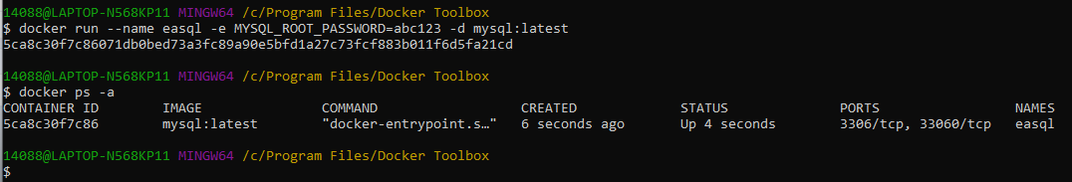
7.3 MySQL Image
https://www.youtube.com/watch?v=HY3WDz6j_hU&list=PL6tu16kXT9PqdhOZk4MNVtQDJp6xFrotg&index=7
The command to get MySQL is
> docker run --name eqsql -e MYSQL_ROOT_PASSWORD=abc123 -d mysql:lastest
> docker ps –a
NOTE:
Missing ROOT in MYSQL_PASSWORD causes status “Exited”
Must be exactly matched “MYSQL_ROOT_PASSWORD”

Slide 14
7.4 Get wordpress Image

Slide 15
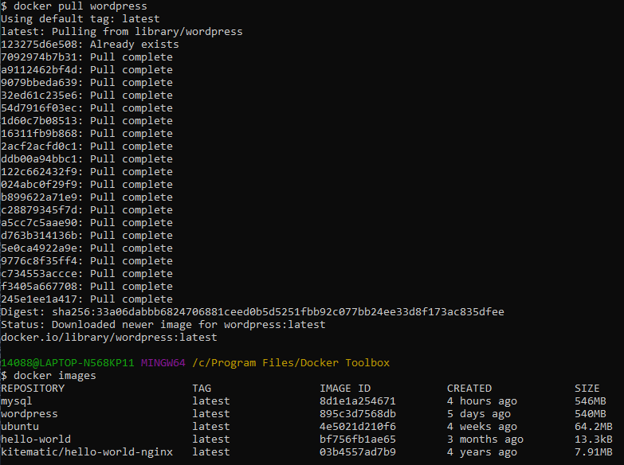
7.4 Get wordpress Image
https://www.youtube.com/watch?v=HY3WDz6j_hU&list=PL6tu16kXT9PqdhOZk4MNVtQDJp6xFrotg&index=7
Get wordpress Image
> docker pull wordpress
> docker images

Slide 16
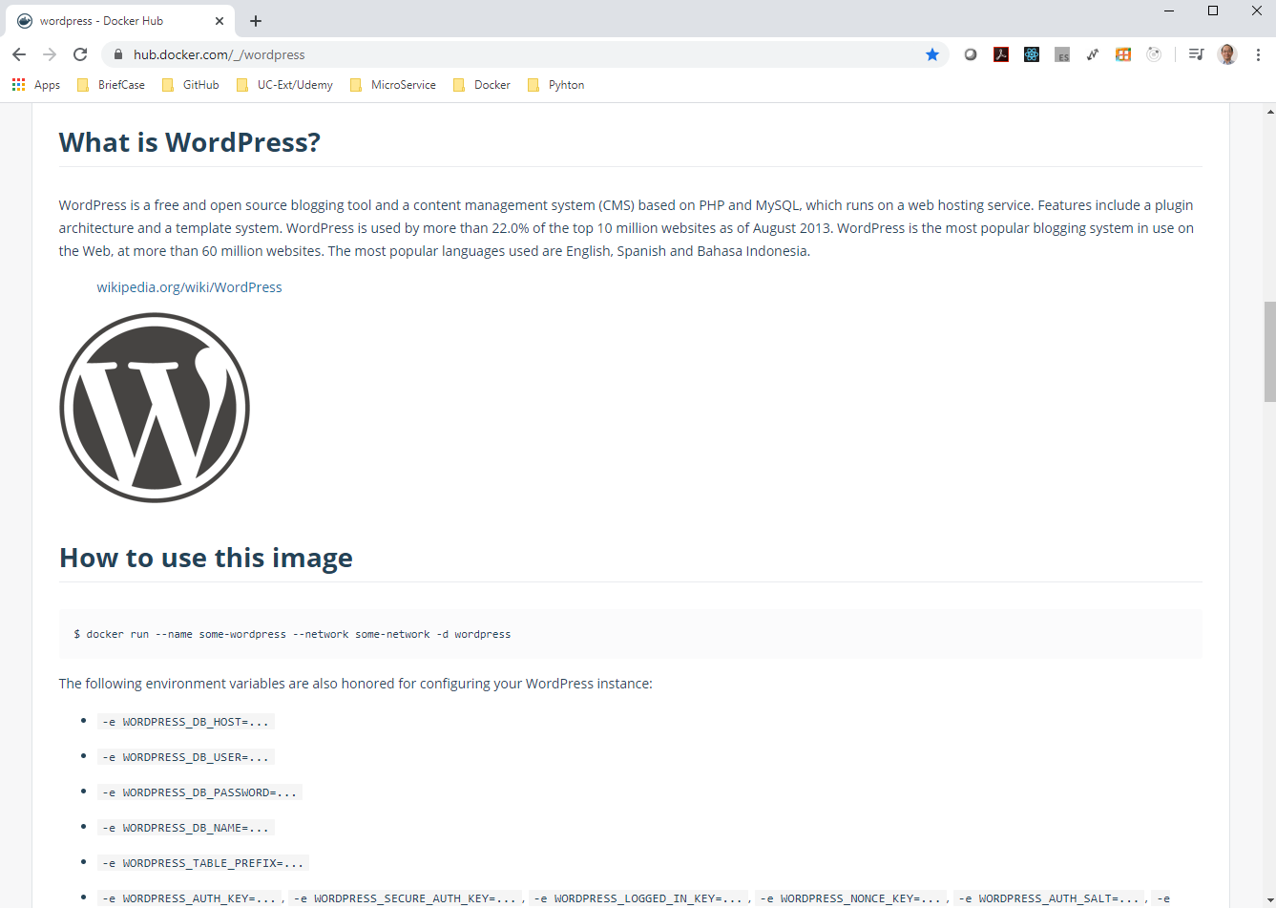
7.4 Get wordpress Image
https://www.youtube.com/watch?v=HY3WDz6j_hU&list=PL6tu16kXT9PqdhOZk4MNVtQDJp6xFrotg&index=7
Get wordpress Image
Go to hub.docker.com and search for “wordpress”
Command to run wordpress
> docker run --name some-wordpress --network some-network -d wordpress
> docker run --name some-wordpress -p 8080:80 -d wordpress
With Link Command:
> docker run --name some-wordpress --link some-mysql:mysql -d wordpress
> docker run --name some-wordpress --link some-mysql:mysql -p 8080:80 -d wordpress

Slide 17
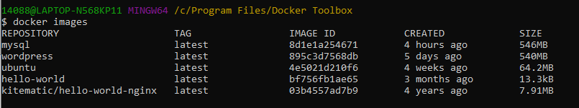
7.4 Get wordpress Image
https://www.youtube.com/watch?v=HY3WDz6j_hU&list=PL6tu16kXT9PqdhOZk4MNVtQDJp6xFrotg&index=7
We have both mysql and wordpress in local docker-machine.
We have mysql running with the names “easql”.
> docker ps -a

Slide 18
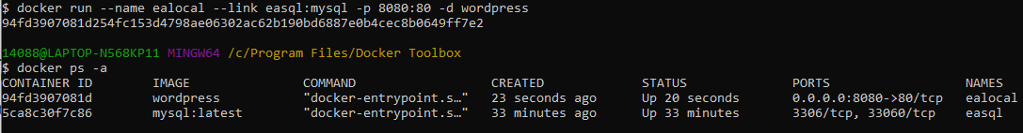
7.4 Get wordpress Image
https://www.youtube.com/watch?v=HY3WDz6j_hU&list=PL6tu16kXT9PqdhOZk4MNVtQDJp6xFrotg&index=7
Now, We need to run both wordpress and mysql with link.
> docker run --name some-wordpress --link some-mysql:mysql -p 8080:80 -d wordpress
Our wordpress and mysql command:
> docker run --name ealocal --link easql:mysql -p 8080:80 -d wordpress
> docker ps –a
We can see the wordpress run at port “0.0.0.0:8080->90/tcp”

Slide 19
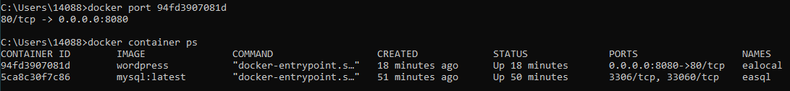
7.4 Get wordpress Image
https://www.youtube.com/watch?v=HY3WDz6j_hU&list=PL6tu16kXT9PqdhOZk4MNVtQDJp6xFrotg&index=7
Verify the port.
> docker port <worpress-id>
>> 80/tcp -> 0.0.0.0:8080
> docker container ps
>> 0.0.0.0:8080 -> 80/tcp

Slide 20
7.4 Get wordpress Image
https://www.youtube.com/watch?v=HY3WDz6j_hU&list=PL6tu16kXT9PqdhOZk4MNVtQDJp6xFrotg&index=7
How to access port 8080?
Open browser
Enter > localhost:8080
https://stackoverflow.com/questions/42866013/docker-toolbox-localhost-not-working
Note:
Docker Toolbox for Home Edition doesn't get as many conveniences as Docker for Windows for Professional/Enterprise Edition.
In Docker Toolbox, nothing will be localhost, and will be 192.168.99.100 by default, since it's running a Linux VM in VirtualBox.
So if you run docker run -p 80:80 nginx (notice I had to publish a port for 192.168.99.100 to listen on that port)
Then going to http://192.168.99.100 should work.

Slide 21
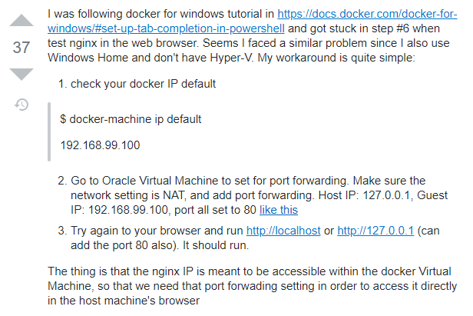
7.4 Get wordpress Image
https://www.youtube.com/watch?v=HY3WDz6j_hU&list=PL6tu16kXT9PqdhOZk4MNVtQDJp6xFrotg&index=7
How to access port 8080 for Docker Toolbox?
Note: Docker for Windows Does not have this problem
https://stackoverflow.com/questions/42866013/docker-toolbox-localhost-not-working

Slide 22
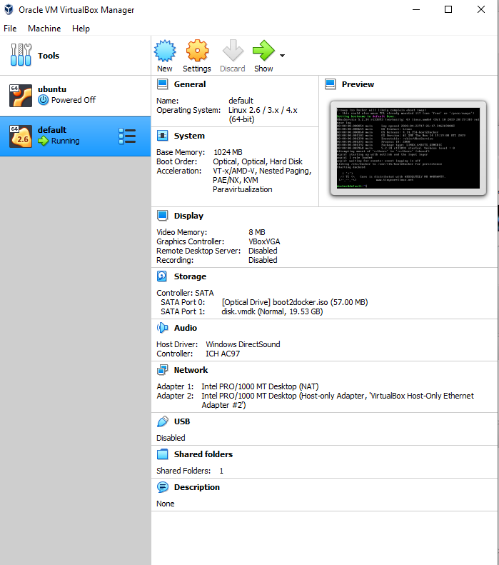
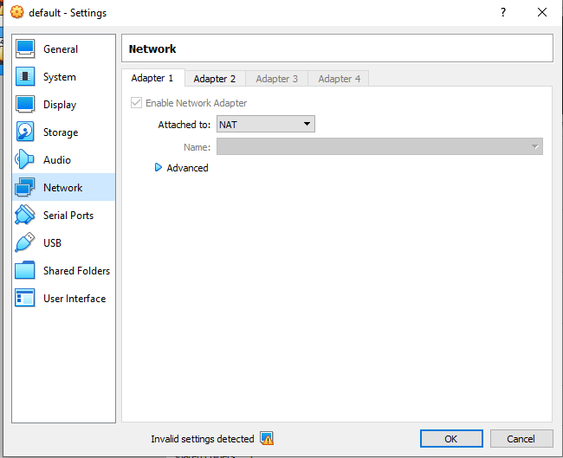

7.4 Get wordpress Image
https://www.youtube.com/watch?v=HY3WDz6j_hU&list=PL6tu16kXT9PqdhOZk4MNVtQDJp6xFrotg&index=7
How to access port 8080 for Docker Toolbox?
https://stackoverflow.com/questions/42866013/docker-toolbox-localhost-not-working
Click “Network” > Click “Advanced”

Slide 23
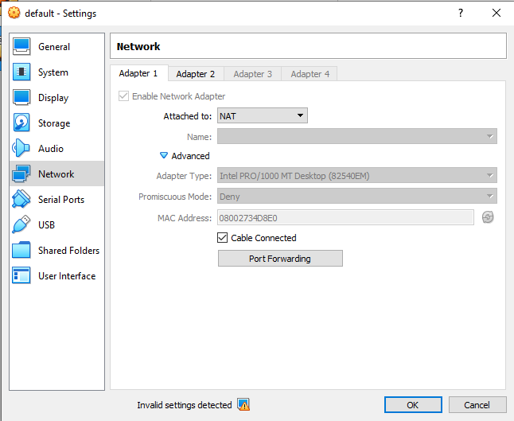
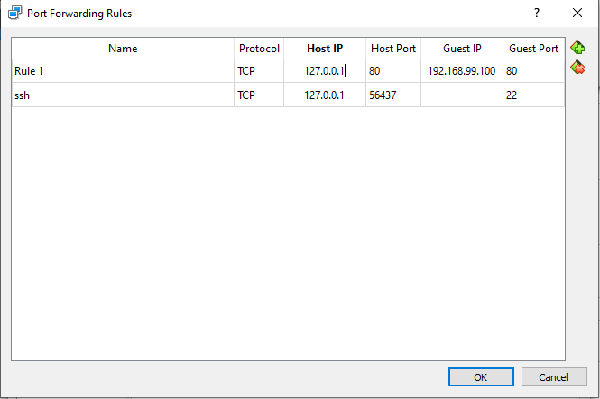
7.4 Get wordpress Image
https://www.youtube.com/watch?v=HY3WDz6j_hU&list=PL6tu16kXT9PqdhOZk4MNVtQDJp6xFrotg&index=7
How to access port 8080 for Docker Toolbox?
https://stackoverflow.com/questions/42866013/docker-toolbox-localhost-not-working
Port Forwaeding > Add Rule > Protocol: TCP, Host IP: 192.168.99.100, Host Port: 80, Guest Port:80

Slide 24
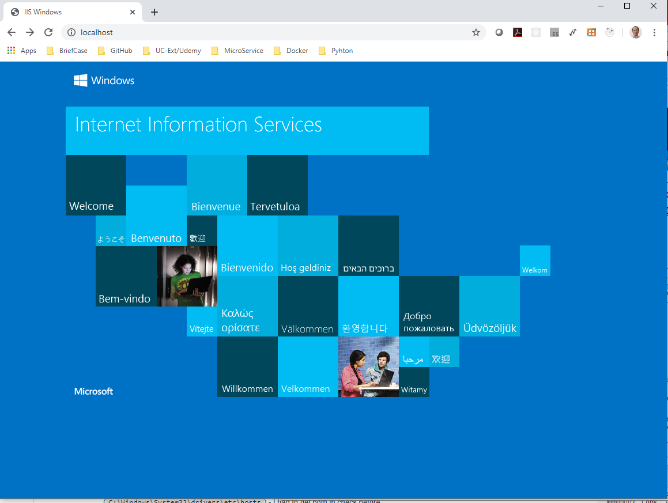
7.4 Get wordpress Image
https://www.youtube.com/watch?v=HY3WDz6j_hU&list=PL6tu16kXT9PqdhOZk4MNVtQDJp6xFrotg&index=7
How to access port 8080 for Docker Toolbox?
https://stackoverflow.com/questions/42866013/docker-toolbox-localhost-not-working
Open Chrome
> http://localhost or localhost
> http://127.0.0.1

Slide 25
End of Chapter

