Slide 1
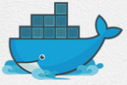
11 Jenkins On Docker
Peter H. Chen

Slide 2
11 Jenkins On Docker
https://www.youtube.com/watch?v=iN3he0eVUyw&list=PLhW3qG5bs-L99pQsZ74f-LC-tOEsBp2rK&index=11
Jenkins on Docker
1. How to start Jenkins on Docker Container?
2. Start and Stop Jenkins Container.
3. How to set Jenkins Home on Docker Volume and Host Machine?
Basic Command:
> docker pull jenkins
> docker run -p 8080:8080 -p 50000:50000 jenkins

Slide 3
11.1 Download Jenkins

Slide 4
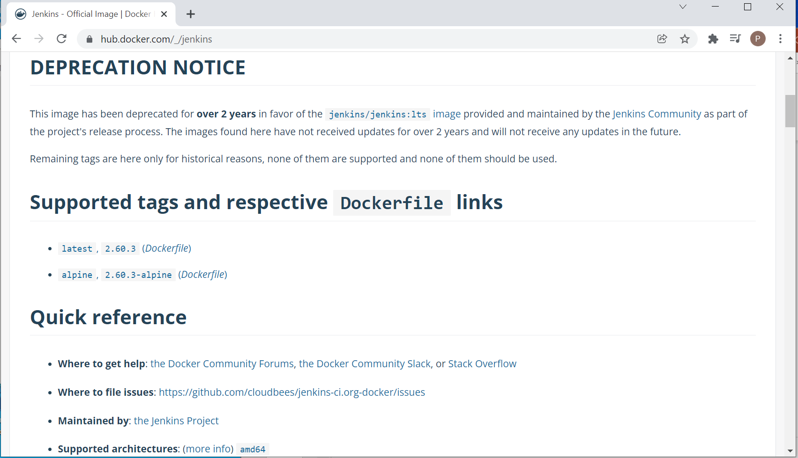
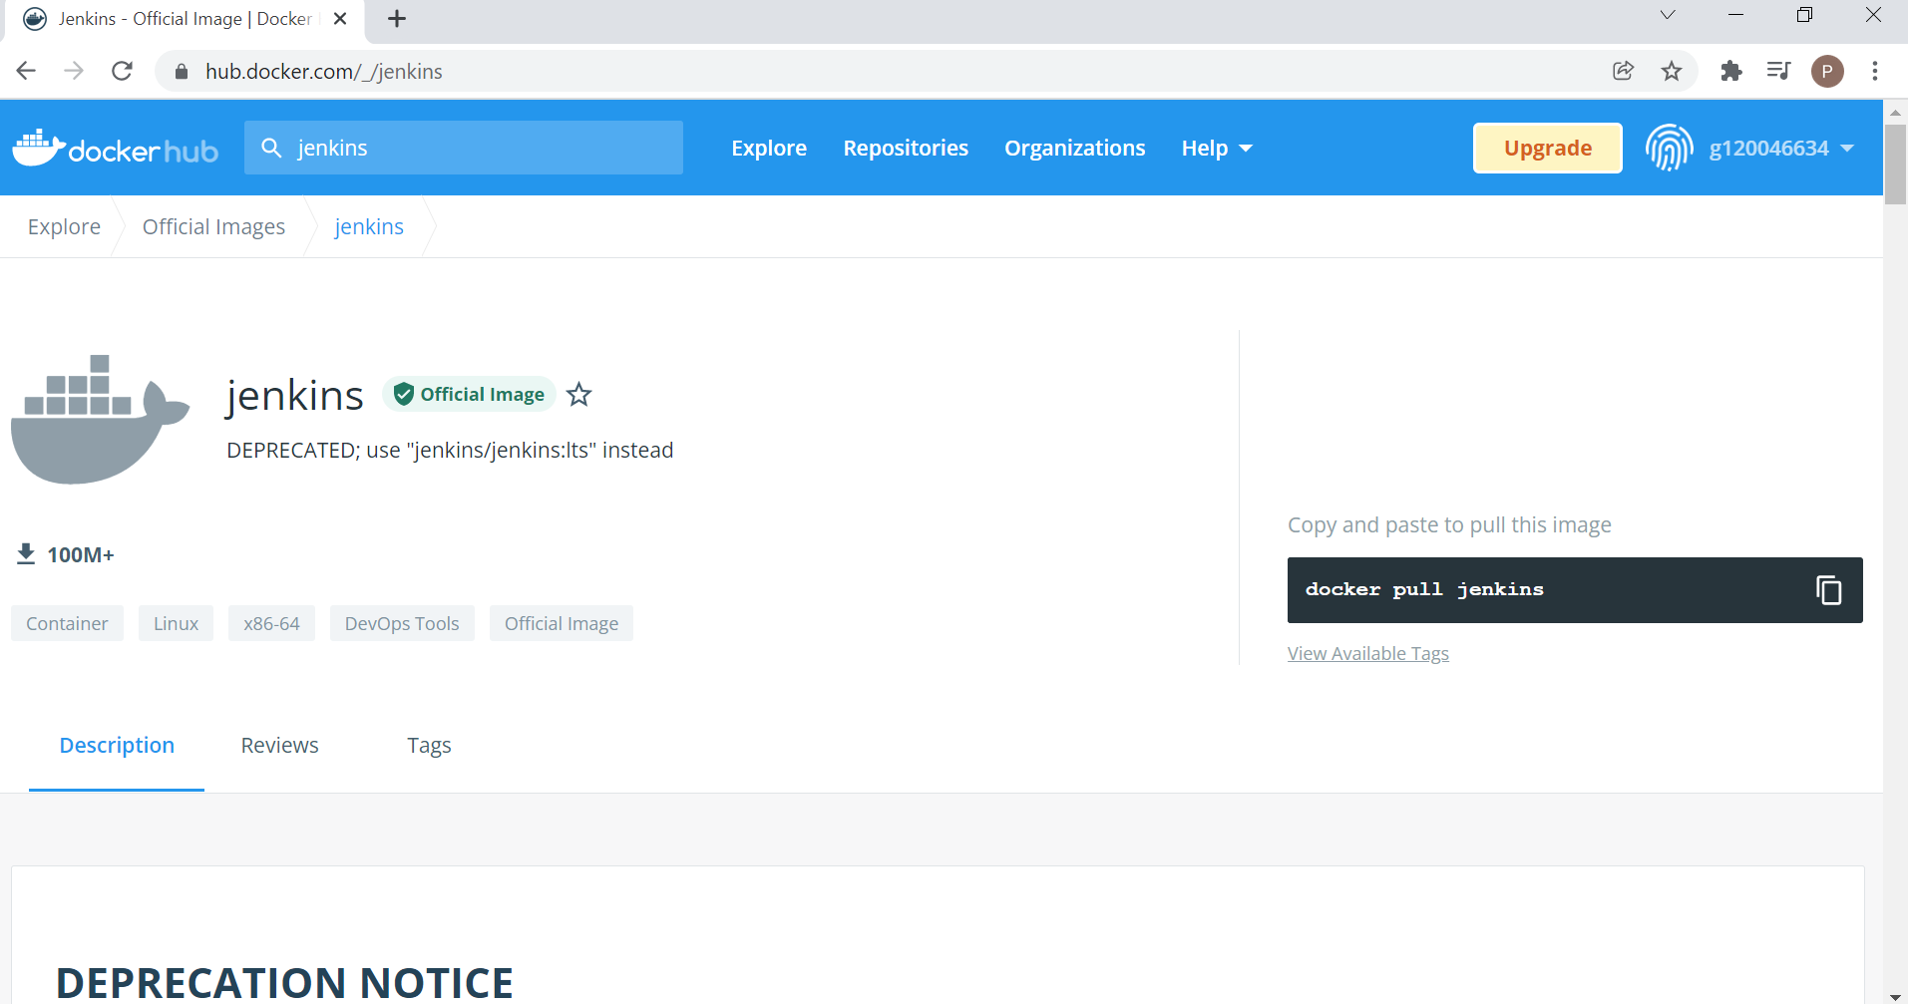
11.1 Download Jenkins
https://www.youtube.com/watch?v=iN3he0eVUyw&list=PLhW3qG5bs-L99pQsZ74f-LC-tOEsBp2rK&index=11
Download Jenkins
> sudo -i
> [sudo] password for pchen: xxxxxx
> docker pull jenkins
>> Got error. Cannot find manifest.
Search “docker hub” and find the version is “2.60.3”

Slide 5
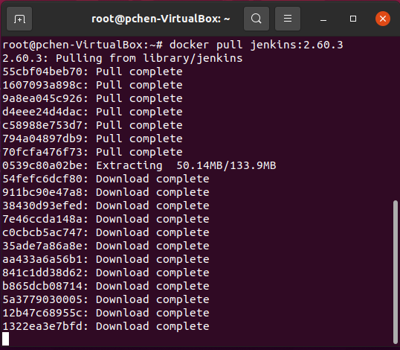
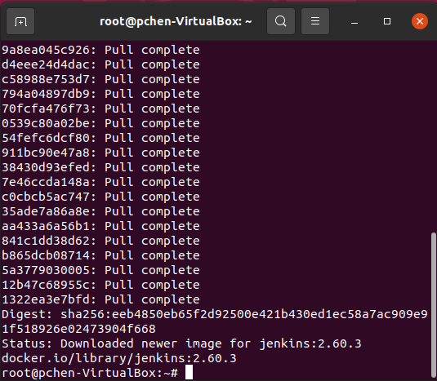
11.1 Download Jenkins
https://www.youtube.com/watch?v=iN3he0eVUyw&list=PLhW3qG5bs-L99pQsZ74f-LC-tOEsBp2rK&index=11
Download Jenkins
> docker pull Jenkins:2.60.3

Slide 6
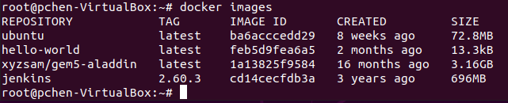
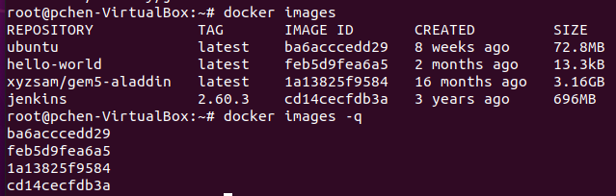
11.1 Download Jenkins
https://www.youtube.com/watch?v=iN3he0eVUyw&list=PLhW3qG5bs-L99pQsZ74f-LC-tOEsBp2rK&index=11
Download Jenkins
> docker images
We can see the “jenkins” image is created on our system and we have image ID.
> docker images -q
We can also use “docker images -q” to get the image ID.

Slide 7
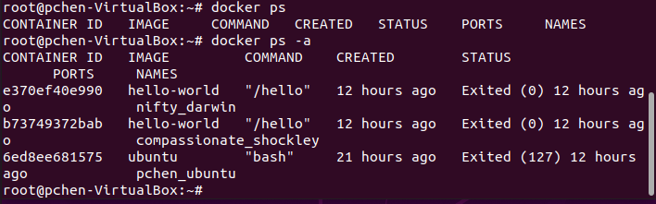
11.1 Download Jenkins
https://www.youtube.com/watch?v=iN3he0eVUyw&list=PLhW3qG5bs-L99pQsZ74f-LC-tOEsBp2rK&index=11
Download Jenkins
Now, we use
> docker ps
> docker ps -a
To list all the containers.

Slide 8
11.2 Run Jenkins

Slide 9
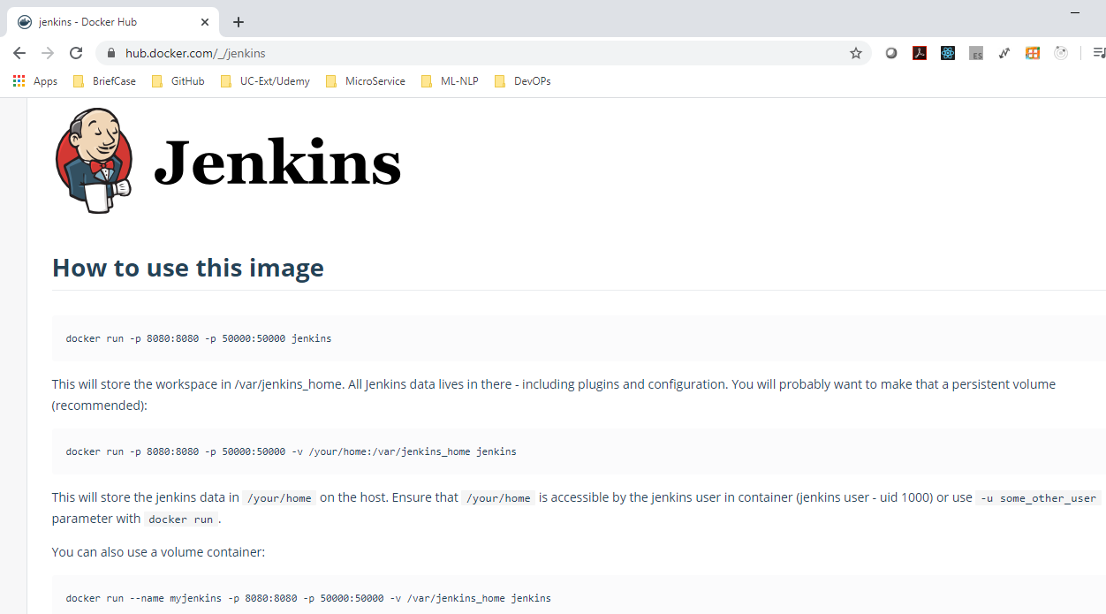
11.2 Run Jenkins
https://www.youtube.com/watch?v=iN3he0eVUyw&list=PLhW3qG5bs-L99pQsZ74f-LC-tOEsBp2rK&index=11
Run Jenkins
Go to hub.docker.com to find the command to run jenkins under docker.
> docker run -p 8080:8080 -p 50000:50000 jenkins:2.60.3
-p 8080:8080: The first port number is on the host system which corresponds to second number 8080 of docker server.
-p 50000: 50000: We are exporting port 50000 for Jenkins API for host and jenkins server.

Slide 10
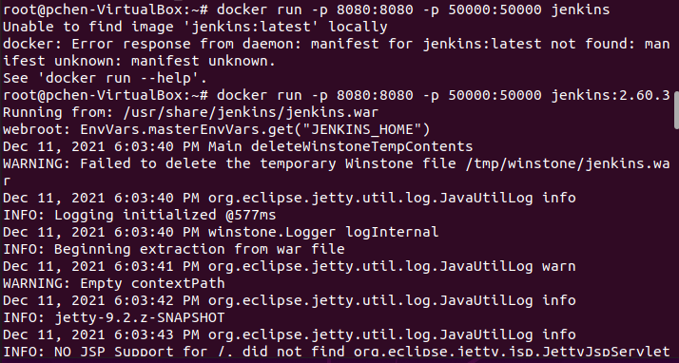
11.2 Run Jenkins
https://www.youtube.com/watch?v=iN3he0eVUyw&list=PLhW3qG5bs-L99pQsZ74f-LC-tOEsBp2rK&index=11
Run Jenkins
> docker run -p 8080:8080 -p 50000:50000 jenkins:2.60.3
Since our system does not have “jenkins:latest “, we use “jenkins:2.60.3” instead.

Slide 11
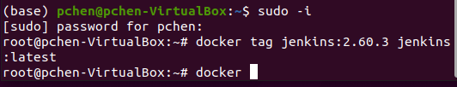
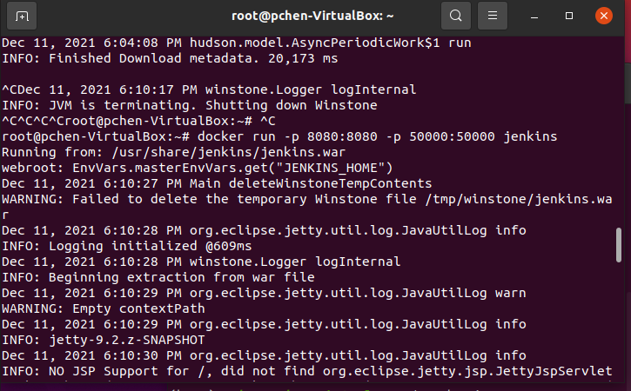
11.2 Run Jenkins
https://www.youtube.com/watch?v=iN3he0eVUyw&list=PLhW3qG5bs-L99pQsZ74f-LC-tOEsBp2rK&index=11
Run Jenkins
We also can change the image name by “tag jenkins:2.60.3 jenkins:latest” to fix this problem.
Open a new terminal (control-ALTY t).
> sudo -i
> docker tag jenkins:2.60.3 jenkins:latest
In another terminal
> ^C to stop previous jenkins
> docker run -p 8080:8080 -p 50000:50000 jenkins

Slide 12
11.3 Run Jenkins with Local Workspace

Slide 13
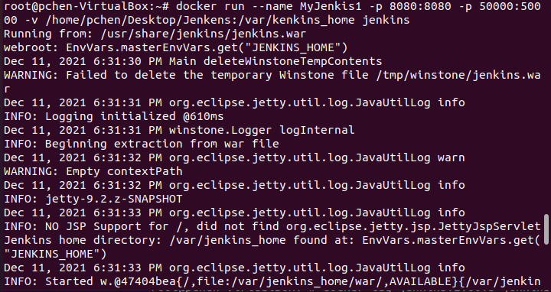
11.3 Run Jenkins with Local Workspace
https://www.youtube.com/watch?v=iN3he0eVUyw&list=PLhW3qG5bs-L99pQsZ74f-LC-tOEsBp2rK&index=11
Run Jenkins with Local Workspace
If you want to store data in your local workspace instead of default Jenkins_home.
> docker run --name MyJenkis1 -p 8080:8080 -p 50000:50000 -v /home/pchen/Desktop/Jenkins:/var/jenkins_home jenkins

Slide 14
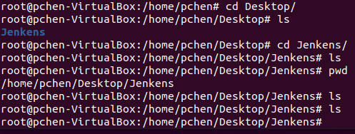
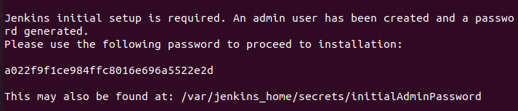
11.3 Run Jenkins with Local Workspace
https://www.youtube.com/watch?v=iN3he0eVUyw&list=PLhW3qG5bs-L99pQsZ74f-LC-tOEsBp2rK&index=11
Run Jenkins with Local Workspace
Jenkins creates a folder /home/pchen/Desktop/Jenkins
Jenkins creates a password for you.
You will need to use this password to browse the data.

Slide 15
11.4 Remove/Restart MyJenkens1

Slide 16
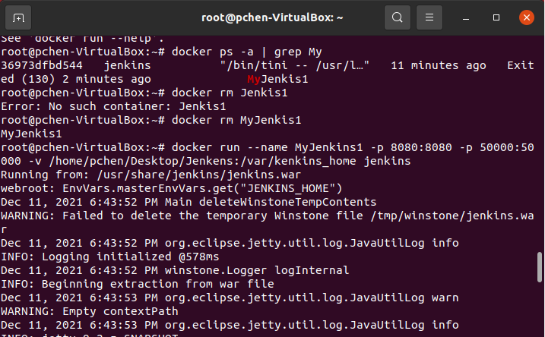
11.4 Remove/Restart MyJenkens1
https://www.youtube.com/watch?v=iN3he0eVUyw&list=PLhW3qG5bs-L99pQsZ74f-LC-tOEsBp2rK&index=11
Remove/Restart MyJenks1
> docker rm MyJenkis1 (we have mis-spelled name)
> docker run --name MyJenkins1 -p 8080:8080 -p 50000:50000 -v /home/pchen/Desktop/Jenkins:/var/jenkins_home jenkins

Slide 17
11.5 Open Server with Browser

Slide 18
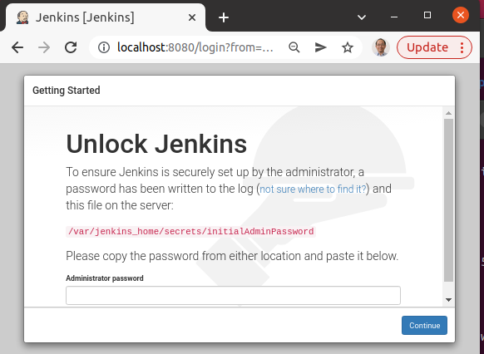
11.5 Open Server with Browser
https://www.youtube.com/watch?v=iN3he0eVUyw&list=PLhW3qG5bs-L99pQsZ74f-LC-tOEsBp2rK&index=11
Open Server with Browser
> docker run --name MyJenkins1 -p 8080:8080 -p 50000:50000 -v /home/pchen/Desktop/Jenkins:/var/jenkins_home jenkins
Open Chrome
> localhost:8080

Slide 19
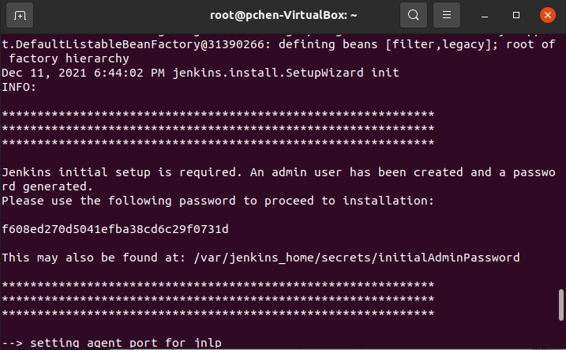
11.5 Open Server with Browser
https://www.youtube.com/watch?v=iN3he0eVUyw&list=PLhW3qG5bs-L99pQsZ74f-LC-tOEsBp2rK&index=11
Open Server with Browser
When you start the MyJenkens1 server, the terminal gives you the Password to unlock the Jenkin server.
Copy the password

Slide 20
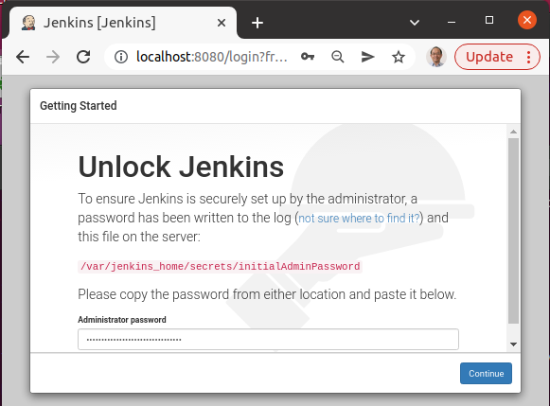
11.5 Open Server with Browser
https://www.youtube.com/watch?v=iN3he0eVUyw&list=PLhW3qG5bs-L99pQsZ74f-LC-tOEsBp2rK&index=11
Open Server with Browser
Paste the password

Slide 21
11.5 Open Server with Browser
https://www.youtube.com/watch?v=iN3he0eVUyw&list=PLhW3qG5bs-L99pQsZ74f-LC-tOEsBp2rK&index=11
Open Server with Browser
Paste the password

Slide 22
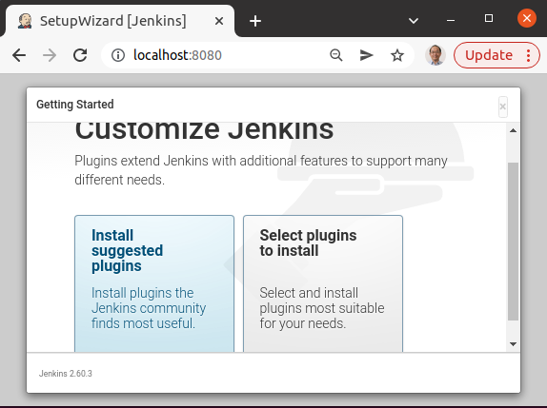
11.5 Open Server with Browser
https://www.youtube.com/watch?v=iN3he0eVUyw&list=PLhW3qG5bs-L99pQsZ74f-LC-tOEsBp2rK&index=11
Open Server with Browser
Browse the data in Jenkins server.

Slide 23
End of Chapter

