Slide 1
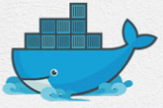
1 Introduction to Docker
Peter H. Chen

Slide 2
1 Introduction to Docker
https://www.youtube.com/watch?v=7ra_tB2q0O0&list=PL6tu16kXT9PrTeP07thlsrF8Sf9zHXmh5
What is Docker?
In a nutshell (simple word, in a small nut shell), it is a software containerization platform.
It provides abstraction of operating system level virtualization.
In High Level
These containers contains all the basic layers of user space
A real operating system
Software that you build
Dependencies to run the software, like pre-requisite software
Environment variables, and
Any thing you can name it are included in the containers

Slide 3
1 Introduction to Docker
https://www.youtube.com/watch?v=7ra_tB2q0O0&list=PL6tu16kXT9PrTeP07thlsrF8Sf9zHXmh5
So, these containers are Virtual Machine image? No. They do not have Guest OS
App 1
App 2
App 3
Bons/Libs
Bons/Libs
Bons/Libs
Guest OS
Guest OS
Guest OS
App 1
App 2
App 3
Bons/Libs
Bons/Libs
Bons/Libs
Hypervisor
Docker Engine
Host Operating System
Operating System
Hardware, Infrastructure, cloud
Hardware, Infrastructure, cloud
Virtual Machines
Containers
Virtual machine include the application, the necessary binaries and libraries, and an entire guest operating system, all of which can be tens of GBs
Containers include the application, all of its dependencies, the share the kernel with other containers, running as isolated processes in user space on the host operating system.
Docker containers are not tied to any infrastructures. They run on any processors, computers, or any clouds.

Slide 4
1 Introduction to Docker
https://www.youtube.com/watch?v=7ra_tB2q0O0&list=PL6tu16kXT9PrTeP07thlsrF8Sf9zHXmh5
Windows Server 2016 Containers
A Windows Server container shares a kernel with the container host and all containers running on the host.
A Windows Server container shares a kernel.
So the kernels of the operating system which are running the windows server 2016 is being shared by the containers host in all the containers running on the host.
If you have like 10 or 15 containers running on your docker, then those containers are going to share the same kernel as of the host operating system which is the Windows Server 2016.
The Docker Daemon for Windows Server does not run Linux images! No virtualization is involved. The Windows Server Containers reuse the host kernel and create a sandbox environment for the process, exactly like it does not Linux.

Slide 5
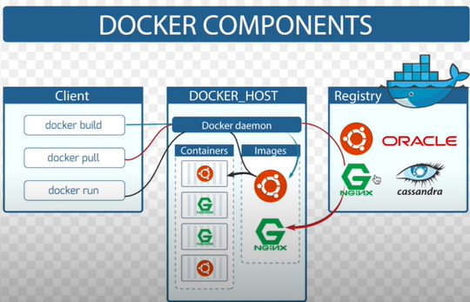
1 Introduction to Docker
https://www.youtube.com/watch?v=7ra_tB2q0O0&list=PL6tu16kXT9PrTeP07thlsrF8Sf9zHXmh5
Docker Components
Registry is Docker Hub.

Slide 6
End of Chapter

