Slide 1
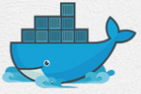
2 Container
Peter H. Chen

Slide 2
2 Container
https://www.youtube.com/watch?v=NYfKsgDv_yA&list=PL6tu16kXT9PqdhOZk4MNVtQDJp6xFrotg&index=2
What is containers?
Constrainers are an isolated, resource controlled, and portable operating environment.
Basically, a container is an isolated place where an application can run without affecting the rest of the system and without the system affecting the application. Container are the next evolution in virtualization.
If you were inside a container, it would look very much like you were inside a freshy installed computer or virtual machine. But actually, it is just container which actually had shared the same kernel but they just have different user space. They is why you feel like you are setting inside a freshly installed physical computer.

Slide 3
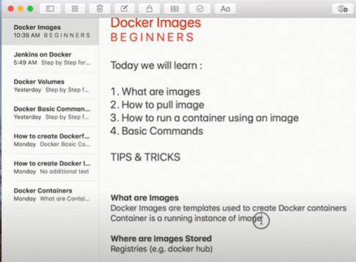
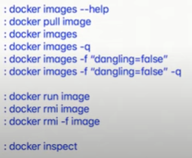
2 Container
https://www.youtube.com/watch?v=NYfKsgDv_yA&list=PL6tu16kXT9PqdhOZk4MNVtQDJp6xFrotg&index=2
What are Images?
https://www.youtube.com/watch?v=QBOcKdh-fwQ&list=PLhW3qG5bs-L99pQsZ74f-LC-tOEsBp2rK&index=9
Docker images are templates used to create Docker containers.
Container is a running instance od image.
Where are Images Stored?
Registries , e.g., Docker Hub

Slide 4
2 Container
https://www.youtube.com/watch?v=NYfKsgDv_yA&list=PL6tu16kXT9PqdhOZk4MNVtQDJp6xFrotg&index=2
Where can I see these containers?
All the different containers are sitting in: https://hub.docker.com/explore/

Slide 5
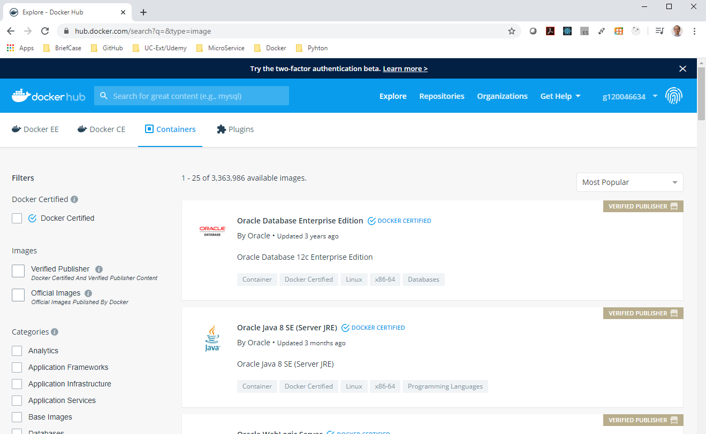
2 Container
https://www.youtube.com/watch?v=NYfKsgDv_yA&list=PL6tu16kXT9PqdhOZk4MNVtQDJp6xFrotg&index=2
Build, Ship, Run
Go to: https://hub.docker.com
You can create your ID and password.
My ID: g120046634
Click explorer
You can see MongoDB etc.

Slide 6
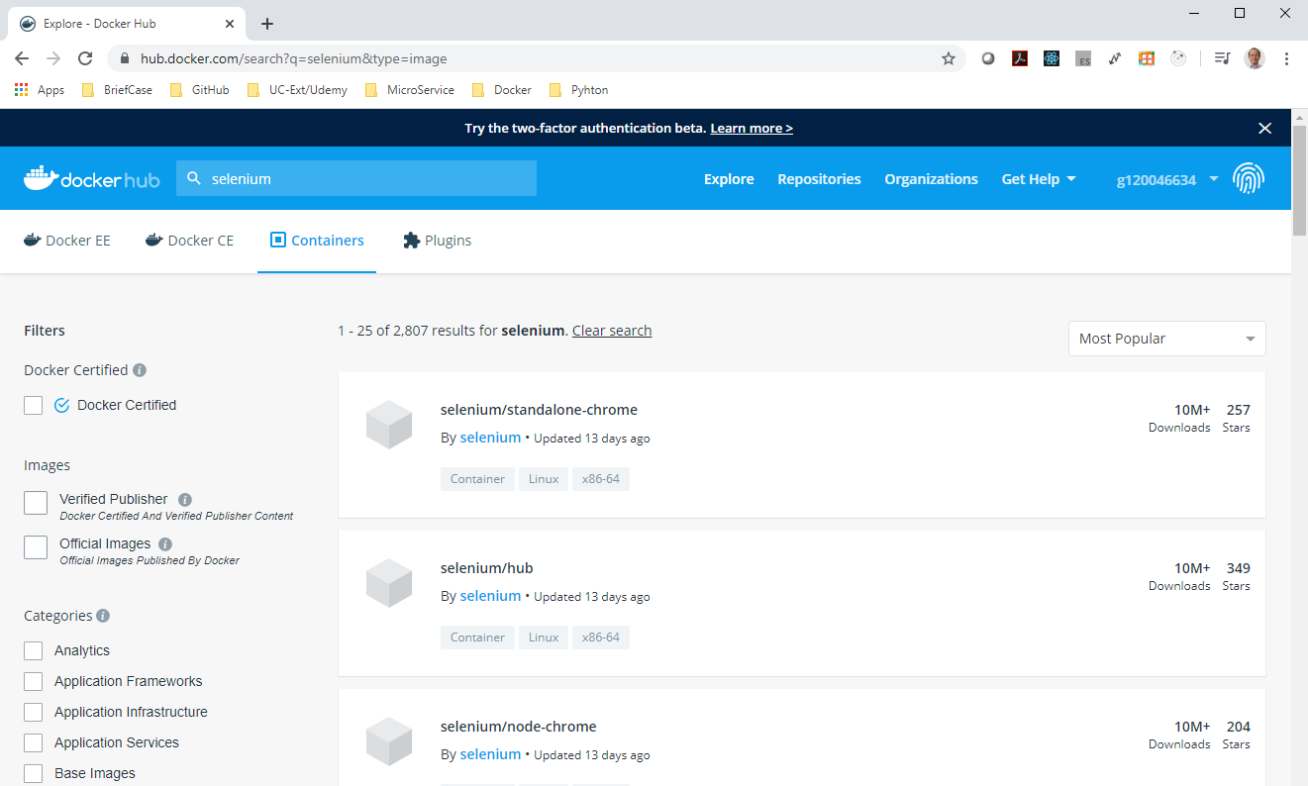
2 Container
https://www.youtube.com/watch?v=NYfKsgDv_yA&list=PL6tu16kXT9PqdhOZk4MNVtQDJp6xFrotg&index=2
Build, Ship, Run
Search for “selenium”
There are lots of containers in docker.com.

Slide 7
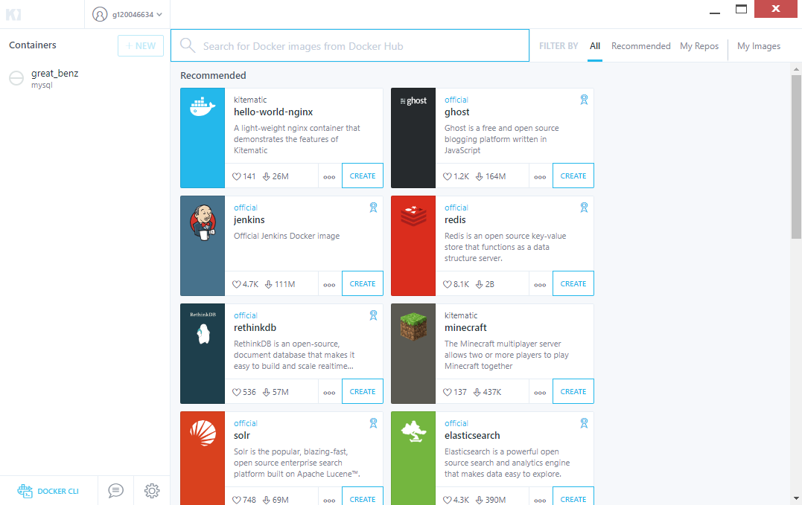

2 Container
https://www.youtube.com/watch?v=NYfKsgDv_yA&list=PL6tu16kXT9PqdhOZk4MNVtQDJp6xFrotg&index=2
Is there any other way to browser containers?
Yes, you can use “Kitematic”.
Uesr ID: g120046634

Slide 8
2 Container
https://www.youtube.com/watch?v=NYfKsgDv_yA&list=PL6tu16kXT9PqdhOZk4MNVtQDJp6xFrotg&index=2
What these container has?
Containers contain everything you require for your software to run like.
Operatizing System
Software that you build
Dependencies to run the software, like pre-requisite software
Environment variable
And you name it

Slide 9
2 Container
https://www.youtube.com/watch?v=NYfKsgDv_yA&list=PL6tu16kXT9PqdhOZk4MNVtQDJp6xFrotg&index=2
What if I change something in my software and dependencies?
https://docs.docker.com
Versioning
Docker includes git-like capabilities for tracking successive versions of a container, inspecting the diff between versions, committing new versions, rolling back, etc.
The history also includes how a container was assembled and by whom, son you get full traceability from the production server all the way back to the upstream developer.
Docker also implements incremental uploads and downloads, similar to git pull, so new versions of a container can be transferred by only sending diffs.

Slide 10
2 Container
https://www.youtube.com/watch?v=NYfKsgDv_yA&list=PL6tu16kXT9PqdhOZk4MNVtQDJp6xFrotg&index=2
Component re-use
Any Container can be used as a “base image” to create more specialized components.
This can be done manually or as part of an automated build. For example, you can prepare the ideal python environment, and use it as a base for 10 different applications.
Your ideal Postgresql setup can be re-used for all your future projects, and so on.

Slide 11
2 Container
https://www.youtube.com/watch?v=NYfKsgDv_yA&list=PL6tu16kXT9PqdhOZk4MNVtQDJp6xFrotg&index=2
This containers only has Linux OS?
No.
Starting Window Server 2016, there is Window Server containers, which provide greater levels of flexibilities, using this, we can integrate with existing windows technology, such as, .NET, ASP.NET, PowerShell, and more.

Slide 12
End of Chapter

