Slide 1

9 Docker Images
Peter H. Chen

Slide 2
9 Docker Images
https://www.youtube.com/watch?v=QBOcKdh-fwQ&list=PLhW3qG5bs-L99pQsZ74f-LC-tOEsBp2rK&index=9
Docker Images
What are images?
How to pull image?
Ho to run a container using an image?
Basic Command

Slide 3
9.1 Docker Pull Image Command

Slide 4

9.1 Docker Command to Pull Image
https://www.youtube.com/watch?v=QBOcKdh-fwQ&list=PLhW3qG5bs-L99pQsZ74f-LC-tOEsBp2rK&index=9
Check docker version
> docker -v

Slide 5
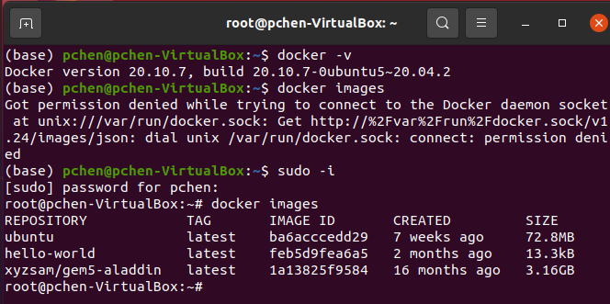
9.1 Docker Command to Pull Image
https://www.youtube.com/watch?v=QBOcKdh-fwQ&list=PLhW3qG5bs-L99pQsZ74f-LC-tOEsBp2rK&index=9
Display images
Change to super user
> sudo –I
Display the images on your system
> docker images
This command will list out all the images on your system.

Slide 6
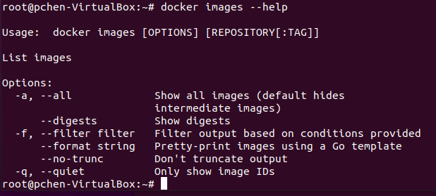
9.1 Docker Command to Pull Image
https://www.youtube.com/watch?v=QBOcKdh-fwQ&list=PLhW3qG5bs-L99pQsZ74f-LC-tOEsBp2rK&index=9
Display images
> docker images --help
This command gives the usage of the docker images command.
We can use options “-a”, -f, and etc.

Slide 7
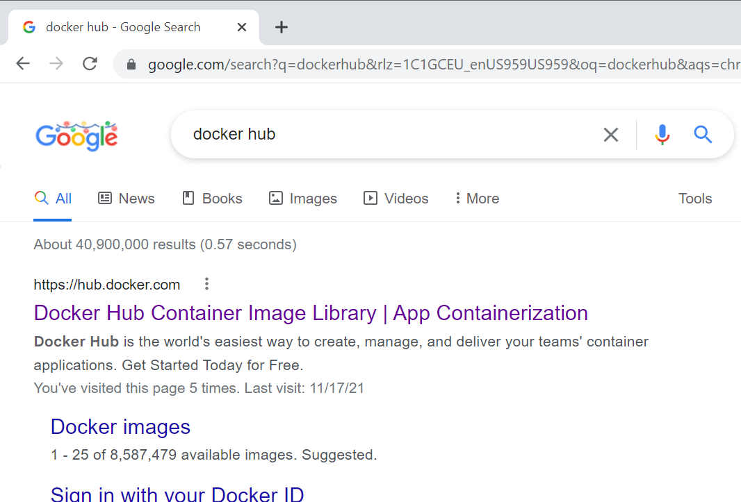
9.1 Docker Command to Pull Image
https://www.youtube.com/watch?v=QBOcKdh-fwQ&list=PLhW3qG5bs-L99pQsZ74f-LC-tOEsBp2rK&index=9
Docker hub
Before we do the docker images, we go the docker hub first.

Slide 8
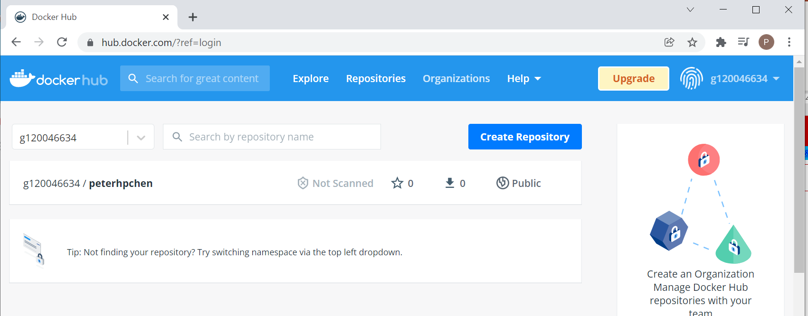
9.1 Docker Command to Pull Image
https://www.youtube.com/watch?v=QBOcKdh-fwQ&list=PLhW3qG5bs-L99pQsZ74f-LC-tOEsBp2rK&index=9
Log into Docker hub
You can log into the docker hub.
My login id: g120046634
Username: peterhpchen
Password: XXXXXX
Click “Explore” Tab to see all the collected images in the Docker hub.

Slide 9
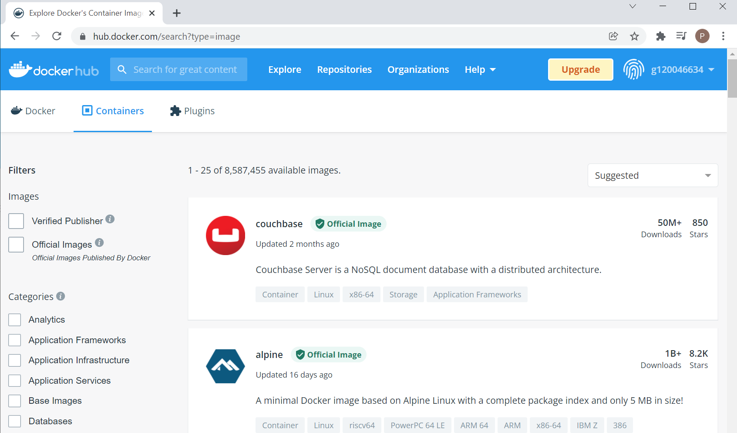
9.1 Docker Command to Pull Image
https://www.youtube.com/watch?v=QBOcKdh-fwQ&list=PLhW3qG5bs-L99pQsZ74f-LC-tOEsBp2rK&index=9
Log into Docker hub
Here, we can see all the collected images in the docker hub.

Slide 10
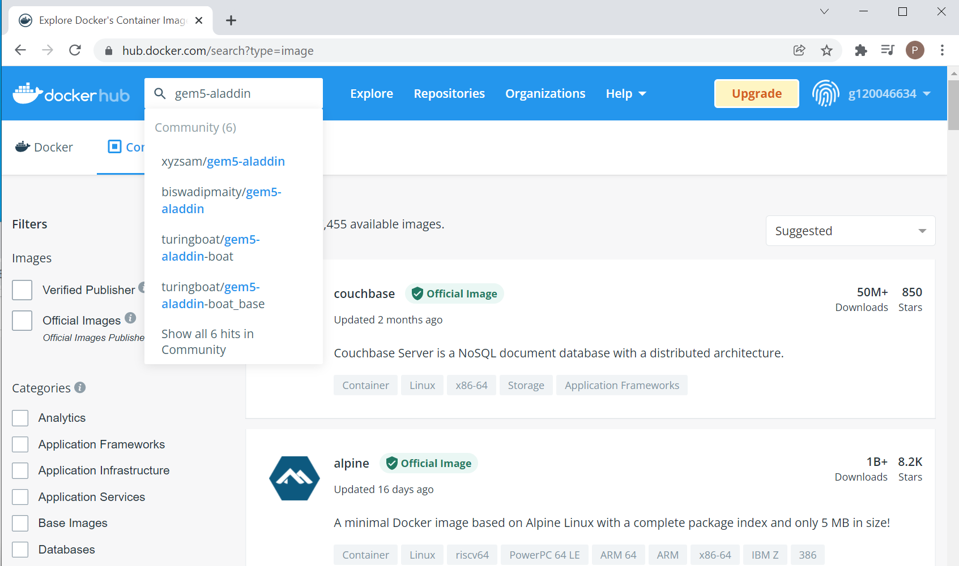
9.1 Docker Command to Pull Image
https://www.youtube.com/watch?v=QBOcKdh-fwQ&list=PLhW3qG5bs-L99pQsZ74f-LC-tOEsBp2rK&index=9
Log into Docker hub
I search for “gem5-aladdin” for the simulator of company project.

Slide 11
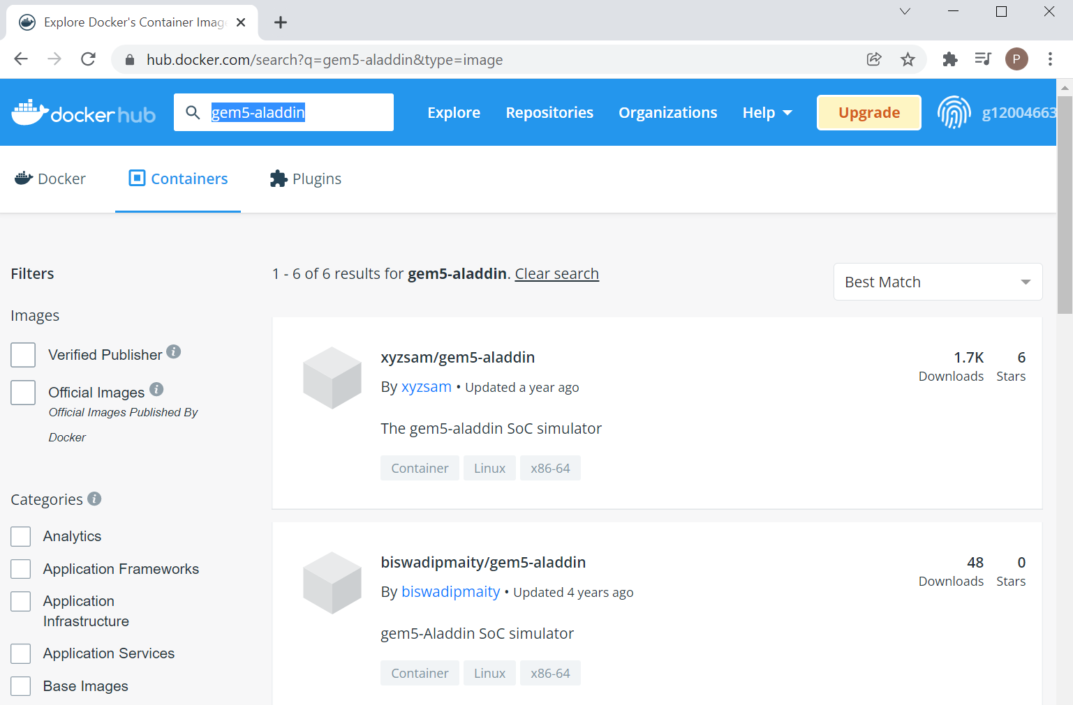
9.1 Docker Command to Pull Image
https://www.youtube.com/watch?v=QBOcKdh-fwQ&list=PLhW3qG5bs-L99pQsZ74f-LC-tOEsBp2rK&index=9
Log into Docker hub
I search for “gem5-aladdin” for the simulator of company project.
You can see “xyzsam/gem5-aladdin” is the most popular one with 1.7K download.

Slide 12
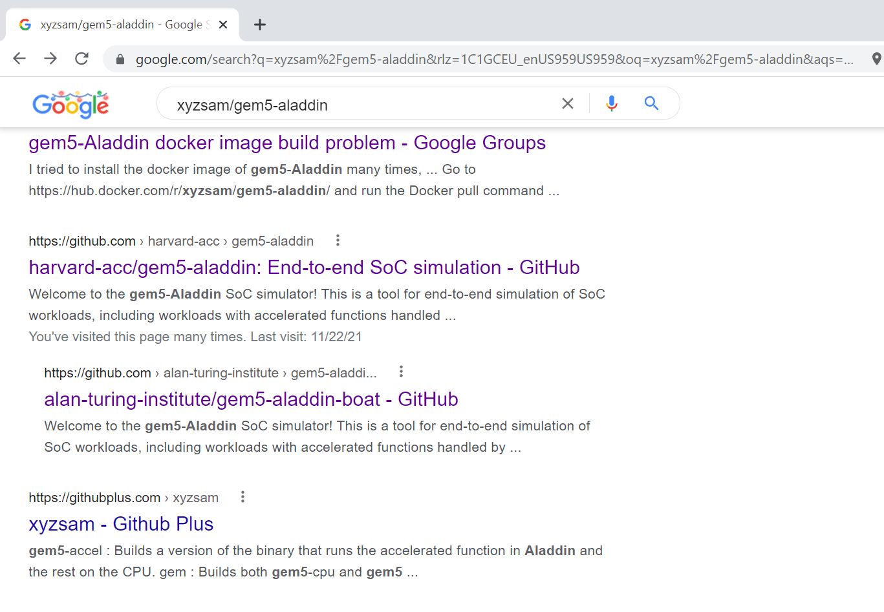
9.1 Docker Command to Pull Image
https://www.youtube.com/watch?v=QBOcKdh-fwQ&list=PLhW3qG5bs-L99pQsZ74f-LC-tOEsBp2rK&index=9
Log into Docker hub
Before you use “xyzsam/gem5-aladdin”, you can search and find it is developed by Harvard University for CPU/Accelerator (“harvard-acc”) and etc.

Slide 13
9.2 Docker Hub

Slide 14
9.2 Docker Hub
https://www.youtube.com/watch?v=QBOcKdh-fwQ&list=PLhW3qG5bs-L99pQsZ74f-LC-tOEsBp2rK&index=9
How to Pull Image?
We will pull the “ubuntu” image as the examples.
We can try and “xyzsam/gem5-aladdin” as well.

Slide 15
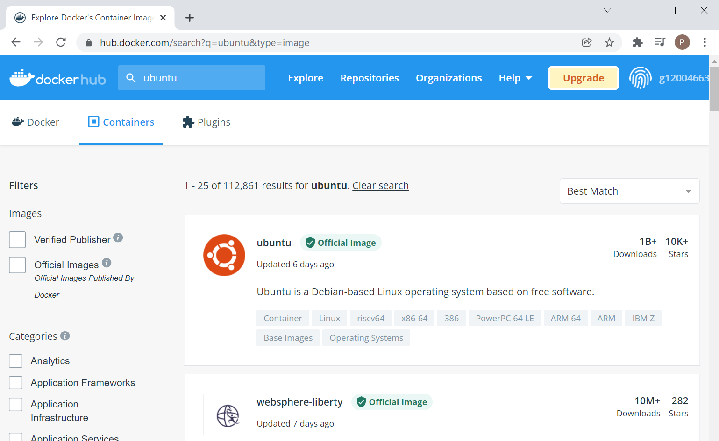
9.2 Docker Hub
https://www.youtube.com/watch?v=QBOcKdh-fwQ&list=PLhW3qG5bs-L99pQsZ74f-LC-tOEsBp2rK&index=9
How to pull Ubuntu image?
Find “Ubuntu” image

Slide 16
9.2 Docker Hub
https://www.youtube.com/watch?v=QBOcKdh-fwQ&list=PLhW3qG5bs-L99pQsZ74f-LC-tOEsBp2rK&index=9
How to pull Ubuntu image?
Click Ubuntu logo to see the image details.

Slide 17
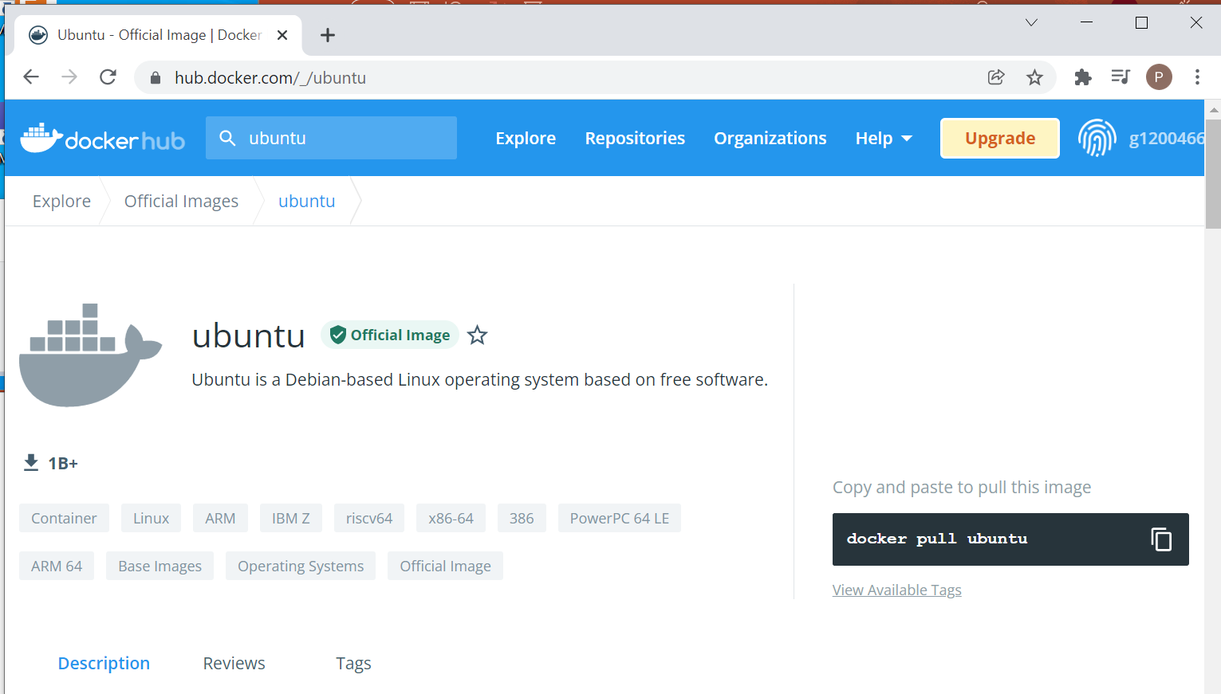
9.2 Docker Hub
https://www.youtube.com/watch?v=QBOcKdh-fwQ&list=PLhW3qG5bs-L99pQsZ74f-LC-tOEsBp2rK&index=9
How to pull Ubuntu image?
We see the command “docker pull ubuntu” is to get the image from docker hub to for our system.

Slide 18
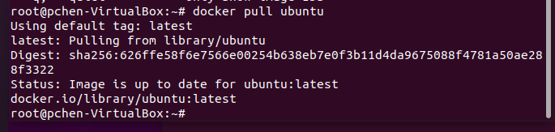
9.2 Docker Hub
https://www.youtube.com/watch?v=QBOcKdh-fwQ&list=PLhW3qG5bs-L99pQsZ74f-LC-tOEsBp2rK&index=9
How to pull Ubuntu image?
> docker pull ubuntu
It pulls the ubuntu image tag.
Now, ubuntu image is downloaded.

Slide 19
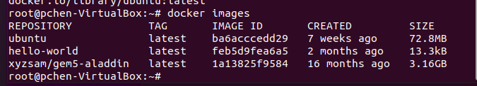
9.2 Docker Hub
https://www.youtube.com/watch?v=QBOcKdh-fwQ&list=PLhW3qG5bs-L99pQsZ74f-LC-tOEsBp2rK&index=9
How to pull Ubuntu image?
> docker images
We can verify the image is downloaded on our system.
The ubuntu image size is “72.8MB”.
This is the “latest” tag.
The image ID is “ba6acccedd29”.
The image was created 7 weeks ago.

Slide 20
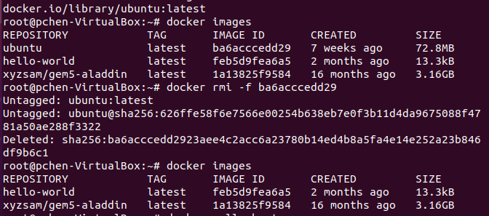
9.2 Docker Hub
https://www.youtube.com/watch?v=QBOcKdh-fwQ&list=PLhW3qG5bs-L99pQsZ74f-LC-tOEsBp2rK&index=9
How to pull Ubuntu image?
> docker rmi -f “Image ID”
We can remove the downloaded image by ID on our system.
We can use “docker images” to check the image is removed.
We can repeat “docker pull ubuntu” and “docker images” to download the ubuntu image.

Slide 21
9.2 Docker Hub
https://www.youtube.com/watch?v=QBOcKdh-fwQ&list=PLhW3qG5bs-L99pQsZ74f-LC-tOEsBp2rK&index=9
How to pull Ubuntu image?
So, using the “docker pull” command, we can get the image from docker registry or a repository of Docker hub.

Slide 22
9.3 What are Images?

Slide 23
9.3 What are Images?
https://www.youtube.com/watch?v=QBOcKdh-fwQ&list=PLhW3qG5bs-L99pQsZ74f-LC-tOEsBp2rK&index=9
What are Images?
Docker images are templates used to create Docker containers.
This are the files which as information about what all things will be required to create a container.
Docker container is a running instance of image.

Slide 24
9.4 Where are Images Stored?

Slide 25
9.4 Where are Images Stored?
https://www.youtube.com/watch?v=QBOcKdh-fwQ&list=PLhW3qG5bs-L99pQsZ74f-LC-tOEsBp2rK&index=9
Where are Images Stored?
When you run an image, the container is created and the images are stored in registries.
Image can be stored at local or remote locations.
for example, Docker hub is a kind of registry where other images are stored.
When we pull the Ubuntu image, if we do not want the latest tag, we can also provide some tag,
for example, ubuntu tag 18.04
> docker pull ubuntu:18.04
I will pull a particular version 18.04 with the specified tag 18.04.

Slide 26
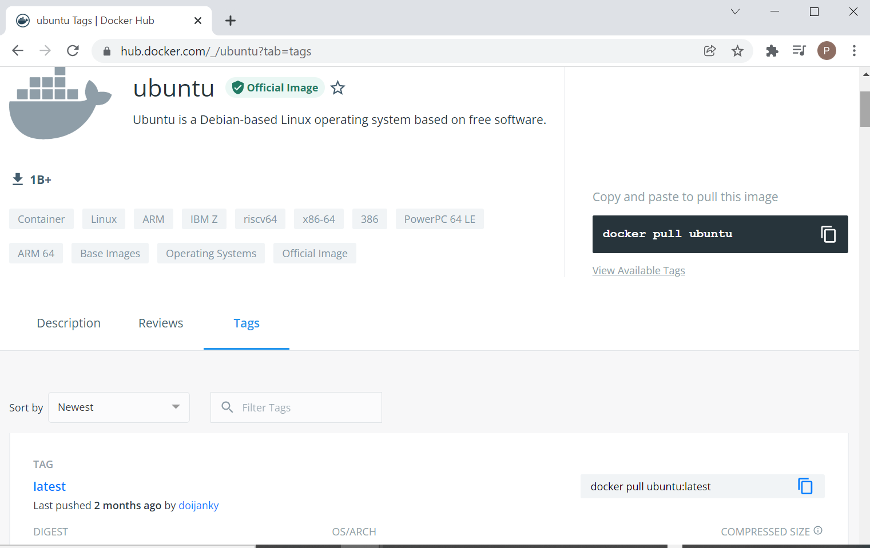
9.4 Where are Images Stored?
https://www.youtube.com/watch?v=QBOcKdh-fwQ&list=PLhW3qG5bs-L99pQsZ74f-LC-tOEsBp2rK&index=9
What are Images Stored?
In Docker hub, click tag tab, we can see different tag for different release of ubuntu.

Slide 27
9.5 Images Command Option

Slide 28
9.5 Images Command Option
https://www.youtube.com/watch?v=QBOcKdh-fwQ&list=PLhW3qG5bs-L99pQsZ74f-LC-tOEsBp2rK&index=9
Images Command Option
> docker images --help
> docker pull image
> docker images
> docker images -q
> docker images -f “dangling=false”
> docker images -f “dangling=false” -q
> docker run image
> docker rmi image
> docker rmi -f image
> docker inspect

Slide 29
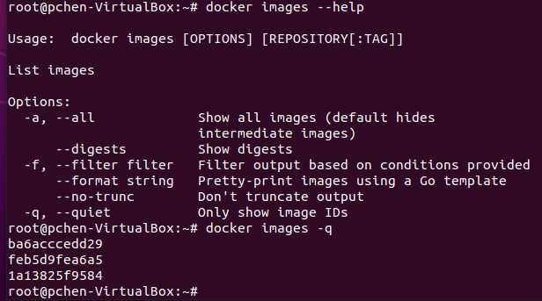
9.5 Images Command Option
https://www.youtube.com/watch?v=QBOcKdh-fwQ&list=PLhW3qG5bs-L99pQsZ74f-LC-tOEsBp2rK&index=9
Images Command Option
> docker images --help
> docker images -q
You can see only image ID is displayed.

Slide 30
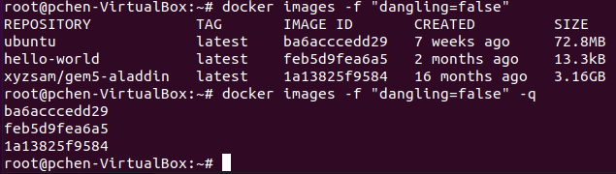
9.5 Images Command Option
https://www.youtube.com/watch?v=QBOcKdh-fwQ&list=PLhW3qG5bs-L99pQsZ74f-LC-tOEsBp2rK&index=9
Images Command Option
> docker images -f “dangling=false”
> docker images -f “dangling=false” -q
Filter (-f) with “dangling=false” will filtered any associated containers. These containers are independent without any association with other containers.

Slide 31
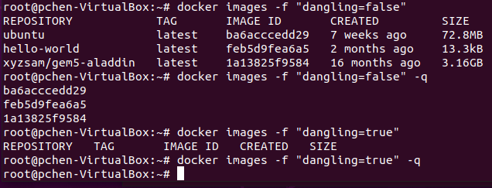
9.5 Images Command Option
https://www.youtube.com/watch?v=QBOcKdh-fwQ&list=PLhW3qG5bs-L99pQsZ74f-LC-tOEsBp2rK&index=9
Images Command Option
> docker images -f “dangling=true”
> docker images -f “dangling=true” -q
Filter (-f) with “dangling=true” will show associated containers only.
In this case, there is no “associated” (dependent or dangling) containers.

Slide 32
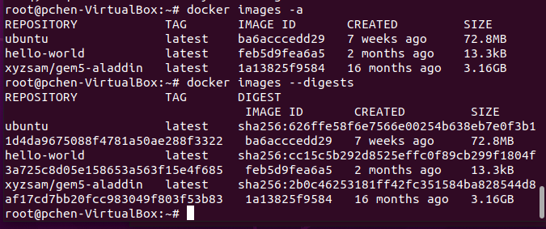
9.5 Images Command Option
https://www.youtube.com/watch?v=QBOcKdh-fwQ&list=PLhW3qG5bs-L99pQsZ74f-LC-tOEsBp2rK&index=9
Images Command Option
> docker images -a
Show all the images information
> docker images --digests
Show the digests (Your system secure encryption the image) information.

Slide 33
9.6 Docker Run Image

Slide 34
9.6 Docker Run Image
https://www.youtube.com/watch?v=QBOcKdh-fwQ&list=PLhW3qG5bs-L99pQsZ74f-LC-tOEsBp2rK&index=9
Run Docker Image with Interactive Mode (-it)
https://manjaro.site/docker-tutorial-running-your-first-image/
> docker run ubuntu
> docker run -it ubuntu bash

Slide 35

9.6 Docker Run Image
https://www.youtube.com/watch?v=QBOcKdh-fwQ&list=PLhW3qG5bs-L99pQsZ74f-LC-tOEsBp2rK&index=9
Run Docker Image with Interactive Mode (-it)
https://manjaro.site/docker-tutorial-running-your-first-image/
> docker run ubuntu
If we run image “docker run ubuntu”. It will run and exit.
Start another terminal (Control-Alt T)
> docker ps
We can not see any ubuntu running.
Ubuntu run and then exit immediately.

Slide 36
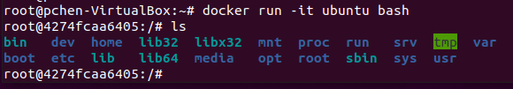
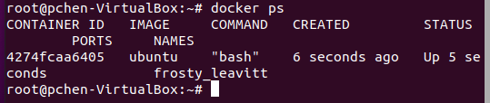
9.6 Docker Run Image
https://www.youtube.com/watch?v=QBOcKdh-fwQ&list=PLhW3qG5bs-L99pQsZ74f-LC-tOEsBp2rK&index=9
How to run docker container and stay there?
https://manjaro.site/docker-tutorial-running-your-first-image/
The “-it” option will allow us to run container and stay inside the container.
The command “> docker run -it ubuntu bash” will allow us to run interactive mode and with “bash” shell.
Start another terminal (Control-Alt T)
> docker ps
Now, we can see Ubuntu stays there. The “-it” (interactive mode) allow all images run the container and stay inside the container.

Slide 37
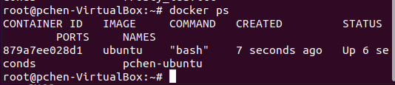
9.6 Docker Run Image
https://www.youtube.com/watch?v=QBOcKdh-fwQ&list=PLhW3qG5bs-L99pQsZ74f-LC-tOEsBp2rK&index=9
How to run container with name?
> docker run --name pchen-ubuntu –it ubuntu bash
Note: The “--name“ option and current time are useful to identify which container we are using.
How to check which container is submitted and running?
> docker ps
We can see “pchen-ubuntu” is running. With current time information, we can exactly identify the running process.

Slide 38
9.6 Docker Run Image
https://www.youtube.com/watch?v=QBOcKdh-fwQ&list=PLhW3qG5bs-L99pQsZ74f-LC-tOEsBp2rK&index=9
https://github.com/moby/moby/issues/23371
Question:
How to remove the container name with “--name pchen-ubuntu”?
To clear containers:
> docker rm -f $(docker ps -a -q)
To clear images:
> docker rmi -f $(docker images -a -q)
To clear volumes:
> docker volumes rm $(docker volume ls -q)
To clear networks:
> docker network rm $(docker network ls | tail -n+2 | awk '{if($2 !~ /bridge|none|host/){ print $1 }}')

Slide 39
9.7 Docker Inspect Image

Slide 40
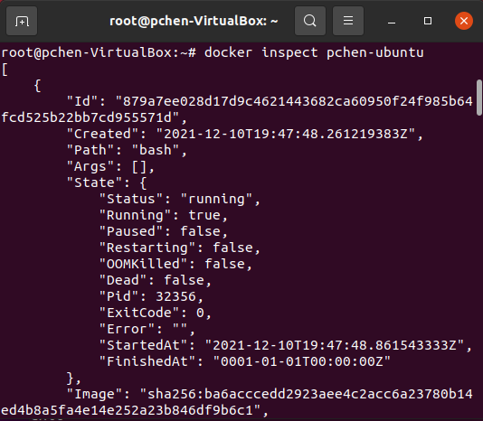
9.7 Docker Inspect Image
https://www.youtube.com/watch?v=QBOcKdh-fwQ&list=PLhW3qG5bs-L99pQsZ74f-LC-tOEsBp2rK&index=9
Docker Inspect Image
> docker inspect pchen-ubuntu
We can use “inspect container-name” to inspect the domain name, host, author, and docker version here.

Slide 41
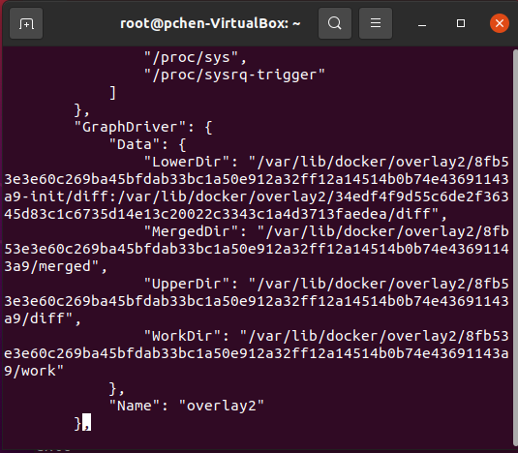
9.7 Docker Inspect Image
https://www.youtube.com/watch?v=QBOcKdh-fwQ&list=PLhW3qG5bs-L99pQsZ74f-LC-tOEsBp2rK&index=9
Docker Inspect Image
We can see the layers.
The images are actually a layer of file systems which are stacked on over the other.
When you inspect any image, you can actually see all these layers.
We will not go deep in the layer of images of file system.

Slide 42
9.8 Docker Remove Images

Slide 43
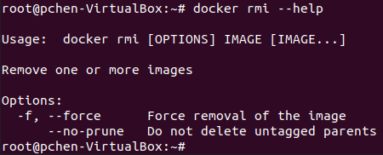
9.8 Docker Remove Image
https://www.youtube.com/watch?v=QBOcKdh-fwQ&list=PLhW3qG5bs-L99pQsZ74f-LC-tOEsBp2rK&index=9
Docker Remove Image
Now, we can remove the docker images.
> docker rmi <image-name>
> docker rmi -f <image-name>
If there is an error message ‘conflict: unable to remove repository reference “ubuntu” …’. This is because the image used by another container.
We have to “docker stop <container-ID>” and then “docker rmi <image-name”

Slide 44
9.8 Docker Remove Image
https://www.youtube.com/watch?v=QBOcKdh-fwQ&list=PLhW3qG5bs-L99pQsZ74f-LC-tOEsBp2rK&index=9
Docker Remove Image
For example, If the image is used by the running container. We have to stop the running container before we remove the image.
Step 1: remove the running container
> docker stop pchen-ubuntu
To stop the running container “pchen-ubuntu”
Step 2: remove the image.
> docker rmi -f ubuntu:18.04
This command is used to remove the image.

Slide 45
End

