Slide 1

8 Docker-Compose
Peter H. Chen

Slide 2
8 Docker-Compose
https://www.youtube.com/watch?v=k900NVwFfcA&list=PL6tu16kXT9PqdhOZk4MNVtQDJp6xFrotg&index=8
Docker-Compose
Docker-Compose is a tool for defining and running multi-container Docker applications.
With compose, you use a Compose file to configure your application’s services. Then, using a single command, you create and start all the services from your configuration.
If we starting the container service with linking a container service, we have to write many commands. For example, if we create a WordPress container and link to MySQL container, we need a very long list of command. We need to run the Docker and link with another container, exposing the ports, and new name of the containers.
It is a kind of nagging. To remember those commands are very hard. To over come these problems. Docker-Compose come into a picture.
Docker-Compose is a great for development, testing, and staging environment, as well as CI workflows.

Slide 3
8 Docker-Compose
https://www.youtube.com/watch?v=k900NVwFfcA&list=PL6tu16kXT9PqdhOZk4MNVtQDJp6xFrotg&index=8
Docker-Compose Manages Services
Docker-Compose command helps to
Start, stop, and rebuild services
View the status and logs of running services, for example, docker ps –a, docker logs <container ID>, these are kinds of pain. Because we have to go every container IDs. Paste that and then perform the operation. In Docker-Compose, it is very simple, all you have to do “Docker-Compose logs”. We will get all logs of all containers. You can get particular service without giving the container ID. Similarly, you can use “Docker-Compose stop” to stop all the containers.

Slide 4
8 Docker-Compose
https://www.youtube.com/watch?v=k900NVwFfcA&list=PL6tu16kXT9PqdhOZk4MNVtQDJp6xFrotg&index=8
Docker as CI?
An important part of any Continuous Deployment or Continuous Integration process is the automated test suite.
Automated end-to-end testing requires an environment in which to run tests.
Compose provides a convenient way to create and destroy isolated testing environment for your test suite.
Docker containers for Selenium Grid is for automatic tests. Selenium automated test on multiple different browsers running in multiple different containers. In order to stop all these containers in a single shot and also stating those containers in a single shot, Docker-Compose is very handy.

Slide 5
8 Docker-Compose
https://www.youtube.com/watch?v=k900NVwFfcA&list=PL6tu16kXT9PqdhOZk4MNVtQDJp6xFrotg&index=8
What is Compose File?
Compose files
Docker-Compose file is like a configuration file, where you define all the different stuffs we perform on command line (via PowerShell) into a file. You can do what you do in command line.
The file is basically an YAML file (.yml)

Slide 6
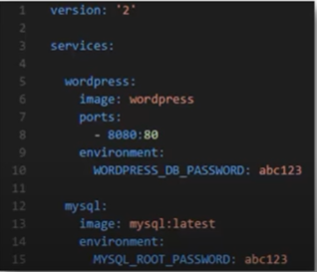
8 Docker-Compose
https://www.youtube.com/watch?v=k900NVwFfcA&list=PL6tu16kXT9PqdhOZk4MNVtQDJp6xFrotg&index=8
What is the YML file content looks like?
YMAL file looks as below. With version, services, and etc.
We have wordpress container and mysql container.
As you can see here, wordpress and mysql are the services.
Image name is “worpress”. Port number 80, environment is WORDPRESS_DB_PASSWORD: abc123.
YAML file contains the whatever commands that you need for starting those two containers and linking those two containers.

Slide 7
8.1 Docker-Compose Commands

Slide 8
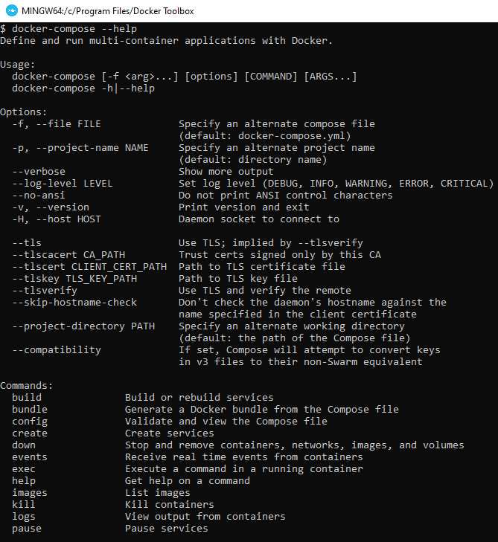
8.1 Docker-Compose Commands
https://www.youtube.com/watch?v=k900NVwFfcA&list=PL6tu16kXT9PqdhOZk4MNVtQDJp6xFrotg&index=8
Docker-Compose Commands
> docker-compose –help
Build: Build services
Bundle: generate docker bundle
Logs: view output form containers
Port: print the public port for a port binding
Ps: list containers
Pull: pull images
Rm: remove
Start: start service
Stop: stop service
Up: Create and start containers

Slide 9
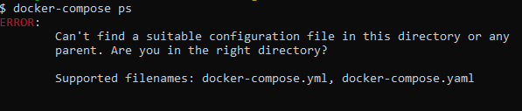
8.1 Docker-Compose Commands
https://www.youtube.com/watch?v=k900NVwFfcA&list=PL6tu16kXT9PqdhOZk4MNVtQDJp6xFrotg&index=8
All the compose commands talk about the services.
Compose command can start a group of and a bunch of survices running in multiple containers.
> docker-compose ps
It has error: There is no docker-compose.yml or docker-compose.yaml file in the folder.
-f: specify an alternate compose file. Default file name is docker-compose.yml. Yu can specify the yml file in different location.
We will discuss docker-compose yml file next.

Slide 10
End of Chapter

