Slide 1
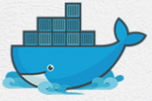
5 Docker Hub 01
Peter H. Chen

Slide 2
5 Docker Hub 01
https://www.youtube.com/watch?v=VHZd7CJBixc&list=PL6tu16kXT9PqdhOZk4MNVtQDJp6xFrotg&index=5
Pull Containers from Docker Hub 01
Work with some of the containers available in: http://hub.docker.com
You do not have to go to hub.docker.com to work.
Your docker command can pull and push the container from hub.docker.com.
We will discuss:
Hello world (using UI: kitematics)
Ubuntu (using command prompt)

Slide 3
5 Docker Hub 01
https://www.youtube.com/watch?v=VHZd7CJBixc&list=PL6tu16kXT9PqdhOZk4MNVtQDJp6xFrotg&index=5
Command Prompt
Open Docker Toolbox/Command Prompt
> docker images
> docker ps -a
> docker rmi ubuntu
> Error: Because the containers currently not running.

Slide 4
5.1 Stop/Remove Container Process
Peter H. Chen

Slide 5
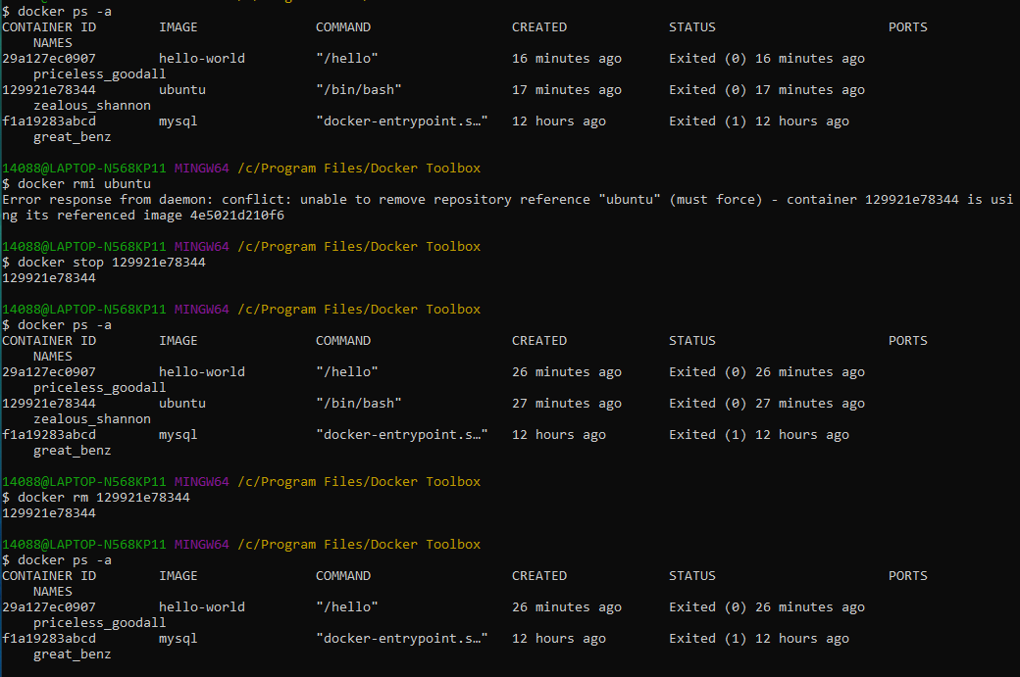
5.1 Stop/Remove Container Process
https://www.youtube.com/watch?v=VHZd7CJBixc&list=PL6tu16kXT9PqdhOZk4MNVtQDJp6xFrotg&index=5
How to stop and remove a container (a container is a process in memory)?
You have to first stop the container and then remove the container from docker.
If the container is running and you try to remove the container, docker will give you an error.
> docker ps -a
> docker stop <container ID>
> docker rm <container ID>
> docker ps -a
You can see container is removed.

Slide 6
5.2 Remove Container Image
Peter H. Chen

Slide 7
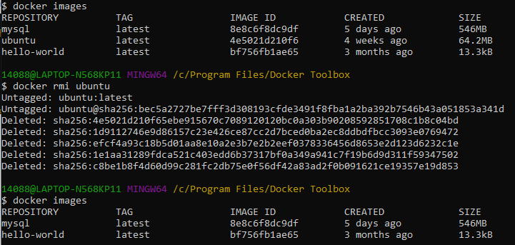
5.2 Remove Container Image
https://www.youtube.com/watch?v=VHZd7CJBixc&list=PL6tu16kXT9PqdhOZk4MNVtQDJp6xFrotg&index=5
How to remove the image (a image is in hard drive)?
First, you need to stop the running of container and remove the container in the memory.
Then remove the container image from the hard drive.
> docker rmi <image-name>
> docker rmi ubuntu
> docker images
You can see the ‘ubuntu’ image is remove.
Note:
Container is a process in memory.
Image is a files in hard driver.

Slide 8
5.3 Get Image for Docker Machine
Peter H. Chen

Slide 9
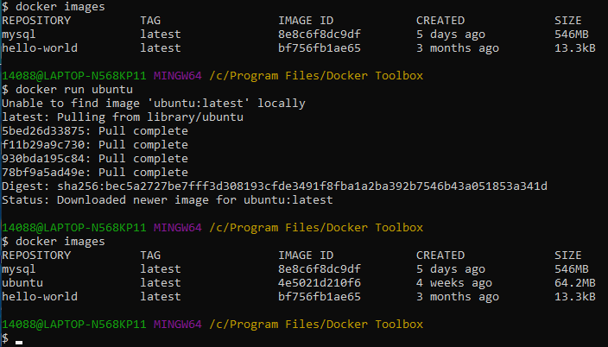
5.3 Get Image for Docker Machine
https://www.youtube.com/watch?v=VHZd7CJBixc&list=PL6tu16kXT9PqdhOZk4MNVtQDJp6xFrotg&index=5
How to get the ubuntu image on docker machine?
You can use “docker pull ubuntu” or “docker run ubuntu”
> docker images
> docker run ubuntu
> docker images
You can see the ubuntu image is there.
Note:
“docker run” will check if there is no image there, docker will download into docker machine first and then run.

Slide 10
End of Chapter

