Slide 1
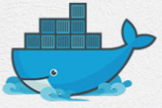
8 Docker Command
Peter H. Chen

Slide 2
8 Docker Command
https://www.youtube.com/watch?v=HqBMEmoAd1M&list=PLhW3qG5bs-L99pQsZ74f-LC-tOEsBp2rK&index=8
Docker Basic Command
Basic command:
> docker version
> docker -v
> docker info
> docker --help
> docker login
Images Command:
> docker images
> docker pull
> docker rmi
Containers Command:
> docker ps
> docker run
> docker start
> docker stop
System Command:
> docker stats
> docker system df
> docker system prune

Slide 3
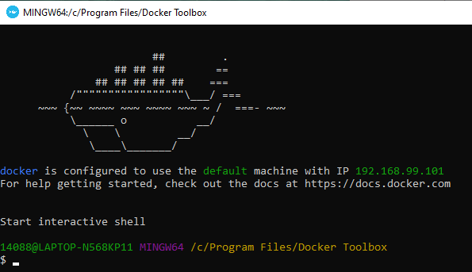

8 Docker Command
https://www.youtube.com/watch?v=HqBMEmoAd1M&list=PLhW3qG5bs-L99pQsZ74f-LC-tOEsBp2rK&index=8
Start Docker Server (Optional for Windows)
Double click “Start Quickstart Terminal…”

Slide 4
8.1 Basic Command

Slide 5
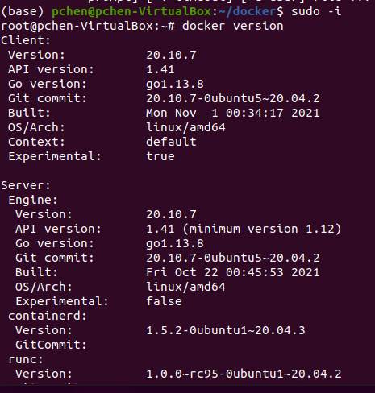
8.1 Basic Command
https://www.youtube.com/watch?v=HqBMEmoAd1M&list=PLhW3qG5bs-L99pQsZ74f-LC-tOEsBp2rK&index=8
Basic Command
Open Command Prompt:
Change from user to sudo user.
> sudo -i
> docker version
You can check the client and server version, go language version, and etc.

Slide 6

8.1 Basic Command
https://www.youtube.com/watch?v=HqBMEmoAd1M&list=PLhW3qG5bs-L99pQsZ74f-LC-tOEsBp2rK&index=8
Basic Command
Open Command Prompt:
> docker -v
> docker --version
These commands display the client version of 19.03.1

Slide 7
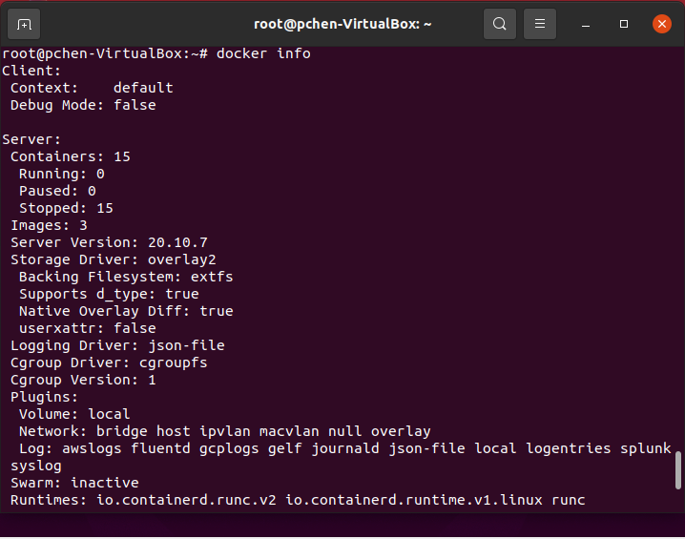
8.1 Basic Command
https://www.youtube.com/watch?v=HqBMEmoAd1M&list=PLhW3qG5bs-L99pQsZ74f-LC-tOEsBp2rK&index=8
Basic Command
> docker info
Information about docker installed on your system.
The number of container running, stopped, and etc.
The number of images.
Server version
Storage drive detail

Slide 8
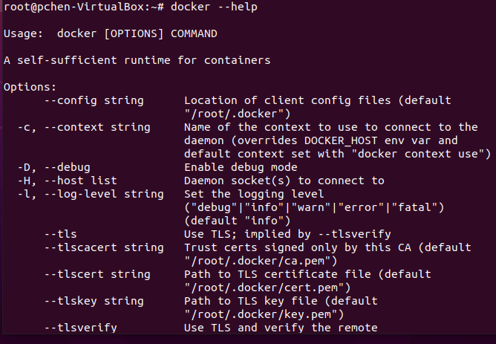
8.1 Basic Command
https://www.youtube.com/watch?v=HqBMEmoAd1M&list=PLhW3qG5bs-L99pQsZ74f-LC-tOEsBp2rK&index=8
Basic Command
> docker --help
This is very useful command to get the information for any other command.

Slide 9
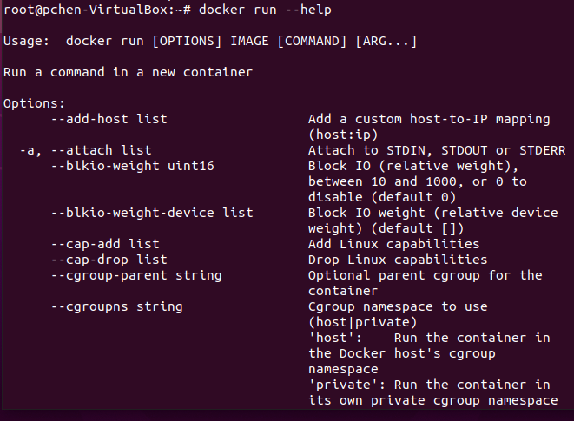
8.1 Basic Command
https://www.youtube.com/watch?v=HqBMEmoAd1M&list=PLhW3qG5bs-L99pQsZ74f-LC-tOEsBp2rK&index=8
Basic Command
For example,
> docker run --help
It shows all the options of “docker run”

Slide 10
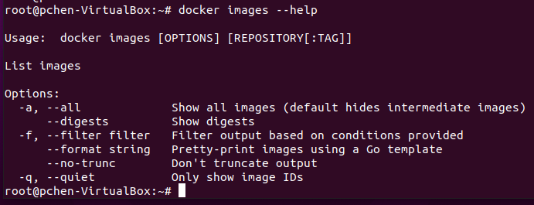
8.1 Basic Command
https://www.youtube.com/watch?v=HqBMEmoAd1M&list=PLhW3qG5bs-L99pQsZ74f-LC-tOEsBp2rK&index=8
Basic Command
For example,
> docker images --help
It gives all the details about the all the option of usage “docker images”.
-a: for show all images.
-q: for quiet showing the numeric IDs of the images.

Slide 11
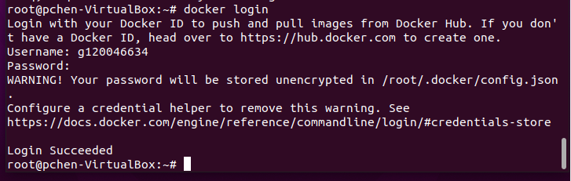
8.1 Basic Command
https://www.youtube.com/watch?v=HqBMEmoAd1M&list=PLhW3qG5bs-L99pQsZ74f-LC-tOEsBp2rK&index=8
Basic Command
> docker login
You can use this command to login in the hub.docker.com
Username: g120046634
Password: Pcxxxx=xx
Google “docker hub” to verify by hub.docker.com.

Slide 12
8.2 Images Command

Slide 13
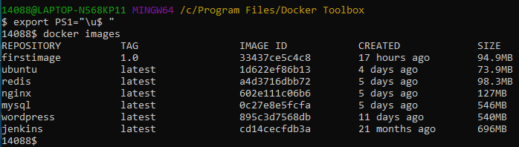
8.2 Images Command
https://www.youtube.com/watch?v=HqBMEmoAd1M&list=PLhW3qG5bs-L99pQsZ74f-LC-tOEsBp2rK&index=8
Images Command
> docker images
Make the display prompt shorter
> export PS1 = “\u$ “
> docker images

Slide 14
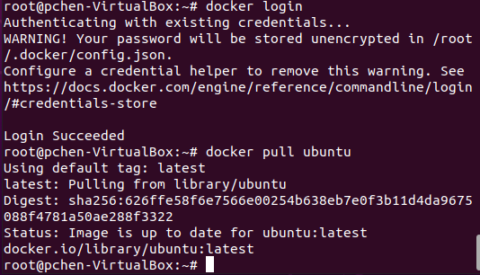
8.2 Images Command
https://www.youtube.com/watch?v=HqBMEmoAd1M&list=PLhW3qG5bs-L99pQsZ74f-LC-tOEsBp2rK&index=8
Images Command
> docker login
>> username: g120046634 (my username on docker hub)
>> password:
After you log into the docker hub account, you can go to hub.docker.com to find any images you want to download.
Select the images and check the command “docker pull ubuntu”
> docker pull ubuntu

Slide 15
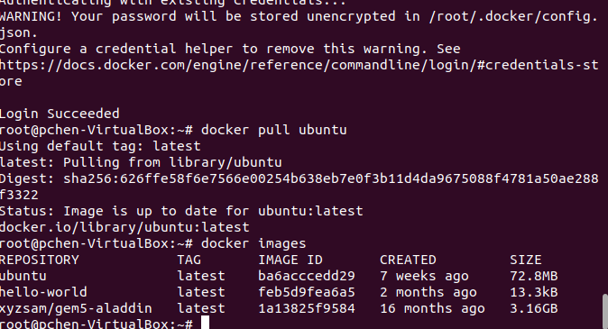
8.2 Images Command
https://www.youtube.com/watch?v=HqBMEmoAd1M&list=PLhW3qG5bs-L99pQsZ74f-LC-tOEsBp2rK&index=8
Images Command
> docker pull ubuntu
Will download the latest ubuntu image for you.
Use
> docker images
To verify the download ubuntu images.

Slide 16
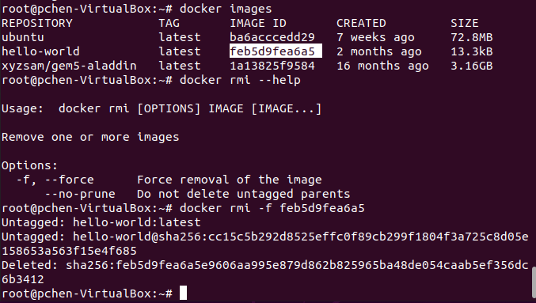
8.2 Images Command
https://www.youtube.com/watch?v=HqBMEmoAd1M&list=PLhW3qG5bs-L99pQsZ74f-LC-tOEsBp2rK&index=8
Images Command
> docker rmi --help
> docker rmi -f <image-ID>
Note: Use “-f” to force to remove image file.

Slide 17
8.3 Containers Command

Slide 18

8.3 Containers Command
https://www.youtube.com/watch?v=HqBMEmoAd1M&list=PLhW3qG5bs-L99pQsZ74f-LC-tOEsBp2rK&index=8
Containers Command
> docker ps
> docker run ubuntu
> docker ps
We cannot see any running <image ID>. We do not have any container running.
However, we can have “-it” option to generate a docker container.

Slide 19

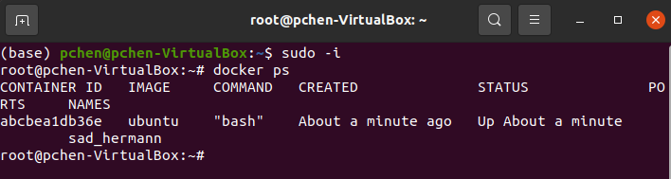
8.3 Containers Command
https://www.youtube.com/watch?v=HqBMEmoAd1M&list=PLhW3qG5bs-L99pQsZ74f-LC-tOEsBp2rK&index=8
Containers Command
1. > docker run -it ubuntu
The “-it” option allow us to start a ubuntu container.
We are inside the Ubuntu container. We need to go outside the Ubuntu container. To go outside Ubuntu container, we need to open another terminal (Use “Control-alt t” to open another terminal)
2. > sudo -i
> docker ps
1
2

Slide 20
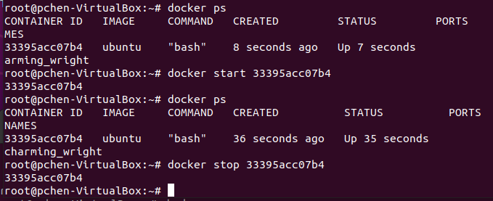
8.3 Containers Command
https://www.youtube.com/watch?v=HqBMEmoAd1M&list=PLhW3qG5bs-L99pQsZ74f-LC-tOEsBp2rK&index=8
Containers Command
Now, we can use “docker start <container-ID>” and “docker stop <container-ID>”
1. > docker ps
>> Container-ID is “33395acc07b4”
2. > docker start <container-ID>
3. > docker stop <container-ID>
1
2
3

Slide 21
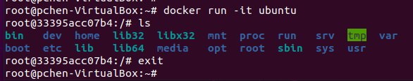
8.3 Containers Command
https://www.youtube.com/watch?v=HqBMEmoAd1M&list=PLhW3qG5bs-L99pQsZ74f-LC-tOEsBp2rK&index=8
Containers Command
Now, in another terminal, we can see Ubuntu is “exit”.

Slide 22
8.4 System Command

Slide 23

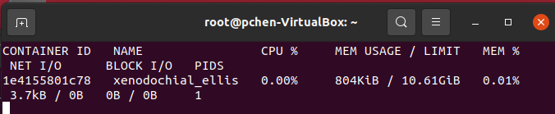
8.4 System Command
https://www.youtube.com/watch?v=HqBMEmoAd1M&list=PLhW3qG5bs-L99pQsZ74f-LC-tOEsBp2rK&index=8
System Command
> docker run -it ubuntu
Open another terminal:
> docker stats
We can see container ID, container name, CPU %, memory usage, memory %, Input / Output (Net IO, block IO), and PIDS.
When you run docker, you can check the memory usage using “docker stats”.

Slide 24
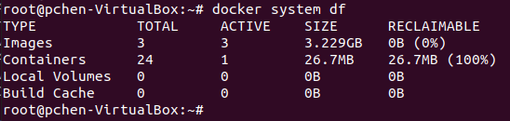
8.4 System Command
https://www.youtube.com/watch?v=HqBMEmoAd1M&list=PLhW3qG5bs-L99pQsZ74f-LC-tOEsBp2rK&index=8
System Command
> docker system df
Check disk usage. You can see images, containers, local volumes, and build cache.
You can check the disk usage by these docker elements

Slide 25
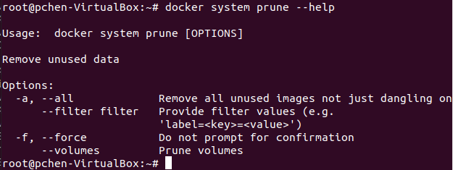
8.4 System Command
https://www.youtube.com/watch?v=HqBMEmoAd1M&list=PLhW3qG5bs-L99pQsZ74f-LC-tOEsBp2rK&index=8
System Command
> docker system prune
Be very careful of using “docker system prune”. This command erase all the docker images on your system.
> docker system prune --help
This command is used to remove unused data.
The dangling image means are not associated with the running container.
Now, -f is force to remove. Be very careful.

Slide 26
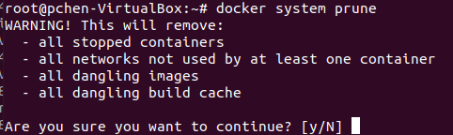
8.4 System Command
https://www.youtube.com/watch?v=HqBMEmoAd1M&list=PLhW3qG5bs-L99pQsZ74f-LC-tOEsBp2rK&index=8
System Command
> docker system prune
The message shows it will remove all the unused data.
Type “y” will clean up all the unused data.
> docker ps -a
> docker images
Will not see any running process or images.

Slide 27
8.5 Summary of Command

Slide 28
8.5 Summary of Command
https://www.youtube.com/watch?v=HqBMEmoAd1M&list=PLhW3qG5bs-L99pQsZ74f-LC-tOEsBp2rK&index=8
Summary of Command
We discussed the Basic, Images, Containers, and System command.
These commands are very useful to work with Docker.

Slide 29
End of Chapter

