Slide 1

9 Docker-Compose Multiple Containers
Peter H. Chen

Slide 2
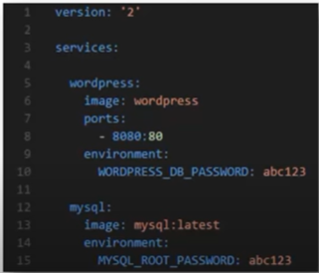
9 Docker-Compose Multiple Containers
https://www.youtube.com/watch?v=UB3-qj2QA50&list=PL6tu16kXT9PqdhOZk4MNVtQDJp6xFrotg&index=9
YML file Content
JML file has indentation but not like XML or JSON file.
JML file example:

Slide 3
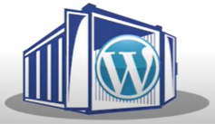
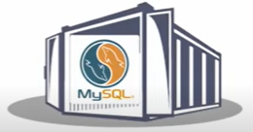
9 Docker-Compose Multiple Containers
https://www.youtube.com/watch?v=UB3-qj2QA50&list=PL6tu16kXT9PqdhOZk4MNVtQDJp6xFrotg&index=9
YML file Content
In this example, we are going to Link by YML.

Slide 4
9.1 Create YML File

Slide 5
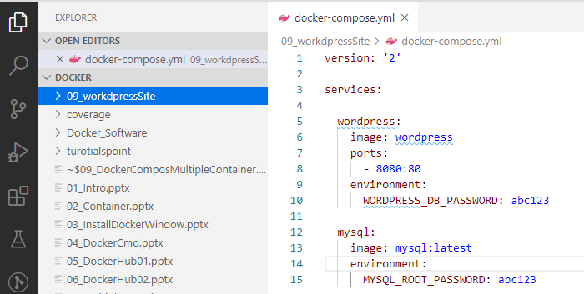
9.1 Create YML File
https://www.youtube.com/watch?v=UB3-qj2QA50&list=PL6tu16kXT9PqdhOZk4MNVtQDJp6xFrotg&index=9
Create a YML file: docker-compose.yml

Slide 6
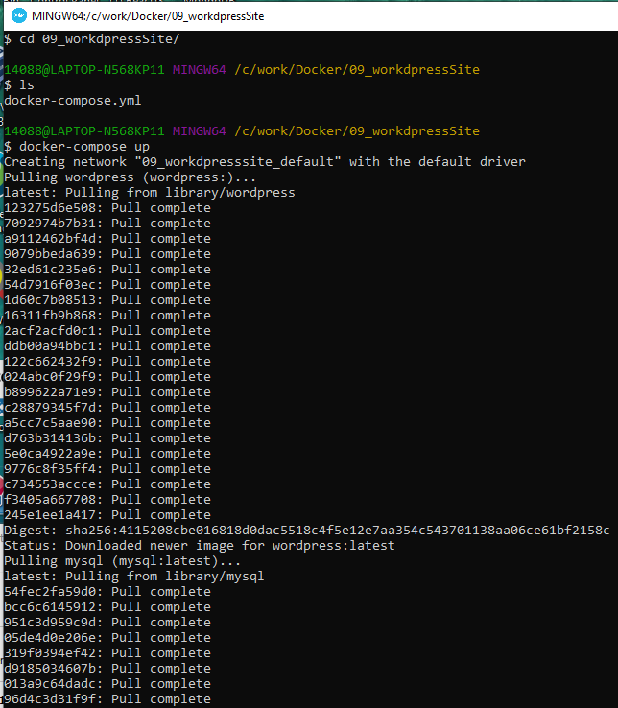
9.1 Create YML File
https://www.youtube.com/watch?v=UB3-qj2QA50&list=PL6tu16kXT9PqdhOZk4MNVtQDJp6xFrotg&index=9
Docker-compose
In the 09_wordPressSite folder which contain the “docker-compose.yml” file.
> docker-compose ps
Start all the services
> docker-compose up

Slide 7
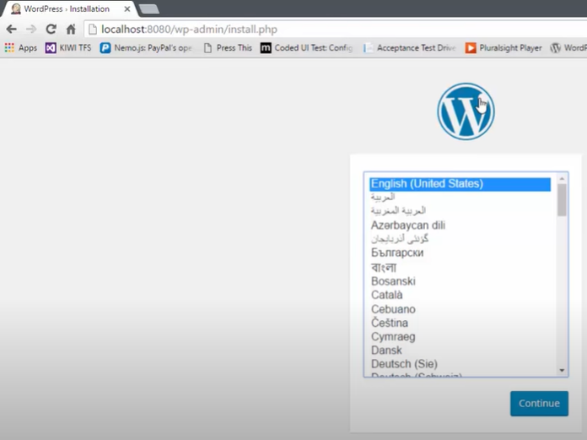
9.1 Create YML File
https://www.youtube.com/watch?v=UB3-qj2QA50&list=PL6tu16kXT9PqdhOZk4MNVtQDJp6xFrotg&index=9
Open browser
> localhost:8080

Slide 8
End of Chapter

