Slide 1
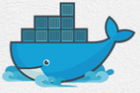
14 Docker Volume
Peter H. Chen

Slide 2
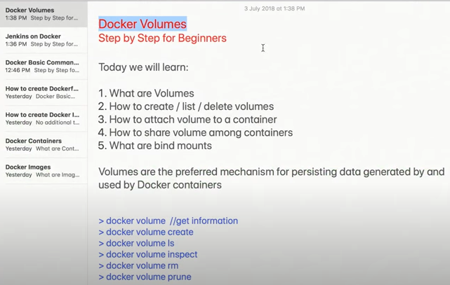
14 Docker Volume
https://www.youtube.com/watch?v=VOK06Q4QqvE&list=PLhW3qG5bs-L99pQsZ74f-LC-tOEsBp2rK&index=14
Docker Volume
Docker Volume is one of the advanced topics on Dockers.
Docker Volume is very important concept and useful concept.
We will know how to create and share the volumes.

Slide 3
14 Docker Volume
https://www.youtube.com/watch?v=VOK06Q4QqvE&list=PLhW3qG5bs-L99pQsZ74f-LC-tOEsBp2rK&index=14
Docker Volume
We are going to see
1. What are volumes?
2. How to create, list, and delete volumes?
3. How to attach volume to a container?
4. How to share volume among containers?
5. What are bind mounts?

Slide 4
14 Docker Volume
https://www.youtube.com/watch?v=VOK06Q4QqvE&list=PLhW3qG5bs-L99pQsZ74f-LC-tOEsBp2rK&index=14
Docker Volume
In Docker, whenever you create a container, there is some place where the data for the container will be stored.
Now, in case, you do not provide any explicit location for that data to be stored.
The data gets stored within the container.
…and when you delete the container or remove the container, the data is also lost.

Slide 5
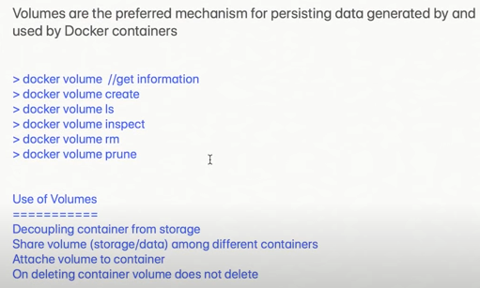
14 Docker Volume
https://www.youtube.com/watch?v=VOK06Q4QqvE&list=PLhW3qG5bs-L99pQsZ74f-LC-tOEsBp2rK&index=14
Docker Volume
…however, when you work on enterprise projects, we want that data is not.
We can actually remove a container but still persist that data.
…and in case it is required to create more containers with the old data
…or to share the data between containers, it should be possible.

Slide 6
14 Docker Volume
https://www.youtube.com/watch?v=VOK06Q4QqvE&list=PLhW3qG5bs-L99pQsZ74f-LC-tOEsBp2rK&index=14
Docker Volume
Before we use the commands, we want to know volume is used for decoupling container from storage.
…the storage is separated from the container
…even we delete or remove the container, the storage is still available.

Slide 7
14 Docker Volume
https://www.youtube.com/watch?v=VOK06Q4QqvE&list=PLhW3qG5bs-L99pQsZ74f-LC-tOEsBp2rK&index=14
Docker Volume
On enterprise projects, we want that data is not lost.
We can actually remove a container but still preserve that data
In case, it is required to create more containers with the old data or to share the data between containers, it should be possible.

Slide 8
14 Docker Volume
https://www.youtube.com/watch?v=VOK06Q4QqvE&list=PLhW3qG5bs-L99pQsZ74f-LC-tOEsBp2rK&index=14
Docker Volume
On enterprise projects, we want that data is not lost.
We can actually remove a container but still preserve that data
In case, it is required to create more containers with the old data or to share the data between containers, it should be possible.

Slide 9
14 Docker Volume
https://www.youtube.com/watch?v=VOK06Q4QqvE&list=PLhW3qG5bs-L99pQsZ74f-LC-tOEsBp2rK&index=14
Docker Volume
Before we start the command, we see this “use of volumes”.
…so, it is used for decoupling the containers from the storage..
…so, the storage is separated from the container and even if you delete or remove the container, the storage is still available.
…or volumes is used to share volume or the data among different containers.

Slide 10
14 Docker Volume
https://www.youtube.com/watch?v=VOK06Q4QqvE&list=PLhW3qG5bs-L99pQsZ74f-LC-tOEsBp2rK&index=14
Docker Volume
We can attach a volume to a container.
We can delete container but the volume will not be deleted.
…so, this is these are the main advantages or uses of volume.

Slide 11
14.1 Docker Volume Command

Slide 12
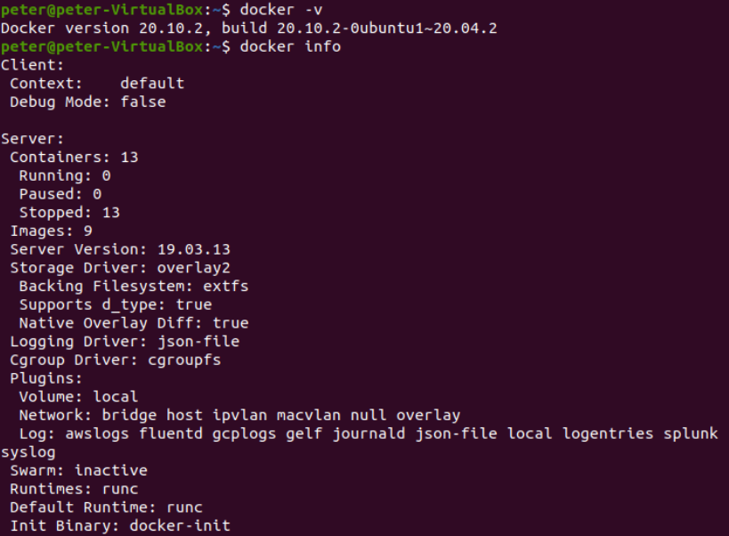
14.1 Docker Volume
https://www.youtube.com/watch?v=VOK06Q4QqvE&list=PLhW3qG5bs-L99pQsZ74f-LC-tOEsBp2rK&index=14
Docker Volume: Get Information
Open Terminal
> sudo -i
>> -i: means initial login
> docker -v
or
> docker info

Slide 13
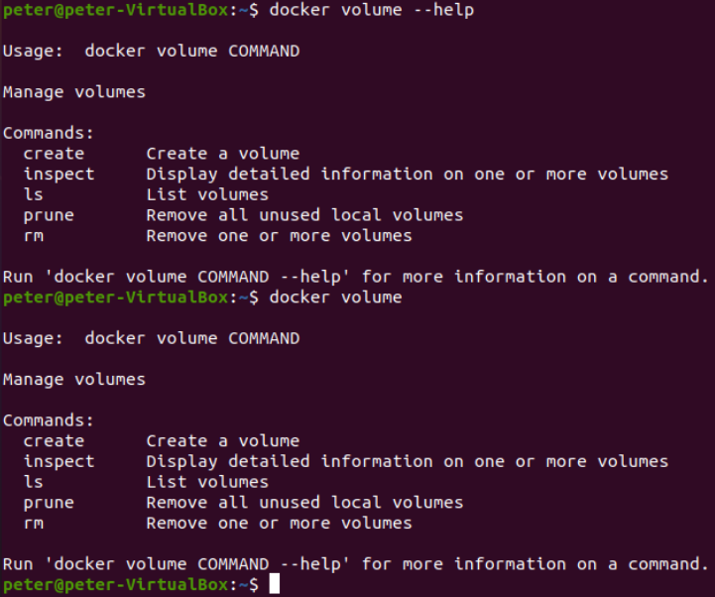
14.1 Docker Volume
https://www.youtube.com/watch?v=VOK06Q4QqvE&list=PLhW3qG5bs-L99pQsZ74f-LC-tOEsBp2rK&index=14
Docker Volume: Get Information
> docker volume --help
Or
> docker volume
The followings are the command options:
1. create: create a volume
2. inspect: display detailed information on one or more volumes.
3. ls: list volumes
4. prune: remove all unused local volumes
5. rm: remove one or more volumes.

Slide 14
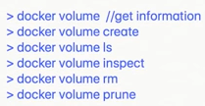
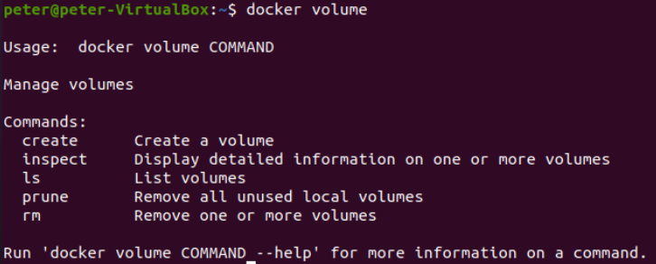
14.1 Docker Volume
https://www.youtube.com/watch?v=VOK06Q4QqvE&list=PLhW3qG5bs-L99pQsZ74f-LC-tOEsBp2rK&index=14
Docker Volume: Get Information
The docker volume has the following options:
Docker volume command options: create, inspect, ls, prune, and rm.
The create is used to create a volume.
The inspect is used to inspect the volume.
The ls is used to list the volume.
The prune will remove all unused local volumes.
The rm is to remove one or more volumes.

Slide 15
14.2 Docker Volume Create

Slide 16
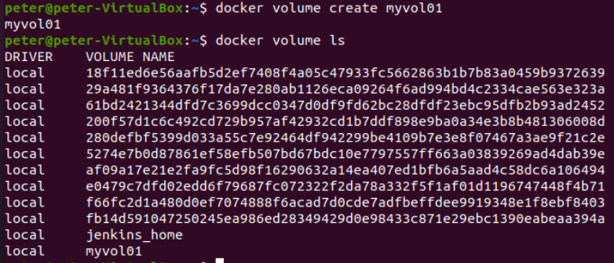
14.2 Docker Volume Create
https://www.youtube.com/watch?v=VOK06Q4QqvE&list=PLhW3qG5bs-L99pQsZ74f-LC-tOEsBp2rK&index=14
Docker Volume Create
Let us create the volume:
> docker volume create myvol01
> docker volume ls

Slide 17
14.3 Docker Volume ls

Slide 18
14.2 Docker Volume ls
https://www.youtube.com/watch?v=VOK06Q4QqvE&list=PLhW3qG5bs-L99pQsZ74f-LC-tOEsBp2rK&index=14
Docker Volume ls
> docker volume ls

Slide 19
14.4 Docker Volume Inspect

Slide 20
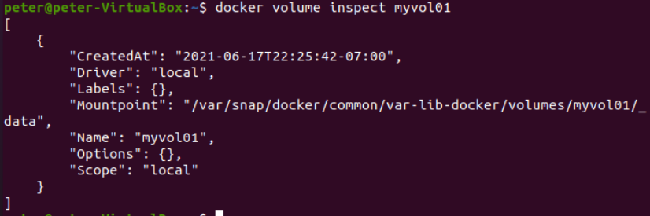
14.4 Docker Volume Inspect
https://www.youtube.com/watch?v=VOK06Q4QqvE&list=PLhW3qG5bs-L99pQsZ74f-LC-tOEsBp2rK&index=14
Docker Volume Inspect
> docker volume inspect myvol01
Get the details of the volume “myvol1”

Slide 21
14.4 Docker Volume Inspect
https://www.youtube.com/watch?v=VOK06Q4QqvE&list=PLhW3qG5bs-L99pQsZ74f-LC-tOEsBp2rK&index=14
Docker Volume Inspect
> docker volume inspect myvol01
Docker Volume Inspect command gets details about the volume.
…so the volume is created at time “2021-06-17…”
…the volume mount point is “/var/snap/docker/…” on your system. The volume cannot be edited locally. So the volume is safe now.
…the name is “myvol01”

Slide 22
14.5 Docker Volume rm

Slide 23
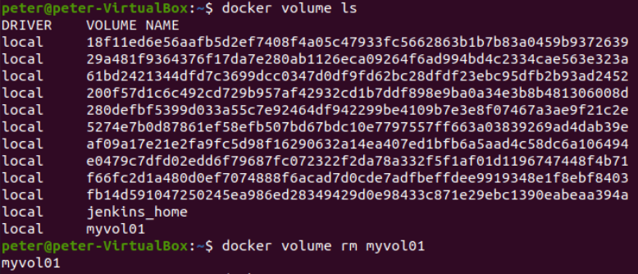
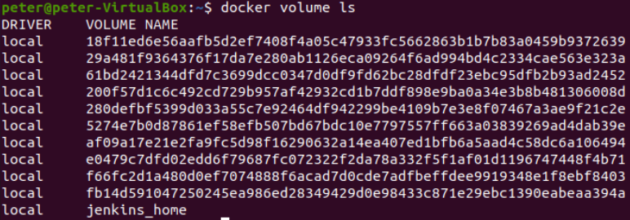
14.5 Docker Volume rm
https://www.youtube.com/watch?v=VOK06Q4QqvE&list=PLhW3qG5bs-L99pQsZ74f-LC-tOEsBp2rK&index=14
Docker Volume rm
If we want to remove the volume myvol01.
> docker volume rm myvol01

Slide 24
14.6 Docker Volume prune

Slide 25
14.6 Docker Volume prune
https://www.youtube.com/watch?v=VOK06Q4QqvE&list=PLhW3qG5bs-L99pQsZ74f-LC-tOEsBp2rK&index=14
Docker Volume prune
If we want to remove the unused local volume
> docker volume prune

Slide 26
14.7 How to use Volume?

Slide 27
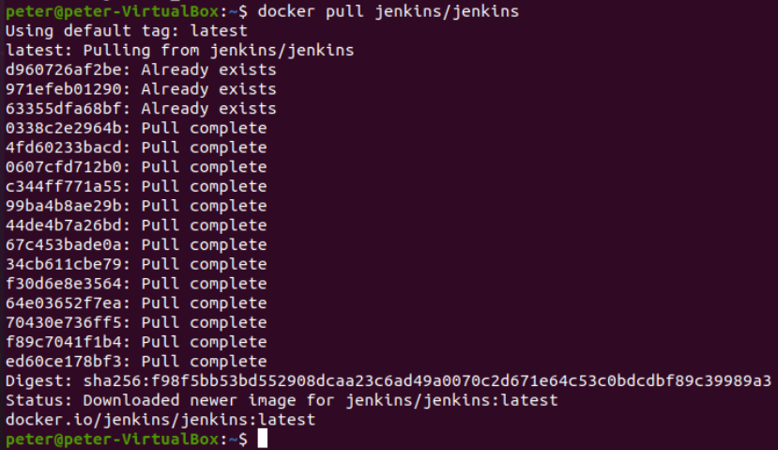
14.7 How to use Volume?
https://www.youtube.com/watch?v=VOK06Q4QqvE&list=PLhW3qG5bs-L99pQsZ74f-LC-tOEsBp2rK&index=14
How to Use Volume
If I want to start our Jenkins container.
You can google “docker hub” and search for “jenkins/jenkins” and check the details of command “docker pull jenkins/jenkins”
> docker pull jenkins/jenkins

Slide 28
14.7 How to use Volume?
https://www.youtube.com/watch?v=VOK06Q4QqvE&list=PLhW3qG5bs-L99pQsZ74f-LC-tOEsBp2rK&index=14
How to Use Volume
> docker run -p 8080:8080 -p 50000:50000 jenkins/jenkins
Run jenkins at Port 8080 at local system and 8080 on the server (-p 8080:8080).
For the API, we use port 50000 for the local system and 50000 for the server.
The API name is “jenkins/jenkins”
If we run the above command, we will start the “jenkins/jenkins” container and we will able to have it running on localhost:8080.
We can go to the browser and localhost:8080 and we will be able to have “jenkins/jenkins” running.
However, we want to have some changes.
We want to give the name of containers. We add “--name MyJenkins01”
> docker run --name MyJenkins01 -p 8080:8080 -p 50000:50000 jenkins/jenkins

Slide 29
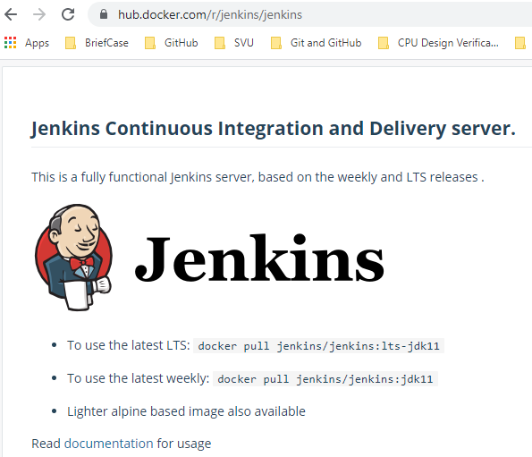
14.7 How to use Volume?
https://www.youtube.com/watch?v=VOK06Q4QqvE&list=PLhW3qG5bs-L99pQsZ74f-LC-tOEsBp2rK&index=14
How to Use Volume
Now, we want to attach a volume. So, I will say “-v myvol01” we just created and this will corresponds to the jenkins/jenkins home directory.
> docker rm MyJenkins01
> docker volume create myvol01
> docker run --name MyJenkins01 -v myvol01:/var/jenkins_home -p 8080:8080 -p 50000:50000 jenkins/jenkins

Slide 30


14.7 How to use Volume?
https://www.youtube.com/watch?v=VOK06Q4QqvE&list=PLhW3qG5bs-L99pQsZ74f-LC-tOEsBp2rK&index=14
How to Use Volume
> docker rm MyJenkins01
> docker volume create myvol01
> docker run --name MyJenkins01 -v myvol01:/var/jenkins_home -p 8080:8080 -p 50000:50000 jenkins/jenkins
1
2
3
1
2
3

Slide 31
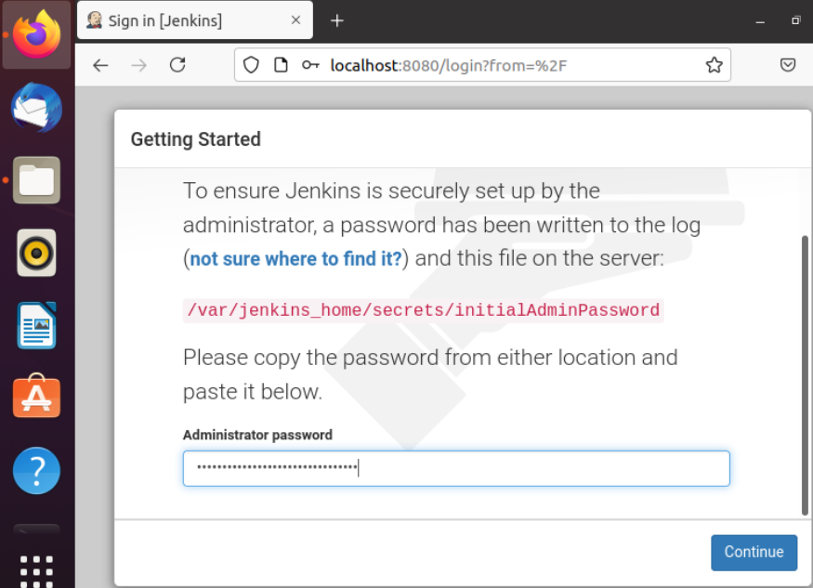
14.7 How to use Volume?
https://www.youtube.com/watch?v=VOK06Q4QqvE&list=PLhW3qG5bs-L99pQsZ74f-LC-tOEsBp2rK&index=14
How to Use Volume
Scroll down the Jenkins message will see the Jenkins password “6924…”
Copy the password to log into jenkins.
Open Firefox browser and paste the password.

Slide 32
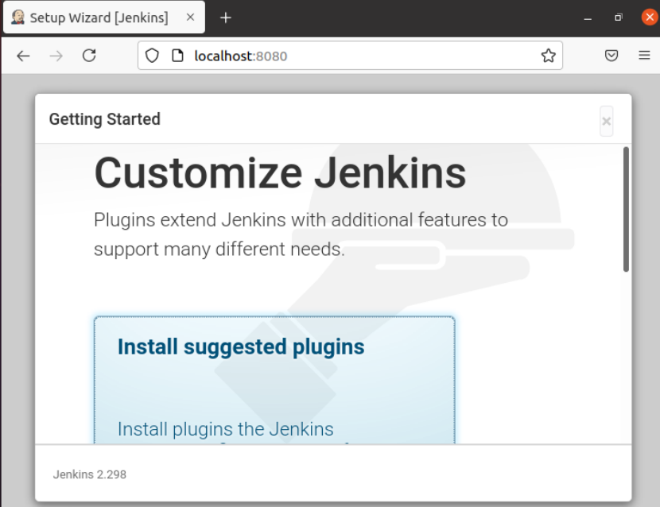
14.7 How to use Volume?
https://www.youtube.com/watch?v=VOK06Q4QqvE&list=PLhW3qG5bs-L99pQsZ74f-LC-tOEsBp2rK&index=14
How to Use Volume
We have the Jenkins option to install the plugins and install plugins to install.
Click “Install suggested plugins” to install.

Slide 33
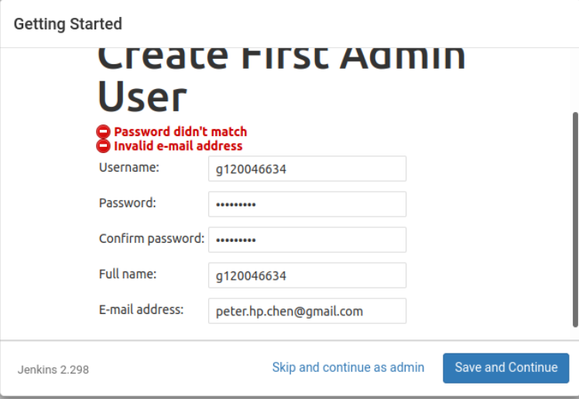
14.7 How to use Volume??
https://www.youtube.com/watch?v=VOK06Q4QqvE&list=PLhW3qG5bs-L99pQsZ74f-LC-tOEsBp2rK&index=14
How to Use Volume
Reset the new password.

Slide 34
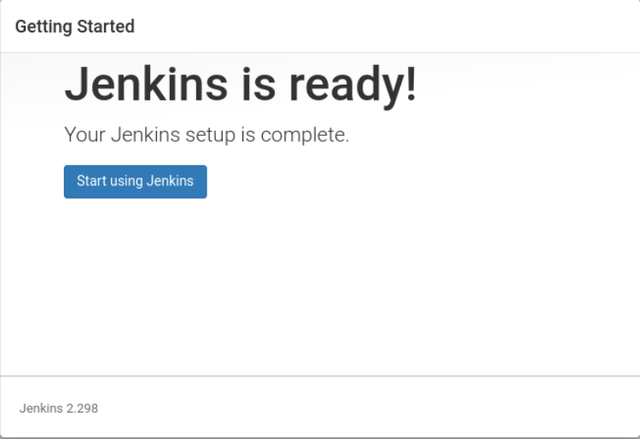
14.7 How to use Volume?
https://www.youtube.com/watch?v=VOK06Q4QqvE&list=PLhW3qG5bs-L99pQsZ74f-LC-tOEsBp2rK&index=14
How to Use Volume
Reset the new password.

Slide 35
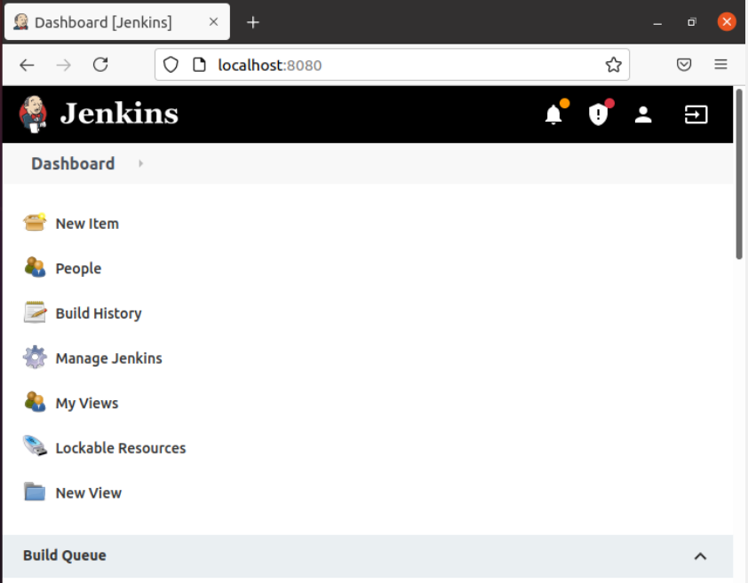
14.7 How to use Volume?
https://www.youtube.com/watch?v=VOK06Q4QqvE&list=PLhW3qG5bs-L99pQsZ74f-LC-tOEsBp2rK&index=14
How to Use Volume
Click “New Item”

Slide 36
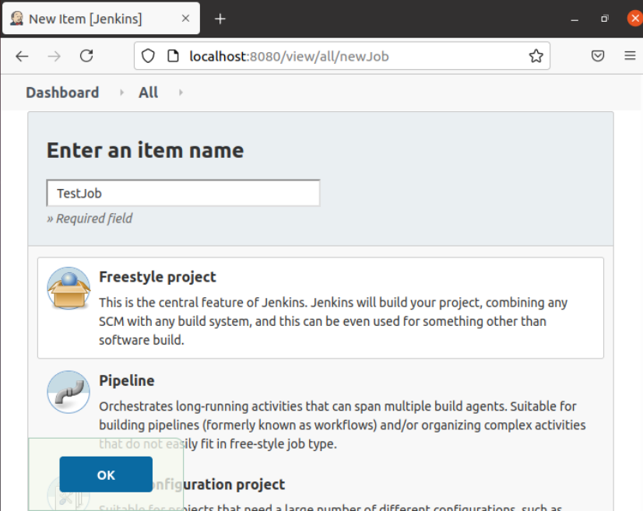
14.7 How to use Volume?
https://www.youtube.com/watch?v=VOK06Q4QqvE&list=PLhW3qG5bs-L99pQsZ74f-LC-tOEsBp2rK&index=14
How to Use Volume
Item Name “TestJob” and select “Freestyle Project”

Slide 37
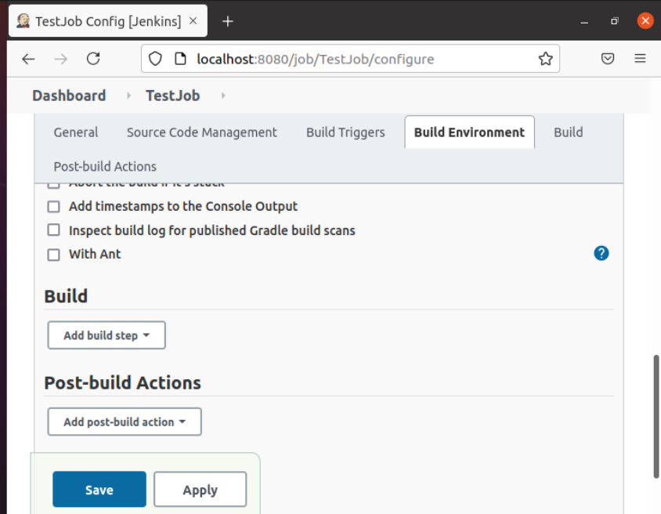
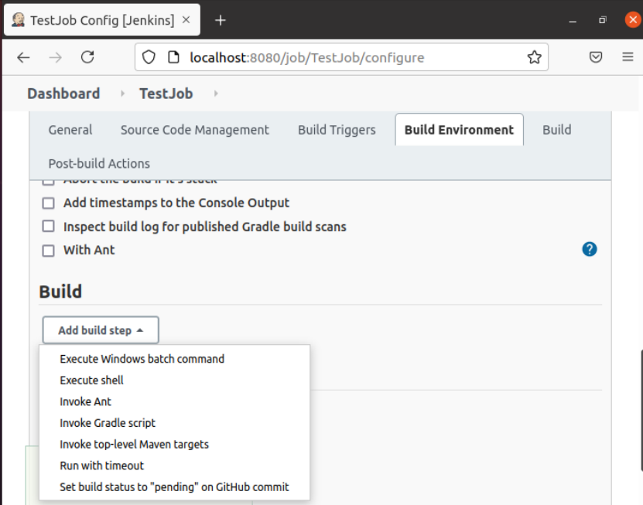
14.7 How to use Volume?
https://www.youtube.com/watch?v=VOK06Q4QqvE&list=PLhW3qG5bs-L99pQsZ74f-LC-tOEsBp2rK&index=14
How to Use Volume
In Build, select “Execute Shell”

Slide 38
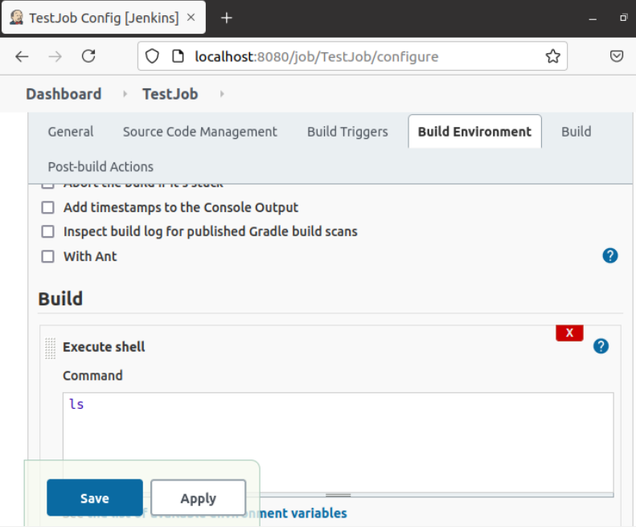
14.7 How to use Volume?
https://www.youtube.com/watch?v=VOK06Q4QqvE&list=PLhW3qG5bs-L99pQsZ74f-LC-tOEsBp2rK&index=14
How to Use Volume
Put the command “ls” and Apply and Save.

Slide 39
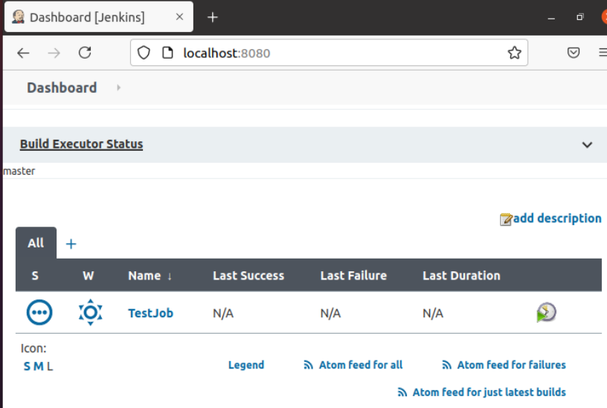
14.7 How to use Volume?
https://www.youtube.com/watch?v=VOK06Q4QqvE&list=PLhW3qG5bs-L99pQsZ74f-LC-tOEsBp2rK&index=14
How to Use Volume
Go to the Dashboard, you will see the project “TestJob”.

Slide 40
14.8 Run Another Jenkins

Slide 41
14.8 Run Another Jenkins
https://www.youtube.com/watch?v=VOK06Q4QqvE&list=PLhW3qG5bs-L99pQsZ74f-LC-tOEsBp2rK&index=14
Run Another Jenkins
We use the same volume of data but with docker container MyJenkins02
> docker run --name MyJenkins02 -v myvol01:/var/jenkins_home -p 9090:8080 -p 60000:50000 jenkins/jenkins
Run jenkins at Port 9090 at local system and 8080 on the server (-p 9090:8080).
For the API, we use port 60000 for the local system and 50000 for the server.
The API name is “jenkins/jenkins”
If we run the above command, we will start the “jenkins/jenkins” container and we will able to have it running on localhost:9090.
We can go to the browser and localhost:9090 and we will be able to have “jenkins/jenkins” running.
However, we want to have some changes.
We want to give the name of containers. We add “--name MyJenkins02”
> docker run --name MyJenkins02 -p 8080:8080 -p 50000:50000 jenkins/jenkins

Slide 42
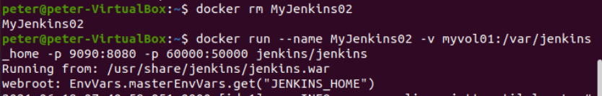
14.8 Run Another Jenkins
https://www.youtube.com/watch?v=VOK06Q4QqvE&list=PLhW3qG5bs-L99pQsZ74f-LC-tOEsBp2rK&index=14
Run Another Jenkins
> docker run --name MyJenkins02 -v myvol01:/var/jenkins_home -p 9090:8080 -p 60000:50000 jenkins/jenkins

Slide 43
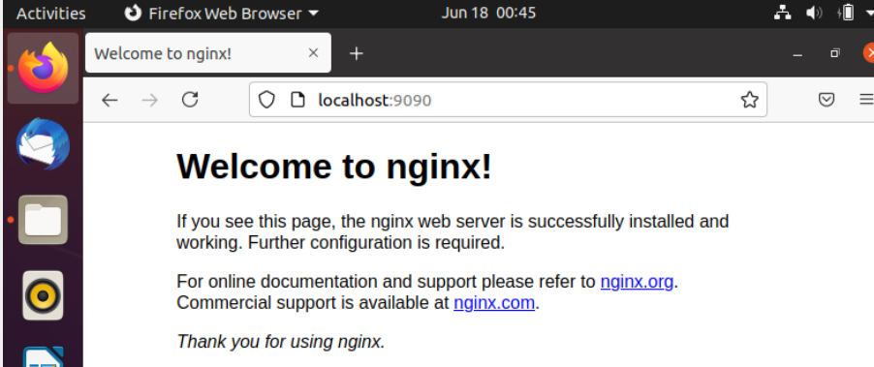
14.8 Run Another Jenkins
https://www.youtube.com/watch?v=VOK06Q4QqvE&list=PLhW3qG5bs-L99pQsZ74f-LC-tOEsBp2rK&index=14
Run Another Jenkins
Open Firefox:
> localhost:9090

Slide 44
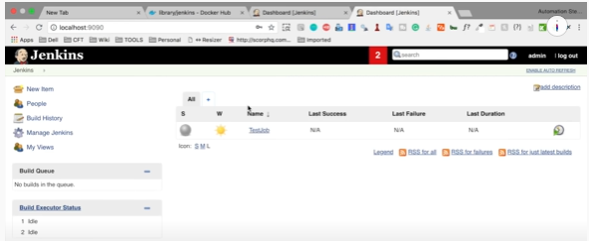
14.8 Run Another Jenkins
https://www.youtube.com/watch?v=VOK06Q4QqvE&list=PLhW3qG5bs-L99pQsZ74f-LC-tOEsBp2rK&index=14
Run Another Jenkins
Open Firefox:
> localhost:9090
You can see the data still in the Jenkins/jenkins.
The volume data is share by for container MyJenins01 at port 8080 and container MyKenins02 at port 9090.

Slide 45
14.9 Stop Containers

Slide 46
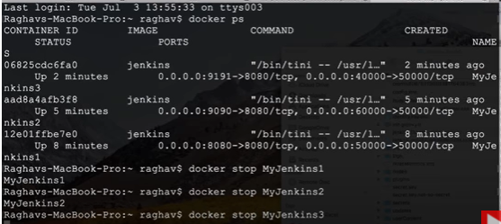
14.9 Stop Containers
https://www.youtube.com/watch?v=VOK06Q4QqvE&list=PLhW3qG5bs-L99pQsZ74f-LC-tOEsBp2rK&index=14
Stop Containers
We can use port 9191 and API use port 70000
Then open the browser, we can see more instances running.
We can use “docker ps” and see three containers is running.
We can stop the containers:
> docker stop MyJenkins01
> docker stop MyJenkins02
> docker stop MyJenkins03

Slide 47
14.10 Remove Containers

Slide 48
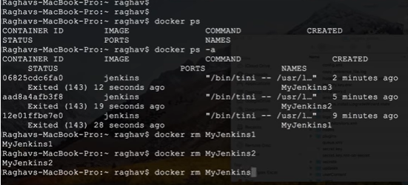
14.10 Remove Containers
https://www.youtube.com/watch?v=VOK06Q4QqvE&list=PLhW3qG5bs-L99pQsZ74f-LC-tOEsBp2rK&index=14
Remove Containers
Remove the images:
> docker rm MyJenkins01
> docker rm MyJenkins02
> docker rm MyJenkins03

Slide 49
14.11 Check Data Volume

Slide 50
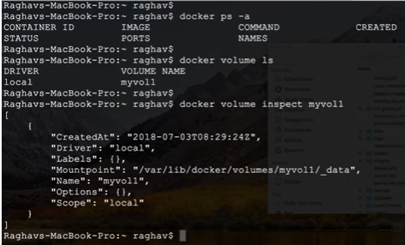
14.11 Check Data Volume
https://www.youtube.com/watch?v=VOK06Q4QqvE&list=PLhW3qG5bs-L99pQsZ74f-LC-tOEsBp2rK&index=14
Check Data Volume
You can check the data volume still there.
> docker volume ls
> docker volume inspect myvol01

Slide 51
End

