Slide 1

15 Docker Swarm
Peter H. Chen

Slide 2
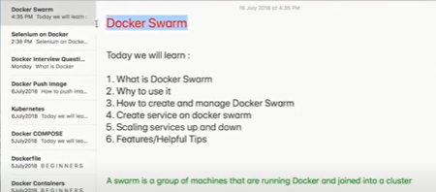
15 Docker Swarm
https://www.youtube.com/watch?v=Tm0Q5zr3FL4
Docker Swarm
We discuss the following topics:
1. What is Docker Swarm?
2. Why to Use it?
3. How to create and manage Docker Swarm?
4. Scaling Services up and Down
5. Features/Helpful tips
A swarm is a group of machine that are running Docker and Joined into a cluster.

Slide 3
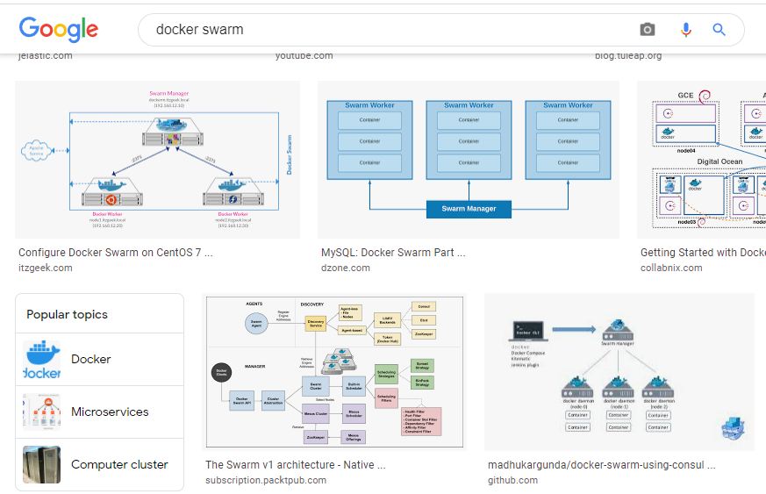
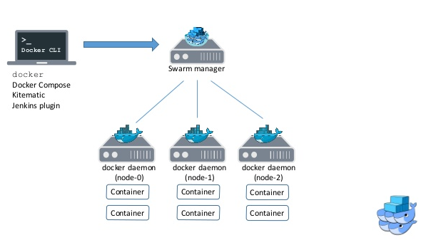
15 Docker Swarm
https://www.youtube.com/watch?v=Tm0Q5zr3FL4
Docker Swarm
Google “Docker Swarm” Images.

Slide 4
15 Docker Swarm
https://www.youtube.com/watch?v=Tm0Q5zr3FL4
Docker Swarm
Here, we have multiple nodes and one node is the manager
…and the other nodes are the workers.

Slide 5
15 Docker Swarm
https://www.youtube.com/watch?v=Tm0Q5zr3FL4
Docker Swarm
We have architecture for multiple machines running Docker connected to each other
…and we can manage all these nodes from a single machine.

Slide 6
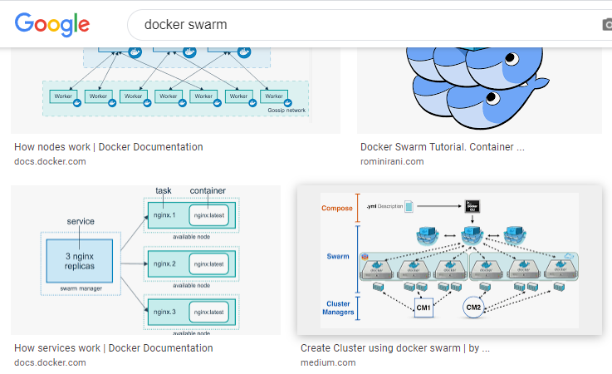
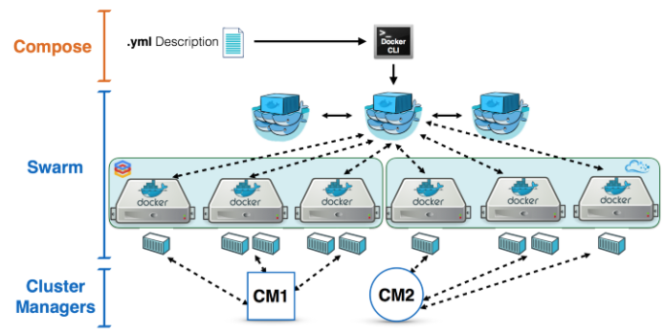
15 Docker Swarm
https://www.youtube.com/watch?v=Tm0Q5zr3FL4
Docker Swarm
We can google other “docker swarm” image.

Slide 7
15 Docker Swarm
https://www.youtube.com/watch?v=Tm0Q5zr3FL4
Docker Swarm
Here, again, we have some managers
…and there are some worker nodes here .

Slide 8
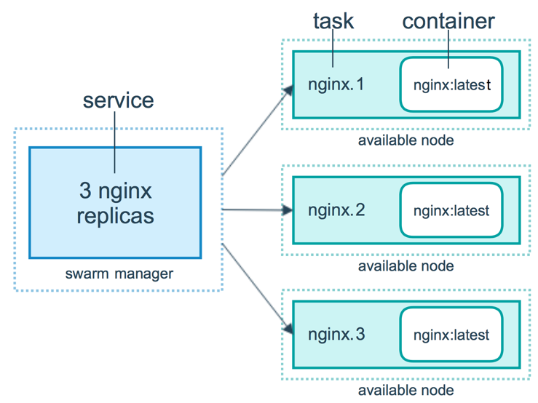
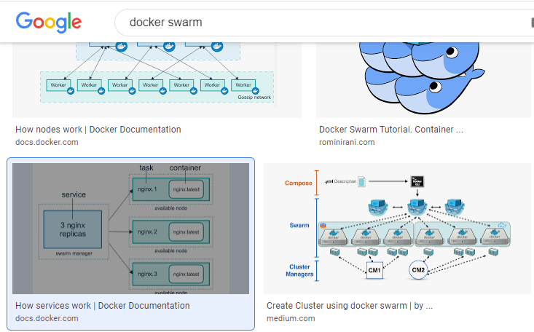
15 Docker Swarm
https://www.youtube.com/watch?v=Tm0Q5zr3FL4
Docker Swarm
We look at some more google “docker swarm” image.

Slide 9
15 Docker Swarm
https://www.youtube.com/watch?v=Tm0Q5zr3FL4
Docker Swarm
This is exactly what we will do in this Episode.
We have a node which we create as a swarm.
This is the swarm manager.

Slide 10
15 Docker Swarm
https://www.youtube.com/watch?v=Tm0Q5zr3FL4
Docker Swarm
This is exactly what we will do in this Episode.
We have a node which we create as a swarm.
This is the swarm manager.

Slide 11
15 Docker Swarm
https://www.youtube.com/watch?v=Tm0Q5zr3FL4
Docker Swarm
We have three workers.
…and we have created services
…and we have all of them in a single machine.

Slide 12
15 Docker Swarm
https://www.youtube.com/watch?v=Tm0Q5zr3FL4
Docker Swarm
The swarm manager control all dockers.
We will look the advantages of Docker manager and how it work together with workers at the Enterprise level.
We will know how useful Docker Swarm can help.

Slide 13
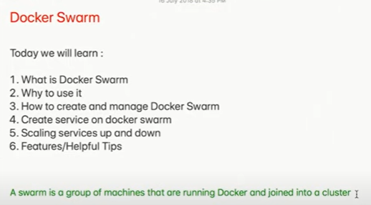
15 Docker Swarm
https://www.youtube.com/watch?v=Tm0Q5zr3FL4
Docker Swarm
Let see some documentation:
Docker Swarm is a group of machines that are running Docker and joined into a cluster.
On this, you will come to know what exactly are the advantages
…so when we work at Enterprise level, we will come to know exactly how useful docker swam can be.

Slide 14
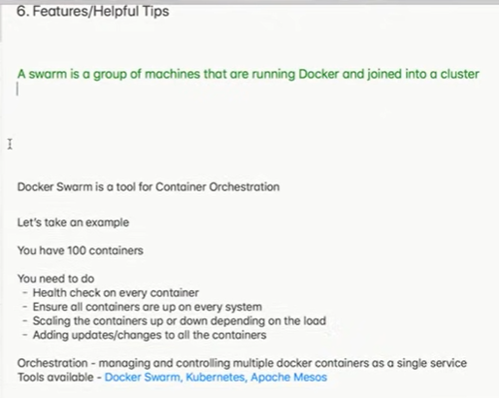
15 Docker Swarm
https://www.youtube.com/watch?v=Tm0Q5zr3FL4
Docker Swarm
Docker Swarm is a tool for container Orchestra. Let’s see how useful of docker swarm.
What does that mean?
For example, suppose we have 100 containers

Slide 15
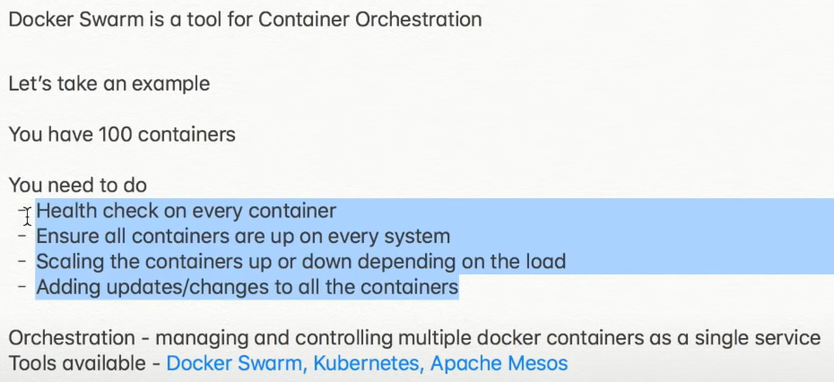
15 Docker Swarm
https://www.youtube.com/watch?v=Tm0Q5zr3FL4
Docker Swarm
In the 100 containers,
…and we need to heath check on every container.
…and we need to ensure that all containers are up every time
…in case one container is down,
…the other container takes up its task and then adding updating

Slide 16
15 Docker Swarm
https://www.youtube.com/watch?v=Tm0Q5zr3FL4
Docker Swarm
…therefore, we need something like Docker Swarm or some other orchestration tools.
Other tools can be Kubernetes or Apache Mesos.
Kubernetes and Apache Mesos work similarly to Docker Swarm.
These are the orchestration tools that help us in managing and controlling multiple Docker containers as a single service.
This is what Docker Swarm and what it does.

Slide 17
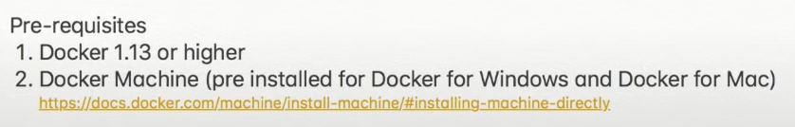
15 Docker Swarm
https://www.youtube.com/watch?v=Tm0Q5zr3FL4
Docker Swarm
The pre-requisites for Docker swarm are:
1. We should have docker 1.13 or higher.
2. Docker Machine as installed for Windows, Mac, and Linux.

Slide 18
15.1 Setup Docker Swarm on Ubuntu

Slide 19
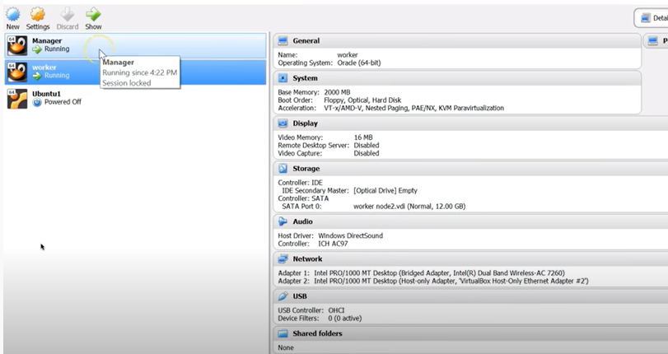
15.1 Setup Docker Swarm on Ubuntu
https://computingforgeeks.com/how-to-install-docker-swarm-on-ubuntu/
Setup Docker Swarm on Ubuntu
First, create two virtual machines: One manager and one worker.
1. Manager
2. Worker

Slide 20
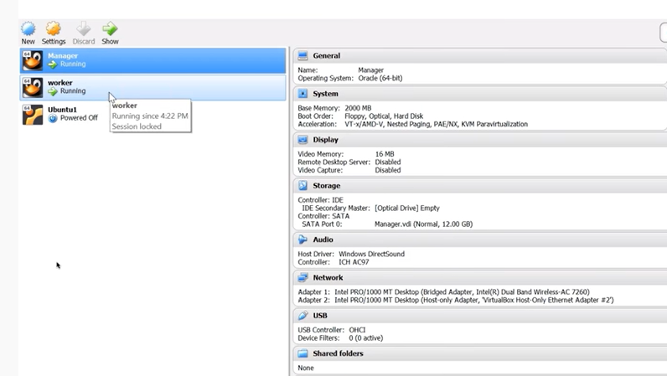
15.1 Setup Docker Swarm on Ubuntu
https://computingforgeeks.com/how-to-install-docker-swarm-on-ubuntu/
Setup Docker Swarm on Ubuntu
Run the Manager on Ubuntu

Slide 21
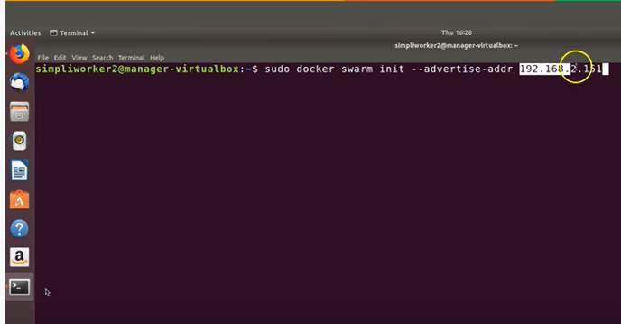
15.1 Setup Docker Swarm on Ubuntu
https://computingforgeeks.com/how-to-install-docker-swarm-on-ubuntu/
Setup Docker Swarm on Ubuntu
On the manager machine.
> sudo docker swarm init –advertise-addr 192.168.2.151
We use the IP address: 192.168.2.151 for the network we are connecting to.

Slide 22
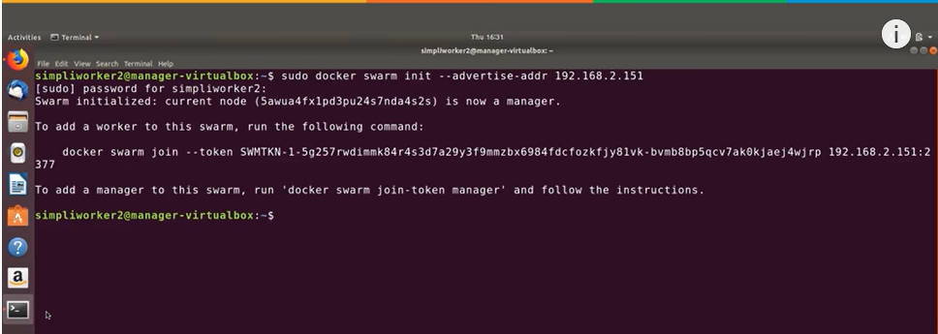
15.1 Setup Docker Swarm on Ubuntu
https://computingforgeeks.com/how-to-install-docker-swarm-on-ubuntu/
Setup Docker Swarm on Ubuntu
Enter the password.
Here we are connected.

Slide 23
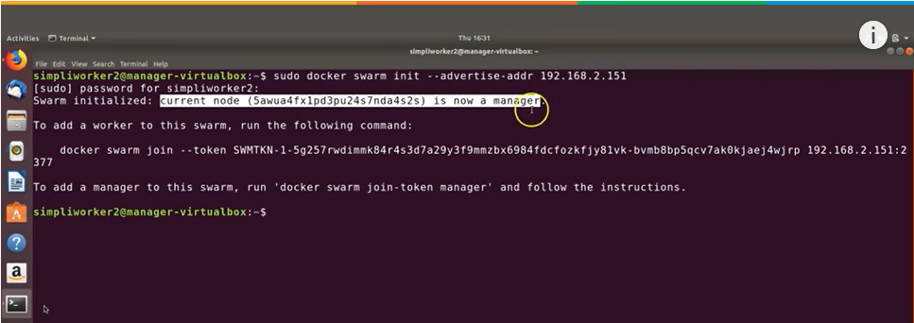
15.1 Setup Docker Swarm on Ubuntu
https://computingforgeeks.com/how-to-install-docker-swarm-on-ubuntu/
Setup Docker Swarm on Ubuntu (11:08/15:41)
This is the manager node.
…and what we want to be able to highlight is the specific token which identifies the docker swarm environment and this is our token.

Slide 24
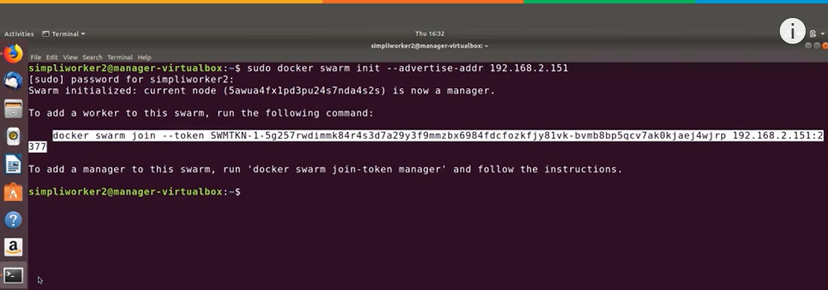
15.1 Setup Docker Swarm on Ubuntu
https://computingforgeeks.com/how-to-install-docker-swarm-on-ubuntu/
Setup Docker Swarm on Ubuntu (11:20/15:41)
We are going to copy this because we will need to use that for our work environment.

Slide 25
15.1 Setup Docker Swarm on Ubuntu
https://computingforgeeks.com/how-to-install-docker-swarm-on-ubuntu/
Setup Docker Swarm on Ubuntu (11:22/15:41)
Then, we open the worker environment.

Slide 26
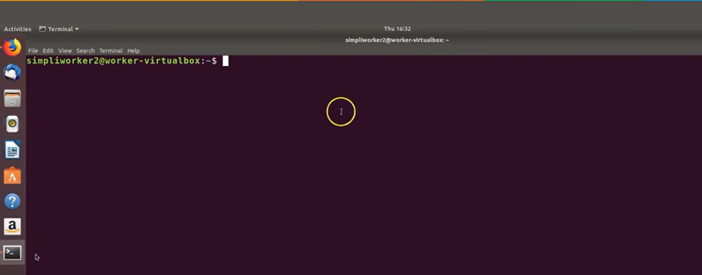
15.1 Setup Docker Swarm on Ubuntu
https://computingforgeeks.com/how-to-install-docker-swarm-on-ubuntu/
Setup Docker Swarm on Ubuntu (11:22/15:41)
Here, we are in working environment.

Slide 27
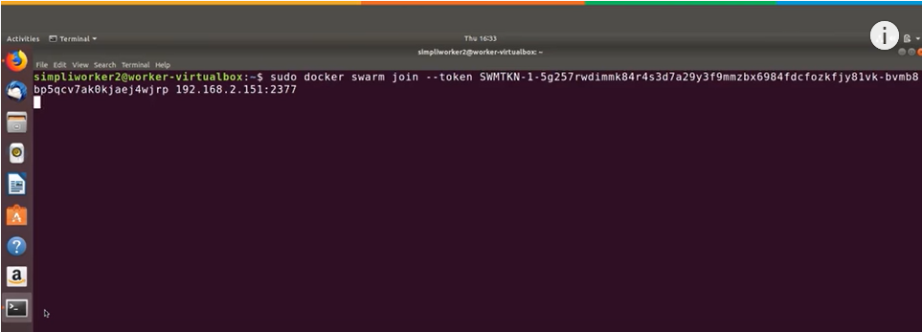
15.1 Setup Docker Swarm on Ubuntu
https://computingforgeeks.com/how-to-install-docker-swarm-on-ubuntu/
Setup Docker Swarm on Ubuntu (11:26/15:41)
We will use the token we just copied as a way to connect the manager
…and connect to docker swarm environment
> sudo <paste the command from manager terminal>
Then, the worker join the swarm environment which is created by manager.

Slide 28
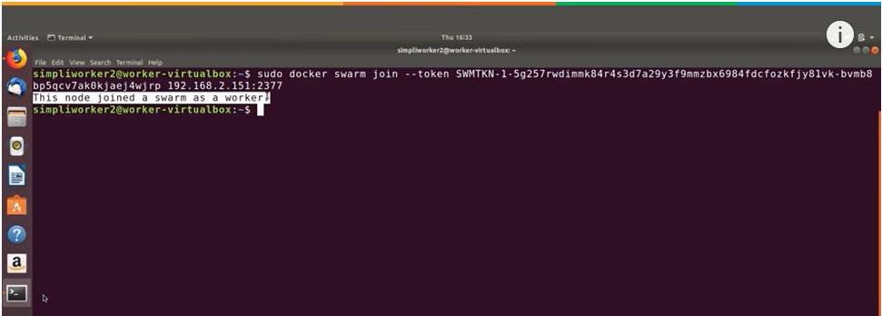
15.1 Setup Docker Swarm on Ubuntu
https://computingforgeeks.com/how-to-install-docker-swarm-on-ubuntu/
Setup Docker Swarm on Ubuntu (11:45/15:41)
We see the message below that we join the swarm environment as a worker.

Slide 29
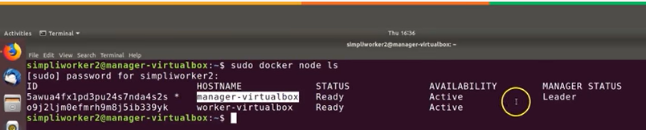
15.1 Setup Docker Swarm on Ubuntu
https://computingforgeeks.com/how-to-install-docker-swarm-on-ubuntu/
Setup Docker Swarm on Ubuntu (12:20/15:41)
In the manager terminal,
> sudo docker node ls
You can see both the worker node and manager node are running.
Both are active.
…and manager is the leader.
…and worker is in the swarm.

Slide 30
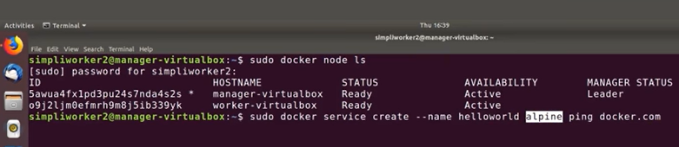
15.1 Setup Docker Swarm on Ubuntu
https://computingforgeeks.com/how-to-install-docker-swarm-on-ubuntu/
Setup Docker Swarm on Ubuntu (12:20/15:41)
In the manager terminal,
In the manger platform, we create a new service
…so we create a helloworld and we use alpine image from docker.com
> sudo docker service create --name helloworld alpine ping docer.com

Slide 31
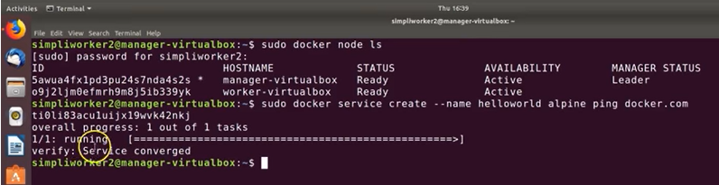
15.1 Setup Docker Swarm on Ubuntu
https://computingforgeeks.com/how-to-install-docker-swarm-on-ubuntu/
Setup Docker Swarm on Ubuntu (12:50/15:41)
It takes minute to run.
We see the message “verify: service converged”
Now, we have the new service has been created.

Slide 32
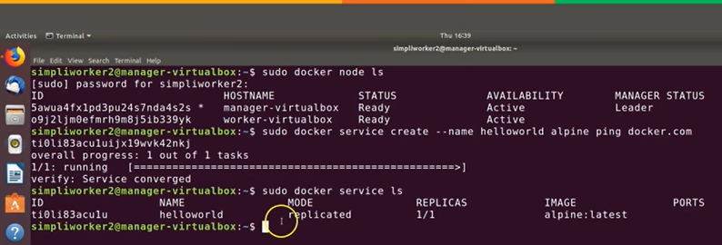
15.1 Setup Docker Swarm on Ubuntu
https://computingforgeeks.com/how-to-install-docker-swarm-on-ubuntu/
Setup Docker Swarm on Ubuntu (13:02/15:41)
On the manager terminal,
> sudo docker service ls
We see the helloWorld service

Slide 33
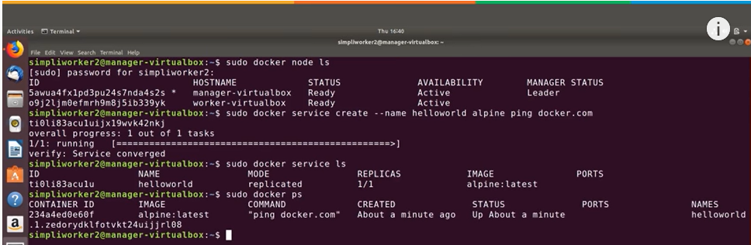
15.1 Setup Docker Swarm on Ubuntu
https://computingforgeeks.com/how-to-install-docker-swarm-on-ubuntu/
Setup Docker Swarm on Ubuntu (13:22/15:41)
On the manager terminal,
> sudo docker ps
>> alpine is the latest image and that is the docker container.
We have container ID, and it is just updated.

Slide 34
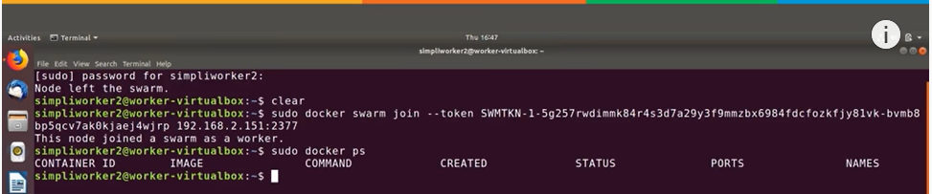
15.1 Setup Docker Swarm on Ubuntu
https://computingforgeeks.com/how-to-install-docker-swarm-on-ubuntu/
Setup Docker Swarm on Ubuntu (13:54/15:41)
Now, on the worker node and make sure everything is working over there.
So, change to the worker terminal and paste the join command.
In the worker node, we do not have any running container yet.

Slide 35
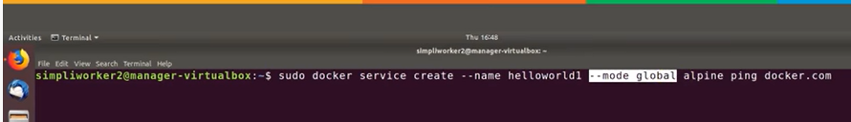
15.1 Setup Docker Swarm on Ubuntu
https://computingforgeeks.com/how-to-install-docker-swarm-on-ubuntu/
Setup Docker Swarm on Ubuntu (14:01/15:41)
Now, on the manager node and make sure everything is working over there.
So, change to the worker terminal and paste the join command.

Slide 36
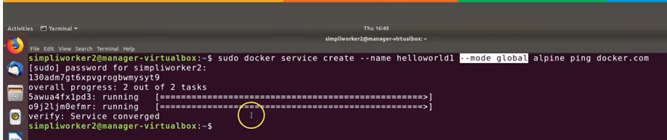
15.1 Setup Docker Swarm on Ubuntu
https://computingforgeeks.com/how-to-install-docker-swarm-on-ubuntu/
Setup Docker Swarm on Ubuntu (14:10/15:41)
Now, on the worker node, we can see there are two tasks are running on the worker node.

Slide 37
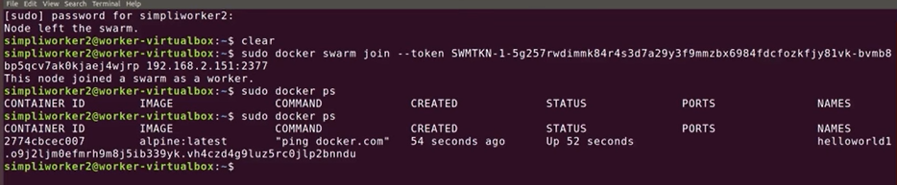
15.1 Setup Docker Swarm on Ubuntu
https://computingforgeeks.com/how-to-install-docker-swarm-on-ubuntu/
Setup Docker Swarm on Ubuntu (14:32/15:41)
We have two different ID for two different services running.
…and if we go back to the worker node and
> sudo docker ps

Slide 38

15.1 Setup Docker Swarm on Ubuntu
https://computingforgeeks.com/how-to-install-docker-swarm-on-ubuntu/
Setup Docker Swarm on Ubuntu (14:46/15:41)
If we want to kill a node from the swarm
We can use the “leave –force” command which will force the node to leave the swarm.

Slide 39
End

