Slide 1
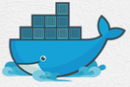
15 Docker Swarm
Peter H. Chen

Slide 2
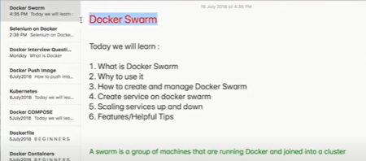
15 Docker Swarm
https://www.youtube.com/watch?v=bU2NNFJ-UXA&list=PLhW3qG5bs-L99pQsZ74f-LC-tOEsBp2rK&index=15
Docker Swarm
We discuss the following topics:
1. What is Docker Swarm?
2. Why to Use it?
3. How to create and manage Docker Swarm?
4. Scaling Services up and Down
5. Features/Helpful tips
A swarm is a group of machine that are running Docker and Joined into a cluster.

Slide 3
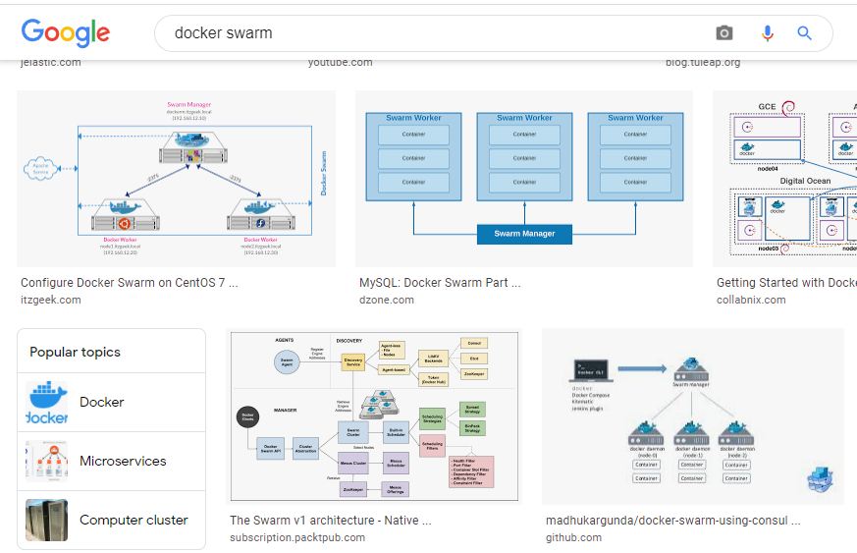
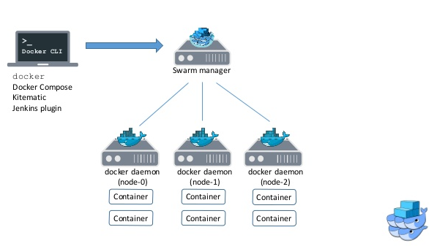
15 Docker Swarm
https://www.youtube.com/watch?v=bU2NNFJ-UXA&list=PLhW3qG5bs-L99pQsZ74f-LC-tOEsBp2rK&index=15
Docker Swarm
Google “Docker Swarm” Images.

Slide 4
15 Docker Swarm
https://www.youtube.com/watch?v=bU2NNFJ-UXA&list=PLhW3qG5bs-L99pQsZ74f-LC-tOEsBp2rK&index=15
Docker Swarm
Here, we have multiple nodes and one node is the manager
…and the other nodes are the workers.

Slide 5
15 Docker Swarm
https://www.youtube.com/watch?v=bU2NNFJ-UXA&list=PLhW3qG5bs-L99pQsZ74f-LC-tOEsBp2rK&index=15
Docker Swarm
We have architecture for multiple machines running Docker connected to each other
…and we can manage all these nodes from a single machine.

Slide 6
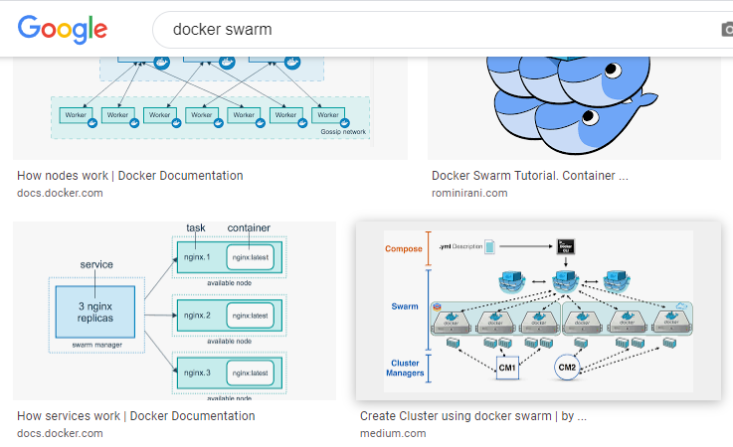
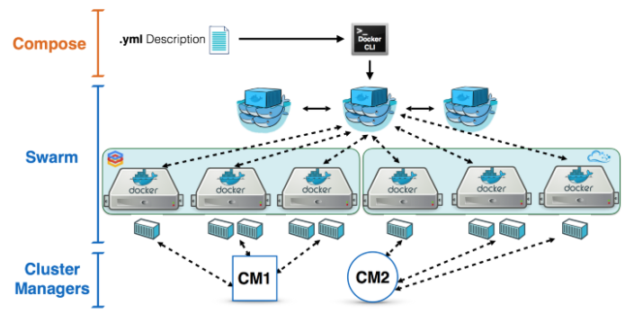
15 Docker Swarm
https://www.youtube.com/watch?v=bU2NNFJ-UXA&list=PLhW3qG5bs-L99pQsZ74f-LC-tOEsBp2rK&index=15
Docker Swarm
We can google other “docker swarm” image.

Slide 7
15 Docker Swarm
https://www.youtube.com/watch?v=bU2NNFJ-UXA&list=PLhW3qG5bs-L99pQsZ74f-LC-tOEsBp2rK&index=15
Docker Swarm
Here, again, we have some managers
…and there are some worker nodes here .

Slide 8
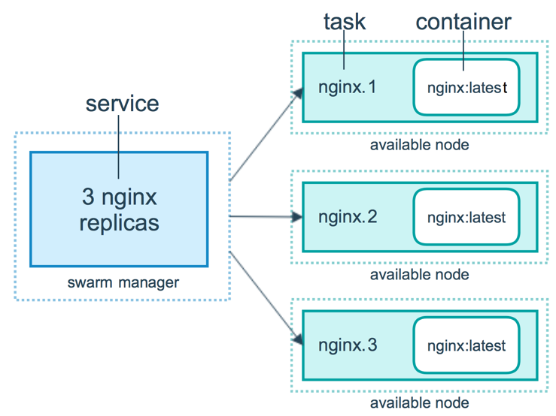
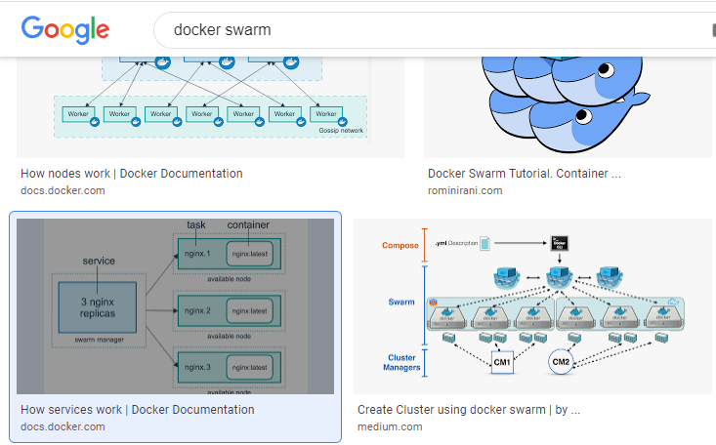
15 Docker Swarm
https://www.youtube.com/watch?v=bU2NNFJ-UXA&list=PLhW3qG5bs-L99pQsZ74f-LC-tOEsBp2rK&index=15
Docker Swarm
We look at some more google “docker swarm” image.

Slide 9
15 Docker Swarm
https://www.youtube.com/watch?v=bU2NNFJ-UXA&list=PLhW3qG5bs-L99pQsZ74f-LC-tOEsBp2rK&index=15
Docker Swarm
This is exactly what we will do in this Episode.
We have a node which we create as a swarm.
This is the swarm manager.

Slide 10
15 Docker Swarm
https://www.youtube.com/watch?v=bU2NNFJ-UXA&list=PLhW3qG5bs-L99pQsZ74f-LC-tOEsBp2rK&index=15
Docker Swarm
This is exactly what we will do in this Episode.
We have a node which we create as a swarm.
This is the swarm manager.

Slide 11
15 Docker Swarm
https://www.youtube.com/watch?v=bU2NNFJ-UXA&list=PLhW3qG5bs-L99pQsZ74f-LC-tOEsBp2rK&index=15
Docker Swarm
We have three workers.
…and we have created services
…and we have all of them in a single machine.

Slide 12
15 Docker Swarm
https://www.youtube.com/watch?v=bU2NNFJ-UXA&list=PLhW3qG5bs-L99pQsZ74f-LC-tOEsBp2rK&index=15
Docker Swarm
The swarm manager control all dockers.
We will look the advantages of Docker manager and how it work together with workers at the Enterprise level.
We will know how useful Docker Swarm can help.

Slide 13
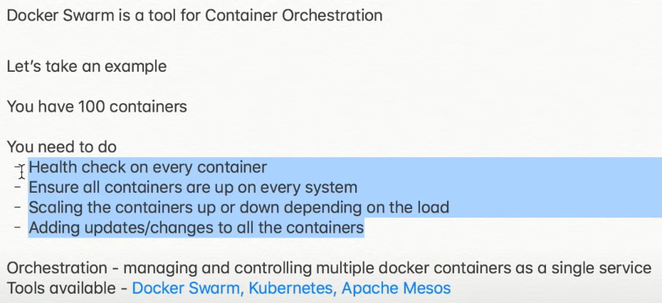
15 Docker Swarm
https://www.youtube.com/watch?v=bU2NNFJ-UXA&list=PLhW3qG5bs-L99pQsZ74f-LC-tOEsBp2rK&index=15
Docker Swarm
Docker Swarm is a tool for container Orchestra.
What does that mean?
For example, suppose we have 100 containers

Slide 14
15 Docker Swarm
https://www.youtube.com/watch?v=bU2NNFJ-UXA&list=PLhW3qG5bs-L99pQsZ74f-LC-tOEsBp2rK&index=15
Docker Swarm
…and we need to heath check on every container.
…and we need to ensure that all containers are up every time
…in case one container is down,
…the other container takes up its task and then adding updating

Slide 15
15 Docker Swarm
https://www.youtube.com/watch?v=bU2NNFJ-UXA&list=PLhW3qG5bs-L99pQsZ74f-LC-tOEsBp2rK&index=15
Docker Swarm
…therefore, we need something like Docker Swarm or some other orchestration tools.
Other tools can be Kubernetes or Apache Mesos.
Kubernetes and Apache Mesos work similarly to Docker Swarm.
These are the orchestration tools that help us in managing and controlling multiple Docker containers as a single service.
This is what Docker Swarm and what it does.

Slide 16
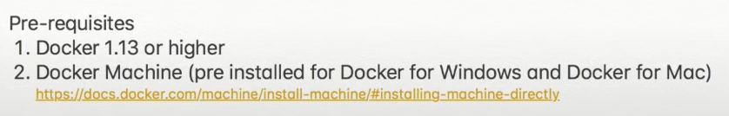
15 Docker Swarm
https://www.youtube.com/watch?v=bU2NNFJ-UXA&list=PLhW3qG5bs-L99pQsZ74f-LC-tOEsBp2rK&index=15
Docker Swarm
The pre-requisites for Docker swarm are:
1. We should have docker 1.13 or higher.
2. Docker Machine as installed for Windows, Mac, and Linux.

Slide 17
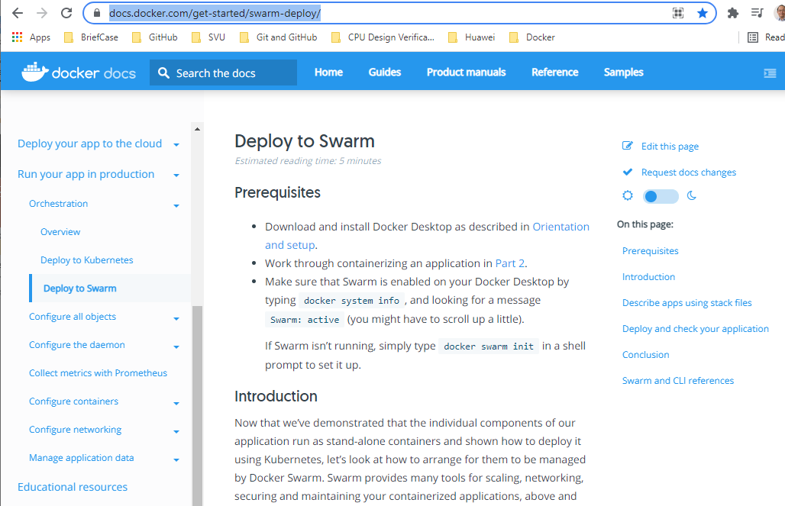
15 Docker Swarm
https://www.youtube.com/watch?v=bU2NNFJ-UXA&list=PLhW3qG5bs-L99pQsZ74f-LC-tOEsBp2rK&index=15
Docker Swarm
Go to https://docs.docker.com/get-started/swarm-deploy/

Slide 18
15 Docker Swarm
https://www.youtube.com/watch?v=bU2NNFJ-UXA&list=PLhW3qG5bs-L99pQsZ74f-LC-tOEsBp2rK&index=15
Install Docker Machine for Windows or Macs
What is difference between the Docker (command-line) and Docker Machine?
https://stackoverflow.com/questions/38623027/what-is-the-difference-between-docker-machine-and-docker-compose
Docker is the command-line tool that uses containerization to manage multiple images and containers and volumes and such -- a container is basically a lightweight virtual machine. See https://docs.docker.com/ for extensive documentation.
Until recently Docker didn't run on native Mac or Windows OS, so another tool was created, Docker-Machine, which creates a virtual machine (using yet another tool, e.g. Oracle VirtualBox), runs Docker on that VM, and helps coordinate between the host OS and the Docker VM.
Since Docker isn't running on your actual host OS, docker-machine needs to deal with IP addresses and ports and volumes and such.
And its settings are saved in environment variables, which means you have to run commands like this every time you open a new shell.

Slide 19
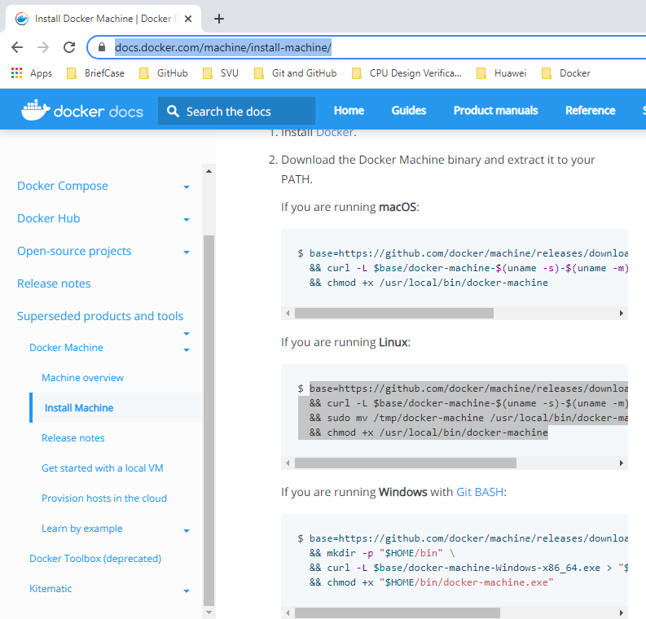
15 Docker Swarm
https://www.youtube.com/watch?v=bU2NNFJ-UXA&list=PLhW3qG5bs-L99pQsZ74f-LC-tOEsBp2rK&index=15
Install Docker Machine for Windows or Macs
Go to https://docs.docker.com/machine/install-machine/
If you do not have Docker Machine on Windows and Macs, you can install it from here.

Slide 20
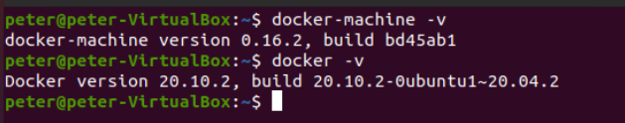
15 Docker Swarm
https://www.youtube.com/watch?v=bU2NNFJ-UXA&list=PLhW3qG5bs-L99pQsZ74f-LC-tOEsBp2rK&index=15
Install Docker Machine for Windows or Macs
Open the terminal
1. Check for docker version:
> docker -v
2. check for Docker machine:
> docker-machine -v
If you dot have the Docker Machine on Windows or Macs, install the Docker Machine first.

Slide 21
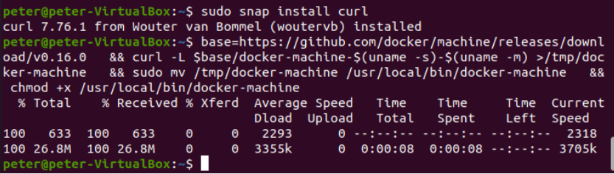
15 Docker Swarm
https://www.youtube.com/watch?v=bU2NNFJ-UXA&list=PLhW3qG5bs-L99pQsZ74f-LC-tOEsBp2rK&index=15
Install Docker Machine for Windows or Macs
For Linux, remove the exiting Docker-machine
https://docs.docker.com/machine/install-machine/
1. Remove docker, installed via snap: sudo snap remove docker.
2. Install docker-machine with official instructions: https://docs.docker.com/machine/install-machine/

Slide 22

15 Docker Swarm
https://www.youtube.com/watch?v=bU2NNFJ-UXA&list=PLhW3qG5bs-L99pQsZ74f-LC-tOEsBp2rK&index=15
Install Docker-machine on Linux:
https://stackoverflow.com/questions/56842036/docker-machine-looks-for-files-in-the-wrong-path
Docker machine install the wrong path /usr/local/bin.
Use the following command after the installation.
> sudo ln /usr/local/bin/docker-machine /snap/bin/docker-machine

Slide 23
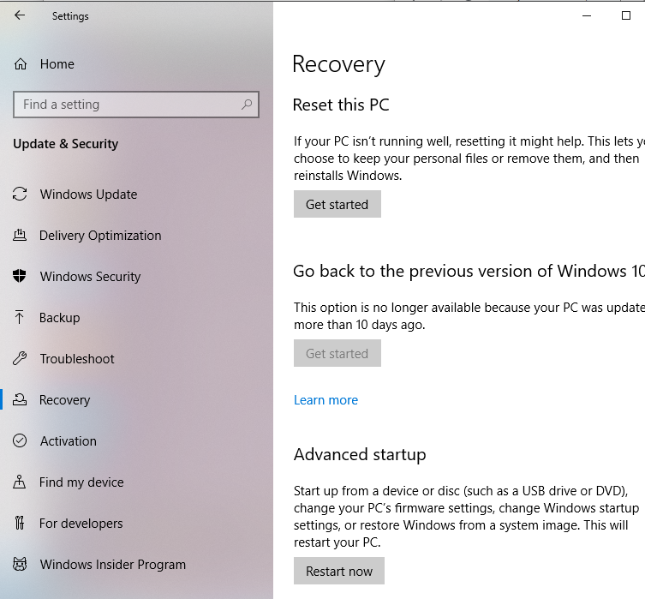
15 Docker Swarm
https://www.youtube.com/watch?v=bU2NNFJ-UXA&list=PLhW3qG5bs-L99pQsZ74f-LC-tOEsBp2rK&index=15
Install Docker-machine on Linux:
https://www.youtube.com/watch?v=RG4Y8ZYbuEU
Turn on Virtualization.
> Start > Settings > Update & Security
> Recovery
>Advanced start > Restart now

Slide 24
15 Docker Swarm
https://www.youtube.com/watch?v=bU2NNFJ-UXA&list=PLhW3qG5bs-L99pQsZ74f-LC-tOEsBp2rK&index=15
Install Docker-machine on Linux:
https://www.youtube.com/watch?v=RG4Y8ZYbuEU
Restart computer
> Trouble Shooting
> Advanced options
> Setting

Slide 25
15.1 Create Docker Machine

Slide 26
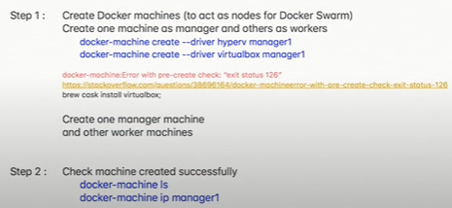
15.1 Create Docker Machine
https://www.youtube.com/watch?v=bU2NNFJ-UXA&list=PLhW3qG5bs-L99pQsZ74f-LC-tOEsBp2rK&index=15
Create Docker Machine
We have to create Docker Machine to access the a node for Docker Swarm.
We are going to create multiple machines as in the right below diagram.
One machine is the manager and other machines are the workers.

Slide 27

15.1 Create Docker Machine
https://www.youtube.com/watch?v=bU2NNFJ-UXA&list=PLhW3qG5bs-L99pQsZ74f-LC-tOEsBp2rK&index=15
Create Docker Machine
Linux
> sudo apt-get install virtualbox
> docker-machine create --driver virtualbox manager1

Slide 28
End of Chapter

