Slide 1

35 Higher Order Components 3
Peter H. Chen

Slide 2
35 Higher Order Components 3
https://www.youtube.com/watch?v=l8V59zIdBXU&list=PLC3y8-rFHvwgg3vaYJgHGnModB54rxOk3&index=35
We discuss two things in this discussion
First, we pass down the props in App Component to Click/Hover Counters.
Second, we specify the parameter from HOC argument to Click/Hover Counters.

Slide 3
35.1 Pass from App Component to Click Counter

Slide 4
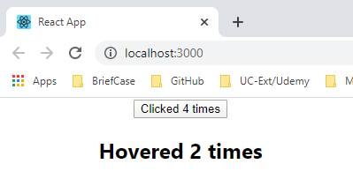
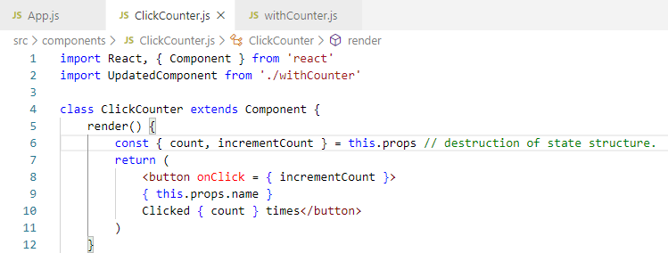
35.1 Pass from App Component to Click Counter
https://www.youtube.com/watch?v=l8V59zIdBXU&list=PLC3y8-rFHvwgg3vaYJgHGnModB54rxOk3&index=35
First, we pass a name props on the click counter component.
<ClickCounter name=“Peter”>
In the ClickCounter.js, we render the name props { this.props.name }
We cannot see the passing parameter.

Slide 5
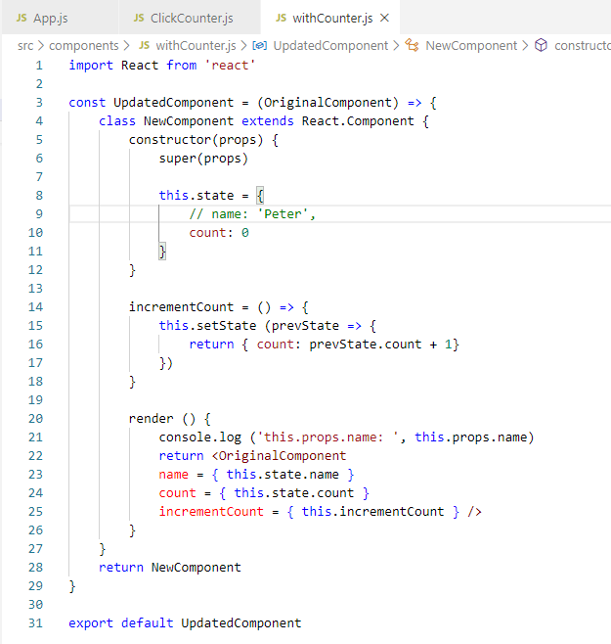
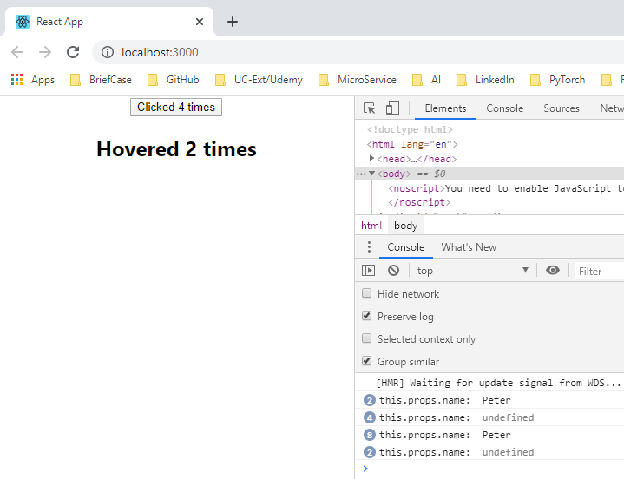
35.1 Pass from App Component to Click Counter
https://www.youtube.com/watch?v=l8V59zIdBXU&list=PLC3y8-rFHvwgg3vaYJgHGnModB54rxOk3&index=35
In the withCounter.js, we console.log (this.props.name) does not find the name.

Slide 6
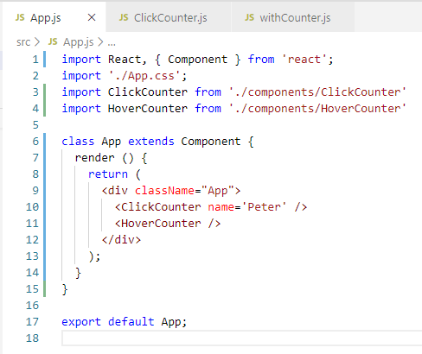
35.1 Pass from App Component to Click Counter
https://www.youtube.com/watch?v=l8V59zIdBXU&list=PLC3y8-rFHvwgg3vaYJgHGnModB54rxOk3&index=35
In App.js, passed in ClickCounter component with parameter name=‘Peter’

Slide 7
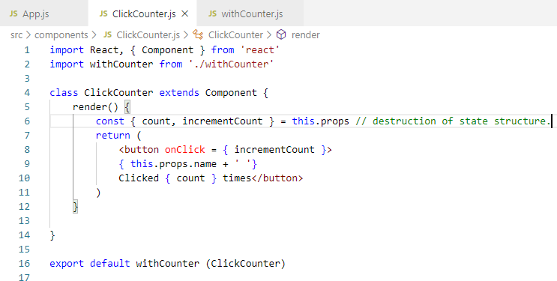
35.1 Pass from App Component to Click Counter
https://www.youtube.com/watch?v=l8V59zIdBXU&list=PLC3y8-rFHvwgg3vaYJgHGnModB54rxOk3&index=35
In clickCounter,js, we destruct the props from App.js and then render parameters.
Component clickCounter is passed to HOC withCouter (clickCounter),

Slide 8
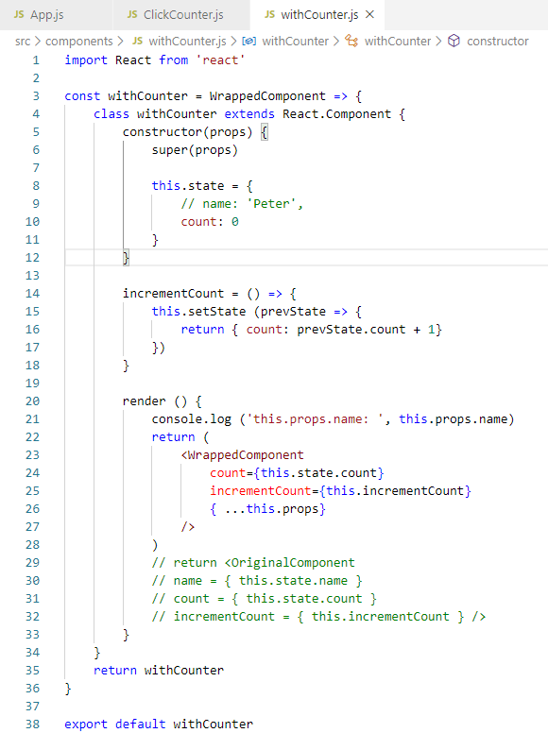
35.1 Pass from App Component to Click Counter
https://www.youtube.com/watch?v=l8V59zIdBXU&list=PLC3y8-rFHvwgg3vaYJgHGnModB54rxOk3&index=35
We pass the props to HOC but not to component that is wrapped.
To fix this issue, we need to pass down the remaining props to the wrap component using the spread operator.
So, what is happening here is that the HOC adds two props to the Wrapped component, and then simply pass down whatever remaining props have been specified.
In our case, it passes down the name props.

Slide 9
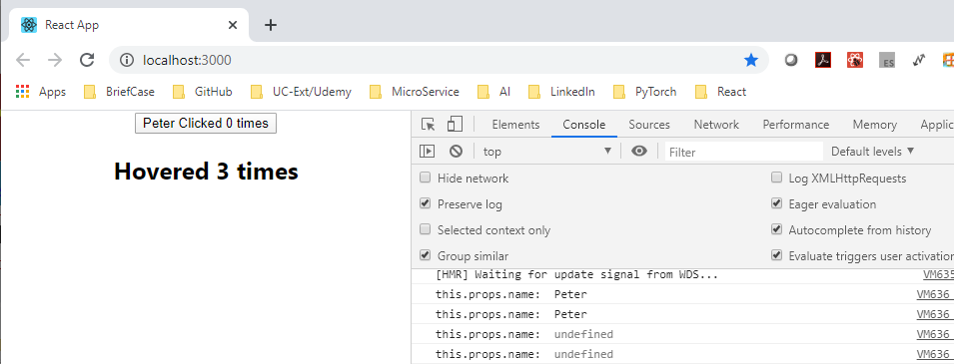
35.1 Pass from App Component to Click Counter
https://www.youtube.com/watch?v=l8V59zIdBXU&list=PLC3y8-rFHvwgg3vaYJgHGnModB54rxOk3&index=35
Now, go back to the browser. You can see the button has the ‘Peter’ Name appeared.

Slide 10
35.2 Pass from App Component to Hover Counter

Slide 11
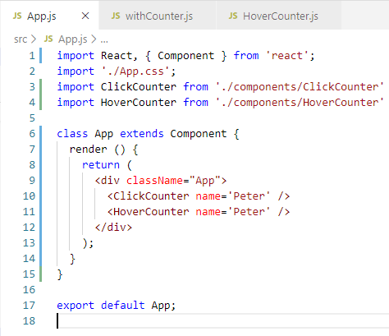
35.2 Pass from App Component to Hover Counter
https://www.youtube.com/watch?v=l8V59zIdBXU&list=PLC3y8-rFHvwgg3vaYJgHGnModB54rxOk3&index=35
We pass the name from App Component

Slide 12
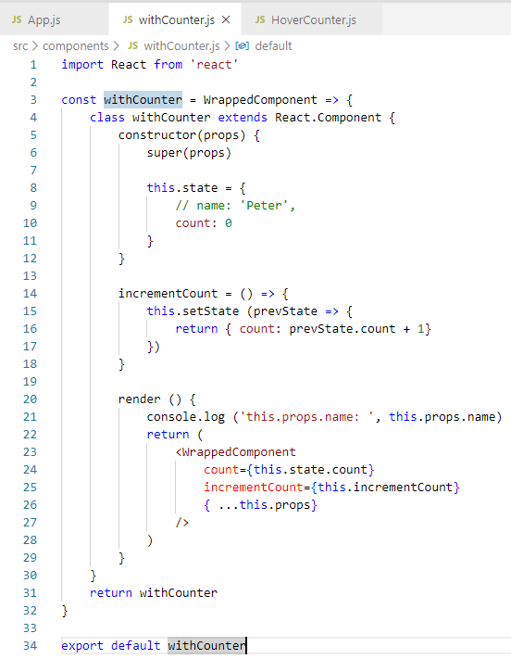
35.2 Pass from App Component to Hover Counter
https://www.youtube.com/watch?v=l8V59zIdBXU&list=PLC3y8-rFHvwgg3vaYJgHGnModB54rxOk3&index=35
HOC Pattern Component: withCounter
Input original component: WrappedComponet
Output new/updated component: withCounter

Slide 13
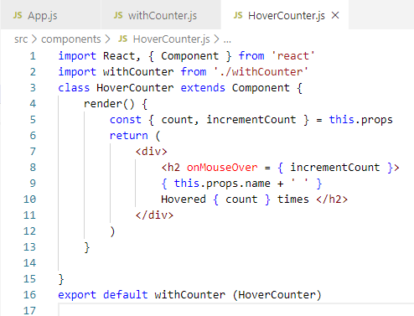
35.2 Pass from App Component to Hover Counter
https://www.youtube.com/watch?v=l8V59zIdBXU&list=PLC3y8-rFHvwgg3vaYJgHGnModB54rxOk3&index=35
Hovered Counter:
Destruct the props
Render the display.

Slide 14
35.3 Pass Parameter from HOC Function

Slide 15
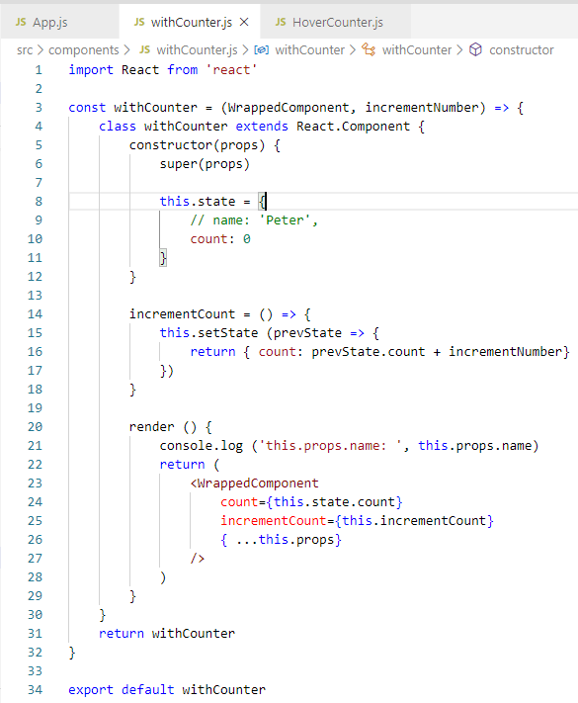
35.3 Pass Parameter from HOC Function
https://www.youtube.com/watch?v=l8V59zIdBXU&list=PLC3y8-rFHvwgg3vaYJgHGnModB54rxOk3&index=35
The second thing we discussed is passing parameters to the HOC function.
Let’s say, instead of incrementing value by one, we want to pass number in different numbers.
We can do that in passing a parameter to the HOC function.
The arrow function now have two parameters.
The first is wrapper component, and the second one is increment number.

Slide 16
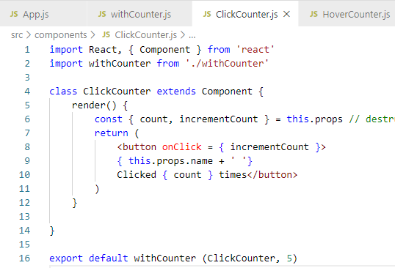
35.3 Pass Parameter from HOC Function
https://www.youtube.com/watch?v=l8V59zIdBXU&list=PLC3y8-rFHvwgg3vaYJgHGnModB54rxOk3&index=35
Pass HOC pattern with click component and number = 5.

Slide 17
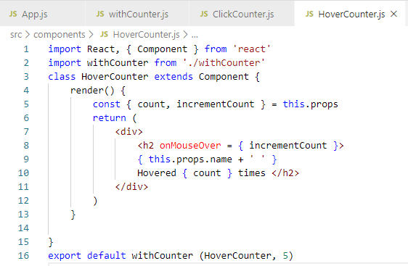
35.3 Pass Parameter from HOC Function
https://www.youtube.com/watch?v=l8V59zIdBXU&list=PLC3y8-rFHvwgg3vaYJgHGnModB54rxOk3&index=35
Pass HOC pattern with hover component and number = 10.

Slide 18
35.4 Verify Pass Parameter from HOC Function

Slide 19
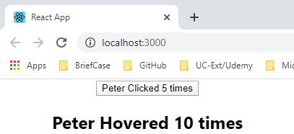
35.4 Verify Pass Parameter from HOC Function
https://www.youtube.com/watch?v=l8V59zIdBXU&list=PLC3y8-rFHvwgg3vaYJgHGnModB54rxOk3&index=35
Pass HOC pattern with hover component and click Counter number = 5 or hovered Counter number = 10, respectively.

Slide 20
35.5 Summary of Passing Parameters in HOC

Slide 21
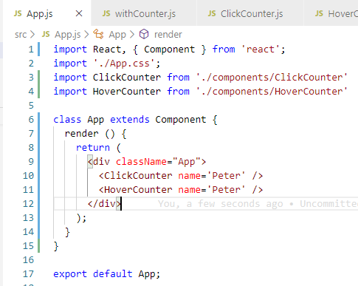
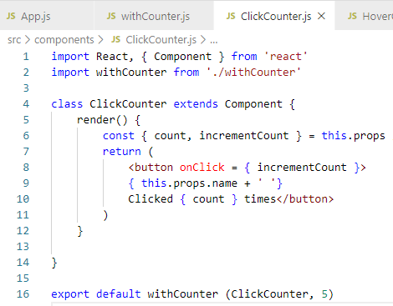
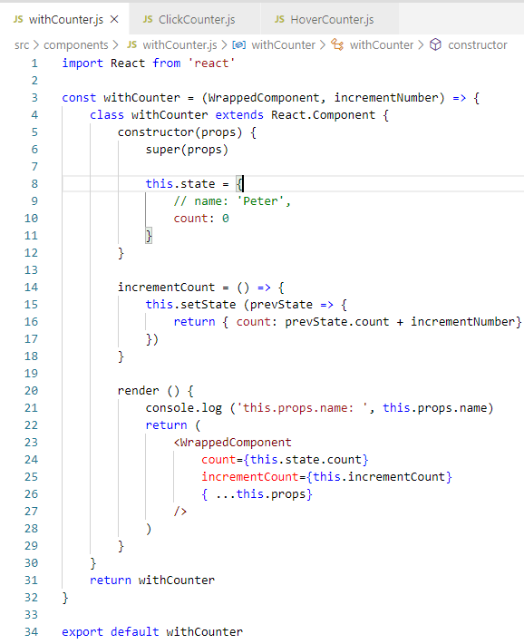
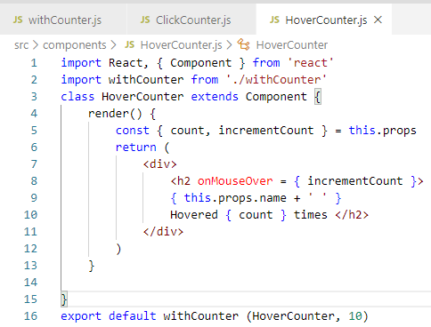
35.5 Summary of Passing Parameters in HOC
https://www.youtube.com/watch?v=l8V59zIdBXU&list=PLC3y8-rFHvwgg3vaYJgHGnModB54rxOk3&index=35
Summary of Passing Parameters in HOC
In this discussion, we
pass in HOC parameter from top App Component to click and hover counter.
Specify parameter from HOC argument to click and hover counter
const arrow function {
class component extend React.Component{
….
}
}

Slide 22
35.5 Summary of Passing Parameters in HOC
https://www.youtube.com/watch?v=l8V59zIdBXU&list=PLC3y8-rFHvwgg3vaYJgHGnModB54rxOk3&index=35
Summary of Passing Parameters in HOC
You may encounter HOC Pattern in some popular React Libraries, for example, connect HOC in Redux, Authorized routes with HOC with router in React Router, connect HOC with Styles in Material-UI, and etc.
HOC connect React and Redux: https://reactjs.org/docs/higher-order-components.html
Authorized routes with HOC with router in React Router: https://stackoverflow.com/questions/50795655/material-ui-how-to-style-an-hoc-using-withstyles
HOC connect Styles in Material-UI: https://stackoverflow.com/questions/50795655/material-ui-how-to-style-an-hoc-using-withstyles
They are nice HOC pattern that can be used to share common functionality between React Components.

Slide 23
35.6 Quiz

Slide 24
35.6 Quiz
https://www.youtube.com/watch?v=l8V59zIdBXU&list=PLC3y8-rFHvwgg3vaYJgHGnModB54rxOk3&index=35
Quiz
1. What are two steps for HOC of Click and Hover Counter?
Ans:
a) First, we pass down the props in App Component to Click/Hover Counters.
b) Second, we specify the parameter from HOC argument to Click/Hover Counters.

Slide 25
35.6 Quiz
https://www.youtube.com/watch?v=l8V59zIdBXU&list=PLC3y8-rFHvwgg3vaYJgHGnModB54rxOk3&index=35
Quiz
2. Give an example of HOC.
Ans: 1) Pass parameters from top to bottom. 2) Pass up the handler from bottom to top.
1
2
1
2
const arrow function {
class component extend React.Component{
….
}
}

Slide 26
End of Chapter

