Slide 1

8 JSX
Peter H. Chen

Slide 2
8 JSX
https://www.youtube.com/watch?v=7fPXI_MnBOY&list=PLC3y8-rFHvwgg3vaYJgHGnModB54rxOk3&index=8
JSX:
React uses a lot of JSX.
It is really important to know what JSX and why JSX is used.
JavaScript XML (JSX): Extension to the JavaScript language syntax.
With the React Library, you can write XML-like code for elements and components.
Just like HTML, JSX tags have a tag name, attributes, and children.
Why do we need JSX?
Well, the truth is JSX is not a necessity to write React applications. You can definitely use React without JSX.
But JSX makes your React code simpler and elegant. As you already seen, it provides a syntax which is familiar to many developers.
JSX ultimately transpiles to pure JavaScript which is understood by the browsers.

Slide 3
8 JSX
https://www.youtube.com/watch?v=7fPXI_MnBOY&list=PLC3y8-rFHvwgg3vaYJgHGnModB54rxOk3&index=8
We discussed what is JXS and why do we use it.
How it works behind the scenes.
What is the code looks like without the JSX?
Let’s look at that.
What is the code looks like with JSX and without JSX?
That way, you not only understand how JXS translates to regular JavaScript but also appreciate how JSX bring out simplicity in your code.

Slide 4
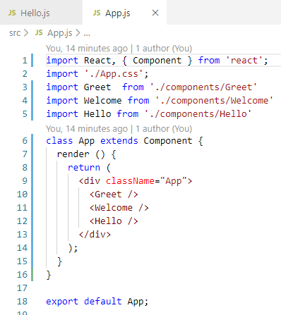
8 JSX
https://www.youtube.com/watch?v=7fPXI_MnBOY&list=PLC3y8-rFHvwgg3vaYJgHGnModB54rxOk3&index=8
JSX:
We will create another file component/Hello.js.
Hello.js is a simple functional component that render “Hello Peter” in the browser.

Slide 5
8.1 With JSX

Slide 6
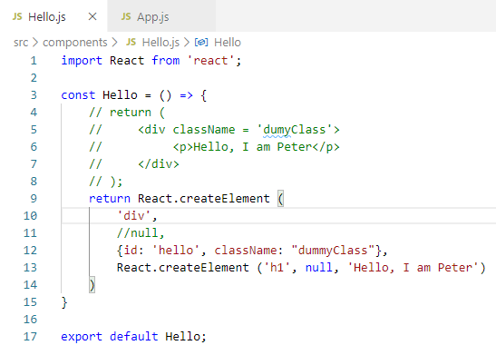
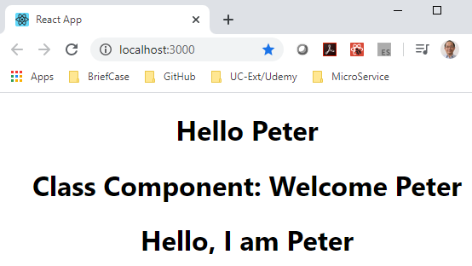
8.1 With JSX
https://www.youtube.com/watch?v=7fPXI_MnBOY&list=PLC3y8-rFHvwgg3vaYJgHGnModB54rxOk3&index=8
JSX:
With JSX, it is very simple, just put the <div> … </div>

Slide 7
8.2 Without JSX

Slide 8
8.2 Without JSX
https://www.youtube.com/watch?v=7fPXI_MnBOY&list=PLC3y8-rFHvwgg3vaYJgHGnModB54rxOk3&index=8
Without JSX, we need to create all the elements by the React.createElement:
React Library can create element React.createElement (HTML element, optional property, children of HTML element)
> return React.createElement (‘div’, null, ‘Hello Peter’);
The third argument have to use createElement() to create element with ‘h1’ and text. 4
The second argument can be used for ID assignment and className assignment.

Slide 9
8.3 HTML vs. JSX

Slide 10
8.3 HTML vs. JSX
https://www.youtube.com/watch?v=7fPXI_MnBOY&list=PLC3y8-rFHvwgg3vaYJgHGnModB54rxOk3&index=8
JSX:
The React Library include the translation of JSX into JavaScript code.
If we have hundreds of elements, the JavaScript code to create element will become very clumsy.
JSX, on the other hand, will keep the code elegant, simple, and readable.

Slide 11
8.3 HTML vs. JSX
https://www.youtube.com/watch?v=7fPXI_MnBOY&list=PLC3y8-rFHvwgg3vaYJgHGnModB54rxOk3&index=8
HTML vs JSX:
We compare the difference of HTML and JSX.
HTML
JSX
Class
for
Lowercase only for property naming convention
onclick
tabindex
className
htmlFor
camelCase property naming convention
onClick
tabIndex

Slide 12
8.3 HTML vs. JSX
https://www.youtube.com/watch?v=7fPXI_MnBOY&list=PLC3y8-rFHvwgg3vaYJgHGnModB54rxOk3&index=8
React Fire: Modernizing React DOM
https://github.com/facebook/react/issues/13525
React changing code discussion panel.
Change the className into Class and etc.
This link will help you to stay update with the changes.

Slide 13
8.1 Quiz

Slide 14
8.4 JSX Sumamry
https://www.youtube.com/watch?v=7fPXI_MnBOY&list=PLC3y8-rFHvwgg3vaYJgHGnModB54rxOk3&index=8
JSX Summary
React uses a lot of JSX.
It is really important to know what JSX and why JSX is used.
JavaScript XML (JSX): Extension to the JavaScript language syntax.
With the React Library, you can write XML-like code for elements and components.
Just like HTML, JSX tags have a tag name, attributes, and children.
JSX makes your React code simpler and elegant.
JSX ultimately transpiles to pure JavaScript which is understood by the browsers.

Slide 15
8.4 JSX Sumamry

Slide 16
8.1 Quiz
https://www.youtube.com/watch?v=7fPXI_MnBOY&list=PLC3y8-rFHvwgg3vaYJgHGnModB54rxOk3&index=8
Quiz
1. What is JSX?
Ans: JavaScript Extension. JSX is very similar to HTML.
2. Why we need JAX?
Ans: JSX makes your React code simpler and elegant.
3. What are difference between HTML and JAX?
Ans:
HTML
JSX
Class
for
Lowercase only for property naming convention
onclick
tabindex
className
htmlFor
camelCase property naming convention
onClick
tabIndex

Slide 17
End of Chapter

