Slide 1

45 useState Hooks
Peter H. Chen

Slide 2
45 useState Hooks
https://www.youtube.com/watch?v=lAW1Jmmr9hc&list=PLC3y8-rFHvwgg3vaYJgHGnModB54rxOk3&index=45
useState Hooks:
We start the first State Hooks: useState in functional Component.
First look at the simple counter example.
We will implement the Counter using class component and then functional component with state Hook.

Slide 3
45.1 Class Components

Slide 4
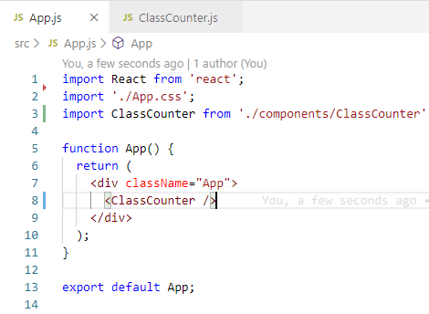
45.1 Class Components
https://www.youtube.com/watch?v=lAW1Jmmr9hc&list=PLC3y8-rFHvwgg3vaYJgHGnModB54rxOk3&index=45
useState Hooks:
Import Class Component “ClassCounter”

Slide 5
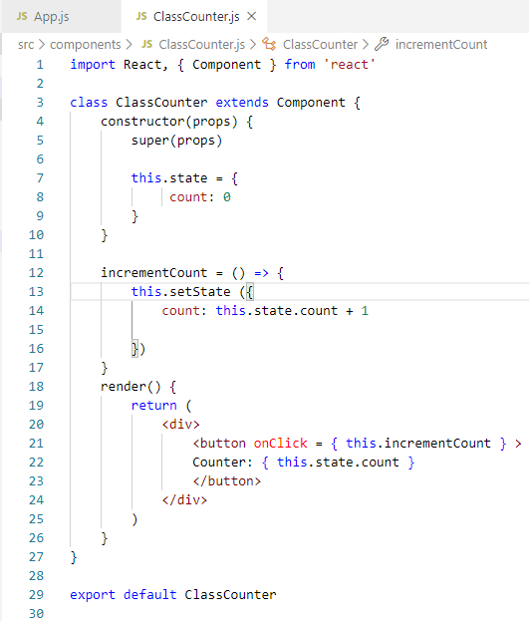
45.1 Class Components
https://www.youtube.com/watch?v=lAW1Jmmr9hc&list=PLC3y8-rFHvwgg3vaYJgHGnModB54rxOk3&index=45
useState Hooks:
Create Class Component ”ClassCounter”.
1. Type ‘rce’ (React Class Component ES7)
2. Type ‘rconst’ (React Constructor)
3. Initialized Counter: 0
4. Arrow Function:
incrementCount = () => {
this.setState (
count: this.state.count + 1
)
}
5. Button onClick:
<button onClick = { this.incrementCount } > Counter: { this.state.count }
</button>

Slide 6
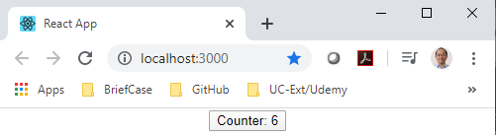
45.1 Class Components
https://www.youtube.com/watch?v=lAW1Jmmr9hc&list=PLC3y8-rFHvwgg3vaYJgHGnModB54rxOk3&index=45
useState Hooks:
> npm start

Slide 7
45.2 Functional Component

Slide 8
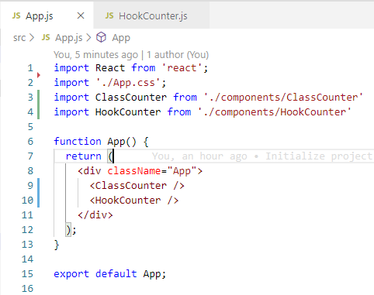
45.2 Functional Component
https://www.youtube.com/watch?v=lAW1Jmmr9hc&list=PLC3y8-rFHvwgg3vaYJgHGnModB54rxOk3&index=45
Import HookCounter from ‘./components/HookCounter’
<HookCounter />

Slide 9
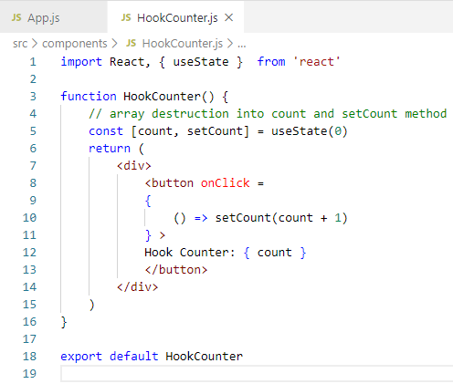
45.2 Functional Component
https://www.youtube.com/watch?v=lAW1Jmmr9hc&list=PLC3y8-rFHvwgg3vaYJgHGnModB54rxOk3&index=45
Create a Functional Component:
1. Type ‘rfce’ (React Functional Component ES7)
2. Initialize counter: useState (0)
3. Create count and method: const [count, setCount] = useState (0)
4. Arrow Function: onClick = { () => setCount (count) }
5. Display count: { count}
2. count is initialized with value 0.
3. const [count, setCount] = useState (0)
The variable count and method setCount () are the destruction and use them in the render function.
4. setCount () pass in count parameter + 1
After setCount() , the count is re-render.

Slide 10
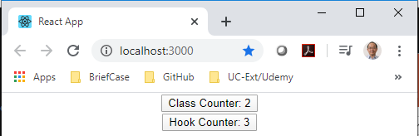
45.2 Functional Component
https://www.youtube.com/watch?v=lAW1Jmmr9hc&list=PLC3y8-rFHvwgg3vaYJgHGnModB54rxOk3&index=45
Create a Functional Component:
> npm start
This is the basic class component and state Hook in functional component.

Slide 11
45.3 Rules of Hooks

Slide 12
45.3 Rules of Hooks
https://www.youtube.com/watch?v=lAW1Jmmr9hc&list=PLC3y8-rFHvwgg3vaYJgHGnModB54rxOk3&index=45
Rules of Hooks:
There are two important rules that you have to follow when using Hooks.
1. “Only Call Hooks at the top Level”: Do not call Hooks inside loops, conditions, or nested functions.
2. “Only Call Hooks from React Function”: make sure call them from within React functional components and not just any regular JavaScript function.

Slide 13
45.4 Summary

Slide 14
45.4 Summary
https://www.youtube.com/watch?v=lAW1Jmmr9hc&list=PLC3y8-rFHvwgg3vaYJgHGnModB54rxOk3&index=45
Summary
There are two important rules that you have to follow when using Hooks.
1. “Only Call Hooks at the top Level”: Do not call Hooks inside loops, conditions, or nested functions.
2. “Only Call Hooks from React Function”: make sure call them from within React functional components and not just any regular JavaScript function.

Slide 15
45.5 Quiz

Slide 16
45.5 Quiz
https://www.youtube.com/watch?v=lAW1Jmmr9hc&list=PLC3y8-rFHvwgg3vaYJgHGnModB54rxOk3&index=45
Quiz
1. In functional component, how to initialize the counter?
Ans: useState (0)
2. In functional component, what is destruction?
Ans: const [count, setCount] = useState (0)

Slide 17
End of Chapter

