Slide 1

39 Context 2
Peter H. Chen

Slide 2
39 Context 2
https://www.youtube.com/watch?v=lTjQjWemKgE&list=PLC3y8-rFHvwgg3vaYJgHGnModB54rxOk3&index=39
React Context
We discussed that is can be a problem of the passing props through several levels in the component tree.
AppComponent
username
username
username
username
A
B
C
username
username
D
E
username
F

Slide 3
39 Context 2
https://www.youtube.com/watch?v=lTjQjWemKgE&list=PLC3y8-rFHvwgg3vaYJgHGnModB54rxOk3&index=39
React Context
We also mentioned that
Context provides a way to pass data through the component tree without having to pass props down manually at every level.
The context API will help solve that problem.

Slide 4
39 Context 2
https://www.youtube.com/watch?v=lTjQjWemKgE&list=PLC3y8-rFHvwgg3vaYJgHGnModB54rxOk3&index=39
React Context
In this discussion, we will implement a user context which will enable every level to read a prop that is passed at the top level.
To simply the example, we will use the rightmost part of the component tree, that is, components, C, E, and F.
Our goal is to pass the username value from AppComponent and read that value in component F using context.
AppComponent
username
username
A
B
C
username
D
E
username
F

Slide 5
39.1 Create Component Tree

Slide 6
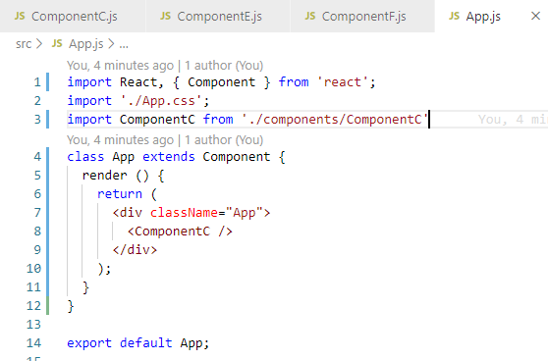
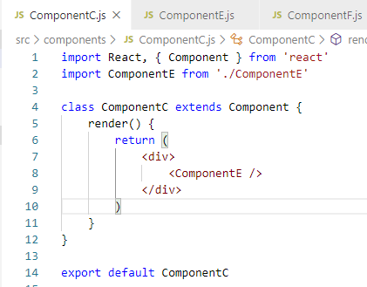
39.1 React Context 2
https://www.youtube.com/watch?v=lTjQjWemKgE&list=PLC3y8-rFHvwgg3vaYJgHGnModB54rxOk3&index=39
Component Tree:
Create ComponentC.js, CompoentE.js, and ComponentF.js for appropriate level.
In App.js, we have ComponentC. In ComponentC, we have Component E.
AppComponent
username
username
A
B
C
username
D
E
username
F

Slide 7
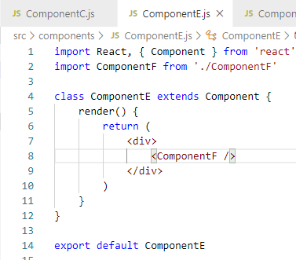
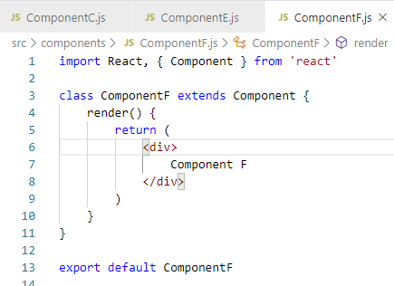
39.1 React Context 2
https://www.youtube.com/watch?v=lTjQjWemKgE&list=PLC3y8-rFHvwgg3vaYJgHGnModB54rxOk3&index=39
Component Tree:
In ComponentE, we have ComponentF.
In ComponentF, we render the text in Component F.

Slide 8
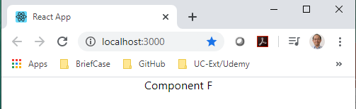
39.1 React Context 2
https://www.youtube.com/watch?v=lTjQjWemKgE&list=PLC3y8-rFHvwgg3vaYJgHGnModB54rxOk3&index=39
Component Tree:
> npm start
AppComponent
username
username
C
username
E
username
F

Slide 9
39.1 React Context 2
https://www.youtube.com/watch?v=lTjQjWemKgE&list=PLC3y8-rFHvwgg3vaYJgHGnModB54rxOk3&index=39
Component Tree:
Now, how to pass data from App Component to ComponentF using context.
AppComponent
username
username
C
username
E
username
F

Slide 10
39.2 Three Steps of Context

Slide 11
39.2 Three Steps of Context
https://www.youtube.com/watch?v=lTjQjWemKgE&list=PLC3y8-rFHvwgg3vaYJgHGnModB54rxOk3&index=39
Component Tree:
There are three steps to implement when making use of context.
Create the context.
Provide a context value.
Consume the context value in the necessary component.
AppComponent
username
username
C
username
E
username
F

Slide 12
39.3 Step 1: Create Context

Slide 13
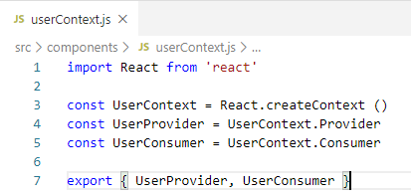
39.3 Step 1: Create Context
https://www.youtube.com/watch?v=lTjQjWemKgE&list=PLC3y8-rFHvwgg3vaYJgHGnModB54rxOk3&index=39
Component Tree:
Let’s begin with step 1:
1. userConext.js
Create and export the User Provider and User Consumer
AppComponent
username
username
C
username
E
username
F

Slide 14
39.4 Step 2: Provide Data

Slide 15
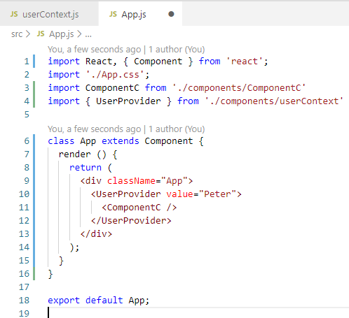
39.4 Step 2: Provide Data
https://www.youtube.com/watch?v=lTjQjWemKgE&list=PLC3y8-rFHvwgg3vaYJgHGnModB54rxOk3&index=39
Component Tree:
2. User Provider
We need to provide this user context.
The place you provide the is import because only the descendent component can consume it.
App Component is a good place because all components are under the App.
We use the component <UserProvider> to wrap the ComponentC and pass the data value=“peter”.
We complete the step 2.
AppComponent
username
username
C
username
E
username
F

Slide 16
39.5 Step 3: Consume Data

Slide 17
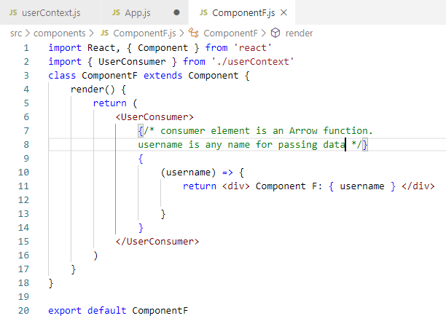
39.5 Step 3: Consume Data
https://www.youtube.com/watch?v=lTjQjWemKgE&list=PLC3y8-rFHvwgg3vaYJgHGnModB54rxOk3&index=39
Component Tree:
3. Consume Data
Final step is to consume the username in the desired component.
For our example, we have to consume the username value in ComponentF.
In ComponentF.js, we need to user consumer components.
AppComponent
username
username
C
username
E
username
F

Slide 18
39.6 Verify Context Display

Slide 19
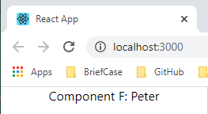
39.6 Verify Context Display
https://www.youtube.com/watch?v=lTjQjWemKgE&list=PLC3y8-rFHvwgg3vaYJgHGnModB54rxOk3&index=39
Component Tree:
> npm start

Slide 20
39.7 Summary of Context

Slide 21
39.7 Summary of Context
https://www.youtube.com/watch?v=lTjQjWemKgE&list=PLC3y8-rFHvwgg3vaYJgHGnModB54rxOk3&index=39
Summary Creation of Context of Component Tree:
There are three steps
Create the context.
Provide a context value.
Consume the context value in the necessary component.
AppComponent
username
C
E
username
F

Slide 22
39.8 Quiz

Slide 23
39.8 Quiz
https://www.youtube.com/watch?v=lTjQjWemKgE&list=PLC3y8-rFHvwgg3vaYJgHGnModB54rxOk3&index=39
Quiz
1. What is three steps to create conext?
Ans:
Create the context for consumer and provider.
Provide a context value.
Consume the context value in the necessary component.

Slide 24
End of Chapter

