Slide 1

13 Event Handling
Peter H. Chen

Slide 2
13 Event Handling
https://www.youtube.com/watch?v=Znqv84xi8Vs&list=PLC3y8-rFHvwgg3vaYJgHGnModB54rxOk3&index=13
Event Handling:
Any web application we create need the user interaction.
When user interact with the application, the events are fired, for example, mouse click, mouse hover, key press change event, and so on.
The application must handle such events and execute the necessary code.
We will see how to handle events in React.
We will focus on click event but the concept is good for other events as well.
Let’s begin with functional components.

Slide 3
13.1 Event in Functional Component

Slide 4
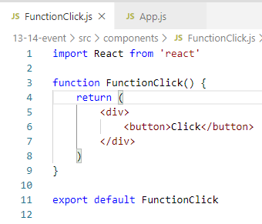
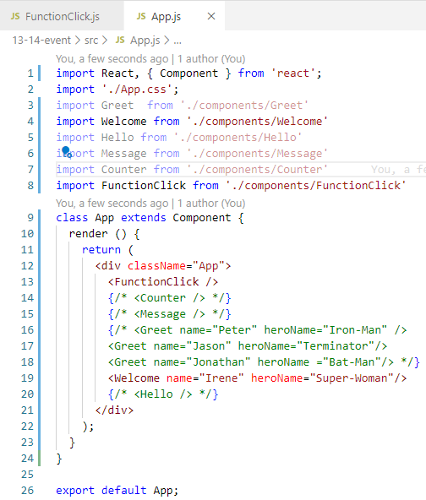
13.1 Event in Functional Component
https://www.youtube.com/watch?v=Znqv84xi8Vs&list=PLC3y8-rFHvwgg3vaYJgHGnModB54rxOk3&index=13
Event Handling:
We create components/FunctionClick.js. Type ‘rfce” for “React Functional Component with ES7”

Slide 5
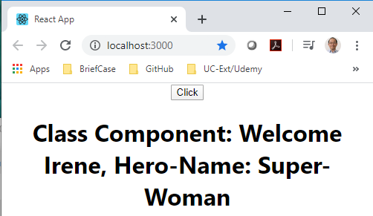
13.1 Event in Functional Component
https://www.youtube.com/watch?v=Znqv84xi8Vs&list=PLC3y8-rFHvwgg3vaYJgHGnModB54rxOk3&index=13
Event Handling:
> npm start
When user click the button, the event will fire.
The goal is to capture the click event and execute some code.

Slide 6
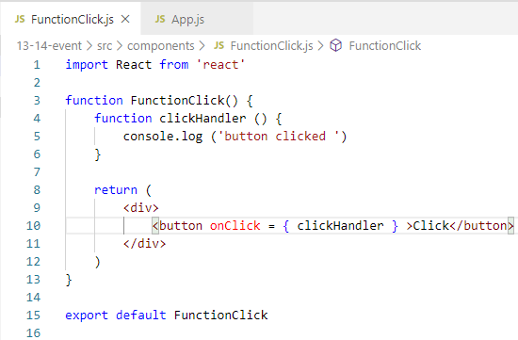
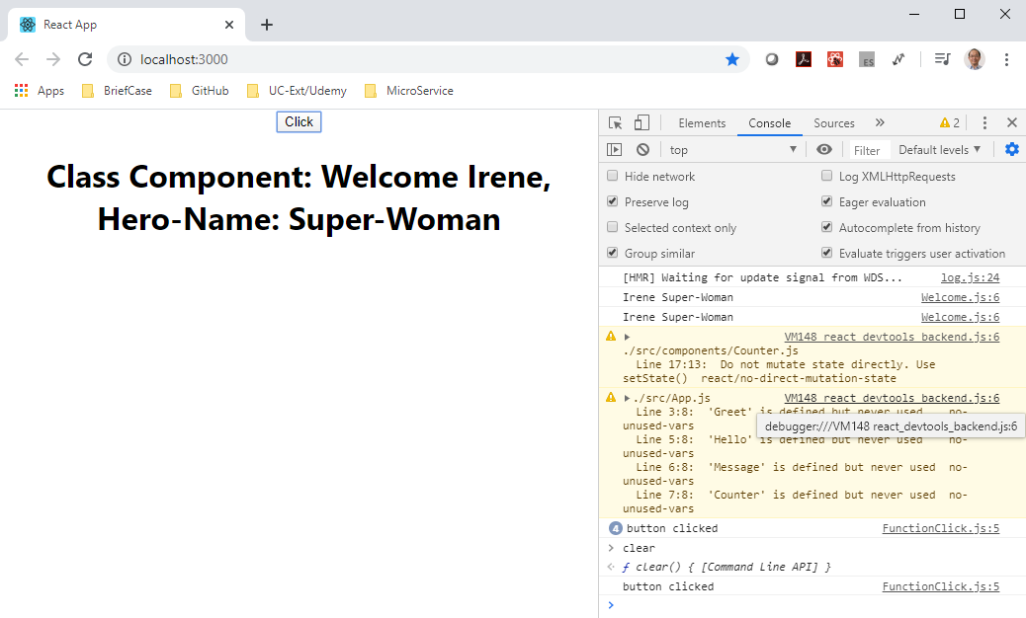
13.1 Event in Functional Component
https://www.youtube.com/watch?v=Znqv84xi8Vs&list=PLC3y8-rFHvwgg3vaYJgHGnModB54rxOk3&index=13
Event Handling:
Add “<button onClick ={ clickHandler } >Click </button> ”
Inside {} is the function handler clickHandler, not function call clickHandler().

Slide 7
13.2 Event in Class Component

Slide 8
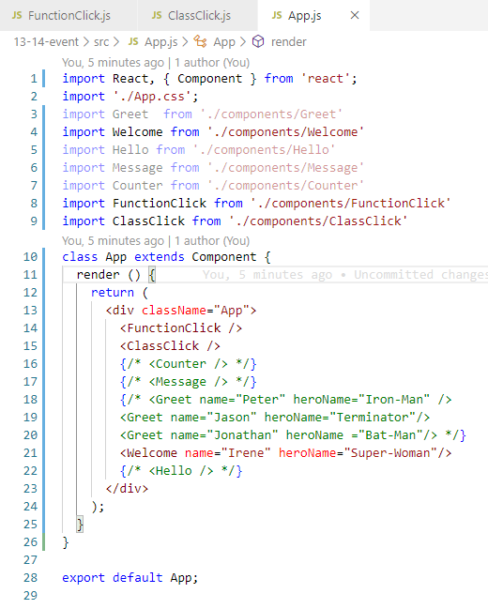
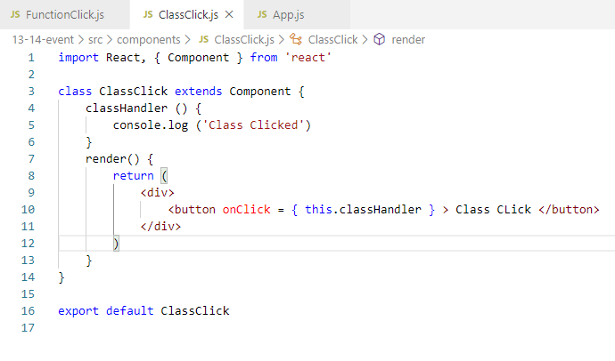
13.2 Event in Class Component
https://www.youtube.com/watch?v=Znqv84xi8Vs&list=PLC3y8-rFHvwgg3vaYJgHGnModB54rxOk3&index=13
Event Handling:
We create components/ClassClick.js. Type ‘rce” for “React Class Component with ES7”
The Handler in the class component need ‘this.Handler’

Slide 9
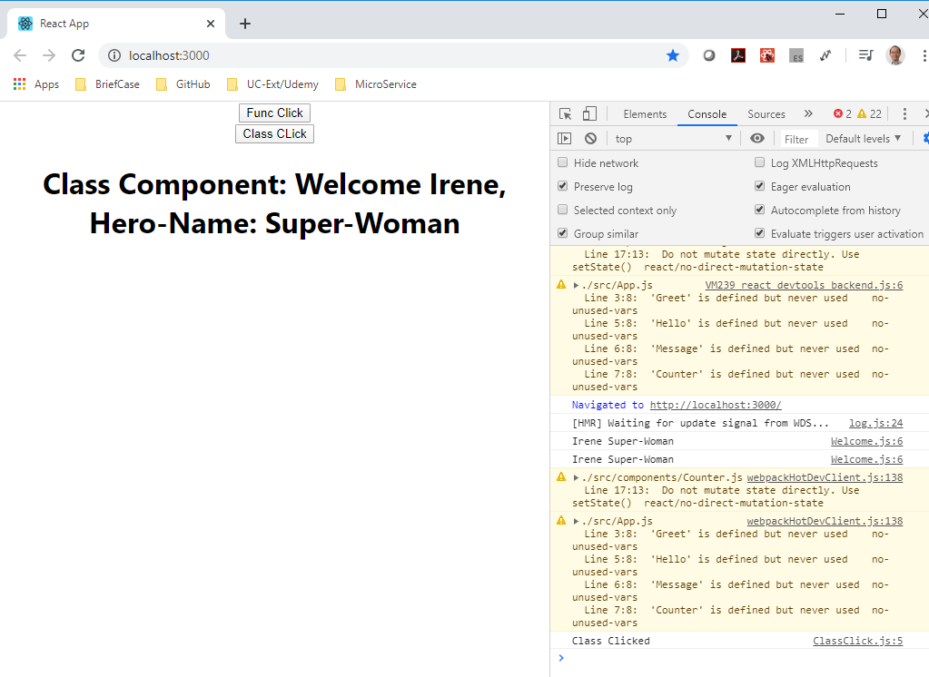
13.2 Event in Class Component
https://www.youtube.com/watch?v=Znqv84xi8Vs&list=PLC3y8-rFHvwgg3vaYJgHGnModB54rxOk3&index=13
Event Handling:
We create components/ClassClick.js. Type ‘rce” for “React Class Component with ES7”

Slide 10
13.2 Summary of Event Handling
https://www.youtube.com/watch?v=Znqv84xi8Vs&list=PLC3y8-rFHvwgg3vaYJgHGnModB54rxOk3&index=13
Summary of Event Handling:
We discuss the event handling in the Functional Component and Class Component.
The onClick is used to trigger the event.
The event handler has to put inside the {}.
Inside the {} is the event Handler. There is no parenthesis (), i.e., event handler function ().
The class event handler need the ‘this’ keyword to access the function inside the class.
We will discuss the event binding for state in the next.

Slide 11
13.3 Quiz

Slide 12
13.3 Quiz
https://www.youtube.com/watch?v=Znqv84xi8Vs&list=PLC3y8-rFHvwgg3vaYJgHGnModB54rxOk3&index=13
Quiz
1. What is event handler in functional component?
Ans:
function FuncClick () {
function funcHandler () {
}
return (
<div>
<button onClick = { funcHandler } > Funcitonal Click </button>
</div>
)
}

Slide 13
13.3 Quiz
https://www.youtube.com/watch?v=Znqv84xi8Vs&list=PLC3y8-rFHvwgg3vaYJgHGnModB54rxOk3&index=13
Quiz
2. What is event handle in class component?
Ans:
class classClick extends Component {
classHandler () {
}
render () {
<div>
<button onClick= { this.classHandler } > Class Click </bttuon>
</div>
}
}

Slide 14
End of Chapter

