Slide 1

28 Refs
Peter H. Chen

Slide 2
28 Refs
https://www.youtube.com/watch?v=FXa9mMTKOu8&list=PLC3y8-rFHvwgg3vaYJgHGnModB54rxOk3&index=28
This section discussed the concepts of Refs in React.
Refs make it possible to access the DOM node directly within React.
For our understanding, we take a look at one of common use cases which is focusing a text input.
For example, we have a login form.
As soon as the page is loaded.
Let’s say, by default, we want the user name input field to be focused.
Let’s see how to achieve that with refs.

Slide 3
28.1 Add Input Text Field
Peter H. Chen

Slide 4
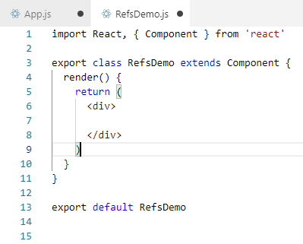
28.1 Add Input Text Field
https://www.youtube.com/watch?v=FXa9mMTKOu8&list=PLC3y8-rFHvwgg3vaYJgHGnModB54rxOk3&index=28
We create a new file called Components/RefsDemo.js.
Within the RefsDemo.js, type rce (React Create component with ES7)

Slide 5
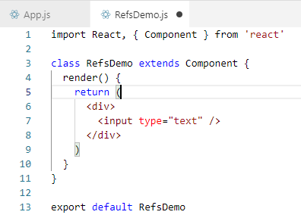
28.1 Add Input Text Field
https://www.youtube.com/watch?v=FXa9mMTKOu8&list=PLC3y8-rFHvwgg3vaYJgHGnModB54rxOk3&index=28
In the JAX, we add the input element and remove ‘export”

Slide 6
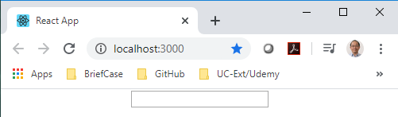
28.1 Add Input Text Field
https://www.youtube.com/watch?v=FXa9mMTKOu8&list=PLC3y8-rFHvwgg3vaYJgHGnModB54rxOk3&index=28
Install the node_modules:
> npm install
Take a loot at the browser.

Slide 7
28.2 Focus Input Text Field

Slide 8
28.2 Focus Input Text Field
https://www.youtube.com/watch?v=FXa9mMTKOu8&list=PLC3y8-rFHvwgg3vaYJgHGnModB54rxOk3&index=28
As soon as the page is loaded, we want the input text field to be focused.
Using refs, we can do this in three input steps.

Slide 9
28.3 First Step

Slide 10
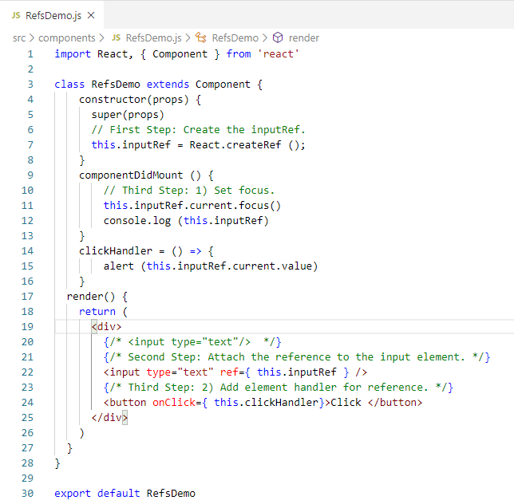
28.3 First Step
https://www.youtube.com/watch?v=FXa9mMTKOu8&list=PLC3y8-rFHvwgg3vaYJgHGnModB54rxOk3&index=28
First step: Create Input Ref
Create a refs using React.createRef() method.
In Refs.Demo.js, type ‘rcons’ (React Constructor).
Within the constructor, we create the new property,
> this.inputRef = React,createRef();
It is common to create reference in the constructor so that they cane be reference throughout the component.

Slide 11
28.4 Second Step

Slide 12
28.4 Second Step
https://www.youtube.com/watch?v=FXa9mMTKOu8&list=PLC3y8-rFHvwgg3vaYJgHGnModB54rxOk3&index=28
Second step: Attach Input Ref
Attach this.inputRef to our input element in the render method.
To attach a ref, we make use of the reserved ref attribute.
So on the input element, ref = { this.inputRef }
The this.inputRef is we just created.
We now have a reference to the input element.

Slide 13
28.5 Third Step: 1) Focus

Slide 14
28.5 Third Step: 1) Focus
https://www.youtube.com/watch?v=FXa9mMTKOu8&list=PLC3y8-rFHvwgg3vaYJgHGnModB54rxOk3&index=28
Third step: 1) Call the focus method on input Element
Let’s find out what exactly does the property this.inputRef hold after the reference is created.
We add componentDidMount()
Lifecycle hood and within the hood, we simply log to the console.log (this.inputRef).

Slide 15
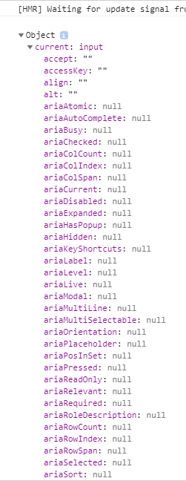
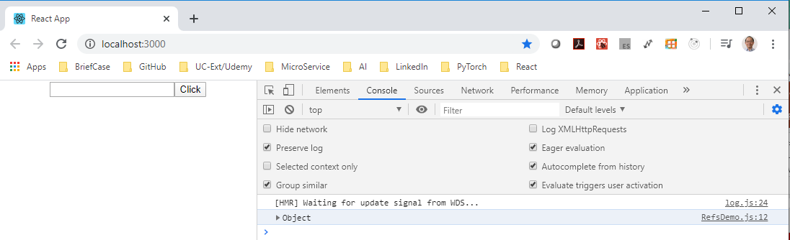
28.5 Third Step: 1) Focus
https://www.youtube.com/watch?v=FXa9mMTKOu8&list=PLC3y8-rFHvwgg3vaYJgHGnModB54rxOk3&index=28
Third step: 1) Call the focus method on input Element
Open the browser and Fn+F12 to open the console.
We can see the Object is display. If we expand the Object, we can see a property called “current” of type “input”.
This current property point the actual DOM node.
To focus on the input element in componentDidMount(), we simply call the focus method on the current property.

Slide 16
28.5 Third Step: 1) Focus
https://www.youtube.com/watch?v=FXa9mMTKOu8&list=PLC3y8-rFHvwgg3vaYJgHGnModB54rxOk3&index=28
Back in componentDidMount(), add the following code:
this.inputRef.current.focus().

Slide 17

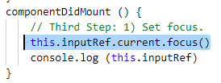
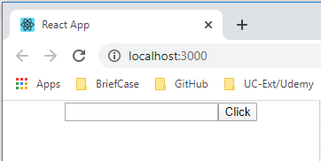
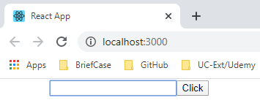
28.5 Third Step: 1) Focus
https://www.youtube.com/watch?v=FXa9mMTKOu8&list=PLC3y8-rFHvwgg3vaYJgHGnModB54rxOk3&index=28
> npm start
Refresh the browser again. The focus is displayed.

Slide 18
28.6 Third Step: 2) Fetch Input Value

Slide 19
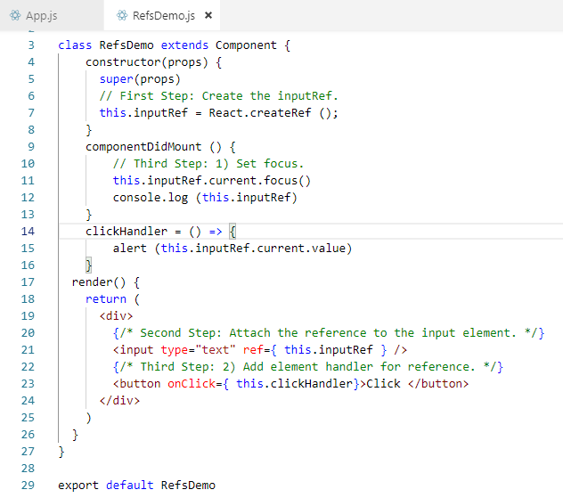
28.6 Third Step: 2) Fetch Input Value
https://www.youtube.com/watch?v=FXa9mMTKOu8&list=PLC3y8-rFHvwgg3vaYJgHGnModB54rxOk3&index=28
The second part of Step 3:
This is the refs used in the input field.
The refs is to fetch the input value.
Go back the input text and create a button with a text click and a click event handler with arrow funciton on click.
It is equal to this.clickhandler.

Slide 20
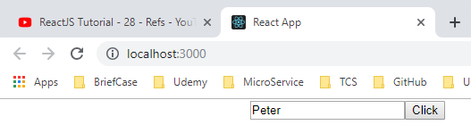
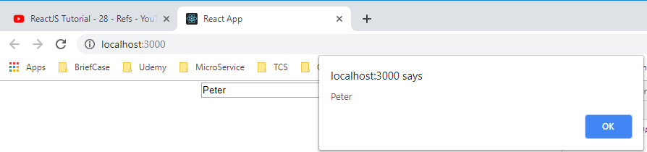
28.6 Third Step: 2) Fetch Input Value
https://www.youtube.com/watch?v=FXa9mMTKOu8&list=PLC3y8-rFHvwgg3vaYJgHGnModB54rxOk3&index=28
Refresh the browser
Enter text and click OK.

Slide 21
28.6 Third Step: 2) Fetch Input Value
https://www.youtube.com/watch?v=FXa9mMTKOu8&list=PLC3y8-rFHvwgg3vaYJgHGnModB54rxOk3&index=28
This is to use createRef () to create Refs.
React also support the second way to set refs which is called the callback refs.

Slide 22
End of Chapter

