Slide 1

28 Refs
Peter H. Chen

Slide 2
28 Refs
https://www.youtube.com/watch?v=yCS2m01bQ6w&list=PLC3y8-rFHvwgg3vaYJgHGnModB54rxOk3&index=71
This section discussed the concepts of Refs in React.
Refs make it possible to access the DOM node directly within Functional Components.
For our understanding, we take a look at one of common use cases which is focusing a text input.
For example, we have a login form.
As soon as the page is loaded.
Let’s say, by default, we want the user name input field to be focused.
Let’s see how to achieve that with refs Hook.

Slide 3
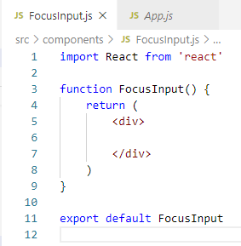
28.1 Add Input Text Field
https://www.youtube.com/watch?v=yCS2m01bQ6w&list=PLC3y8-rFHvwgg3vaYJgHGnModB54rxOk3&index=71
We create a new file called Components/FocusInput.js.
Type ‘rfce’ (React Functional Component ES7)

Slide 4
28.1 Add Input Text Field

Slide 5
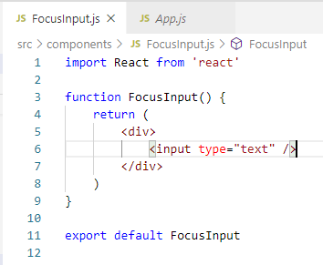
28.1 Add Input Text Field
https://www.youtube.com/watch?v=yCS2m01bQ6w&list=PLC3y8-rFHvwgg3vaYJgHGnModB54rxOk3&index=71
Add the input element input type = “text”

Slide 6
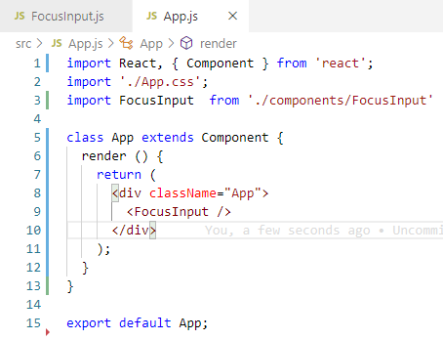
28.1 Add Input Text Field
https://www.youtube.com/watch?v=yCS2m01bQ6w&list=PLC3y8-rFHvwgg3vaYJgHGnModB54rxOk3&index=71
Add the input element input type = “text”

Slide 7
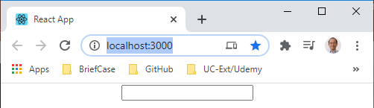
28.1 Add Input Text Field
https://www.youtube.com/watch?v=yCS2m01bQ6w&list=PLC3y8-rFHvwgg3vaYJgHGnModB54rxOk3&index=71
> npm start
Open Browser
We can see the input field on the browser.
What we want here is add the focus when the input page loaded.

Slide 8
28.2 Add Input Focus

Slide 9
28.2 Add Input Focus
https://www.youtube.com/watch?v=yCS2m01bQ6w&list=PLC3y8-rFHvwgg3vaYJgHGnModB54rxOk3&index=71
First, we need to implement the componentDidMount() Behavior as we only focus the element only once and that is after component has mounted.
We import the useEffect
useEffect (() => {
// Focus on the input element.
}, [])

Slide 10
28.3 Import useRef

Slide 11
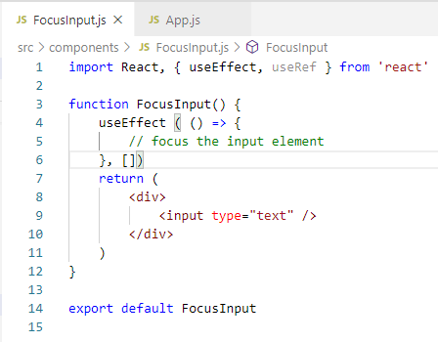
28.3 Import useRef
https://www.youtube.com/watch?v=yCS2m01bQ6w&list=PLC3y8-rFHvwgg3vaYJgHGnModB54rxOk3&index=71
The way to do that is to use the ref hook.
Now, there are three simple steps.
First step is to import useRef.

Slide 12
28.3 Create Ref Variable

Slide 13
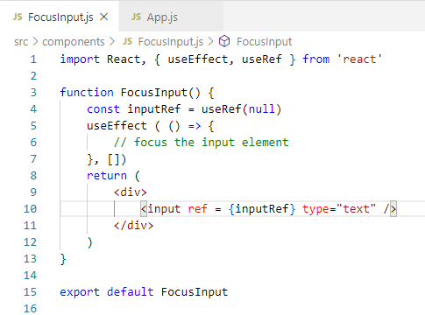
28.3 Create Ref Variable
https://www.youtube.com/watch?v=yCS2m01bQ6w&list=PLC3y8-rFHvwgg3vaYJgHGnModB54rxOk3&index=71
Second step: Create a ref variable by calling useRef and passing the initial value.
Initially, the ref will hold the null value.
> const inputRef = useRef (null)
Once we create the ref, we need to attach it to the input element and to attach a ref, we need to make use of the reserve ref attribute.
> <input ref = { inputRef } …>

Slide 14
28.4 Call Focus Method

Slide 15
28.4 Call Focus Method
https://www.youtube.com/watch?v=yCS2m01bQ6w&list=PLC3y8-rFHvwgg3vaYJgHGnModB54rxOk3&index=71
The final step: to call the focus method on the input element.
Note: Put the focus method inside the useEffect (). UseEffect() is for all the page is loaded, i.e., componentDidMount() in the class component.
Within the arrow function, we specify
useEffect (() => {
// focus the input element
inputRef.current.focus()
}, [])
Where is the current property come from? That is something React does.
React will set the current property to the corresponding DOM node.
This is how we actually access the input element, inputRef.current.
Let’s save this and look at the browser.

Slide 16
28.5 Verify Input Focus

Slide 17
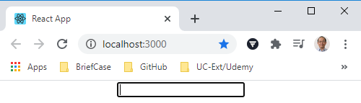
28.5 Verify Input Focus
https://www.youtube.com/watch?v=yCS2m01bQ6w&list=PLC3y8-rFHvwgg3vaYJgHGnModB54rxOk3&index=71
Open browser
> npm start
The input is focus.

Slide 18
28.5 Verify Input Focus
https://www.youtube.com/watch?v=yCS2m01bQ6w&list=PLC3y8-rFHvwgg3vaYJgHGnModB54rxOk3&index=71
This is how to use ref Hook to access the DOM Node in react functional component.
However, this is not the only use of the ref Hook.
We will take a look another one in the next discussion.

Slide 19
28.6 Quiz
Peter H. Chen

Slide 20
28.6 Quiz
https://www.youtube.com/watch?v=yCS2m01bQ6w&list=PLC3y8-rFHvwgg3vaYJgHGnModB54rxOk3&index=71
Quiz
1. What is ref Hook?
Ans: To add the focus for the input text.
2. How many steps and how to add the ref Hook?
Ans: Three steps.
a) First step: import useEffect and useRef
b) Second Step: Create variable inputRef by useRef (), initialized to null, ant then attach to the input element.
> const inputRef = useRef (null)
> <input ref = { inputRef} type = “text” />
c) Third Step: put the focus() method after the page loaded.
> useEffect (() => {
> # focus the input element
> inputRef.current.focus()
> }, [])

Slide 21
End of Chapter

