Slide 1

29 Refs with Class Component
Peter H. Chen

Slide 2
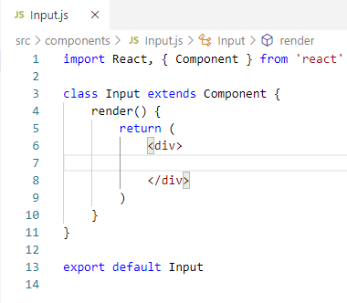
29 Refs with Class Component
https://www.youtube.com/watch?v=8aCXVC9Qmto&list=PLC3y8-rFHvwgg3vaYJgHGnModB54rxOk3&index=29
In the last discussion, we saw how to add refs to a normal HTML element like the input element for the functional component.
In this discussion, we will add ref to the class component.
We create a file called input.js.
Type ‘rce’ (React Class Component for ES7). Remove ‘export’ of class component.

Slide 3
29.1 Child: Input Text Field

Slide 4
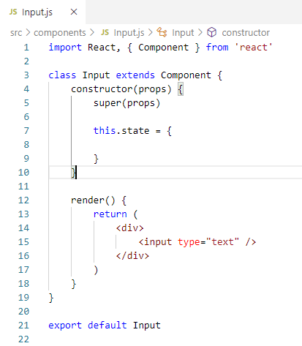
29.1 Child: Input Text Field
https://www.youtube.com/watch?v=8aCXVC9Qmto&list=PLC3y8-rFHvwgg3vaYJgHGnModB54rxOk3&index=29
In the render (), we add the <input type=“text”/>
Type rconst (React Constructor)
> constructor (props) {
> super (props)
> }

Slide 5
29.2 Child: Create Input Ref

Slide 6
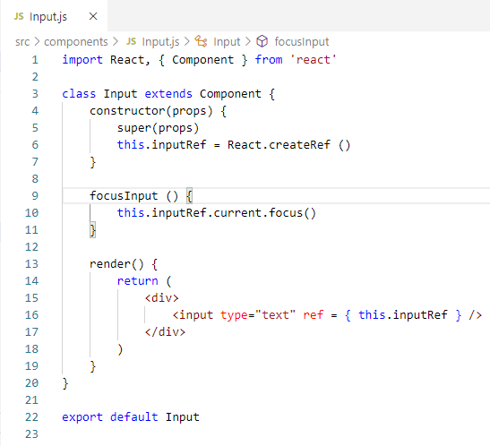
29.2 Child: Create Input Ref
https://www.youtube.com/watch?v=8aCXVC9Qmto&list=PLC3y8-rFHvwgg3vaYJgHGnModB54rxOk3&index=29
Create the inputRef and attached this ref to the input element.
> constructor (props) {
> super (props)
> this.inputRef = React.createRef()
> }
> render() {
> return (
> <input type=“text” ref = { this.inputRef } />
> )
> }

Slide 7
29.3 Child: focusInput ()

Slide 8
29.3 Child: focusInput ()
https://www.youtube.com/watch?v=8aCXVC9Qmto&list=PLC3y8-rFHvwgg3vaYJgHGnModB54rxOk3&index=29
We can focus on the input element in the ComponentDidMount().
In this example, we do not want to do that, instead, we will create a method that will in turn to focus the element and that method will be called by the parent component.
In the input.js, we have method
> focusInput() {
> this.inputRef.current.focus()
>}
That is it for the input component.
We basically have an input element and a method focus input when called, will focus the input element.
Now, we create the parent component for this input component.

Slide 9
29.4 Parent: FocusInputClass.js

Slide 10
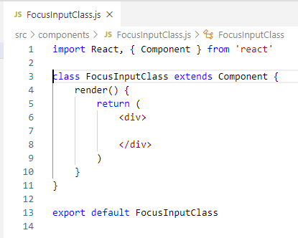
29.4 Parent: FocusInputClass.js
https://www.youtube.com/watch?v=8aCXVC9Qmto&list=PLC3y8-rFHvwgg3vaYJgHGnModB54rxOk3&index=29
Create a file called FocusInputClass.js
Type ‘rce’ (React class component for ES7).

Slide 11
29.4 Parent: FocusInputClass.js
https://www.youtube.com/watch?v=8aCXVC9Qmto&list=PLC3y8-rFHvwgg3vaYJgHGnModB54rxOk3&index=29
In the JSX, just add the input component that we justed created.
> <input />
> <button> Focus Input </button>
When we click the “Focus Input” button in the parent component, the input element in the child component should receive the focus.
We achieve that using the refs on this input component.
In the parent component, we are going to create a ref using the createRef() method.

Slide 12
29.5 Parent: Step 1: Create Ref

Slide 13
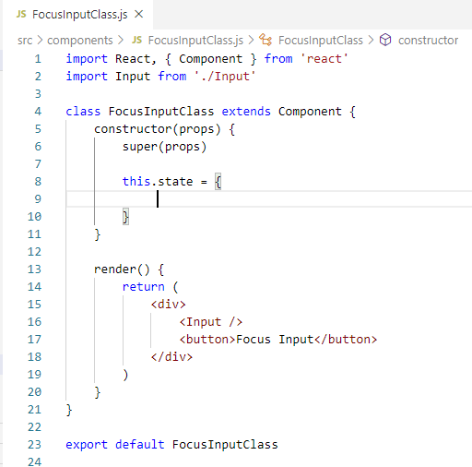
29.5 Parent: Step 1: Create Ref
https://www.youtube.com/watch?v=8aCXVC9Qmto&list=PLC3y8-rFHvwgg3vaYJgHGnModB54rxOk3&index=29
Step 1: In the Parent Component FocusInputClass, we are going to create ref using the CreateRef Method()
Type rconst (React Constructor).

Slide 14
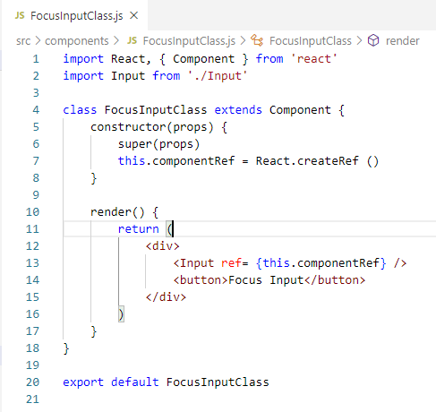
29.5 Parent: Step 1: Create Ref
https://www.youtube.com/watch?v=8aCXVC9Qmto&list=PLC3y8-rFHvwgg3vaYJgHGnModB54rxOk3&index=29
Step 1:
Create the omponentRef = React.createRef()
> constructor (props) {
> super (props)
> this.componentRef = React.createRef()
>}

Slide 15
29.6 Parent: Step 2: Attach Ref

Slide 16
29.6 Parent: Step 2: Attach Ref
https://www.youtube.com/watch?v=8aCXVC9Qmto&list=PLC3y8-rFHvwgg3vaYJgHGnModB54rxOk3&index=29
Step 2:
Attach the ref to the Input element
> <Input ref = { this.componentRef} />

Slide 17
29.7 Parent: Step 3: Button Handler

Slide 18
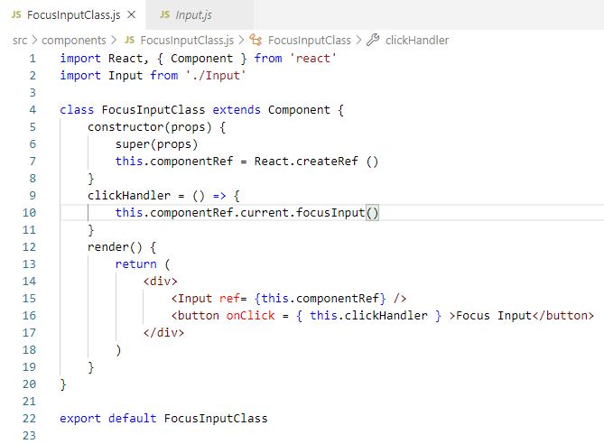
29.7 Parent: Step 3: Button Handler
https://www.youtube.com/watch?v=8aCXVC9Qmto&list=PLC3y8-rFHvwgg3vaYJgHGnModB54rxOk3&index=29
Step 3:
Add Button Click Handler. It call the child component method
> clickHandler = () => {
> this.componentRef.current.focusInput()
> }
> <button onClick = { this.clickHandler } > Focus Input </button>
This focusInput() method is defined in Input.js
Parent get the focus() from child component
Pass the ref to child component

Slide 19
29.8 App.js

Slide 20
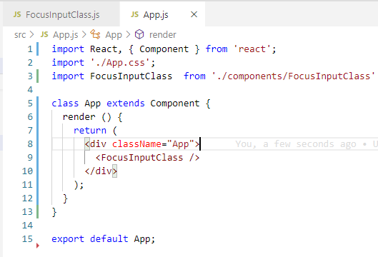
29.8 App.js
https://www.youtube.com/watch?v=8aCXVC9Qmto&list=PLC3y8-rFHvwgg3vaYJgHGnModB54rxOk3&index=29
In App.js
<FocusInputClass />

Slide 21
29.9 Verify

Slide 22
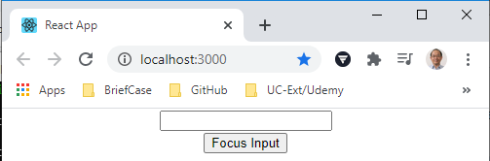
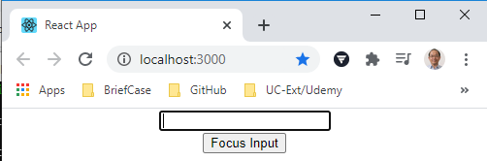
29.9 Verify
https://www.youtube.com/watch?v=8aCXVC9Qmto&list=PLC3y8-rFHvwgg3vaYJgHGnModB54rxOk3&index=29
Verify
> npm start
Click button to display the focus.

Slide 23
29.9 Verify
https://www.youtube.com/watch?v=8aCXVC9Qmto&list=PLC3y8-rFHvwgg3vaYJgHGnModB54rxOk3&index=29
If you have a ref from a child component, the parent component knows that it is definitely possible.
The component, however, has to be a class component. The refs cannot be attached to functional component.
Please keep this in mind.

Slide 24
29.10 Quiz

Slide 25
29.6 Quiz
https://www.youtube.com/watch?v=8aCXVC9Qmto&list=PLC3y8-rFHvwgg3vaYJgHGnModB54rxOk3&index=29
Quiz
1. Give an example of pass refs from parent component to child and access function from parent component.
Ans:
Parent get the focus() from child component
Pass the ref to child component

Slide 26
End of Chapter

