Slide 1

34 Higher Order Components 2
Peter H. Chen

Slide 2
34 Higher Order Components 2
https://www.youtube.com/watch?v=rsBQj6X7UK8&list=PLC3y8-rFHvwgg3vaYJgHGnModB54rxOk3&index=34
Why Higher Order Components?
To share the common functionality between components
We have a need to share common functionality between the components.
The HOC (Higher Oder Components) will help us with that.
What exactly is a Higher Order Components?

Slide 3
34 Higher Order Components 2
https://www.youtube.com/watch?v=rsBQj6X7UK8&list=PLC3y8-rFHvwgg3vaYJgHGnModB54rxOk3&index=34
HOC (Higher Order Component)
To share the common functionality between components
The Higher Order Components which will be referred to as HOC from now on.
The HOC is a pattern where a function takes a component as an argument and returns a new component.

Slide 4
34 Higher Order Components 2
https://www.youtube.com/watch?v=rsBQj6X7UK8&list=PLC3y8-rFHvwgg3vaYJgHGnModB54rxOk3&index=34
HOC (Higher Order Component)
In simple code, it will look something like this:
const NewCompoent = highOrderComponent (originalComponent)
const new component is equal to a function called higher order component.
We passed in the original component as an argument.
Typically, an HOC adds additional data or functionality to the original component.
So, the new component can also be referred to as enhanced component.
const EnhanceCompoent = highOrderComponent (originalComponent)

Slide 5
34 Higher Order Components 2
https://www.youtube.com/watch?v=rsBQj6X7UK8&list=PLC3y8-rFHvwgg3vaYJgHGnModB54rxOk3&index=34
From a non-technical point of view, we have Iron Main is equal to With Suit (Passing Tony Stark as the passing parameter).
We have Iron Man as an enhanced component of Tony Stark.
const IronMan = withSuit (TonyStark)
Here, Tony Stark is the original component, with suit is the function that will enhance Tony Stark and return the iron man as a enhanced component.
From React point view, we have a function which accepts the original component, add functionality, and returns an enhanced component.
Or in other words, we have the HOC pattern.
Now, we know what is the HOC pattern.
We will implement a basic HOC pattern for counter.

Slide 6
34.1 Create HOC Pattern

Slide 7
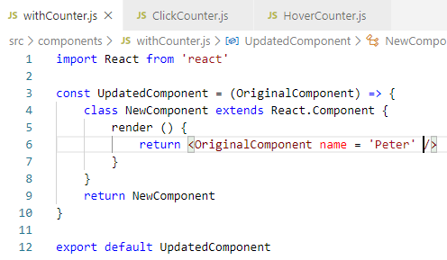
34.1 Create HOC Pattern
https://www.youtube.com/watch?v=rsBQj6X7UK8&list=PLC3y8-rFHvwgg3vaYJgHGnModB54rxOk3&index=34
Create HOC Pattern
Now, we create HOC. Create ./component/WithCounter.js
We create an arrow function. The arrow function is a HOC pattern accept the Original Component as it parameter.
The HOC pattern also return a new component. So, within the function body, le’st create a new component, class NewComponent extends React.Component.

Slide 8
34.1 Create HOC Pattern
https://www.youtube.com/watch?v=rsBQj6X7UK8&list=PLC3y8-rFHvwgg3vaYJgHGnModB54rxOk3&index=34
Create HOC Pattern
The render method is required by the NewComponent.
But what do we render?
We simply return the original component.
Now, the new component is defined.

Slide 9
34.1 Create HOC Pattern
https://www.youtube.com/watch?v=rsBQj6X7UK8&list=PLC3y8-rFHvwgg3vaYJgHGnModB54rxOk3&index=34
Create HOC Pattern
We return the new component in the error function.
We have the very first of Higher-Order Component.
The HOC is a function that accepts the original component and return a new component.
This HOC, though, does not really add anything to the original component.
Let’s change that.

Slide 10
34.1 Create HOC Pattern
https://www.youtube.com/watch?v=rsBQj6X7UK8&list=PLC3y8-rFHvwgg3vaYJgHGnModB54rxOk3&index=34
Create HOC Pattern
In the JSX, we are going to add a prop name is equal to ‘Peter’.

Slide 11
34.2 Share Name for Components

Slide 12
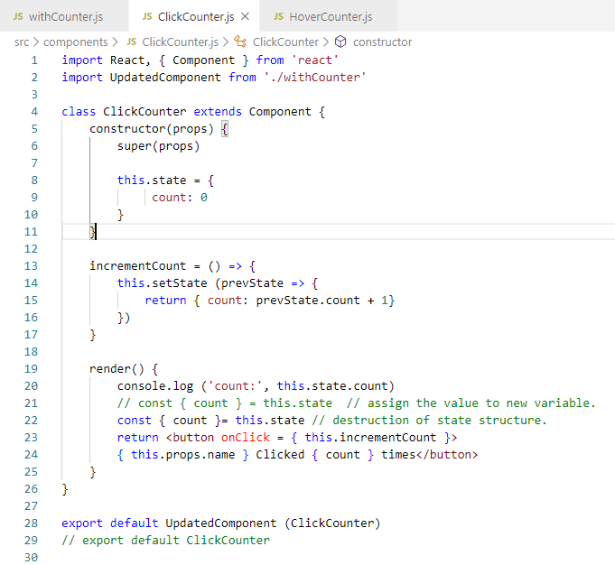
34.2 Share Name for Components
https://www.youtube.com/watch?v=rsBQj6X7UK8&list=PLC3y8-rFHvwgg3vaYJgHGnModB54rxOk3&index=34
Pass Component to HOC Pattern
Now, we apply this pattern to our clickCounter and HoverCounter.
In ClickCounter, we import UpdatedComponent from ‘./withCounter’

Slide 13
34.2 Share Name for Components
https://www.youtube.com/watch?v=rsBQj6X7UK8&list=PLC3y8-rFHvwgg3vaYJgHGnModB54rxOk3&index=34
Pass Component to HOC Pattern
We have new prop name=‘Peter’
So both components, we can actually render this props name=‘Peter’

Slide 14
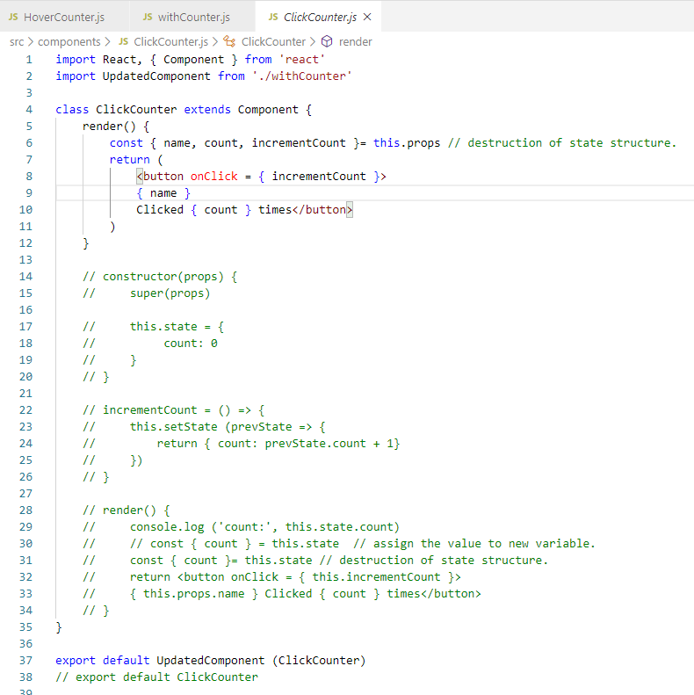
34.2 Share Name for Components
https://www.youtube.com/watch?v=rsBQj6X7UK8&list=PLC3y8-rFHvwgg3vaYJgHGnModB54rxOk3&index=34
Pass Component to HOC Pattern
So in both components, we can actually render this.props.name in the JSX.

Slide 15
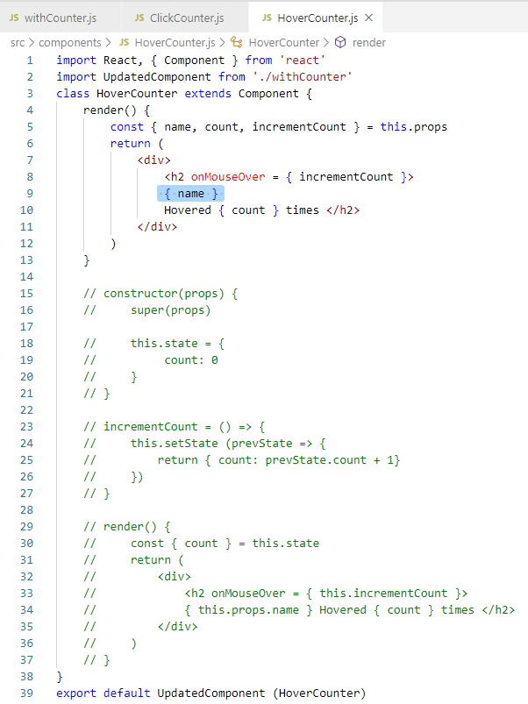
34.2 Share Name for Components
https://www.youtube.com/watch?v=rsBQj6X7UK8&list=PLC3y8-rFHvwgg3vaYJgHGnModB54rxOk3&index=34
Pass Component to HOC Pattern
In the HoverCounter.js, we change this.props.name and UpdatedComponent (HoverCounter).

Slide 16
34.2 Share Name for Components
https://www.youtube.com/watch?v=rsBQj6X7UK8&list=PLC3y8-rFHvwgg3vaYJgHGnModB54rxOk3&index=34
Pass Component to HOC Pattern
What do we here is instead of exporting the click counter or hover counter component, we export the higher-order component, the HOC.
In addition to be the click counter or the hover counter, now, we have a new props called name, in both components, we can actually render this props name = ‘Peter’.

Slide 17
34.2 Share Name for Components
https://www.youtube.com/watch?v=rsBQj6X7UK8&list=PLC3y8-rFHvwgg3vaYJgHGnModB54rxOk3&index=34
Pass Component to HOC Pattern
In the JSX, this.props.name in both click counter and hover counter.

Slide 18
34.3 Verify Share Name for Components

Slide 19
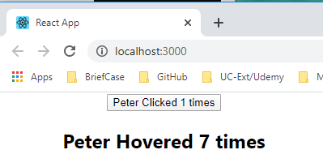
34.3 Verify Share Name for Components
https://www.youtube.com/watch?v=rsBQj6X7UK8&list=PLC3y8-rFHvwgg3vaYJgHGnModB54rxOk3&index=34
Verify Share Name for Components
> npm start
You look at the browser, you should be able to see the prop ‘Peter’ being rendered.

Slide 20
34.4 Share Counter for Components

Slide 21
34.4 Share Counter for Components
https://www.youtube.com/watch?v=rsBQj6X7UK8&list=PLC3y8-rFHvwgg3vaYJgHGnModB54rxOk3&index=34
Share the Counter
We have share the name for both click component and hover component.
For the counter example, we want to share the counter for click component and hover component.
We want the counter functionality to be shared among the components.
So, let’s modify the HOC pattern.
We copy the constructor and increment function from the click Counter into the HOC pattern.
These functions will be shared with ClickCounter and HoverCounter. These are the common functionalities we want to share.
We will remove constructor and increment code from clickCounter and HoverCounter.

Slide 22
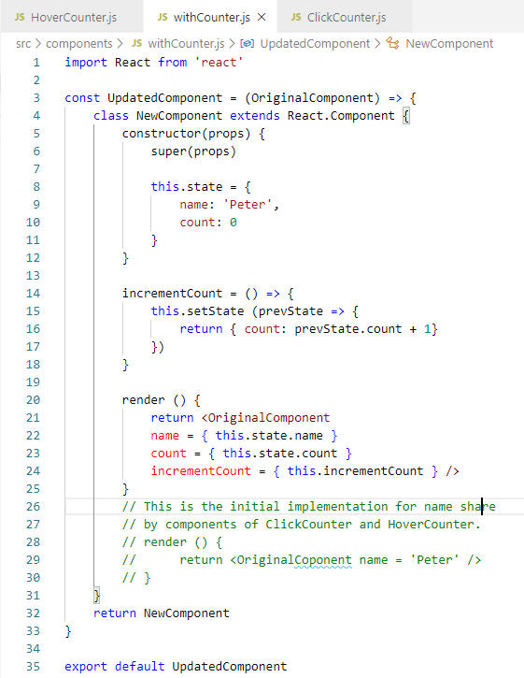
34.4 Share Counter for Components
https://www.youtube.com/watch?v=rsBQj6X7UK8&list=PLC3y8-rFHvwgg3vaYJgHGnModB54rxOk3&index=34
Share the Counter
Remove the initial implementation for the name shared between the component ClickCounter.js and HoverCounter.js.
In withCounter.js, we add shared constructor, incrementCount, and render.
In the shared render, we add render name, count, and incrementCount.

Slide 23
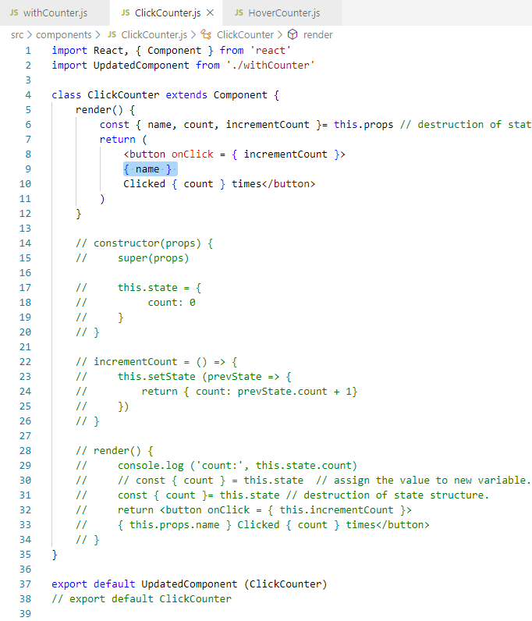
34.4 Share Counter for Components
https://www.youtube.com/watch?v=rsBQj6X7UK8&list=PLC3y8-rFHvwgg3vaYJgHGnModB54rxOk3&index=34
Share the Counter
In clickCounter.js, we remove the constructor, render, and call back function incrementCount.
We separate the props into name, count, incrementCnt from new updated components.
We render name, count, and click with incrementCount.

Slide 24
34.4 Share Counter for Components
https://www.youtube.com/watch?v=rsBQj6X7UK8&list=PLC3y8-rFHvwgg3vaYJgHGnModB54rxOk3&index=34
Share the Counter
In HoverCounter.js, we remove the constructor, render, and call back function render function destruct this.props and get incrementCount, name, and count.
We separate the props into name, count, incrementCnt from new updated components.
We render name, count, and click with incrementCount.

Slide 25
34.5 Verify Share Counter for Components

Slide 26
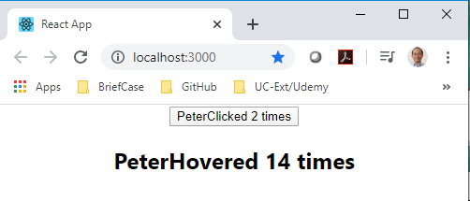
34.5 Verify Share Counter for Components
https://www.youtube.com/watch?v=rsBQj6X7UK8&list=PLC3y8-rFHvwgg3vaYJgHGnModB54rxOk3&index=34
Share the Counter
> npm start
The counter is working again.
The difference is that we are using the share code instead of duplicating code in clickCounter and hoverCounter.
This is what HOC pattern bring to the table.

Slide 27
34.5 Summary of HOC

Slide 28
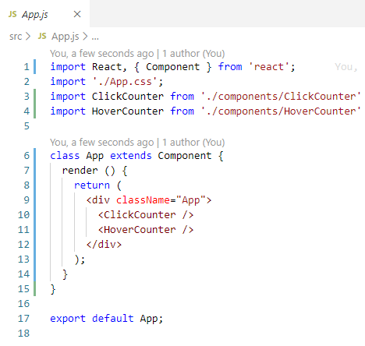
34.5 Summary of HOC
https://www.youtube.com/watch?v=rsBQj6X7UK8&list=PLC3y8-rFHvwgg3vaYJgHGnModB54rxOk3&index=34
Summary of HOC:
At top, we have App.js.
We include the ClickCounter and HoverCounter Components.

Slide 29
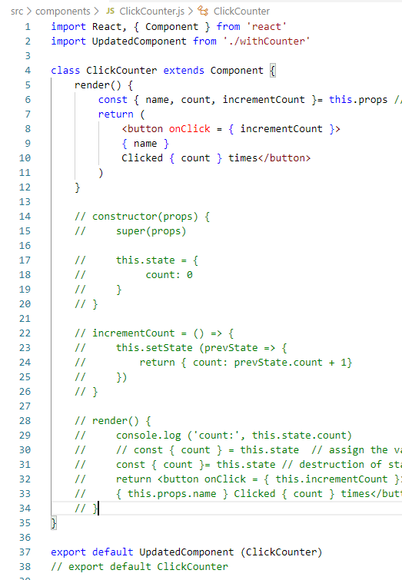
34.5 Summary of HOC
https://www.youtube.com/watch?v=rsBQj6X7UK8&list=PLC3y8-rFHvwgg3vaYJgHGnModB54rxOk3&index=34
Summary of HOC:
In ClickCounter.js, we export the Updated Component HOC.

Slide 30
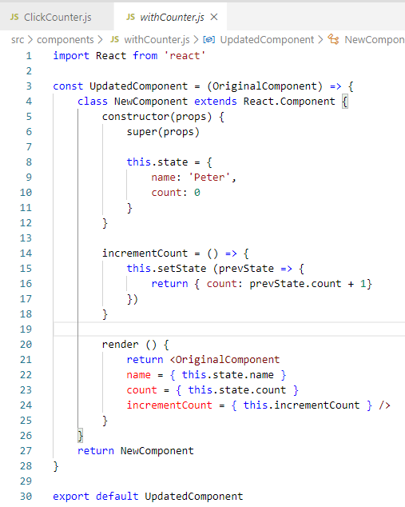
34.5 Summary of HOC
https://www.youtube.com/watch?v=rsBQj6X7UK8&list=PLC3y8-rFHvwgg3vaYJgHGnModB54rxOk3&index=34
Summary of HOC:
withCounter: Pass in the OrginalCompoent and return NewComponent.
The withCounter maintain the state by constructor and incrementCount.
The parameters are passed the render function and passed to the props (parameters) of OriginalComponent and then return to NewComponent.

Slide 31
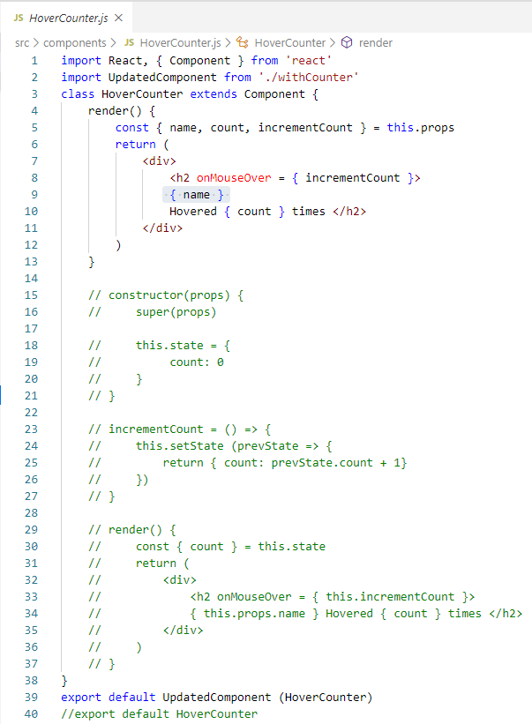
34.5 Summary of HOC
https://www.youtube.com/watch?v=rsBQj6X7UK8&list=PLC3y8-rFHvwgg3vaYJgHGnModB54rxOk3&index=34
Summary of HOC:
hoverCounter: The same execution flow also happen for the hoverCounter.

Slide 32
34.5 Summary of HOC
https://www.youtube.com/watch?v=rsBQj6X7UK8&list=PLC3y8-rFHvwgg3vaYJgHGnModB54rxOk3&index=34
Summary of HOC:
Now, how can we re-ruse this code.
We can reuse clickCounter.js code immediate thought is to lift this state to the parent component (App.js) and pass down the handler as a props.
Define the counter functionality in App Component and provide the state and the handler
Passed props to click counter and hover counter.
Component Tree
Parent
Lift counter logic (state) to Parent and
pass down the handler as props
2
props
2
props
ClickCounter
HoverCounter
1
state

Slide 33
34.5 Summary of HOC
https://www.youtube.com/watch?v=rsBQj6X7UK8&list=PLC3y8-rFHvwgg3vaYJgHGnModB54rxOk3&index=34
Summary of HOC:
Image a scenario where the counter components are scattered in the React Component Tree.
Lifting the state would definitely not be the correct solution.
There is a need to share common functionality between components without repeating code and that is where the concept of higher-order components comes into the picture.
We will discuss more in the next.
Component Tree
Parent
ClickCounter
RandomComponentA
RandomComponentB
Lifting the state is not a great solution
HoverCounter

Slide 34
34.6 Quiz

Slide 35
34.6 Quiz
https://www.youtube.com/watch?v=rsBQj6X7UK8&list=PLC3y8-rFHvwgg3vaYJgHGnModB54rxOk3&index=34
Quiz
1. What are two steps of HOC?
Ans: We can reuse clickCounter.js code immediate thought is to lift this state to the parent component (App.js) and pass down the handler as a props.
Define the counter functionality in App Component and provide the state and the handler
Passed props to click counter and hover counter.
Component Tree
Parent
Lift counter logic (state) to Parent and
pass down the handler as props
2
props
2
props
ClickCounter
HoverCounter
1
state

Slide 36
End of Chapter

