Slide 1

15 Parent/Child Communication
Peter H. Chen

Slide 2
15 Parent/Child Communication
https://www.youtube.com/watch?v=QpfyjwhY9kg&list=PLC3y8-rFHvwgg3vaYJgHGnModB54rxOk3&index=15
Method As Props:
What if child component want to communicate with the parent?
We still use props but in this time, we pass in a reference to a method as props to the child component.

Slide 3
15.1 Pass Handle from Parent to Child

Slide 4
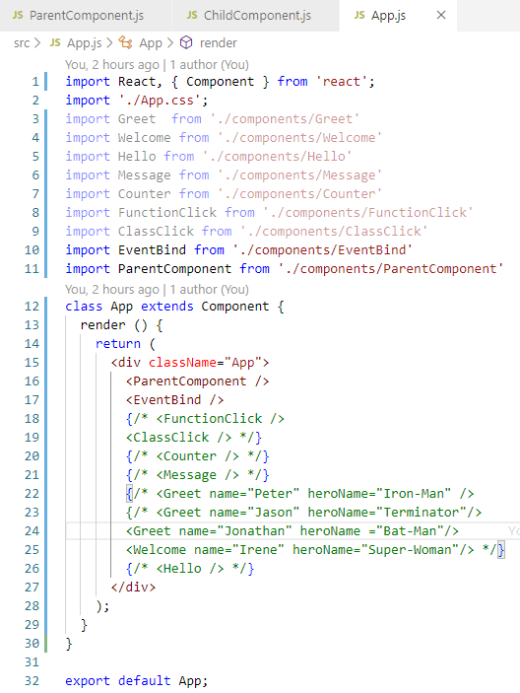
15.1 Pass Handle from Parent to Child
https://www.youtube.com/watch?v=QpfyjwhY9kg&list=PLC3y8-rFHvwgg3vaYJgHGnModB54rxOk3&index=15
Method As Props:
In App.js, add the <ParentCompoent />

Slide 5
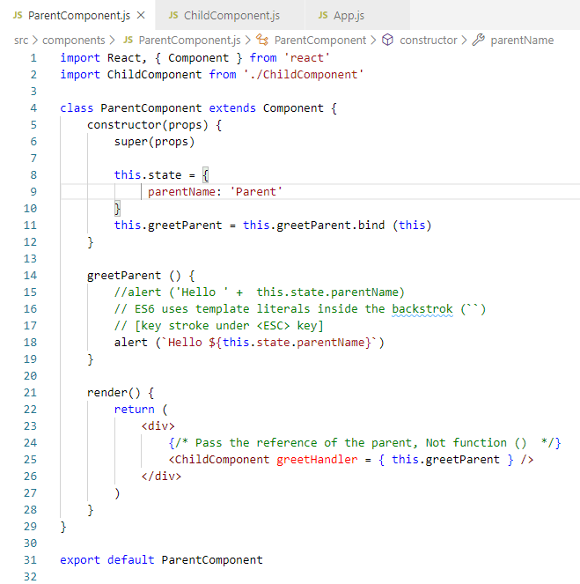
15.1 Pass Handle from Parent to Child
https://www.youtube.com/watch?v=QpfyjwhY9kg&list=PLC3y8-rFHvwgg3vaYJgHGnModB54rxOk3&index=15
Method As Props:
We create a new file ParentComponent.js under components folder.
We passed reference from parent to child by <ChildComponent greetHandler = { this.greetParent } />
In the greetParent(), we use ES6 feature of template literals inside the ``.

Slide 6
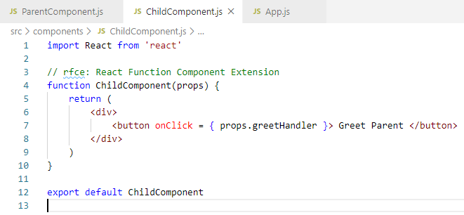
15.1 Pass Handle from Parent to Child
https://www.youtube.com/watch?v=QpfyjwhY9kg&list=PLC3y8-rFHvwgg3vaYJgHGnModB54rxOk3&index=15
Method As Props:
We create a new file ChildComponent.js under components folder.
When user click the button, the handler reference is passed back to parent and displayed by parent.

Slide 7
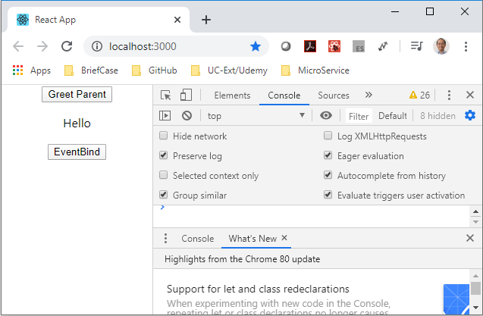
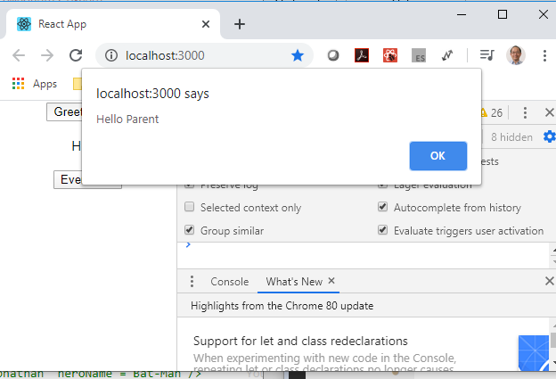
15.1 Pass Handle from Parent to Child
https://www.youtube.com/watch?v=QpfyjwhY9kg&list=PLC3y8-rFHvwgg3vaYJgHGnModB54rxOk3&index=15
Method As Props:
> npm start

Slide 8
15.2 Pass Data from Child to Parent

Slide 9
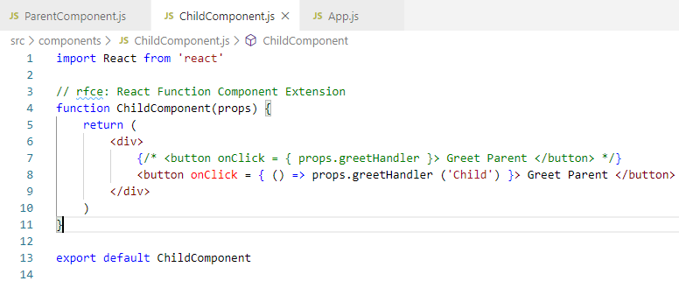
15.2 Pass Data from Child to Parent
https://www.youtube.com/watch?v=QpfyjwhY9kg&list=PLC3y8-rFHvwgg3vaYJgHGnModB54rxOk3&index=15
Method As Props:
In the child, We use arrow function to pass the parameter back to parent.

Slide 10
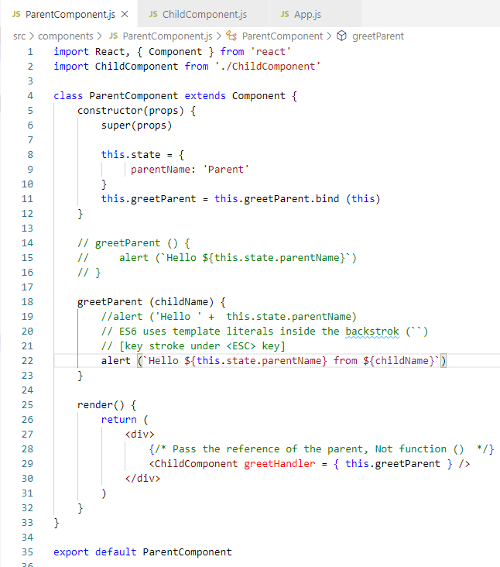
15.2 Pass Data from Child to Parent
https://www.youtube.com/watch?v=QpfyjwhY9kg&list=PLC3y8-rFHvwgg3vaYJgHGnModB54rxOk3&index=15
Method As Props:
Parent get the parameter from argument.

Slide 11
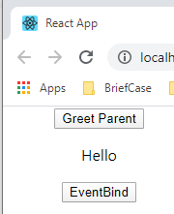
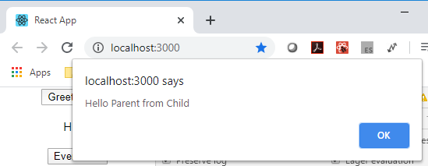
15.2 Pass Data from Child to Parent
https://www.youtube.com/watch?v=QpfyjwhY9kg&list=PLC3y8-rFHvwgg3vaYJgHGnModB54rxOk3&index=15
Method As Props:
> npm start

Slide 12
15.2 Summary of Parent/Child Communication
https://www.youtube.com/watch?v=QpfyjwhY9kg&list=PLC3y8-rFHvwgg3vaYJgHGnModB54rxOk3&index=15
Summary of Parent/Child Communication:
Parent pass handler with function name to the child.
When Child onClick,
1) get the parameter by props and
2) pass the arrow function and
3) back with parameter back to parent function.
The parent function get the parameter and display by template literal.

Slide 13
15.3 Quiz

Slide 14
15.3 Quiz
https://www.youtube.com/watch?v=QpfyjwhY9kg&list=PLC3y8-rFHvwgg3vaYJgHGnModB54rxOk3&index=15
Quiz
1. How to pass handler from parent component to child component?
Ans:
> class ParentComponent extends Component {
> constructor (props) {
> this.state {
> message: ‘abc’
> }
> }
> greetParent = (param) => {
> console.log ({ `$param` })
> }
> render () {
> return (<div> <childComponent greetHandler = { greetParent } </div>)
> }
> }

Slide 15
15.3 Quiz
https://www.youtube.com/watch?v=QpfyjwhY9kg&list=PLC3y8-rFHvwgg3vaYJgHGnModB54rxOk3&index=15
Quiz
2. How to pass child parameter back to parent component?
Ans:
// props.greetHandler () is passed from parent component.
> function childCoponent (props) {
> return (<div>
> <button onClick = { () => props.greetHandler (‘Child’) } > Greet Parent</button>
> </div>)
> }

Slide 16
End of Chapter

