Slide 1

40 Context 3
Peter H. Chen

Slide 2
40 Context 3
https://www.youtube.com/watch?v=A9WlkhdLnn0&list=PLC3y8-rFHvwgg3vaYJgHGnModB54rxOk3&index=40
React Context
We discussed how to make use of the context API to pass data through the component tree.
We have Passed the username from AppComponent and read value from Component F as below.
AppComponent
username
A
B
C
D
E
F
username

Slide 3
40 Context 3
https://www.youtube.com/watch?v=A9WlkhdLnn0&list=PLC3y8-rFHvwgg3vaYJgHGnModB54rxOk3&index=40
React Context
In this discussion, we have two more points in the context API.
The first point is that you can set a default value to your context.
If there is no matching provider in the component tree, the default Value will be displayed. If there is provider in the component tree, the provide value will replace the default value.
The second point is the context type property.
We already implemented the component F to read data and render data.
We will add the read data from component E using context type property and render data.

Slide 4
40.1 Create Context with Default Value

Slide 5
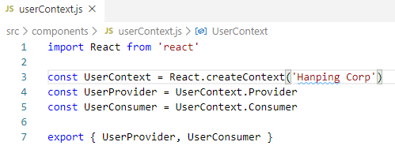
40.1 Create Context with Default Value
https://www.youtube.com/watch?v=A9WlkhdLnn0&list=PLC3y8-rFHvwgg3vaYJgHGnModB54rxOk3&index=40
Create Context with Default Value
The default value is set while creating the context. It is passed as an argument to the create context method.
Now, in the userContext.js, we will add string (‘Hanping Corp’) as the default value.

Slide 6
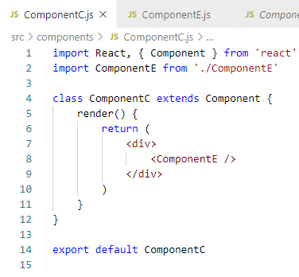
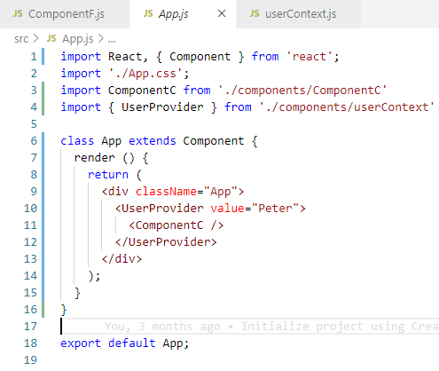
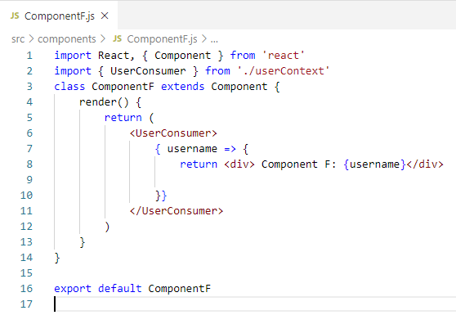
40.1 Create Context with Default Value
https://www.youtube.com/watch?v=A9WlkhdLnn0&list=PLC3y8-rFHvwgg3vaYJgHGnModB54rxOk3&index=40
Create Context with Default Value
In App.js, comment out the provider component.
AppComponent
username
A
B
C
D
E
username
F

Slide 7
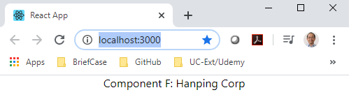
40.1 Create Context with Default Value
https://www.youtube.com/watch?v=A9WlkhdLnn0&list=PLC3y8-rFHvwgg3vaYJgHGnModB54rxOk3&index=40
Create Context with Default Value
> npm start
Verify with the browser.

Slide 8
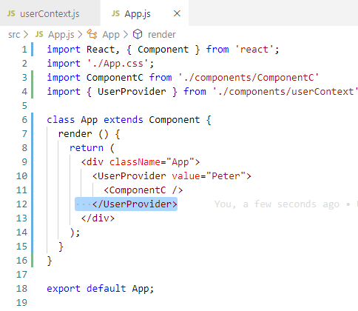
40.1 Create Context with Default Value
https://www.youtube.com/watch?v=A9WlkhdLnn0&list=PLC3y8-rFHvwgg3vaYJgHGnModB54rxOk3&index=40
Create Context with Default Value
In App.js, if I add provider back.

Slide 9
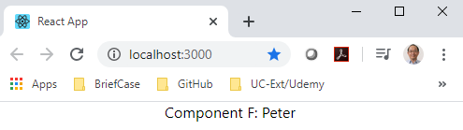
40.1 Create Context with Default Value
https://www.youtube.com/watch?v=A9WlkhdLnn0&list=PLC3y8-rFHvwgg3vaYJgHGnModB54rxOk3&index=40
Create Context with Default Value
> npm start
Verify with the browser. You can see the ‘Peter’ is been displayed.
The default value ‘Hanping Corp’ is displayed when there is no matching provider in the component tree.
AppComponent
username
A
B
C
D
E
username
F

Slide 10
40.2 Context Type Property

Slide 11
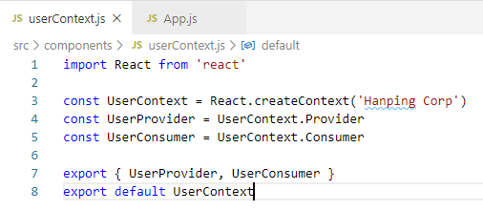
40.2 Context Type Property
https://www.youtube.com/watch?v=A9WlkhdLnn0&list=PLC3y8-rFHvwgg3vaYJgHGnModB54rxOk3&index=40
Context Type Property
In the last discussion, we use the consumer component to consume the context value.
There is another way to do that. That is the context type property on a class.
Let’s see how that work by consuming the user context value in component tree.
The first step in userContext.js, we need to export the userContext itself, i.e., export default UserContext.

Slide 12
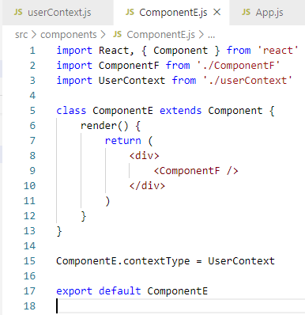
40.2 Context Type Property
https://www.youtube.com/watch?v=A9WlkhdLnn0&list=PLC3y8-rFHvwgg3vaYJgHGnModB54rxOk3&index=40
Context Type Property
Next step, assign this user context to the context type on the class.
In componentE.js, outside the code of the class component, we are going to have ComponentE.contextType = userContext
And make sure import it at the top.

Slide 13
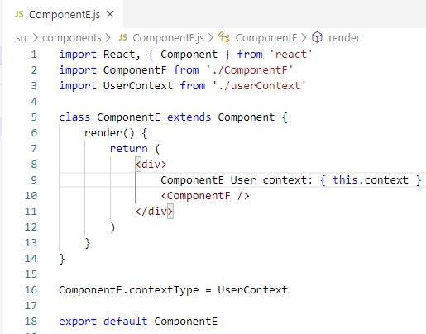
40.2 Context Type Property
https://www.youtube.com/watch?v=A9WlkhdLnn0&list=PLC3y8-rFHvwgg3vaYJgHGnModB54rxOk3&index=40
Context Type Property
Now, in the render method, the UserContext value is available as this.Context.
We will read the context from component.
In the render method, in addition to render componentF, we will also include the Component E Context is going to be { this.context } and then include <ComponentF />

Slide 14
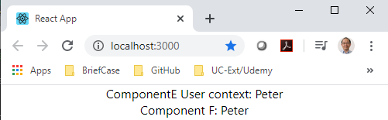
40.2 Context Type Property
https://www.youtube.com/watch?v=A9WlkhdLnn0&list=PLC3y8-rFHvwgg3vaYJgHGnModB54rxOk3&index=40
Context Type Property
Take a look at the Browser.
Now, Component E is able to render the User name ‘Peter’.

Slide 15
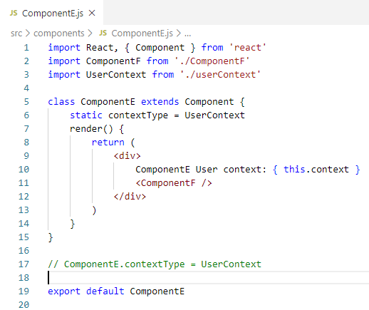
40.2 Context Type Property
https://www.youtube.com/watch?v=A9WlkhdLnn0&list=PLC3y8-rFHvwgg3vaYJgHGnModB54rxOk3&index=40
Context Type Property
If your application supports the public class view syntax, you can replace component.contextType with
> static contextType = userContext

Slide 16
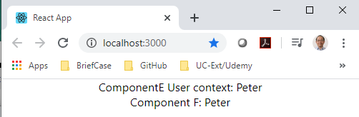
40.2 Context Type Property
https://www.youtube.com/watch?v=A9WlkhdLnn0&list=PLC3y8-rFHvwgg3vaYJgHGnModB54rxOk3&index=40
Context Type Property
> npm start
Look at the browser.

Slide 17
40.2 Context Type Property
https://www.youtube.com/watch?v=A9WlkhdLnn0&list=PLC3y8-rFHvwgg3vaYJgHGnModB54rxOk3&index=40
Context Type Property
Note the context Type property has two limitations:
First, the context type property is only work for class component.
Second, you can subscribe to a single context using context type.
Many times, in your application, you need to read more than one context. In this scenario, the consumer component is the way to go.

Slide 18
40.2 Context Type Property
https://www.youtube.com/watch?v=A9WlkhdLnn0&list=PLC3y8-rFHvwgg3vaYJgHGnModB54rxOk3&index=40
Context Type Property
The code to consume multiple contexts looks somewhat like this. You can see there are two contexts, themeContext and UserContentxt.
Consuming Multiple Contexts
> function Context() {
> return {
> <ThemeContext.Consumer>
> { theme => (
> <UserContext.Consumer>
> {user => {
> <ProfilePage user= {user} theme = {theme} />
> }
> </UserContext.Consumer>
> }
> </ThemeContext.Consumer>
> }
> }

Slide 19
40.2 Context Type Property
https://www.youtube.com/watch?v=A9WlkhdLnn0&list=PLC3y8-rFHvwgg3vaYJgHGnModB54rxOk3&index=40
Consuming Multiple Contexts
We have two contexts theme context and user context. ThemeContext consumer accepts a function as a child passing in the theme value.
Within the function body, we have another function as a child which provides the userContext value. Both of them as passed as props to a component.
> function Context() {
> return {
> <ThemeContext.Consumer>
> {theme => (
> <UserContext.Consumer>
> {user => {
> <ProfilePage user= {user} theme = {theme} />
> }
> </UserContext.Consumer>
> }
> </ThemeContext.Consumer>
> }
> }

Slide 20
40.3 Summary of Context 3

Slide 21
40.3 Summary of Context 3
https://www.youtube.com/watch?v=A9WlkhdLnn0&list=PLC3y8-rFHvwgg3vaYJgHGnModB54rxOk3&index=40
Summary of Context 3
We discussed two points in this discussion: the default value and context value.
Now, we understand how Context API work in React.

Slide 22
40.4 Quiz

Slide 23
40.4 Quiz
https://www.youtube.com/watch?v=A9WlkhdLnn0&list=PLC3y8-rFHvwgg3vaYJgHGnModB54rxOk3&index=40
Quiz
1. What is default value and context value?
Ans:
We can set a default value to your context.
If there is no matching provider in the component tree, the default Value will be displayed. If there is provider in the component tree, the provide value will replace the default value.

Slide 24
End of Chapter

