Slide 1

47 useState with Object
Peter H. Chen

Slide 2
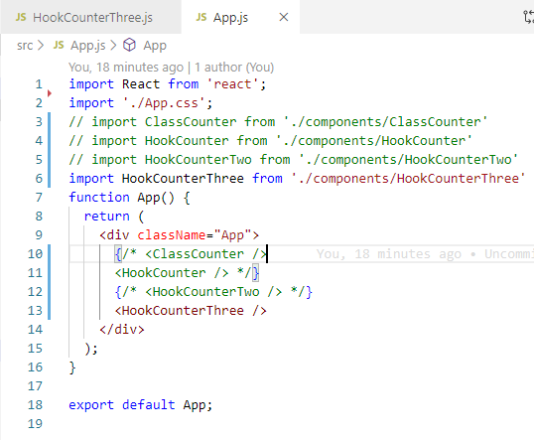
47 useState with Object
https://www.youtube.com/watch?v=-3lL8oyev9w&list=PLC3y8-rFHvwgg3vaYJgHGnModB54rxOk3&index=47
useState with Object
We discusses another example of useState with object.
We use the object as the state variable of Hooks.
Import Functional Component HookCounterThree

Slide 3
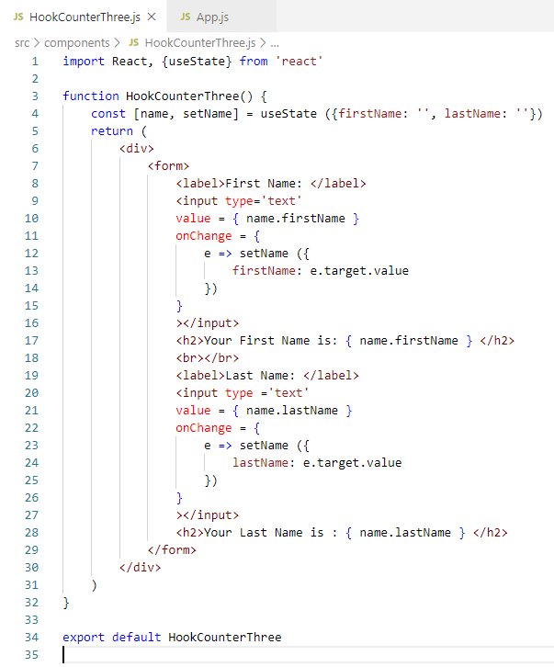
47 useState with Object
https://www.youtube.com/watch?v=-3lL8oyev9w&list=PLC3y8-rFHvwgg3vaYJgHGnModB54rxOk3&index=47
useState with Object
Create HookCounterThree.js
Type ‘rfce’ (React Functional Component ES7)
Include { useState } Hook component.

Slide 4
47 useState with Object
https://www.youtube.com/watch?v=-3lL8oyev9w&list=PLC3y8-rFHvwgg3vaYJgHGnModB54rxOk3&index=47
useState with Object
const [name, setName] = useState ([firstName: ‘’, lastName: ‘’})
Keep in mind: a state variable can be a string, a number, Boolean, an object, or even an array.
You can use any of those types based on your requirement.
Right now, we have a variable called ‘name’ which is an object and a setter function called setName to update the corresponding state variables (name).

Slide 5
47 useState with Object
https://www.youtube.com/watch?v=-3lL8oyev9w&list=PLC3y8-rFHvwgg3vaYJgHGnModB54rxOk3&index=47
useState with Object
Define a render() function:
Basically, we have two input fields: one for first Name, and one for last name.
We create a <form> which includes two input fields. Below the input fields, we simply display the first name and last name.
Input have value = {name.firstName} and
onChange = { e => setName ( { firstName: e.target.value })}

Slide 6
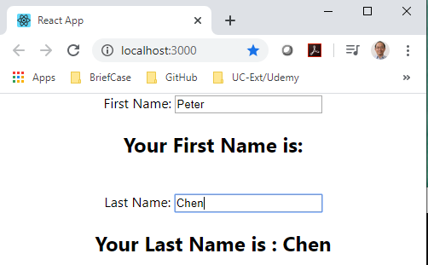
47 useState with Object
https://www.youtube.com/watch?v=-3lL8oyev9w&list=PLC3y8-rFHvwgg3vaYJgHGnModB54rxOk3&index=47
useState with Object:
> npm start
There is one problem: When we change the text field and type, the previous display is automatically clear.

Slide 7
47.1 useState Object

Slide 8
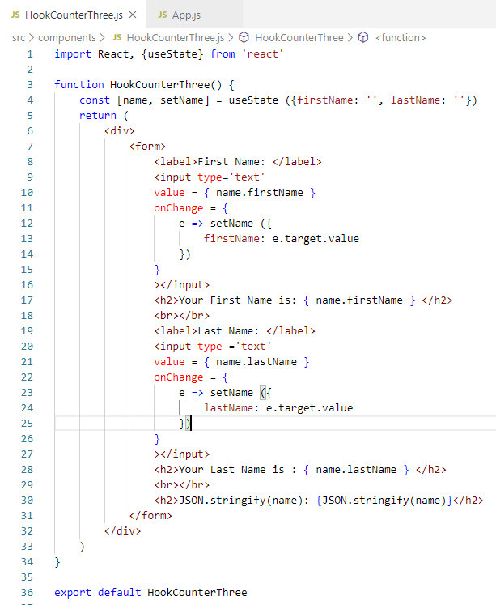
47.1 useState Object
https://www.youtube.com/watch?v=-3lL8oyev9w&list=PLC3y8-rFHvwgg3vaYJgHGnModB54rxOk3&index=47
Add <h2>JSON.stringify(name)</h2>

Slide 9
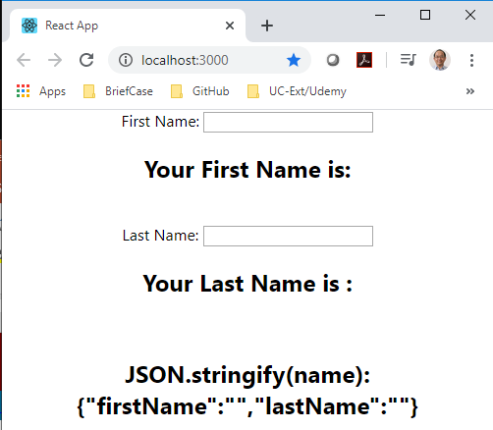
47.1 useState Object
https://www.youtube.com/watch?v=-3lL8oyev9w&list=PLC3y8-rFHvwgg3vaYJgHGnModB54rxOk3&index=47
JSON.stringify(name)
Display the first name and last name.
However, when you typing in, only last name or first name is kept.

Slide 10
47.2 Spread Operator for Object

Slide 11
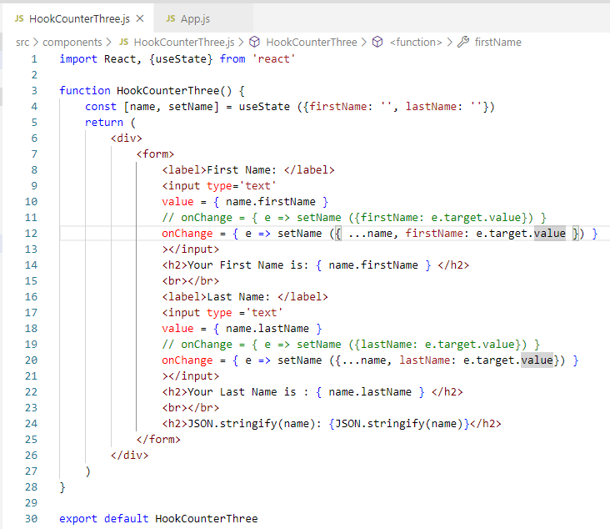
47.2 Spread Operator for Object
https://www.youtube.com/watch?v=-3lL8oyev9w&list=PLC3y8-rFHvwgg3vaYJgHGnModB54rxOk3&index=47
useState Object
The problem with useState object is not automatically merge the object.
We have to do it manually. It is not difficult since we can use spread operator to manually merge.

Slide 12
47.2 Spread Operator for Object
https://www.youtube.com/watch?v=-3lL8oyev9w&list=PLC3y8-rFHvwgg3vaYJgHGnModB54rxOk3&index=47
Spread operator for Object
onChange arrow funcrion, we first spread the name and then set the appropriate property. Spread the name and overwrite the las name or first name.
onChange = (e => setName ({ …name, firstName: e.target.value }) }
onChange = (e => setName ({ …name, lastName: e.target.value }) }

Slide 13
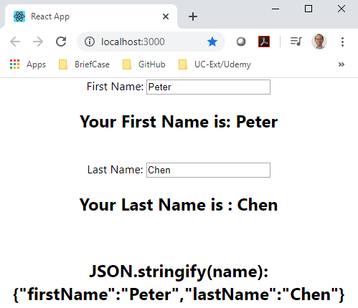
47.2 Spread Operator for Object
https://www.youtube.com/watch?v=-3lL8oyev9w&list=PLC3y8-rFHvwgg3vaYJgHGnModB54rxOk3&index=47
Spread operator for Object
> npm
Using the spread operator,
The first name is updated
The last name is also updated.

Slide 14
47.2 Summary of useState Object
https://www.youtube.com/watch?v=-3lL8oyev9w&list=PLC3y8-rFHvwgg3vaYJgHGnModB54rxOk3&index=47
Summary if useState Object
The object will not automatically merge and update object.
You have to manually it by yourself then pass the value to the setter function.
Use the spread operator to spread the arrary object and update the property, e.g., {e => setName ( …name, lastname: e.target.value)}

Slide 15
47.3 Quiz

Slide 16
47.3 Quiz
https://www.youtube.com/watch?v=-3lL8oyev9w&list=PLC3y8-rFHvwgg3vaYJgHGnModB54rxOk3&index=47
Quiz
1. How to set the variable firstName, lastName?
Ans:
We can setup variable by object.
const [name, setName] = useState ([firstName: ‘’, lastName: ‘’})
Note: name is the object. How to set the object name?
setName ({ firstName: ‘Peter’ })
setName ({ lastName: ‘Chen’ })
onChange = { e => setName ( { firstName: e.target.value })}

Slide 17
End of Chapter

